Slide 1


Georgia Adopt-A-Stream
Introduction
2 Martin Luther King Jr. Dr. SE
Suite 1462 East
Atlanta, Georgia 30334
AdoptAStream.Georgia.gov
404.463.1464
Revised November 2017

Slide 2
Georgia Adopt-A-Stream
What is it?
  Georgia’s volunteer water quality monitoring program
Program Goals
  A: Increase public awareness
  D: Collect quality baseline water quality data
  O: Gather observations
  P: Encourage partnerships between citizens & local government
  T: Provide tools & training

Slide 3
Water Quality Issues In Georgia
Control of toxic substance in rivers, streams and lakes
Reduction of nonpoint source pollution
Increase public involvement in water quality improvement projects
Continued implementation of a comprehensive water management plan

Slide 4
Point Source Pollution
    Easily identifiable pollutant source (point to source)
    Regulated by the EPD through the NPDES (National Pollutant Discharge Elimination System) permitting process
    Examples:
    Industrial Discharge
    Sewage treatment plant
    Exposed leaking sewer pipe

Slide 5
Nonpoint Source Pollution
The #1 cause of water quality problems in Georgia
Typically caused by sources that are not easily distinguishable or identifiable
Everyone contributes
    Examples:
    Runoff from roads and parking lots
    Erosion/Sediment
    Fertilizers and pesticides
    Animal waste
    Illicit spills and illegal dumping
    Leaking septic systems

Slide 6
Why Is Monitoring Water Quality Important?
  Our quality of life is directly related to the quality of the rivers, streams and wetlands around us
  Regular monitoring provides specific information about the health of our local streams and other water bodies
  All the water we have now is all the water we’ll ever have (Water Cycle)

Slide 7
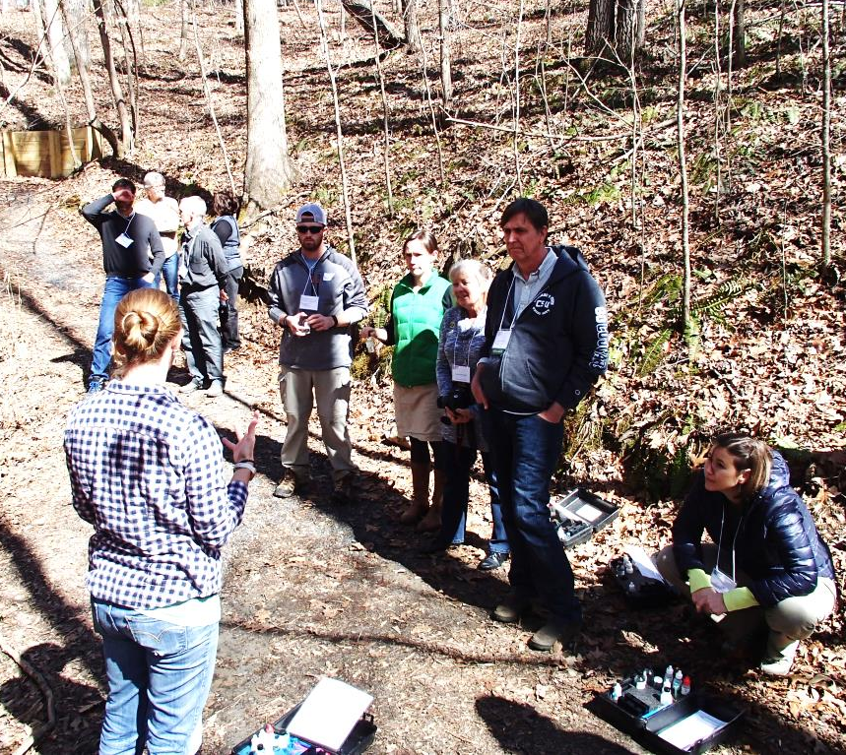
Getting Started
Register a Group Name
Register your monitoring site on our online database
Set up a monitoring schedule
Notify your local government
Decide who will receive your data
Find local partners
Develop a “Who To Call” list
Conduct at least one cleanup and one outreach activity annually

Slide 8
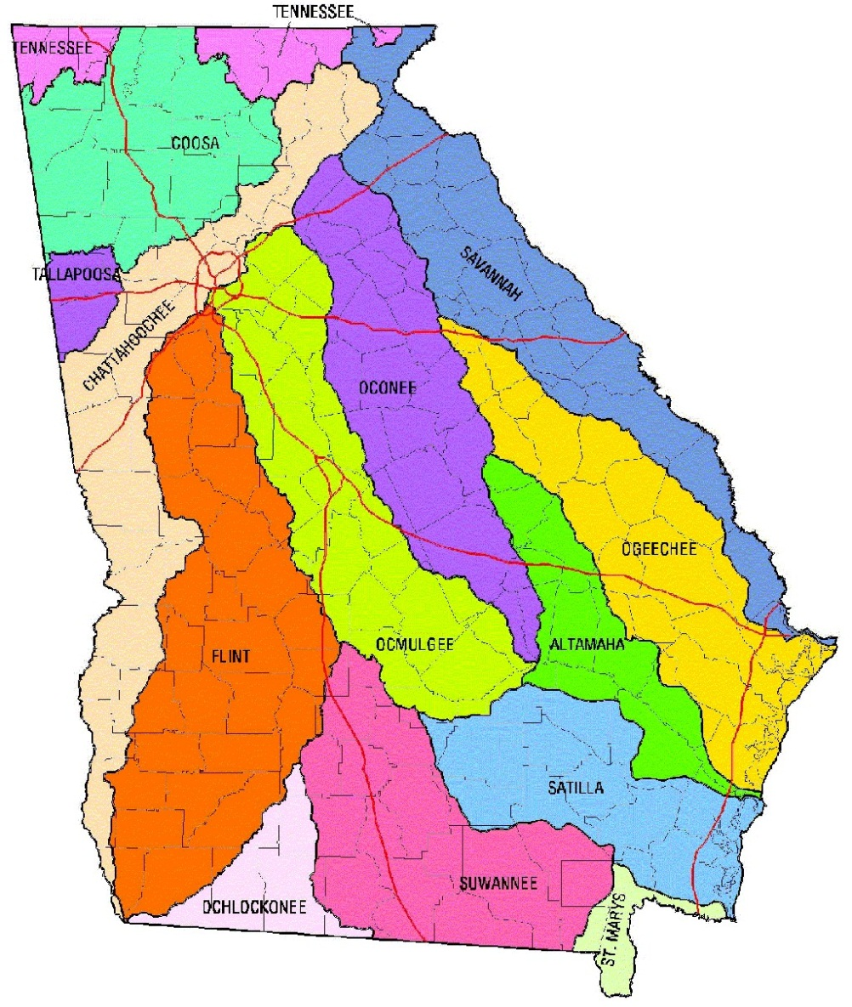
Getting to Know Your Watershed
https://adoptastream.georgia.gov/manuals

Slide 9
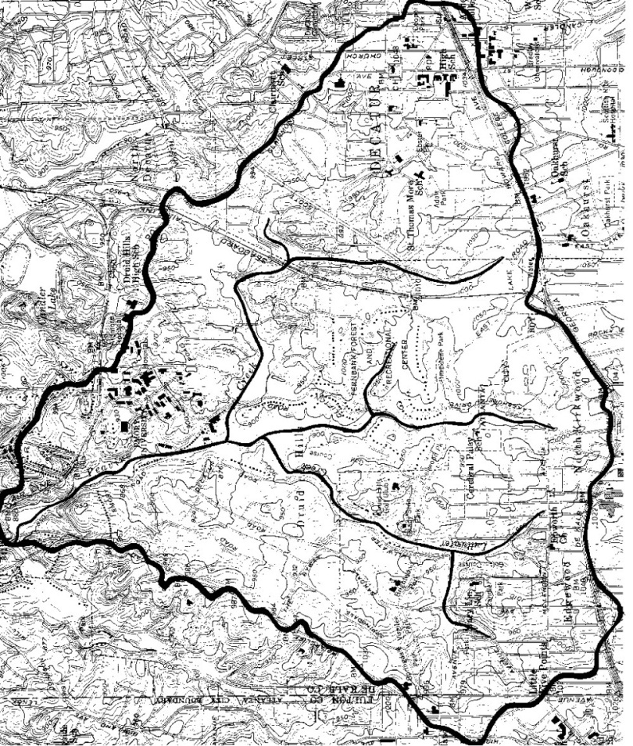
Watershed Survey & Map Assessment
What
Map your watershed and conduct a comprehensive survey of the land uses, potential and actual pollution sources, geography and history of your waterbody and its watershed
Why
Getting to know your watershed is the first step to understanding your stream, wetland, lake, or coastal water
The health of your waterbody is directly impacted by land uses and activities
When
Every year

Slide 10
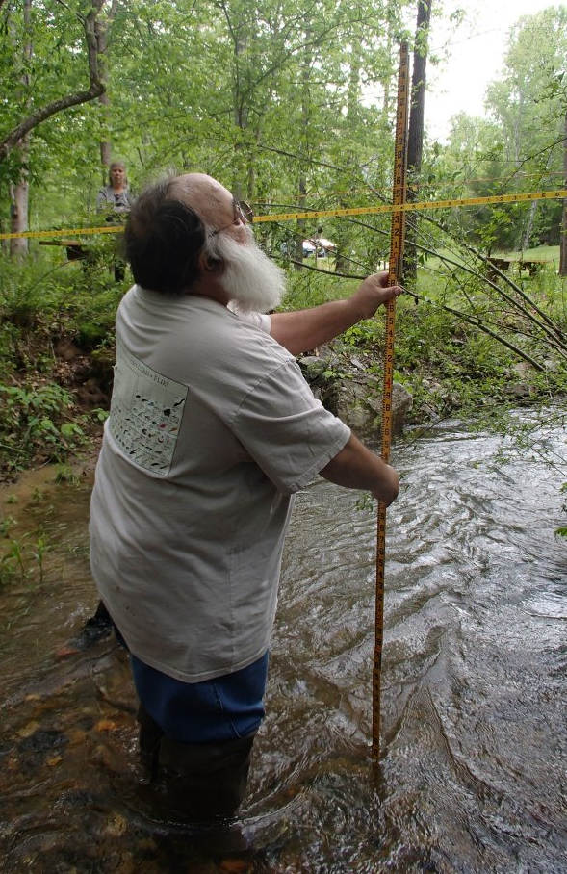
Visual Stream Monitoring
What
Visual & physical evaluation of stream conditions
Why
Critical water pollutants and habitat damage, such as sedimentation, erosion and excessive nutrients, can be detected through the visual survey
When
Quarterly or once every season

Slide 11
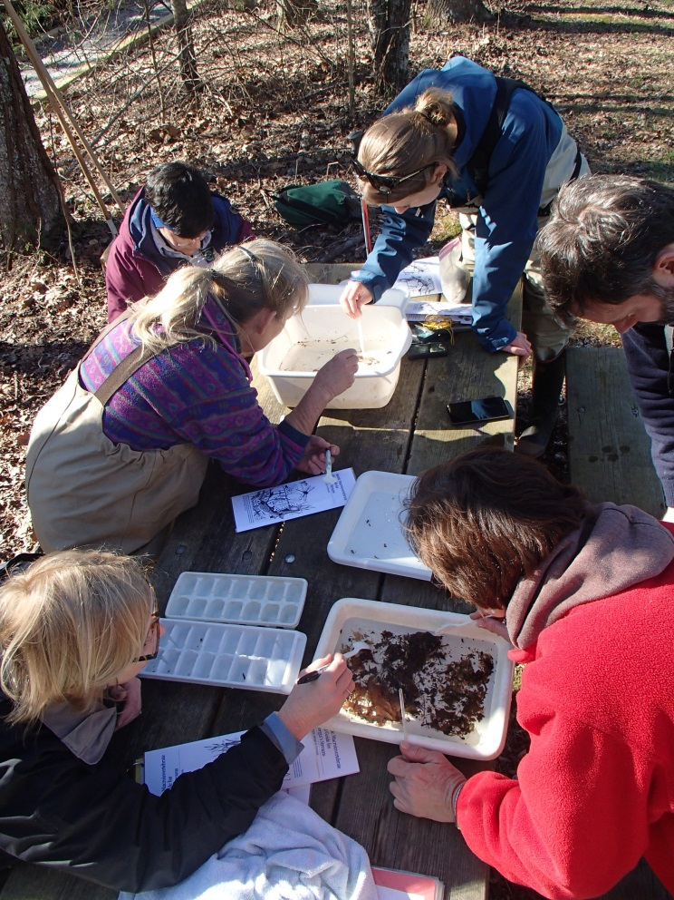
Macroinvertebrate Monitoring
What
Inventory of macroinvertebrates in the stream
Why
The overall health of the stream can be determined by the diversity of macroinvertebrates found.
The presence of macroinvertebrates indicate the quality of both water and habitat
When
Quarterly or once every season

Slide 12
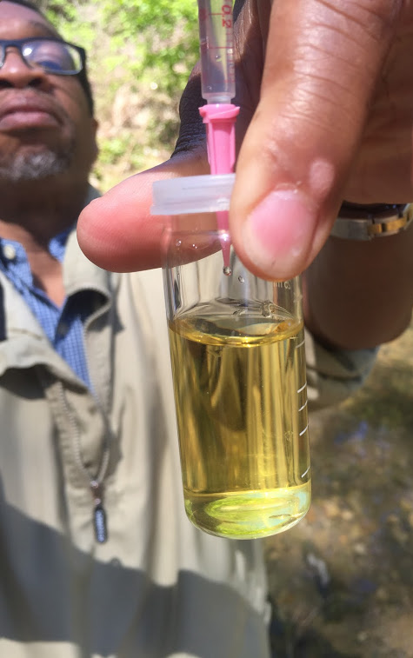
Chemical Monitoring
What
Testing for pH, dissolved oxygen, temperature, and conductivity
Additional tests include nutrient sampling, Secchi disk, salinity, turbidity, and settleable solids
Why
Provides “snap shot” of water quality
Oxygen is needed for respiration
Temperature is directly related to biological activity
pH measures the acidity or basicity of the water
Conductivity measurements indicate potential inorganic or organic pollutants
When
Once a month

Slide 13
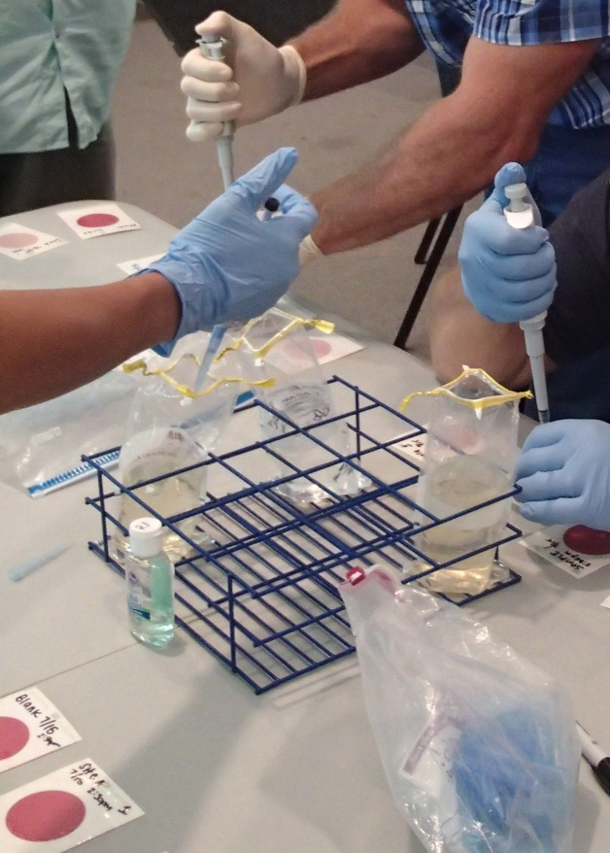
Bacterial Monitoring
What
Sampling for E. coli bacteria
Why
Indicates presence of disease causing agents in the water body
Indicates the safety of the waterbody for recreational uses
When
Once a month

Slide 14
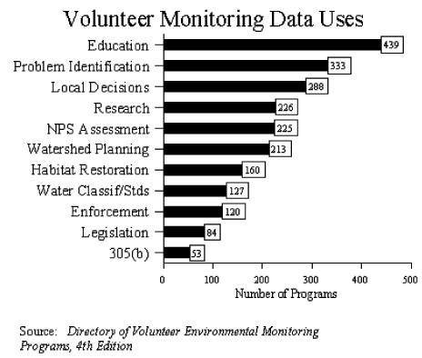
Quality Assurance Project Plan
Quality Assurance Quality Control (QAQC)
Only individuals are certified
Certification is valid for one year

Slide 15
Organizational Levels of
Georgia Adopt-A-Stream
State Staff
Advisory Board
Local Coordinators & Trainers
Partners who act as local contacts and provide assistance to monitoring groups
Individuals or groups who monitor a stream, wetland,
lake or coastal waters
Citizens who participate in a cleanup or other outreach activity organized by any of the above mentioned groups of people

Slide 16
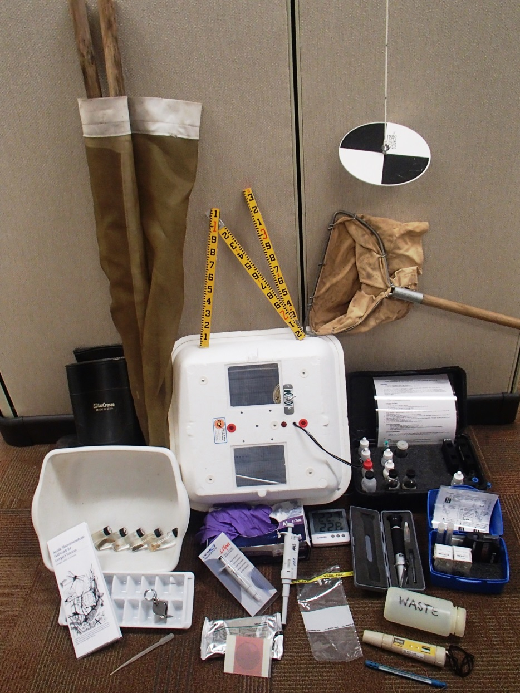
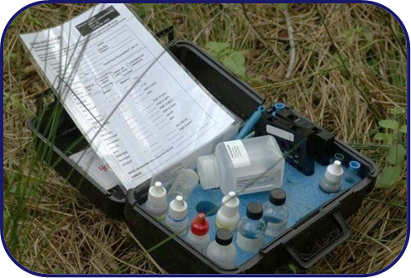
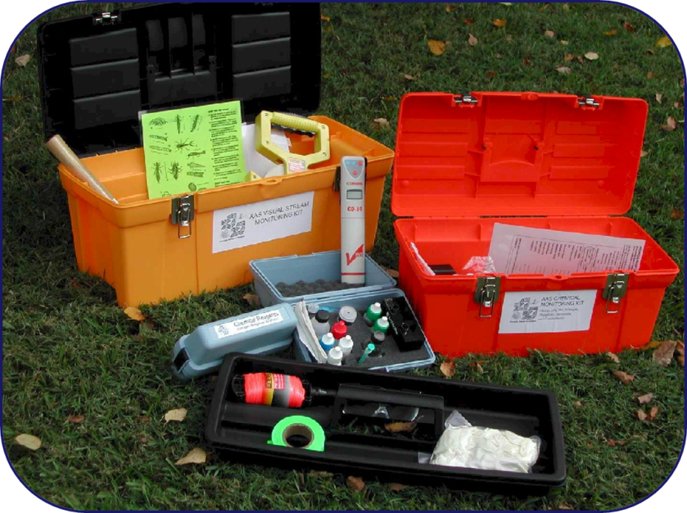
Equipment for Volunteers

Slide 17
Georgia Adopt-A-Stream Resources
Website: AdoptAStream.Georgia.gov
Getting To Know Your Watershed Manual
Visual Stream Survey Manual
Macroinvertebrate and Chemical Stream Monitoring Manual
Aquatic Macroinvertebrate Field Guide for Georgia’s Streams
Amphibian Monitoring Manual
Wetland Monitoring Manual
Adopt-A-Lake Manual
Adopt-A-Stream Educator’s Guide
Georgia Outdoors: Georgia Adopt-A-Stream & Rivers Alive Video
Getting Started: Watershed and Visual Stream Assessment workshops
Macroinvertebrate Monitoring workshops
Chemical & Physical Monitoring workshops
Bacterial Monitoring workshops
Amphibian Monitoring workshops
Train – The – Trainer workshops
You Are The Solution To Water Pollution Poster and Brochure
Life at the Water’s Edge: A guide to stream care in Georgia
Online Water Quality Database
Newsletter
Teacher PLU Credits
Technical and logistical support for volunteers and communities

