Slide 1

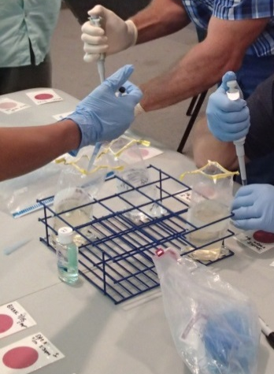
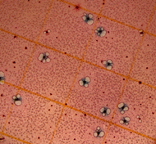

Georgia Adopt-A-Stream
Bacterial Monitoring
2 Martin Luther King Jr. Drive
Suite 1462, East Tower
Atlanta, Georgia 30334
AdoptAStream.Georgia.gov
404.463.1464
Revised May 2015

Slide 2
Georgia Adopt-A-Stream
What is it?
  Georgia’s volunteer water quality monitoring program
Program Goals
  A: Increase public awareness
  D: Collect quality baseline water quality data
  O: Gather observations
  P: Encourage partnerships between citizens & local government
  T: Provide tools & training

Slide 3
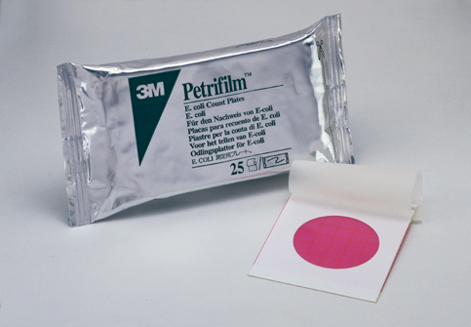
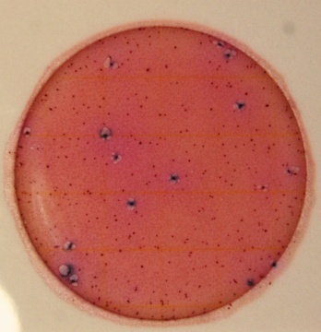
Bacterial Monitoring
Involves: collecting, plating, and counting E. coli colonies
Purpose: quickly assess health risks due to bacterial contamination of surface waters
Characterizes: Stream health by identifying potential for harmful bacteria in stream

Slide 4
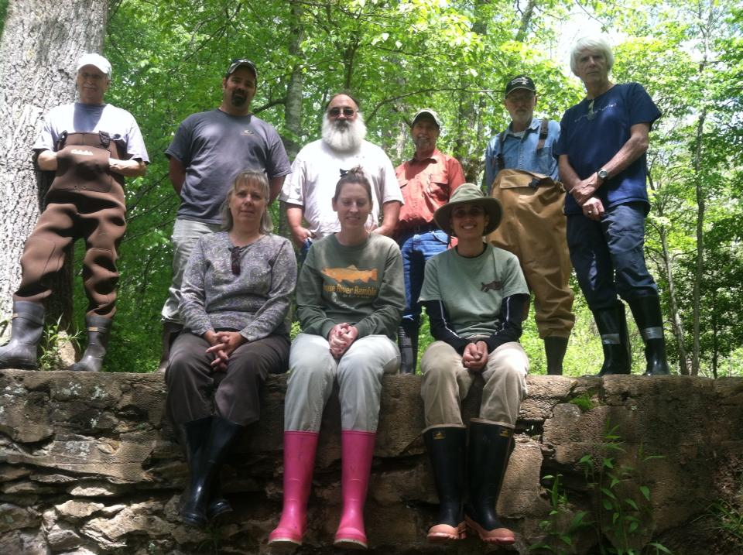
EPA Quality Assurance Project Plan
Quality Assurance/
Quality Control (QA/QC)
Only individuals are
certified
Certification is valid for
one year
Volunteers must attend an annual recertification workshop
Only certified volunteers can submit data

Slide 5
To Become a Certified QA/QC Volunteer
FIELD & LAB:
Volunteers must demonstrate how to properly collect and plate a sample
WRITTEN TEST:
Volunteers must pass a written evaluation with a score of at least 80%
&
Volunteers must correctly identify E.coli colonies and calculate E.coli levels of example plates with accuracy of at least 90%

Slide 6
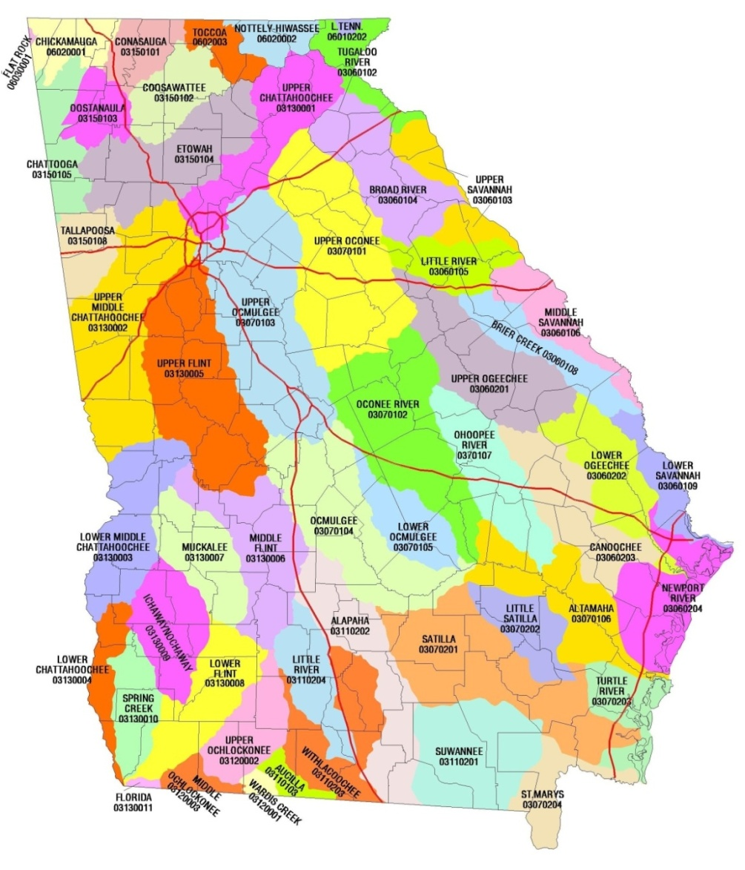
What is a Watershed?
A watershed is the land area from which water, sediment, and dissolved materials drain to a common point along a stream, wetland, lake or river.
Its boundaries are marked by the highest points of land around the waterbody.

Slide 7
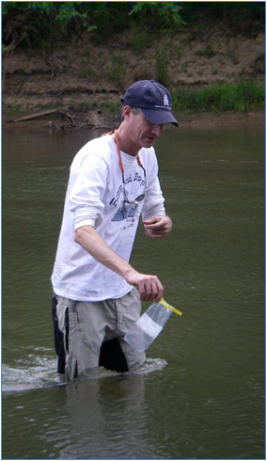
When, Where, & How Often?
Where: Same site location and in a well mixed area of flowing water
When: Same time of day and during normal flow conditions
How often: At least once a month

Slide 8
Safety Considerations
If conditions are too dangerous to sample…
DON’T SAMPLE!
Wait until storm has stopped and strong flow has subsided
Never sample alone
Remember to wear gloves and boots
Disinfect and dispose of used plates properly
Receive permission from land owner before going onto private property

Slide 9
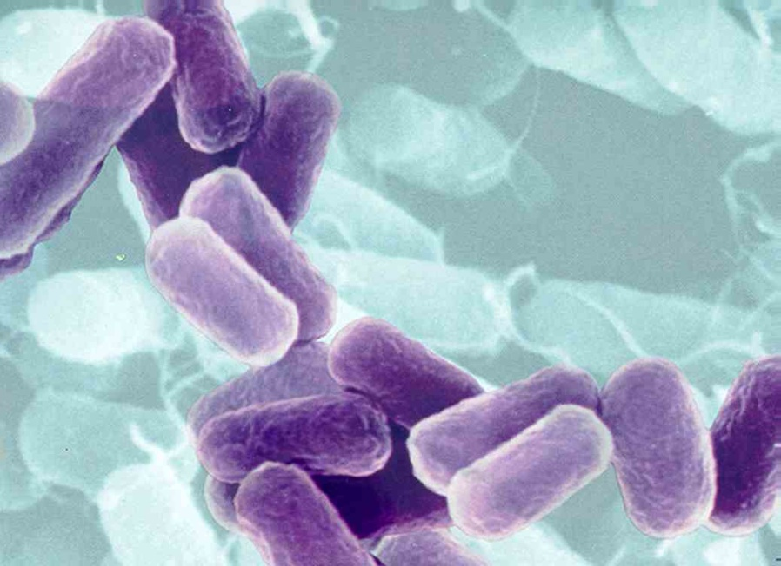
What are Bacteria?
Single-celled, living microscopic organisms
There are more bacteria on Earth than any other living thing
Found all over the world in many different environments

Slide 10
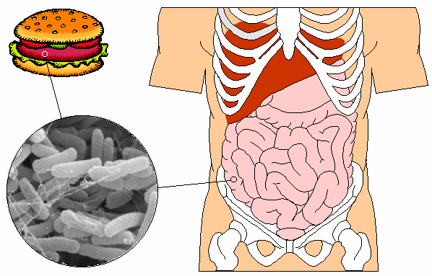
Why are Bacteria Important?
Benefits
  Decomposition
    Digestion
  Nutrient cycling
  Can be used to aid in pollution control
    Sewage treatment
    Oil spills
    Other pollutants
Risks
  Some bacteria that live in soil, water or air can cause human, animal and plant health problems
    Pathogenic bacteria

Slide 11
Coliform Bacteria
Total Coliform refers to a biological family of bacteria that are naturally found in soil
Fecal coliforms are a subgroup within coliform bacteria found in intestinal tracts of humans and other warm-blooded animals
E. coli are one subgroup of fecal coliform
Total Coliforms
Fecal Coliform
E. coli

Slide 12
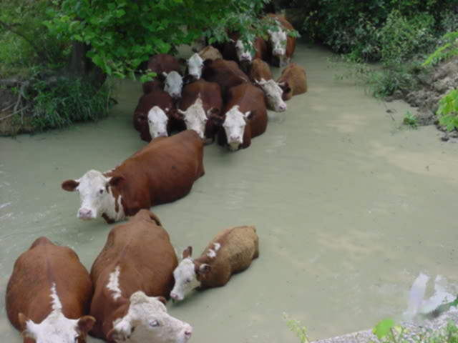
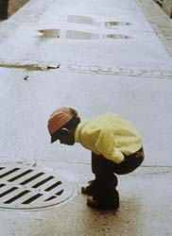
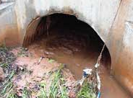
Why Monitor for E. coli ?
E. coli serve as an indicator species
  High levels indicate possible presence of pathogens
Sources of E. coli in our waterways
  Wildlife
  Livestock
  Urban storm runoff
  Leaking pipes
  Failing septic systems

Slide 13
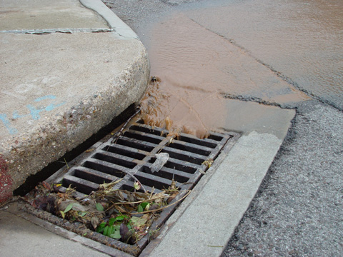
Weather and Seasonal Influences
Bacteria numbers often increase following a heavy rainstorm or heavy runoff event
E. coli counts are often higher in summer compared to lower counts in winter months
      Warmer surface water temps = higher replication rates for E. coli
      Colder surface water temps = lower replication rates for E. coli

Slide 14

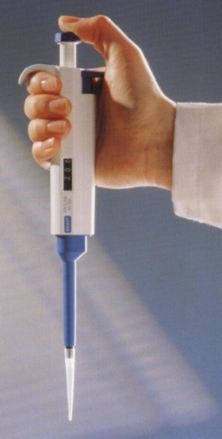
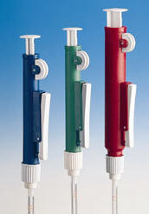
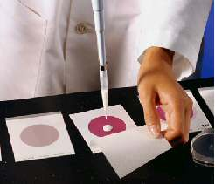
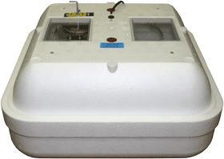
6 Steps for E.coli Monitoring
Preparing the blank/control
Collecting a sample
Plating your samples and blank
Incubating
Counting
Disposing

Slide 15
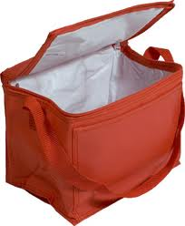
1. Preparing the blank/control
Creating a blank checks to see if sampling methods allow for contamination.
Label Whirl-pak® bag as a blank
Wear gloves and remove the perforated seal
Use small white tabs to pull open the bag
Fill the bag 2/3 full with distilled water (brought from home)
Whirl!
Place blank in a sanitized cooler with ice
where other sample will be stored
Blank
3/25/17
10AM

Slide 16
2. Collecting a sample
Use one Whirl-pak® to sample upstream of yourself
Clearly label your sample
Place sample in your cooler after collection
  Exposure to UV will decrease bacteria levels
Plate sample as soon as possible, but the maximum holding time on ice is no more than 24 hours
Clear Creek
3/25/2015
10AM

Slide 17
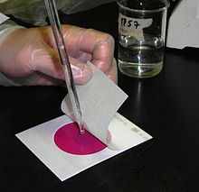
3. Plating your sample
Clean work area with disinfectant spray
Before plating, invert sample to mix the water
Prepare 3M Petrifilm plates
  Check expiration dates!
  Label: Blank, 1, 2, 3 (+ site name)
Run in triplicate + 1 blank (3 plates from your one sample + 1 control/blank plate)
  4 plates total

Slide 18
4. Incubating
35°C ± 1 degree for 24 hours ± 1 hour
  Turn on early to get stable temperature reading with a digital thermometer inside
  Adjust using metal dial on top
Check minimum and maximum temperatures after incubating

Slide 19
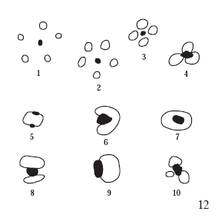
5. Reading the Results… counting the E.coli colonies
  Standard reporting units for bacteria are in CFU/100 ml → Colony Forming Units per 100ml
Only count blue colonies with entrapped gas bubbles!
Do not count colonies that are growing more than halfway off of the medium
Possible gas bubble patterns associated with gas producing colonies.
All of these examples would be counted when reading plates.
Notes:
Mention that general coliforms appear as red colonies with surrounding gas bubbles compared to E. coli

Slide 20
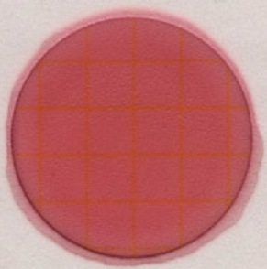
The Blank/Control
  There should not be any colonies on the blank.
  If any colonies appear on blank, sample is null and void! And new sample must be taken from site location.

Slide 21
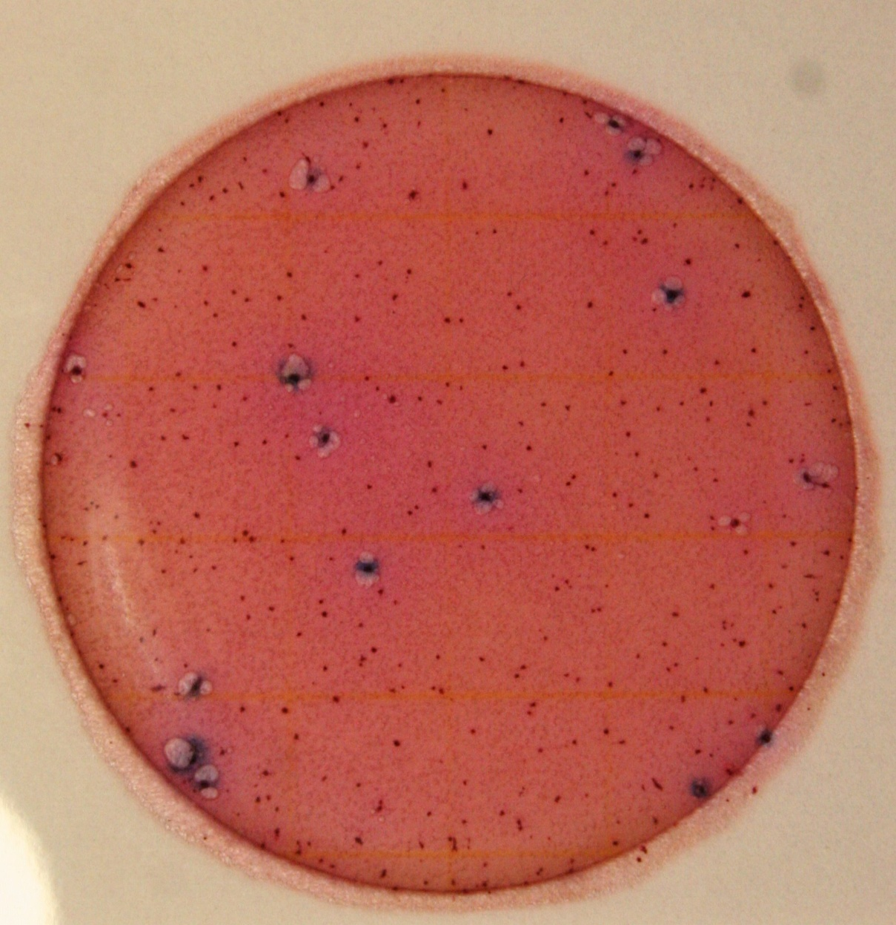
Example #1
  How many E. coli colonies can you see?
Notes:
~12

Slide 22
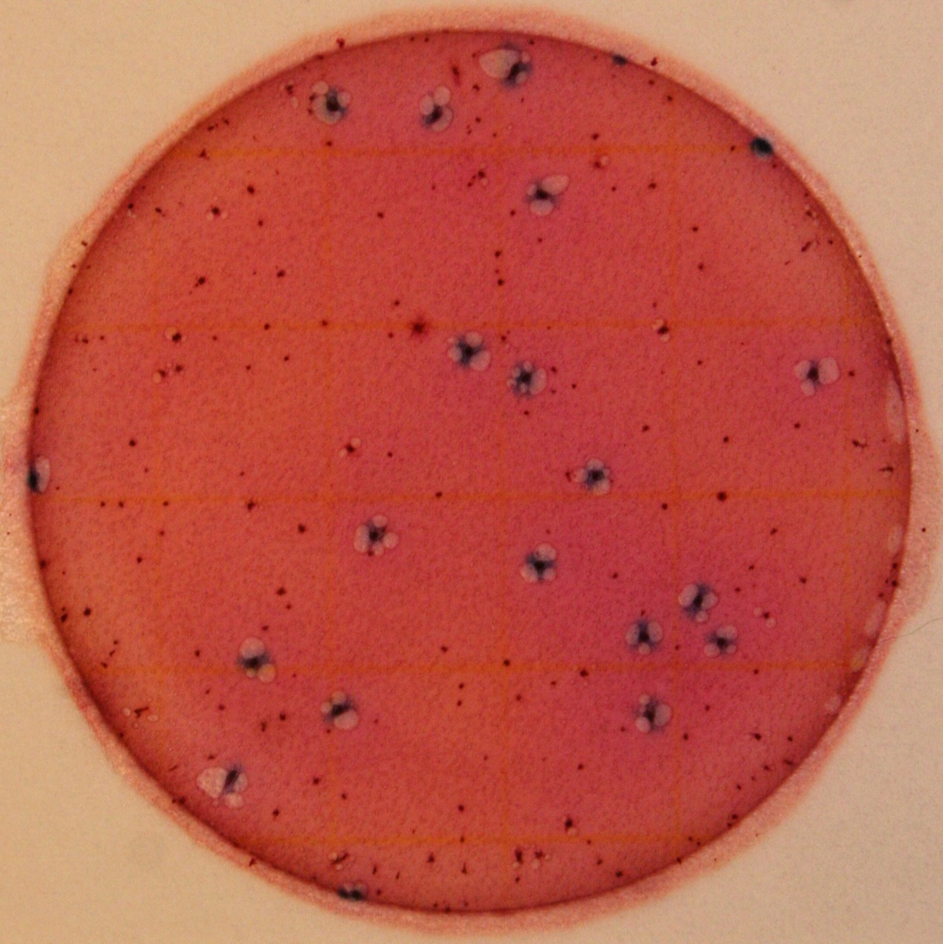
Example #2
  How many E. coli colonies can you see?
Notes:
~20

Slide 23
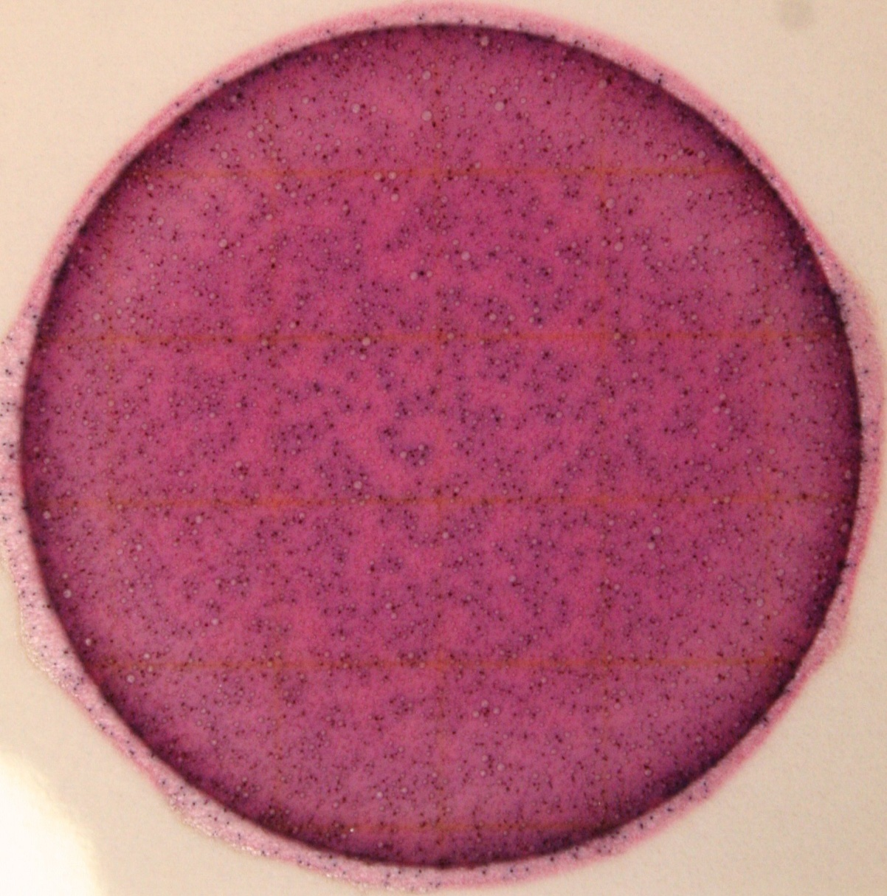
Example #3
  How many E. coli colonies can you see?
Notes:
~TNTC

Slide 24
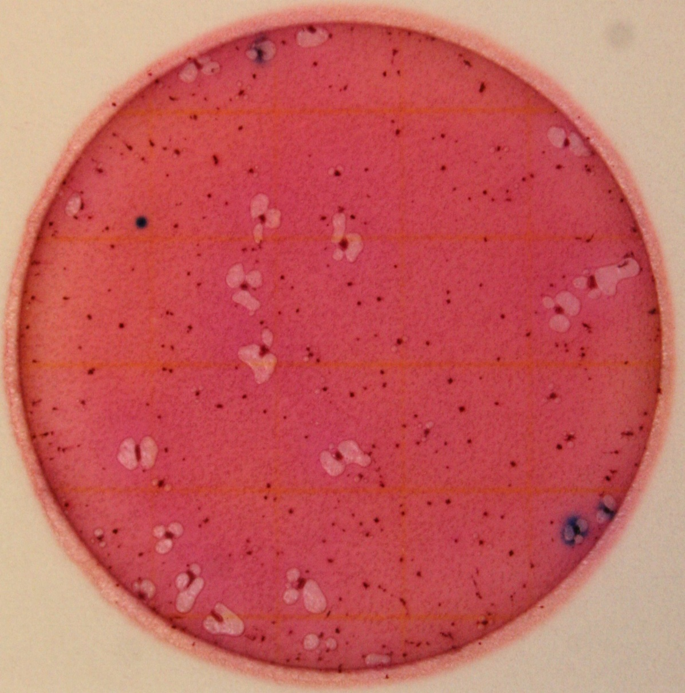
Example #4
  How many E. coli colonies can you see?
  Do not count blue colonies without gas bubbles
Notes:
~3

Slide 25
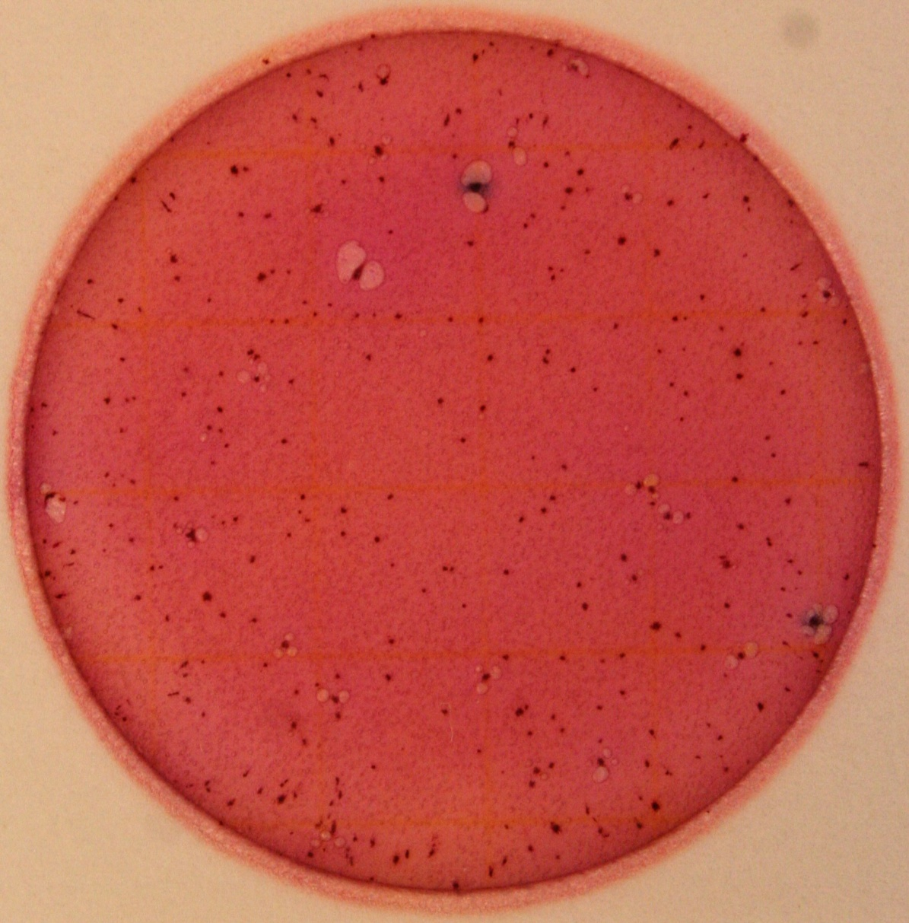
Example #5
  How many E. coli colonies can you see?
Notes:
~2

Slide 26
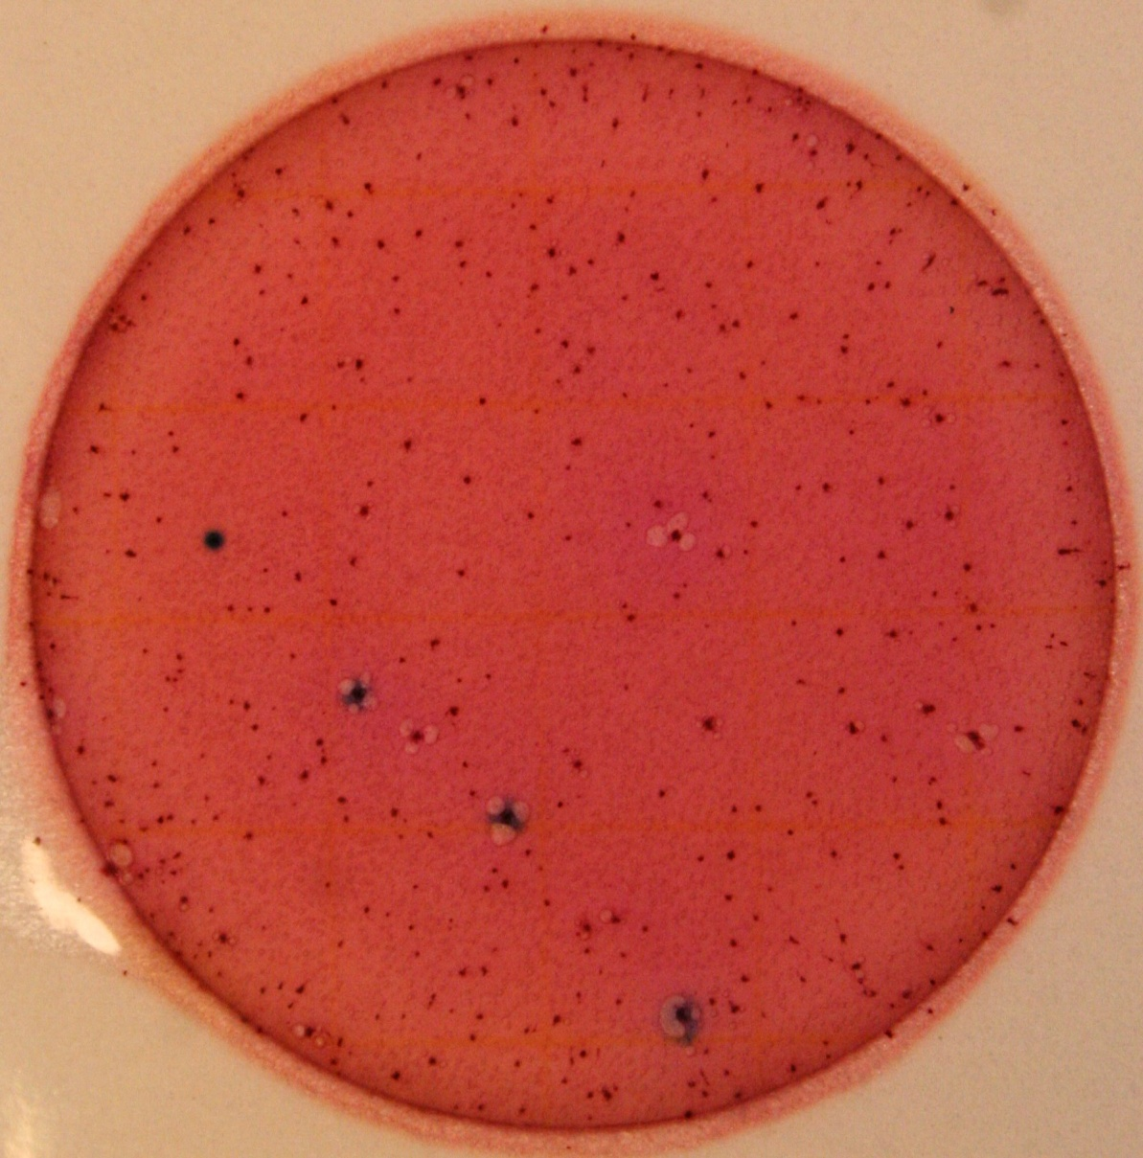
Example #6
  How many E. coli colonies can you see?
Notes:
~3

Slide 27
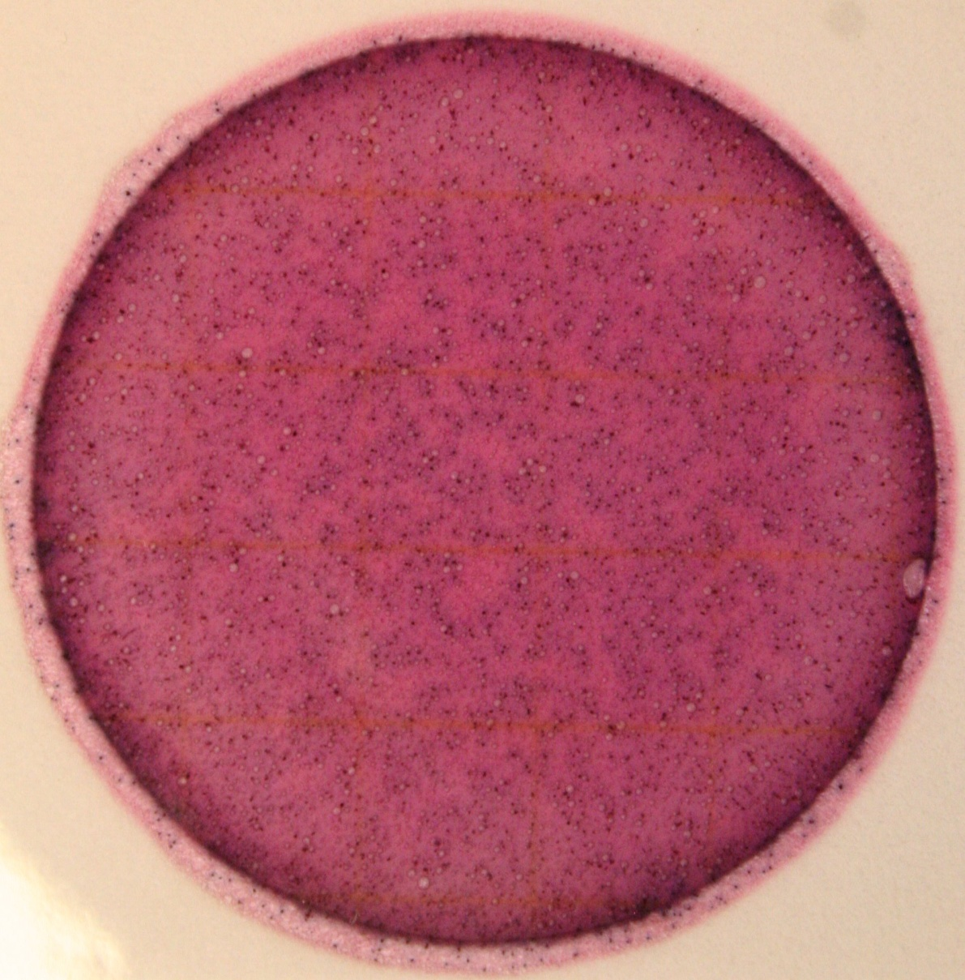
Example #7
  How many E. coli colonies can you see?
Notes:
~TNTC

Slide 28
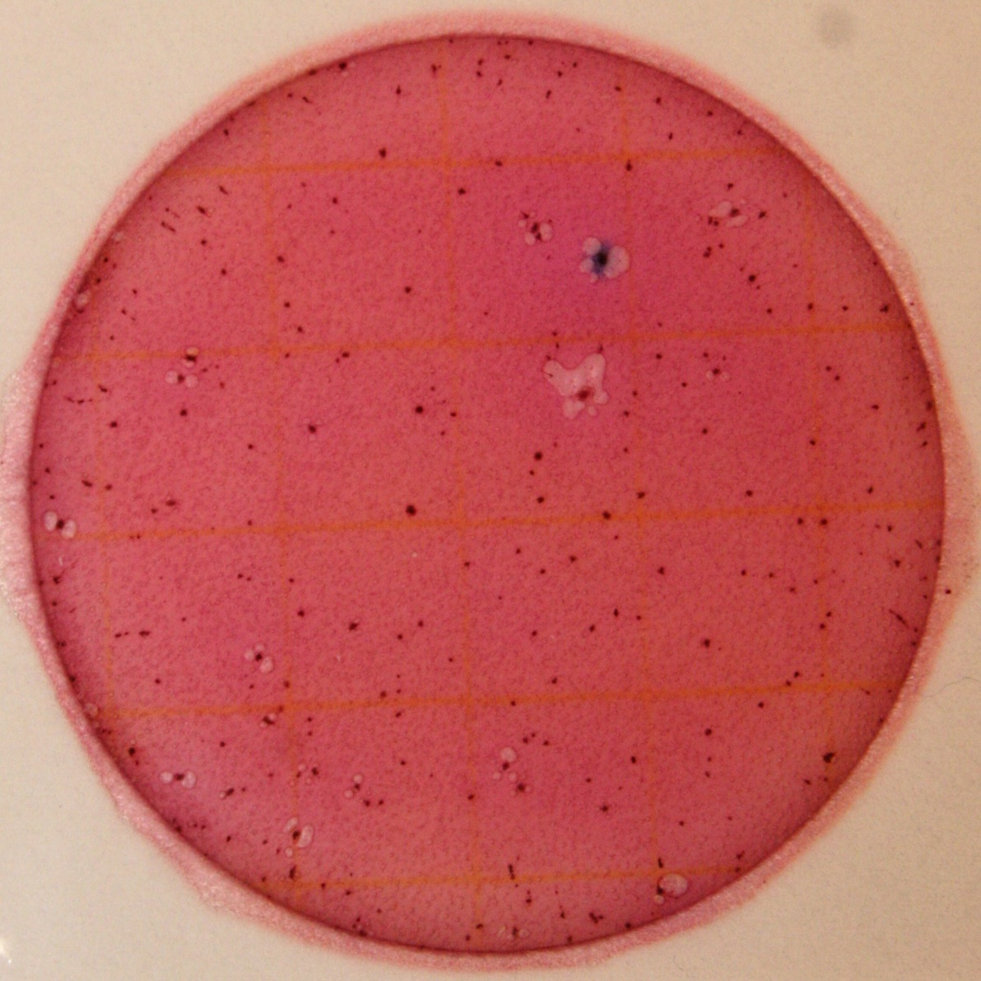
Example #8
  How many E. coli colonies can you see?
Notes:
~1

Slide 29
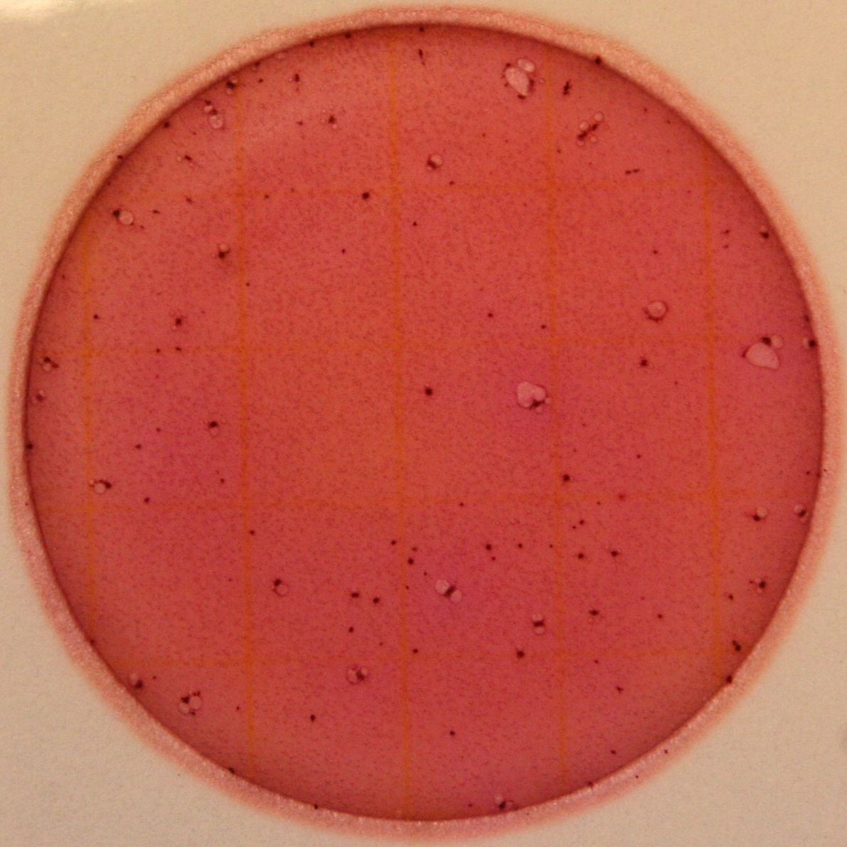
Example #9
  How many E. coli colonies can you see?
Would this plate be acceptable as a blank?
Notes:
~0

Slide 30
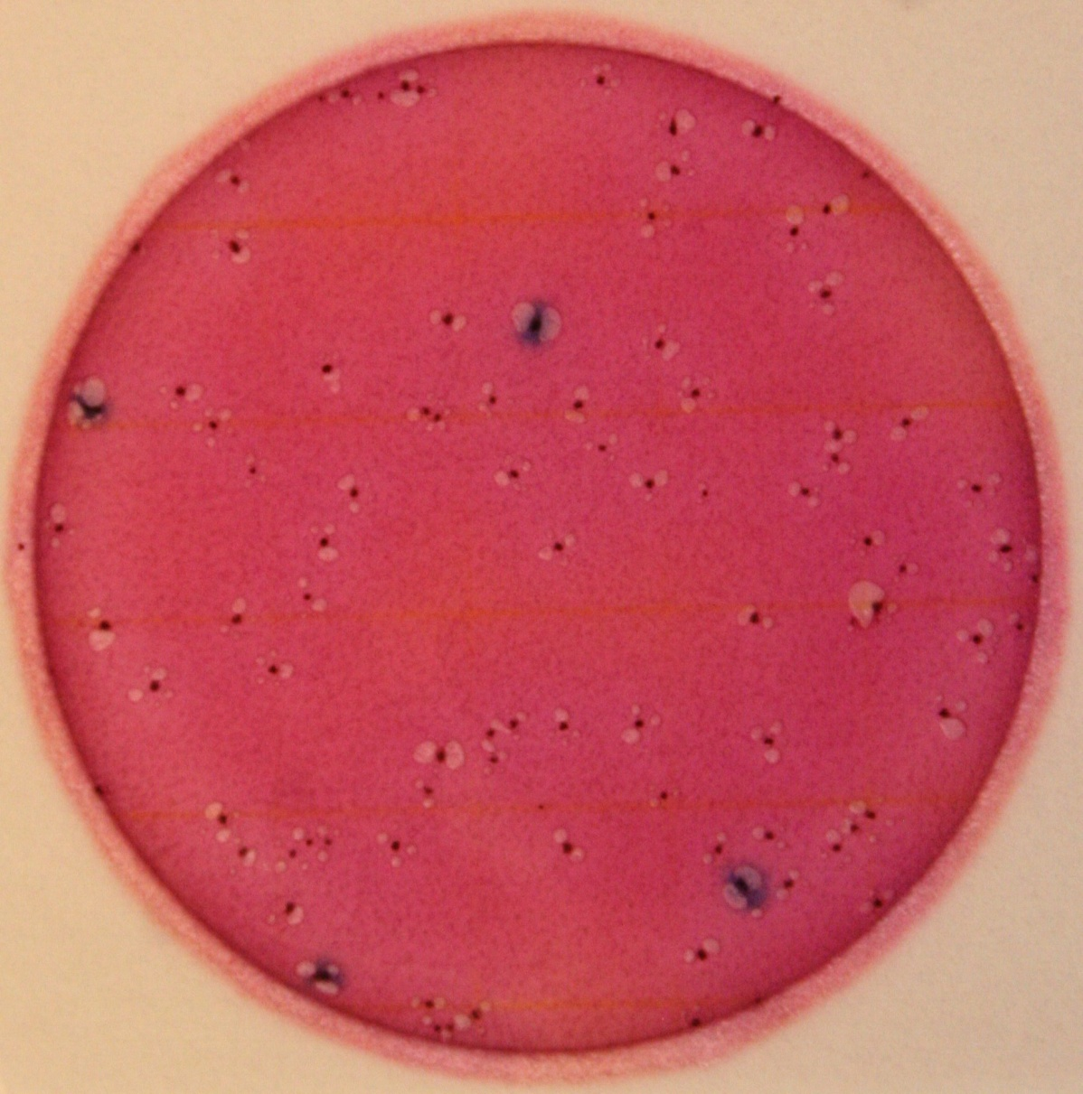
Example #10
  How many E. coli colonies can you see?
Notes:
~4

Slide 31
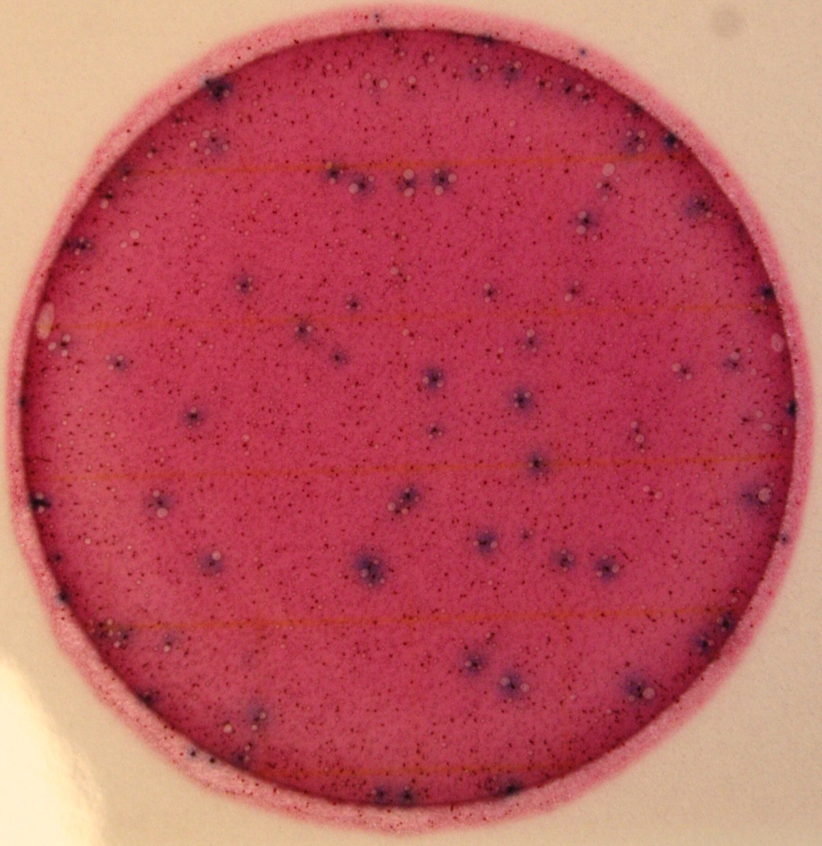
Example #11
  How many E. coli colonies can you see?
When plates turn a deep red color, or plates have many gas bubbles due to the presence of many coliforms, count ALL blue colonies as presumptive E. coli colonies
This is the only case where blue colonies without gas bubbles are counted
Notes:
~63

Slide 32
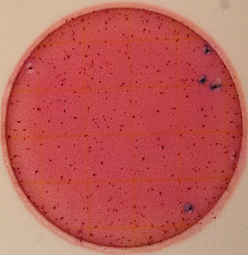
Example #12
  How many E. coli colonies can you see?
Notes:
~20

Slide 33

How Do We Calculate Results from the Plates?
Plate 1
Plate 2
Plate 3
 | Plate 1 | Plate 2 | Plate 3
E. coli Colonies | 3 | 2 | 3

Slide 34
How Do We Calculate Results?
Calculate the results:
Step 1: Plate 1 + Plate 2 + Plate 3
3 plates
= Average CFU/1 ml
Step 2: Average CFU/1 mL x 100 mL = # CFU/100 ml

Slide 35
How Do We Calculate Results?
 | Plate 1 | Plate 2 | Plate 3
E. coli Colonies | 3 | 2 | 3
Step 1: 3 + 2 + 3
3
= 2.67 CFU/1 ml
Step 2: 2.67 CFU/1 ml x 100 ml = 267 CFU/100 ml

Slide 36
How Do We Calculate Results
from these Plates?
Plate 1
Plate 2
Plate 3
 | Plate 1 | Plate 2 | Plate 3
E. coli Colonies | TNTC | TNTC | TNTC

Slide 37
How Do We Calculate Results?
 | Plate 1 | Plate 2 | Plate 3
E. coli Colonies | TNTC | TNTC | TNTC
= TNTC
Step 1: TNTC + TNTC + TNTC
3
*TNTC is generally defined as more than 150 colonies

Slide 38
6. Disposal and Clean-up
Spray plates with disinfectant (10% bleach, disinfectant spray, rubbing alcohol, etc.) and seal in bag or used Whirl-Pak before throwing away
Spray incubator with disinfectant to clean after use
Remember to wear gloves – these are living bacteria colonies!
Wash your hands when finished

Slide 39
Storage of Petrifilm
If using within one month, keep in the fridge
If not, keep them in the freezer for storage
Remember to thaw before use!

Slide 40

EPA Recommended E. coli Levels for recreational waters
 | Designated swimming | Moderate swimming area | Light swimming area | Infrequent swimming area
E. coli (cfu/100ml) | <235 | <298 | <410 | <576
These levels correspond to an acceptable risk level of 8 people out of 1000 getting sick
(from US EPA 1986, 2002a)

Slide 41
Fecal vs. E. coli
According to the EPA, approximately 60% of fecal coliform represents E. coli
  For example:
    A fecal coliform sample that has 1000 cfu/100 ml has approximately 600 cfu/100 ml of E. coli
    A fecal coliform sample that has 500 cfu/100 ml has approximately 300 cfu/100 ml of E. coli
Fecal Coliform
E. coli
But what level is AAS concerned with?

Slide 42
Counts that Warrant Action
>1000 cfu/100ml threshold
Investigate
site
Identify possible sources
Continue to monitor site
Above threshold
Below threshold
Continue
monitoring
NOTIFY
Collect a
regulatory
level sample
Local AAS
coordinator
Local water
authority
Local health
agency

Slide 43
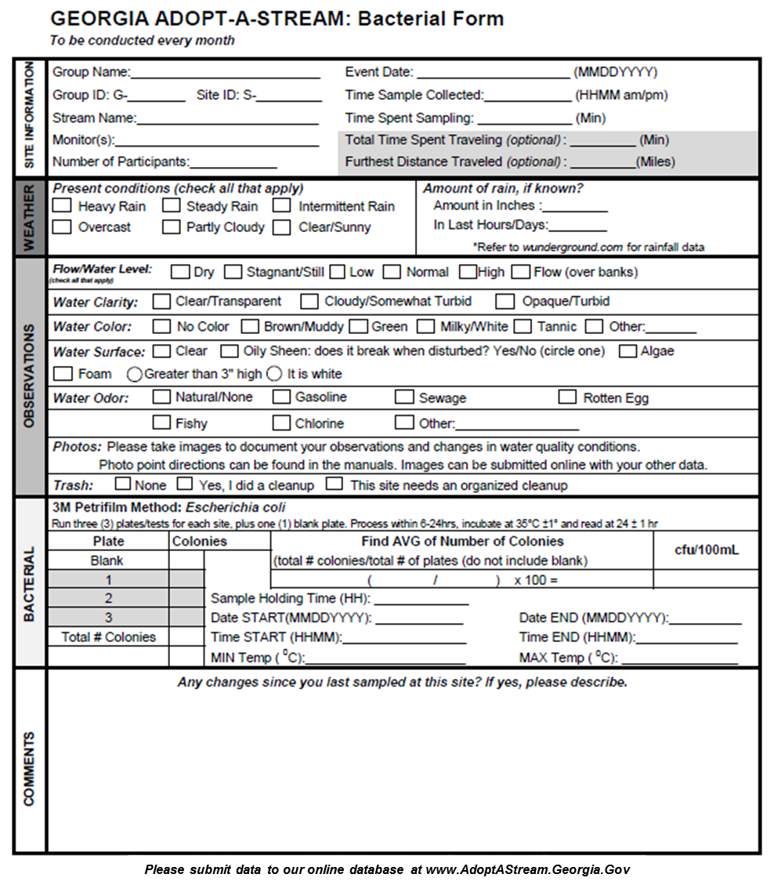

All monitoring
programs
Bacterial
specific

Slide 44
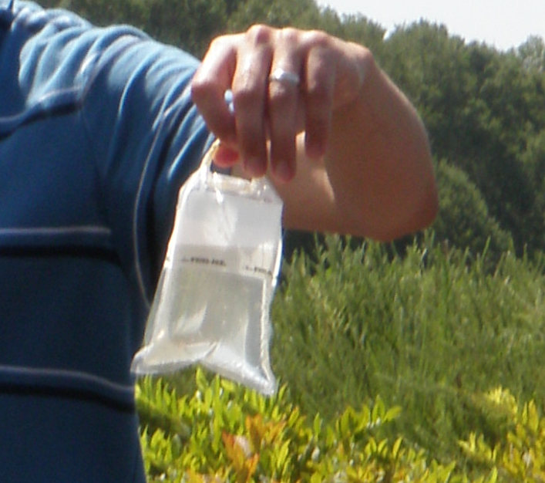
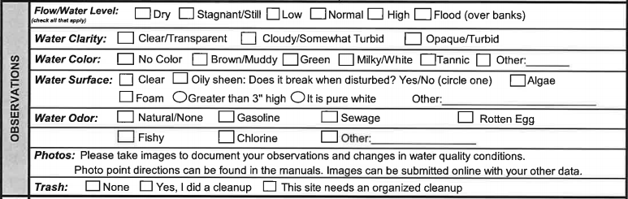
Observations
Flow/Water Level
Water Clarity
Water Color
Water Surface
Water Odor
Photos
Trash

Slide 45
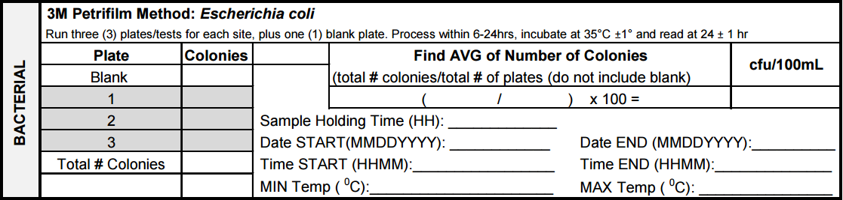
Bacterial Data Form
Use Bacterial data form (Chemical/Bacterial combo data form may also be used)
Fill in number of colonies for each plate
  Blank count should be zero
Volunteers can send scanned color images of plates to AAS or their local coordinator if they need assistance with counting colonies

Slide 46
Submit the Data
As soon as possible after monitoring is complete
Data should be submitted to the state program’s online database:
AdoptAStream.Georgia.gov
Share your data with partners, local governments and your local Adopt-A-Stream coordinators

Slide 47
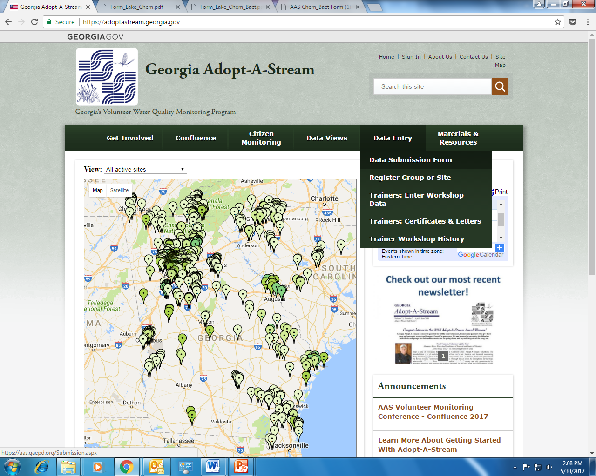
From the website’s Home Page, select “Data Submission Form” under the Data Entry tab.

Slide 48
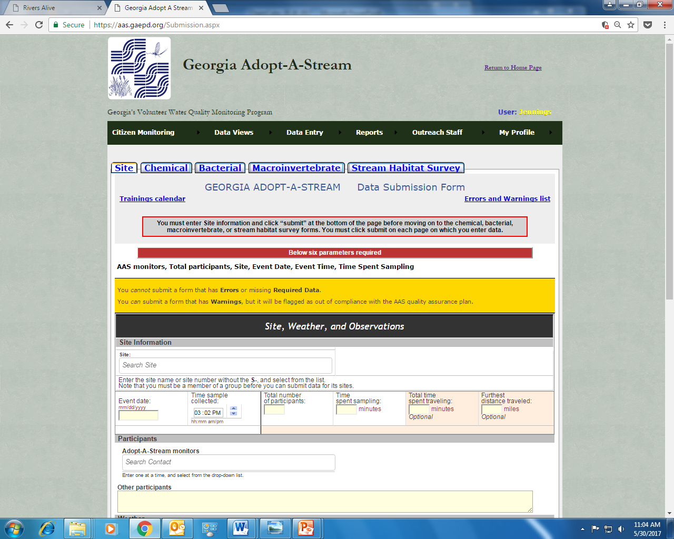
Enter your site information as well as any weather and observation information on this page.

Slide 49
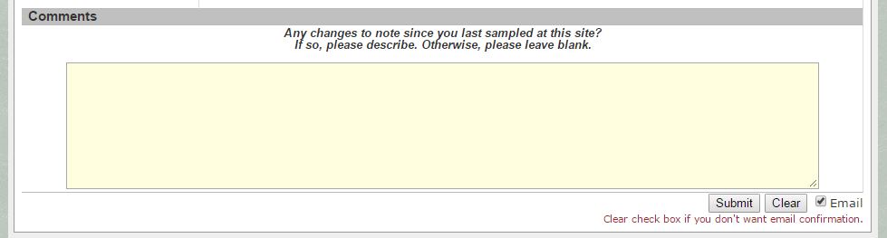
Click “Submit” at the bottom of the page to record your data. You must submit your site data before you can enter bacterial data
(scroll to the bottom of the page…)

Slide 50
After clicking “Submit,” click on the Bacterial tab to continue entering data

Slide 51
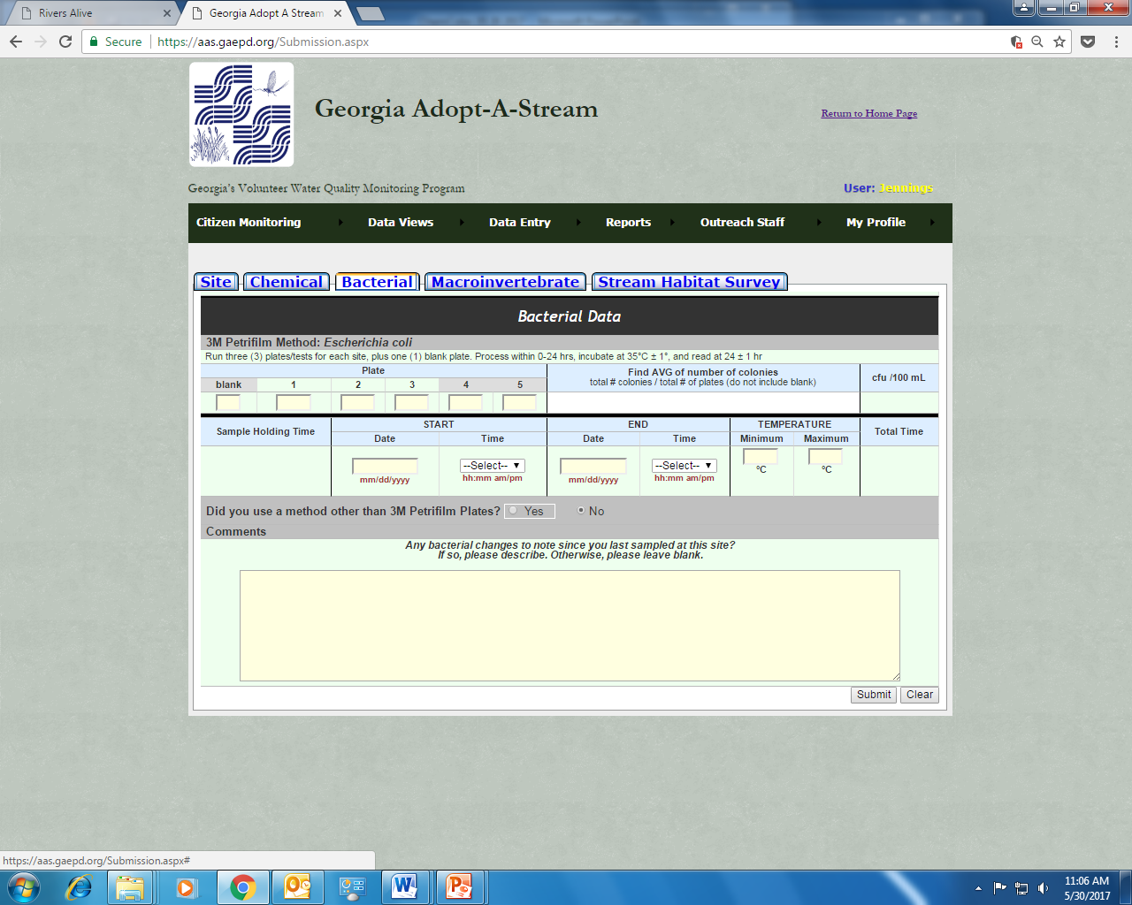
Fill out the form and click “Submit” to record your bacterial data!
Note: You must click “Submit” on each tab if you are entering data for multiple parameters

Slide 52
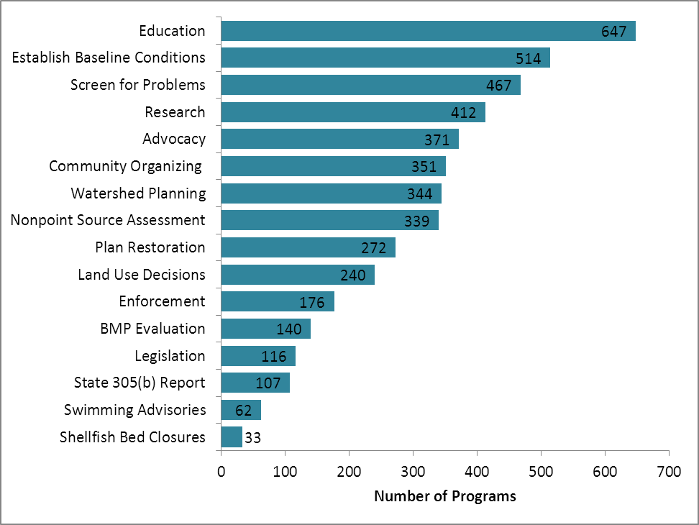
Volunteer Monitoring Data Uses
Local water departments
City Councils
Colleges and Universities
Forestry Services
Environmental Groups
Riverkeepers
Consulting Agencies
Local and State Government
Source: National Directory of Volunteer
Environmental Monitoring Programs, 5th Edition

Slide 53
Just the Facts
Raise Awareness
Water quality Data
Gather Observations
Encourage Partnerships
Provide Tools and Training
Quickly assess health risks due to bacterial contamination of surface waters
Single-celled, living microorganisms
Wildlife
Livestock
Urban storm runoff
Leaking pipes
Failing septic systems
1000 cfu/100 ml
CFU/100 mL – colony forming units/100 mL
1 blank + triplicate of sample = 4 plates
Purpose of a blank?
Once a month
Place samples in cooler with ice
Rainstorm
UV light will reduce bacteria levels
Warmer temps = higher E. coli survival rates
Cooler temps = lower E. coli survival rates
Spray plate with disinfectant and seal in plastic bag for disposal
General coliforms are red in color with entrapped gas bubbles, while E. coli are blue in color with entrapped gas bubbles
asap, but no more than 24 hours after collection
35°C ± 1 degree for 24 hours ± 1 hour

