Slide 1
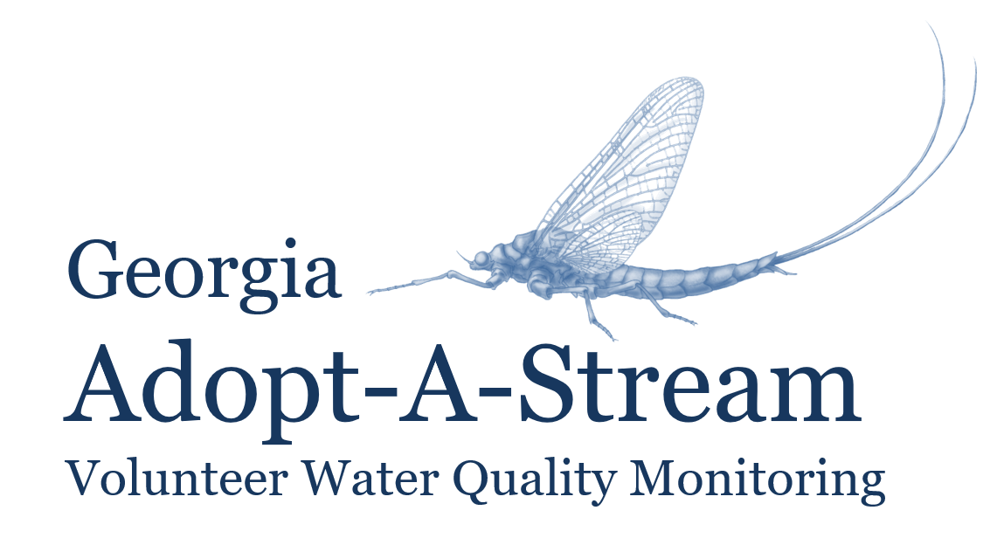
Georgia Adopt-A-Stream
Introduction
Notes:
Notes to Presenters:
You are not required to say everything that is in the notes or present the information in the same way; these notes are simply included for your reference, so use them as much or as little as you like.
Please feel free to use your own examples, anecdotes, photos, etc. throughout the presentation. Make the presentation yours!
Notes Key:
Italicized text= direction for presenter, not to be said aloud
Underlined text= give emphasis

Slide 2
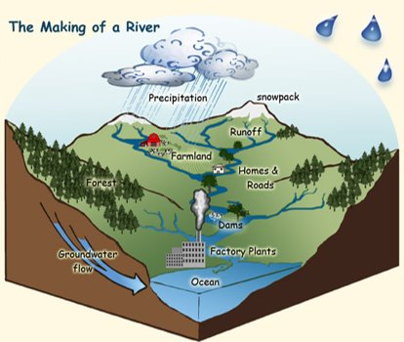
What is a Watershed?
A land area from which water, sediment, and dissolved materials drain to a common point along a stream, wetland, lake, or river. ​
Its boundaries are defined by the highest points of land around the waterbody.
A. Vicente, U.S. Forest Service
Notes:
Water is one of our most valuable resources.
We depend on waterways to be a source of clean, safe drinking water, to use towards agriculture, industry, and recreation, and to provide rich, stable habitat for fish and wildlife.
Water connects us individuals and regionally, and both its movement and quality are influenced by the actions of communities.
What is a watershed?
A watershed is a land area! A watershed is not just the waterbody, rather the entire area of land over which all the water, sediment, and dissolved materials flow and drain to a common point (i.e. the waterbody)
Its boundaries are defined by the highest points of land around the waterbody
Everything that touches the land (flora, fauna, pollution, man-made disturbances) impacts waterways.
This is where we see the effects of nonpoint source pollution accumulate and potentially harm ecosystems and impact human health
Essentially, each waterbody has its own watershed, and the size of the watershed depends on the size of the waterbody; therefore, watersheds can be as small as a neighborhood or go across an entire state (will see state watersheds on next slide)
Ultimately everything will drain to the oceans
Example: you can cup your hands to show that high points (thumb and pointer fingers) define the land area/watershed. When precipitation falls over the watershed, everything that’s on the land (fertilizers, car fluids, litter, pet waste, etc.) will wash down into the common/low point (crease where pinky fingers meet). This common point is usually a stream, river, wetland, or lake.
Photo source: https://www.fs.fed.us/rm/boise/research/techtrans/projects/scienceforkids/watersheds.shtml; A. Vicente, U.S. Forest Service.

Slide 3
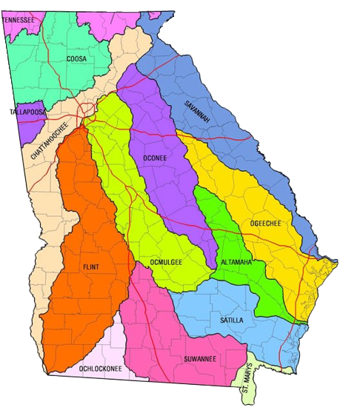
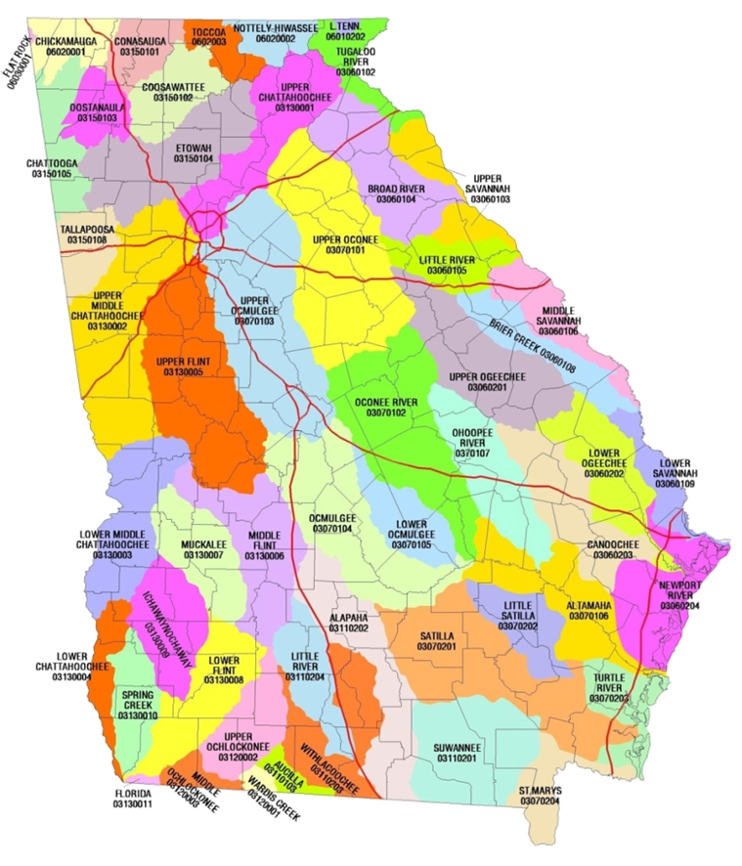
Where is Your Watershed?
Notes:
This slide has animations
Feel free to give an example of an issue specific to your watershed that can help demonstrate the watershed concept. Or add a local watershed map if you have one available.​
​
Now that we know what a watershed is- where can they be found in our state?
The answer is literally everywhere!​ Everything is located on a watershed
Georgia has 14 major watersheds (1st photo), what major watershed are we in today?​
The second photo shows us the 52 sub-watersheds in the state. What watershed are we in according to the second photo? ​
Notice how the larger watersheds can be broken down into smaller watersheds​​
Even though these land areas are separated by high points of land and other demarcating factors, remember that “we all live downstream” ​​
Look at the metro Atlanta area; there are 4 watersheds just within the perimeter of 285. Imagine the impact on water quality! ​​​
helpful resource for GA watersheds: https://garivers.org/georgia-rivers/

Slide 4
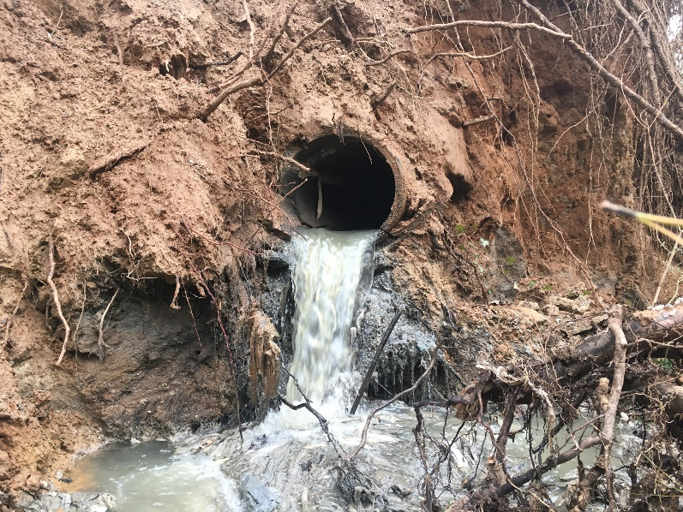
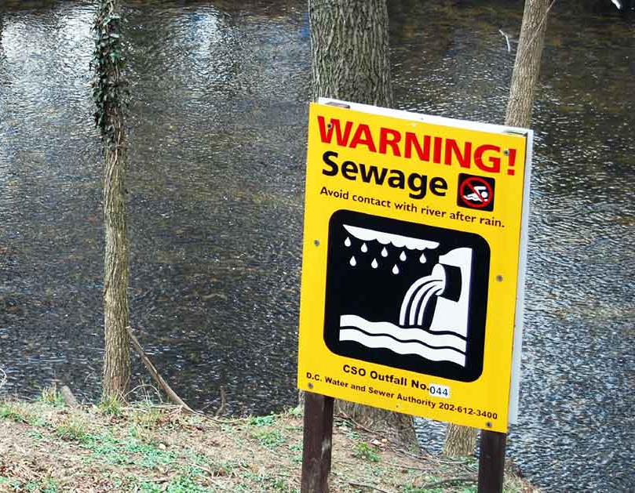
Point vs. Nonpoint Source Pollution
Point Source
Easily identifiable pollutant source
Regulated by GA EPD through the NPDES permitting process
Chattahoochee Riverkeeper​
American Rivers
Notes:
Pollutants- substances that when introduced, have adverse effects on the surrounding environment.
While pollutants take on many forms, from household trash to fertilizers and pesticides, they all threaten water quality.
There are two main types of pollution: point source and nonpoint source.
Point source pollution:
Discharged from an easily identifiable source such as factories, construction sites, or wastewater treatment plants.
Georgia's Environmental Protection Division (EPD) regulates point source discharges through a permitting process called the National Pollutant Discharge Elimination System (NPDES). These permits set limits for the amount of pollutants discharged into a system.
Photo sources:
Chattahoochee Riverkeeper
https://www.americanrivers.org/threats-solutions/clean-water/sewage-pollution/
https://oceanservice.noaa.gov/education/tutorial_pollution/03pointsource.html

Slide 5
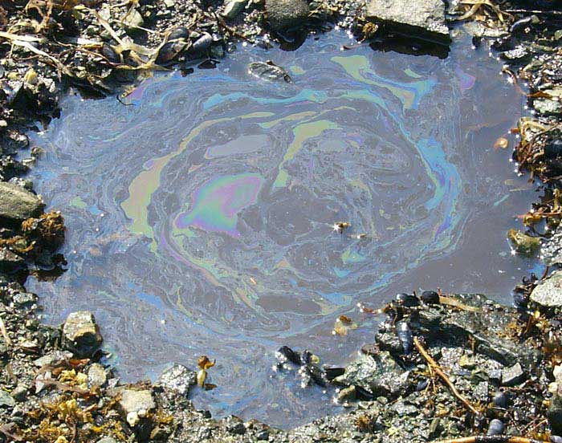
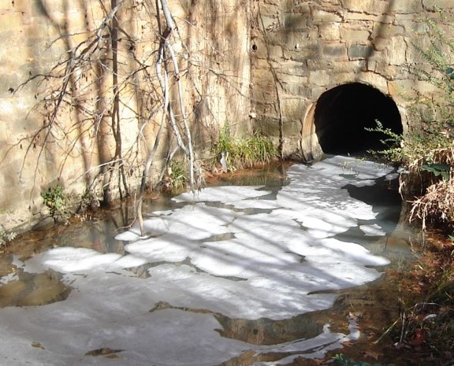
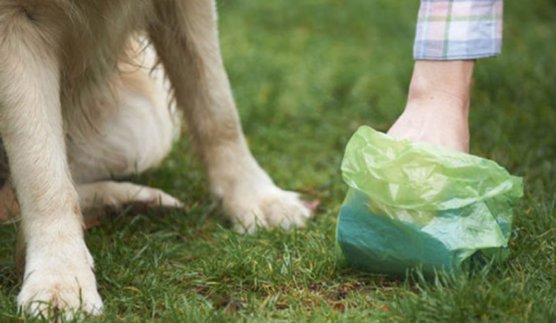
Point vs. Nonpoint Source Pollution
Nonpoint Source
Sources that are not easily distinguishable or identifiable
Everyone contributes
The main cause of water quality problems in GA
Notes:
Nonpoint source pollution:
Discharge source is not easily identifiable and/or pollutants come from an array of different sources (compare to point source)
More difficult to control, and therefore is the main cause of water quality issues throughout Georgia.
Enters waterways as runoff, a result of precipitation traveling over the ground and picking up substances before eventually entering a waterbody.
Examples: fertilizer from agricultural fields, oil from impervious surfaces, soaps and chemicals from car washes or pressure washing, E. coli from dog poop, etc.
NPS pollution moves through the stormwater system to get to the waterways. For example, the vast majority of the ATL metro area is on a stormwater system that is separate from the sewer. Many people don’t understand this and think that the storm drains lead to treatment plants, and so dumping pollutants in these drains is harmless. However, this is not true!
NPS is the main type of pollution that AAS monitoring is focused on- you can help identify sources of nonpoint source pollution
Photo sources: https://oceanservice.noaa.gov/education/tutorial_pollution/04nonpointsource.html
https://www.nrcs.usda.gov/wps/portal/nrcs/detail/nm/programs/financial/eqip/?cid=nrcseprd323312
http://www.seattle.gov/utilities/protecting-our-environment/sustainability-tips/pollution-prevention/pet-waste

Slide 6
Why Monitor Water Quality?
Our quality of life is directly related to the quality of the rivers, streams and wetlands around us.
Regular monitoring provides baseline information about the health of our local streams and other water bodies.
All the water we have now is all the water we’ll ever have!
Notes:
Our quality of life is directly related to the quality of the rivers, streams and wetlands around us.
Water is a necessary component of our daily lives!
Drinking water, agriculture, fishing, recreation, etc.
Regular monitoring provides baseline information about the health of our local streams and other water bodies
Think of it as finding and monitoring the "heartbeat" of a waterbody
There is seasonal variation, but spikes or dips that deviate from baseline data can indicate an issue with overall water quality
All the water we have now is all the water we’ll ever have (mention Water Cycle), so it’s important that we conserve and protect this valuable resource

Slide 7
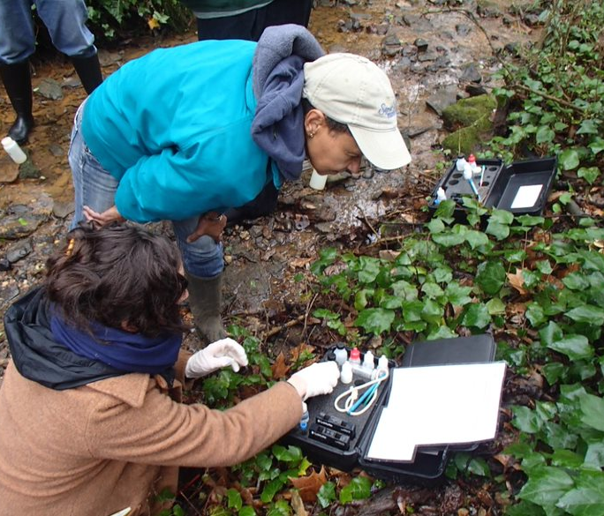
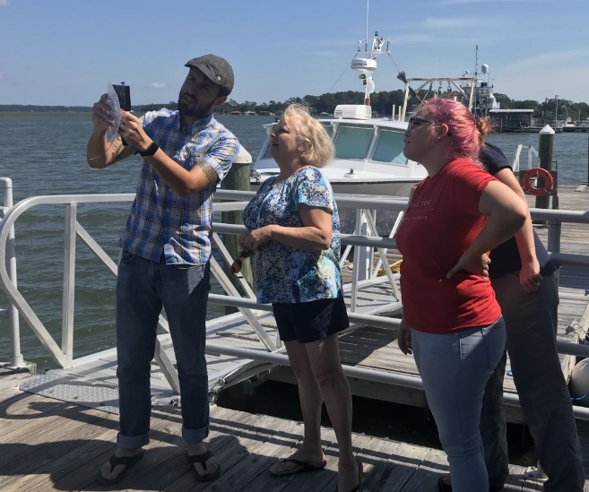
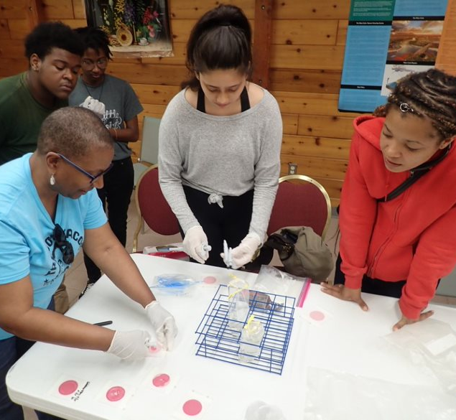
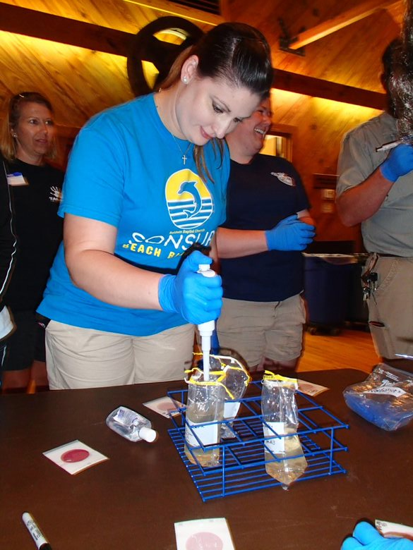
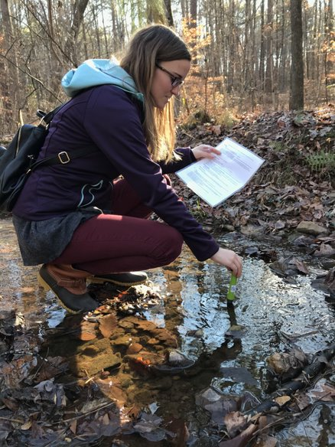
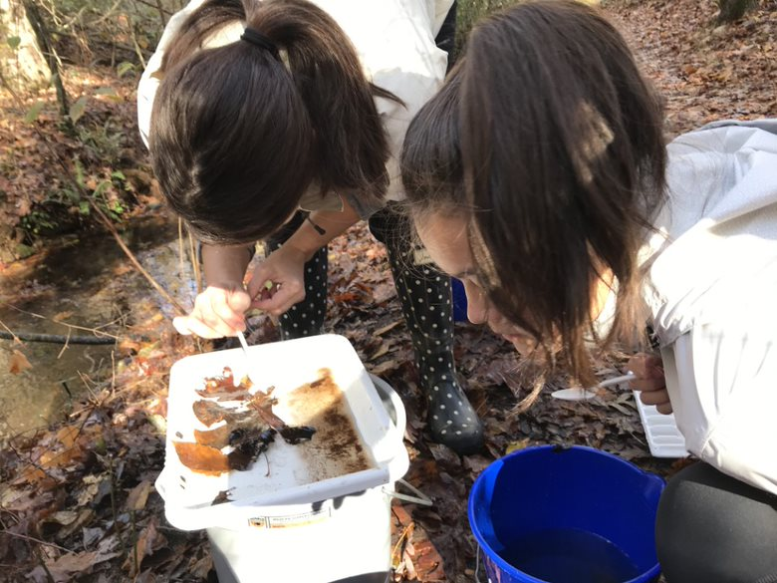
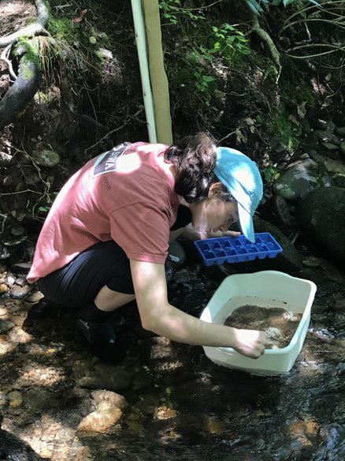
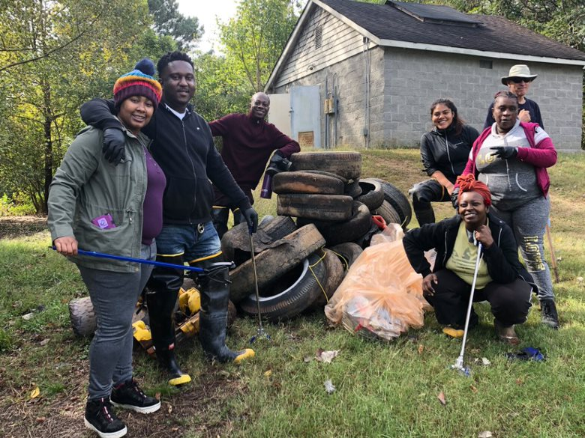
What is Georgia Adopt-A-Stream?
Notes:
Georgia Adopt-A-Stream is the State's volunteer water quality monitoring program
Housed within the Nonpoint Source Unit of the Watershed Protection Branch of Georgia’s Environmental Protection Division (a part of Georgia's Department of Natural Resources)
One of four programs in the Nonpoint Source Outreach Unit funded by an EPA 319 grant (Clean Water Act funds).
These programs target awareness, prevention, and monitoring of nonpoint source pollution
AAS encourages individuals and communities to monitor and/or improve sections of streams, wetlands, lakes or estuaries through several different monitoring programs.
Engages citizen scientists across Georgia and beyond in water protection activities through a series of educational workshops, which train individuals on the physical, chemical and biological health of their waterways.

Slide 8
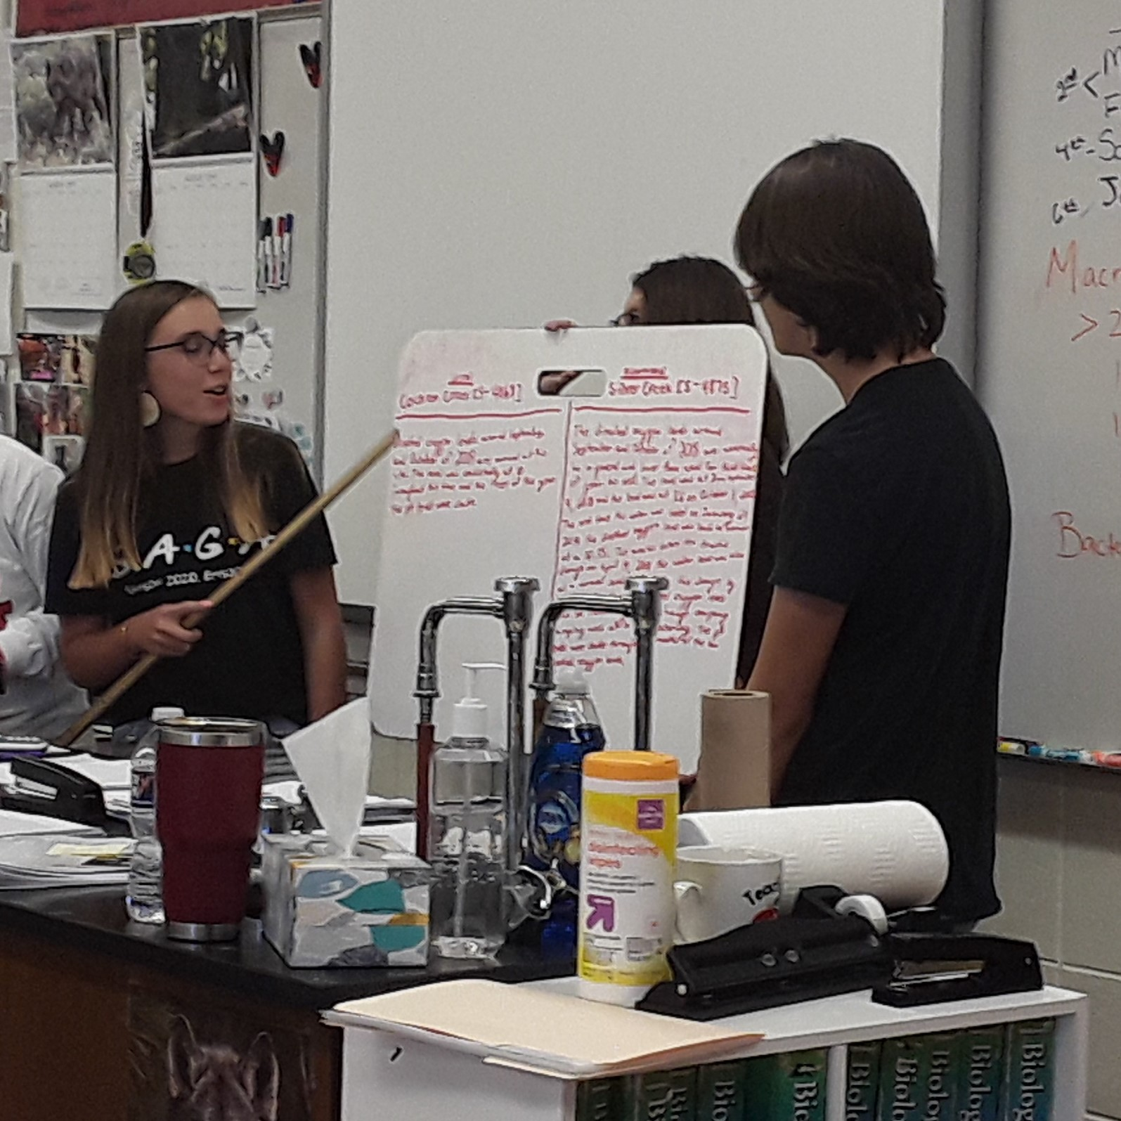
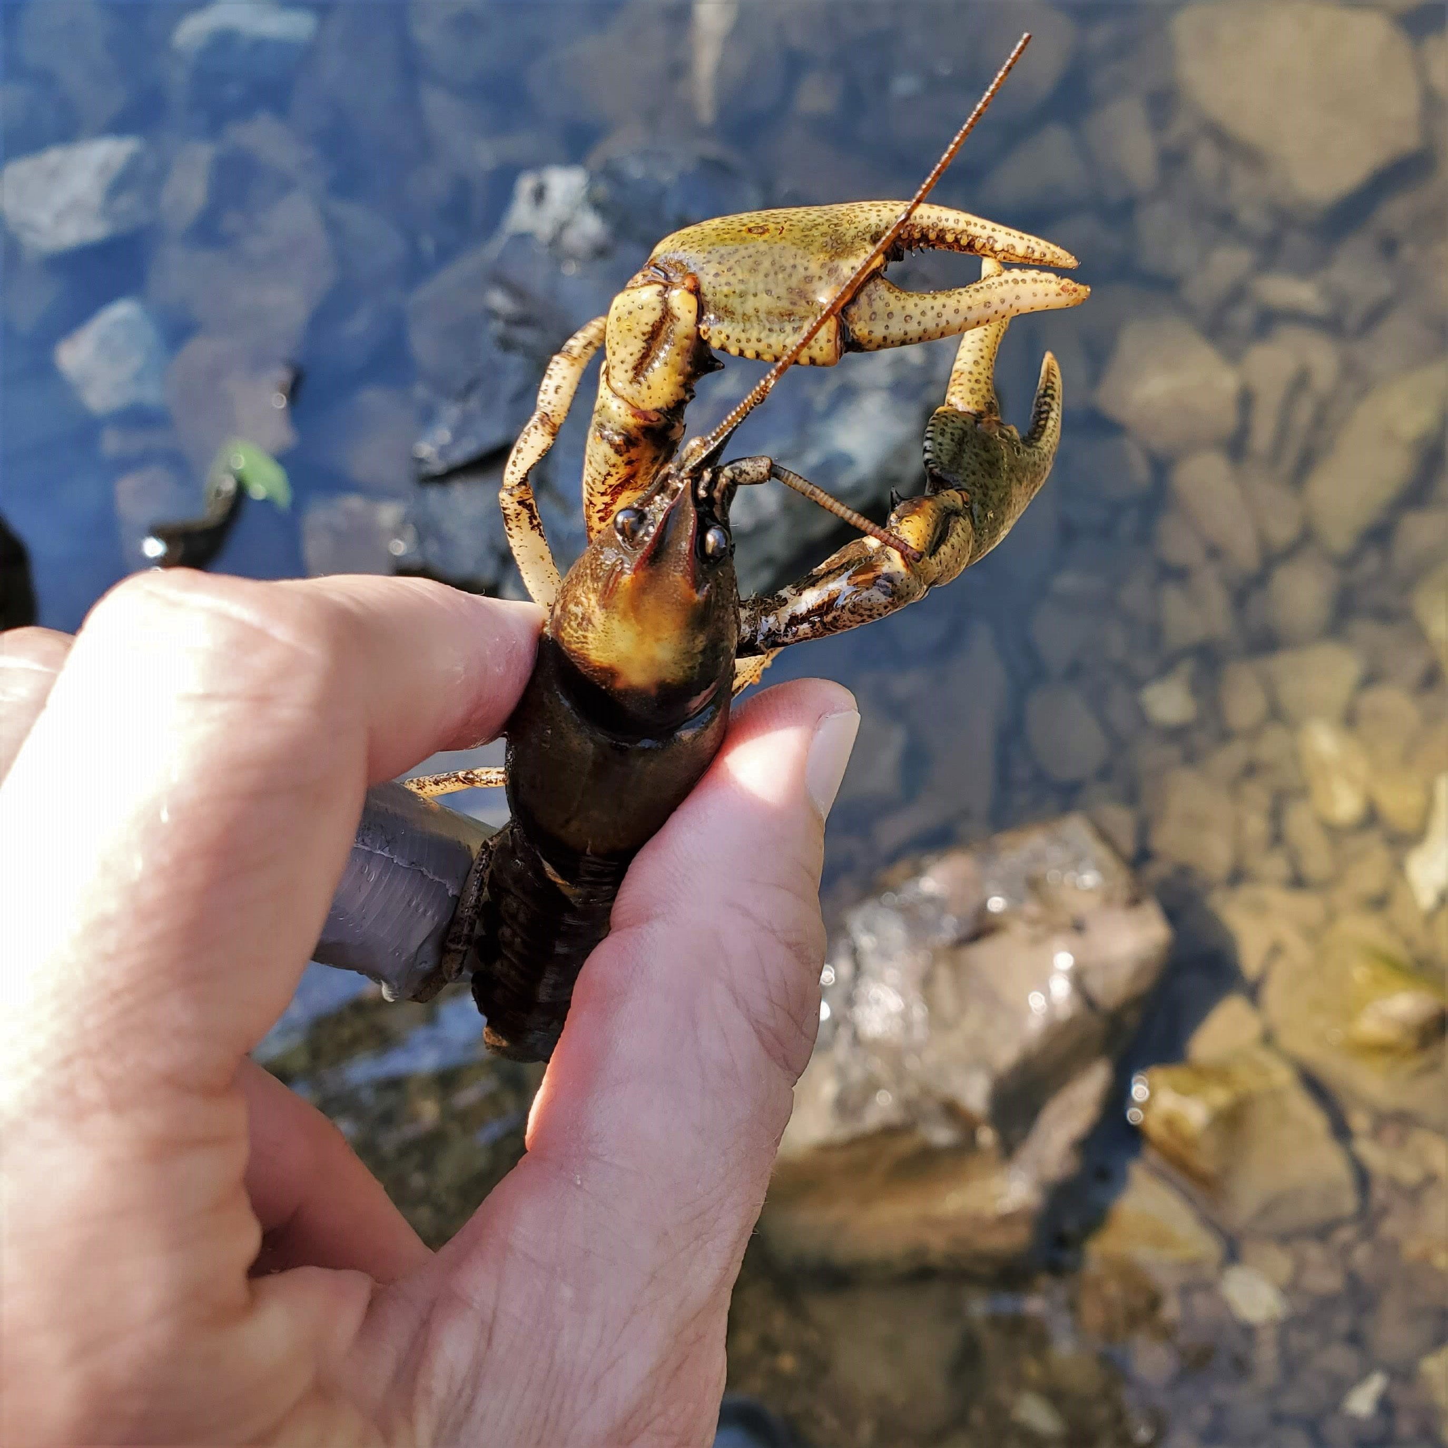
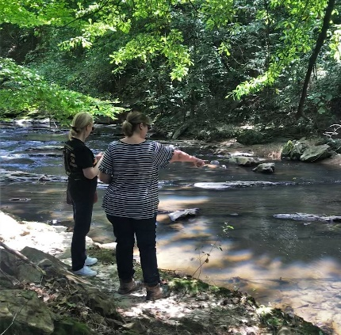
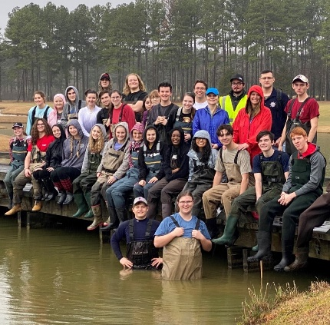
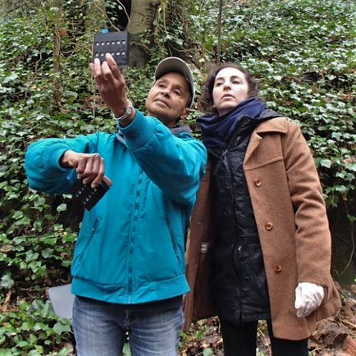
Georgia Adopt-A-Stream
A citizen science water quality monitoring program encouraging all Georgians to get familiar with their watersheds, monitor impacts, improve streams, rivers, wetlands, lakes, and estuaries, and inform others about their effect on water quality.
A
D
O
P
T
Awareness
Data
Observations
Partnerships
Tools & Training
Increase public awareness of nonpoint source pollution & water quality issues
Collect baseline water quality data according to Adopt-A-Stream protocols
Take observations of sites to note water quality conditions
Seek partnerships with local gov’ts, nonprofits, & other organizations to share results & resources
Utilize tools & training provided by staff & local coordinators
Notes:
Awareness: we are striving to increase public awareness of water quality issues throughout Georgia and its neighboring states by hosting outreach events (like cleanups, monitoring demos, etc.) in communities, consistent monitoring, understandable data, and an annual conference to celebrate and foster connectivity between volunteers
Data: AAS has an online, open-access database that has thousands of data points that allow anyone to see the value and importance of baseline data. Over time, data collected consistently (in the same locations, using the same protocols) will show natural fluctuations and trends in the waterbody that can be monitored for any deviations that could indicate pollution or impairment. Think of this like the stream’s heartbeat; it needs to be monitored carefully to ensure that the stream is healthy and any issues can be found and resolved quickly.
Observations: An incredibly important part of monitoring is being aware of the area around you and making careful observations. Just by noting what you see or smell, a sewage spill or other pollutant source could be found before you even start monitoring! It is also important to note any changes you see over time as these can also represent impacts on water quality. Once you take a look at the AAS data form, you'll quickly see the prominence observations have and how easy it is to gather these data!
Partnerships: forming partnerships throughout your journey as an AAS volunteer is incredibly valuable! Not only can forming these relationships help you get equipment you need (like macro kits, Petrifilm, reagent refills, etc.), but you will also find that you will be supported if you find any pollutants or harmful impacts on your stream. We all have something we can offer when we work together to solve problems.
Tools and training: You’re here today to fulfill part of this goal. AAS has many partners that work to provide equipment, support, and training opportunities for our volunteers.

Slide 9
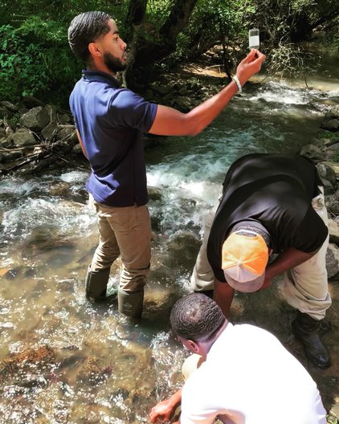
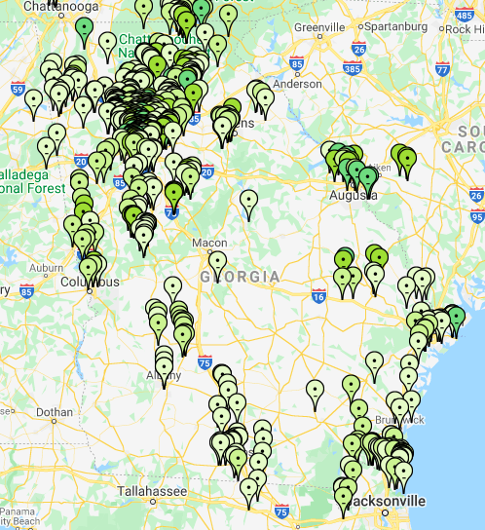
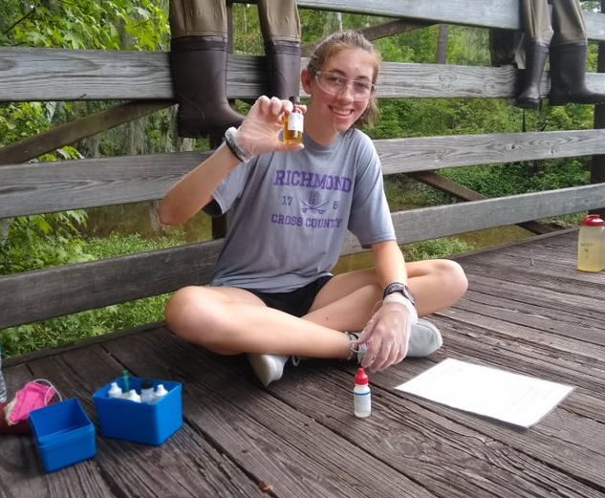
Volunteer Network and Support
State
Staff
2 to 4
Board Members
20
Local Coordinators
70
Volunteers
3,000 +
Notes:
This slide has animations
(Map photo) This map shows all the active AAS sites across the state. Working off the knowledge from earlier on in the presentation, are there vols working in your watershed already?
Hopefully, this map shows that you have AAS sites in your watershed already. If it does not, we are so excited that you are leading the way in your area!
You can use this map to see if there is a site already established near you and reach out to that group or find a waterbody to establish your own.
Sites extend into SC, NC, FL, and can be added anywhere!
(map with photos) You are joining a network of volunteers across the state (and beyond!) that are collecting and submitting data. These may be professors or their students using the data for research, a retiree acting on their interest in water chemistry, a neighborhood association member concerned about the lake they live on, a young family making sure their backyard stream is safe for their children and pets to play in, a scout troop, a riverkeeper volunteer, you name it!
(triangle graphic)
Volunteers- As you can see, volunteers are the reason this program exists. Without so many interested and active community members, AAS would not be able to monitor anywhere close to the number of sites shown on the previous map. But thanks to you and all other AAS volunteers, our database is ever growing, and we are here to support your efforts.
Local coordinators- Local coordinators/trainers are an integral part to the AAS program as well. They are responsible for providing training and support to regions of the state and staying up to date with information that the state and local governments put out. These coordinators are trained by the state office and provide many of the workshop opportunities that are offered across the state.
Board members- AAS also has an advisory board that guides the program to be the most effective and meaningful for the citizen scientists that are engaged.
State staff- The smallest number you can see at the top of the triangle is state staff. These few employees support this volunteer program for the state of Georgia and provide support and guidance when possible. They also organize the annual conference and travel to participate in other outreach and data collection events.

Slide 10
Getting Started with AAS
Determine Your Goals
Attend a Monitoring Workshop
Form a Group and Select a Site
Obtain Equipment
Start Monitoring!
Notes:
Here are some steps on how to get started with AAS!
Note that this is not a set order, there is flexibility (you may have a site in mind before attending a workshop, come into the program as part of a group, etc.)
We will go through each of these one by one in this section of the presentation

Slide 11
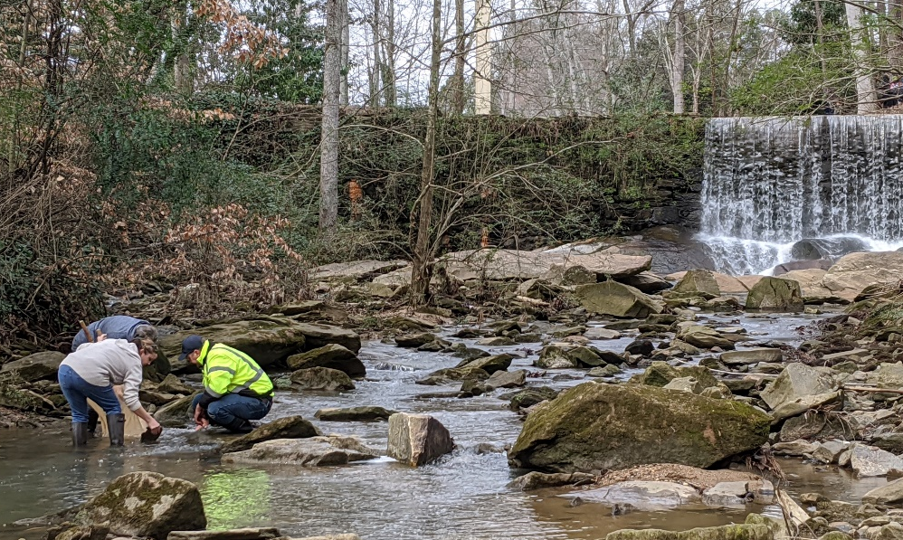
Determine Your Goals
Questions to consider:
Why do I want to monitor?
What site might I like to adopt?
What type of data do I want to collect?
Who might be interested in my data?
Can be driven by group, site, community, etc.
Goals may shift over time, but can help focus monitoring efforts and maintain participation
Notes:
The first question to ask is, why do I want to monitor? Here are some examples:
Determine the health of my backyard stream
Educate community/take action
Use as a way to get outside with my family
303(d) listed stream- work to inform status of stream on the 303d/305b list
Clean Water Act requires waterways that are not supporting their designated uses to be put on this list.
If waterbodies are not meeting their designated uses, this could limit recreation (fishing, swimming, boating, etc.) and more (resource below)
Use own examples if possible
What site? Will get into that later, but begin to think about waterbodies of interest around you
Type of data? There are a number of different monitoring types as part of AAS; we'll also go into that more later
Who might be interested? Going back to partnerships, could be local gov't, riverkeeper orgs, tool for classrooms, etc
Your goals can be driven by group (school groups=education), site (in backyard, want it to be safe for kids to play), community (construction happening, want to know environmental impacts), etc.
OK for goals to shift, but it is helpful to form goals and reassess as you continue monitoring
303(d) list resource: https://epd.georgia.gov/watershed-protection-branch/watershed-planning-and-monitoring-program/water-quality-Georgia

Slide 12
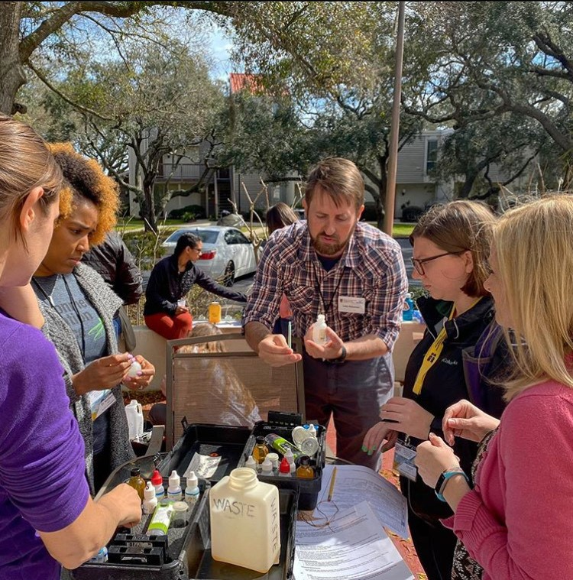
Attend a Monitoring Workshop
QA/QC workshops
Quality Assurance/Quality Control
Procedure based data collection
More frequent monitoring
Non-QA/QC workshops
Observational data collection
Less frequent monitoring
Allows you to create an AAS account
Notes:
AAS offers a variety of monitoring programs for you to choose what best suits your interests and availability, and you can learn more about them by attending monitoring workshops.
Attending a monitoring workshop does more than just relay protocols.
You get the chance to learn background information on the monitoring program and its different parameters
Will also learn how your monitoring efforts can help you determine a waterway’s health and water quality
AAS offers two main categories of monitoring programs
QA/QC (quality assurance/quality control)
Data must be collected with specific protocols and equipment; this ensures the data are replicable, accurate, and trustworthy.
Volunteers must pass a certification test after each workshop to enter QA/QC data
Suggested monitoring frequency: monthly to quarterly
Non-QA/QC
Focuses on collecting valuable data with a less stringent methodology (more observation-based)
Attend a workshop to learn background information and guidance on how to conduct each monitoring type (no need to pass a certification test!)
Suggested monitoring frequency: quarterly to annually
Once you attend a workshop, you receive an AAS account that allows you to access database.

Slide 13
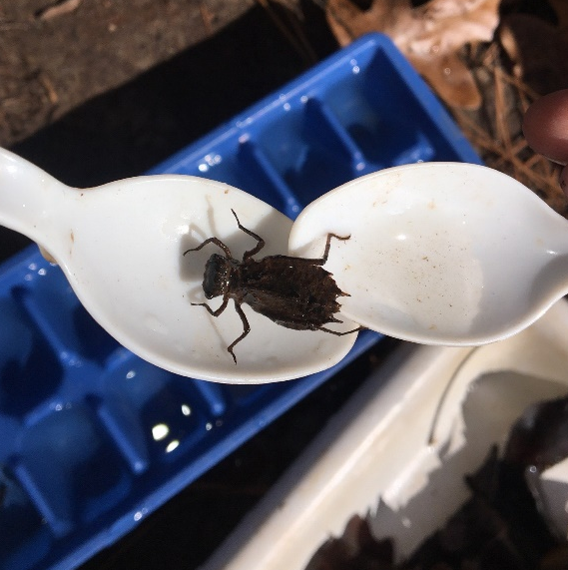
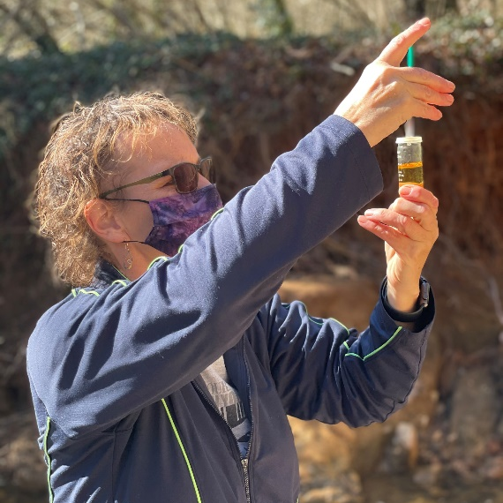
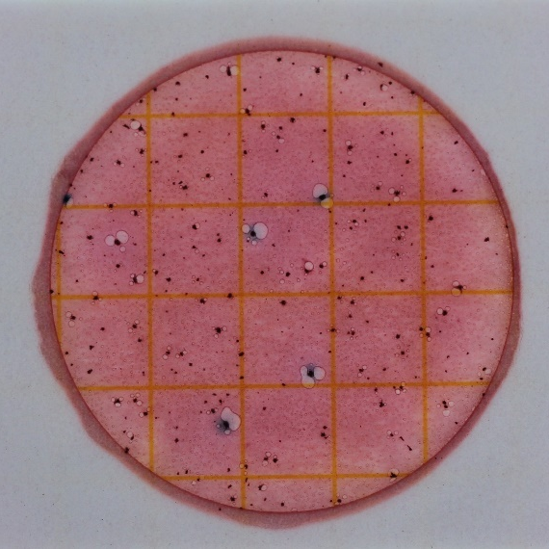
QA/QC Monitoring Programs
Macroinvertebrate
Test for stream macroinvertebrate diversity
Survey quarterly or once every season
Chemical
Test for basic parameters: dissolved oxygen, temperature, pH, & conductivity
Survey monthly
Bacterial
Test for E. coli bacteria, which can indicate the presence of pathogens
Survey monthly
Notes:
Start off with our QA/QC monitoring programs
Macroinvertebrate monitoring:
Learn how to collect and identify stream macroinvertebrates (insects, mollusks, and crustaceans)
Can give valuable information about the water quality and habitat quality of a waterbody
A great hands-on activity for any group!
Chemical monitoring:
Designed to teach volunteers about basic stream water chemistry and how to conduct various chemical tests using hand-held field equipment
Gives us significant information about water quality and is the most popular type of monitoring
You can collect data in just the four core parameters or add on, depending on interest levels
Bacterial monitoring:
Involves monthly monitoring for E. coli, an indicator bacteria, in waterbody
Gives a great snapshot of the potential contamination of surface waters
All of these monitoring programs require volunteers to attend a workshop to review and practice protocols and take a certification test which must be renewed annually. (this is explained on the next slide)

Slide 14
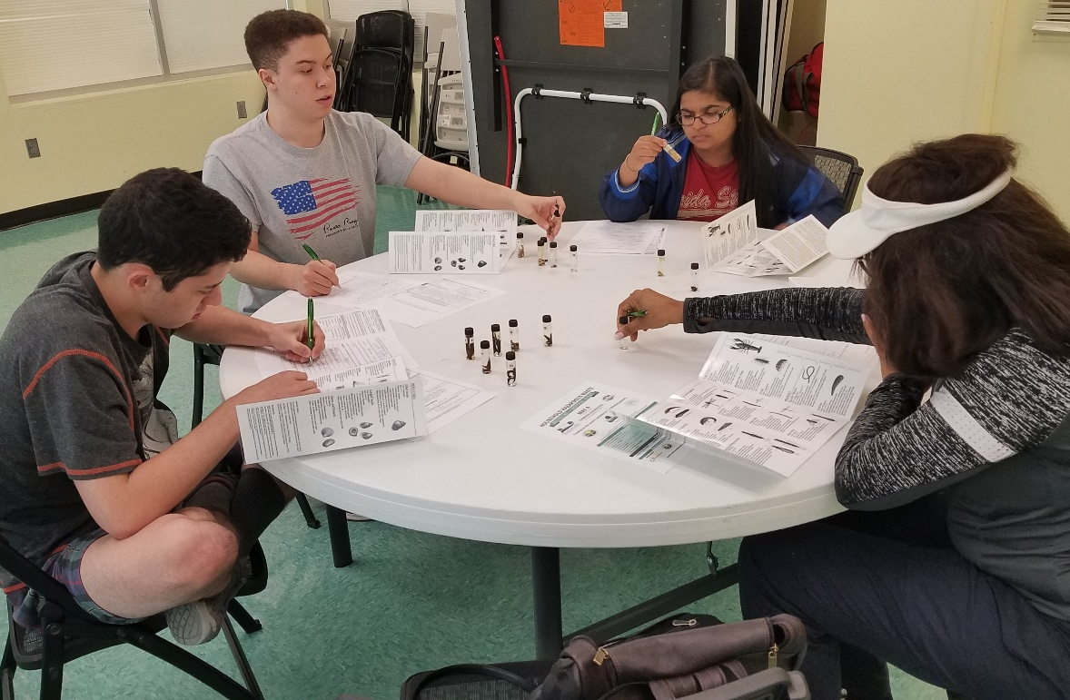
Quality Assurance Project Plan
Certification
QA/QC and Trainer workshops
Annual recertifications
Consistent monitoring schedule and set protocol
Database
Only certified volunteers can enter and edit data
Errors and warnings
Notes:
Adopt-A-Stream has an EPA approved QAPP (Quality Assurance Project Plan) for the macro, bact, and chem monitoring programs
Data is held to a certain quality standard (QA/QC= quality assurance/quality control)
QAPP stipulates that individual volunteers must be trained, pass a certification test, and maintain that certification by attending recertification workshops annually. Trainers must do the same.
Certification for volunteers (and trainers) ensures that everyone follows the same protocol and that the data going into our database is credible
Must maintain your certification in order to be able to enter or edit data in the AAS database
Errors and warnings will pop up if values are out of range or protocol standards are not met
Help you catch issues with monitoring techniques and deviations from your baseline
Also sent to your local AAS coordinator
Can view graphs of data and download all site data to Excel

Slide 15
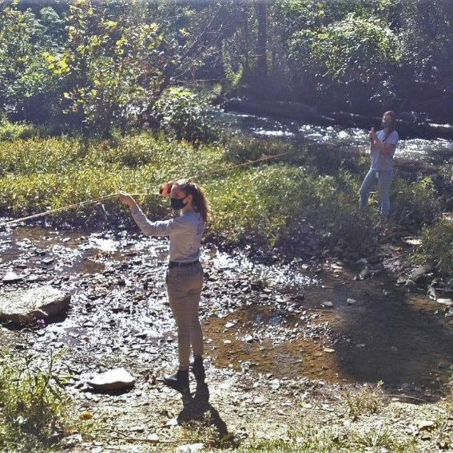
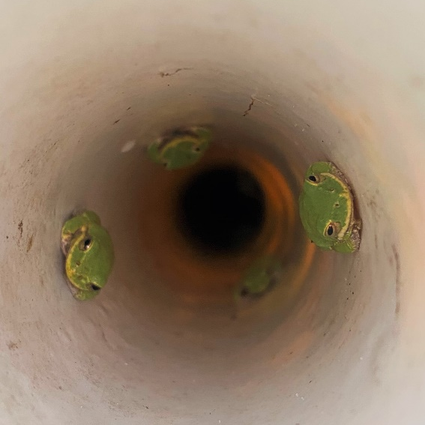
Non-QA/QC Monitoring Programs
Watershed Survey
Map your watershed and conduct survey of the land uses around your waterbody
Survey annually
Visual Stream Monitoring
Visual and physical evaluation of stream conditions
Survey quarterly or once every season
Amphibian Monitoring
Passively monitor for frogs and salamanders
Survey quarterly or once every season
Notes:
Non-QA/QC programs fall outside of the QAPP and do not require a certification to participate; however, you are still encouraged to attend a monitoring workshop before beginning.
If you can’t find one in your area, you can request one by contacting your local coordinator (found on Find Your Local AAS Coordinator page) or the State Office.
Watershed Survey
A great addition to any monitoring routine as it helps to assess land use changes in your area and keep you updated on potential sources of pollutants or other factors that could affect your water quality.
Encouraged to use online mapping resources; more info on AAS website (resource below)
Conducted annually
Visual stream monitoring
Helps to assess physical changes at your site location (habitat assessment, riparian health, bank erosion, water flow, etc.)
conducted seasonally (4x a year)
Amphibian monitoring
Involves passively monitoring for frogs and salamanders via tree frog refugia (PVC pipes, see photo) and salamander coverboards
conducted seasonally (4x a year)
Online mapping resource: https://adoptastream.georgia.gov/data-forms-2/online-mapping-resources

Slide 16
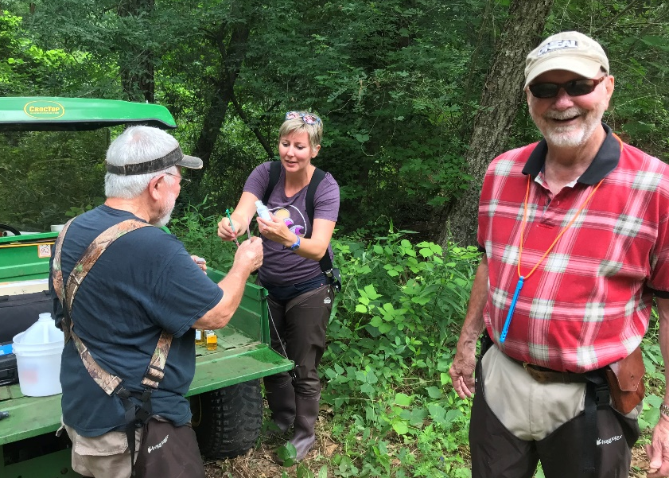
Form a Group and Select a Site
Form a Group
Must register a group to register site and enter data
Can be an individual, but recommend at least 2 people
Community groups, classes, families, etc.
Select a Site
AAS does not assign sites
Ask local coordinators for suggestions
Easy, safe, and legal to access!
Notes:
Once you’re certified, you can figure out where and with whom you want to monitor
Once you get access to the database, form a group
Must do this first before you can select a site
If you don’t have other people to monitor with, you can be a one-person group; however, it is highly recommended to have at least one other person in your group
Examples of groups: neighborhood group, classroom, family, extracurricular group, non-profit, local gov’t, etc.
Look around your neighborhood or community to find a site that you would be interested in monitoring
AAS does not assign sites; can check out map of all sites in GA on AAS website- find a waterway near you that is not being monitored or pick up a site that is no longer being monitored
Contact AAS local coordinator for suggestions
Be sure that your site is easy, safe, and legal to access!

Slide 17
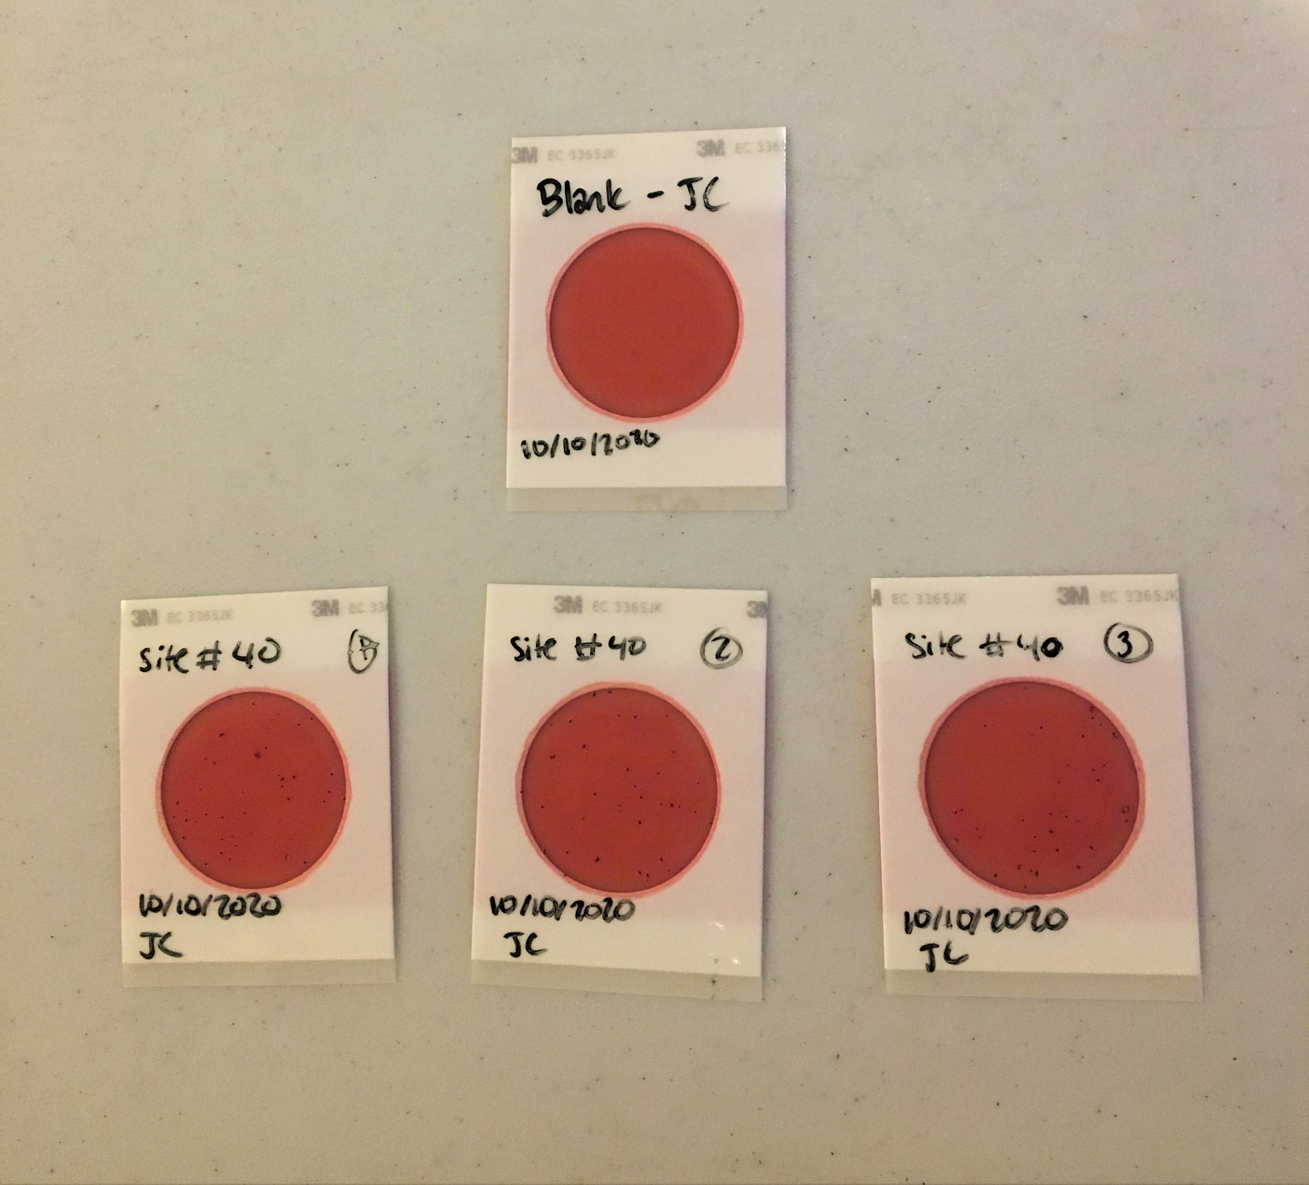
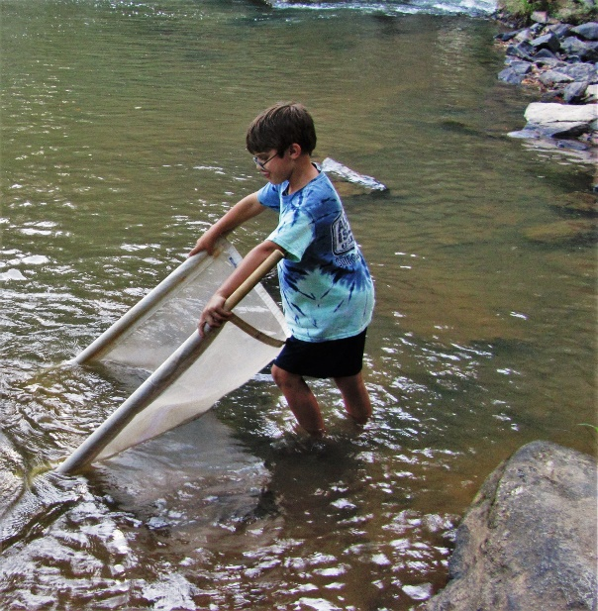
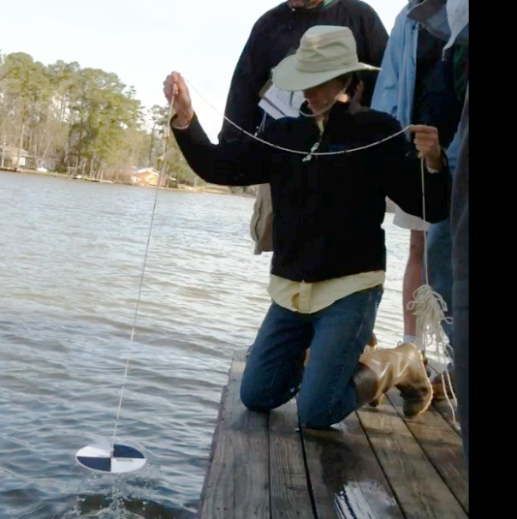
Obtain Equipment
Purchasing info on AAS website
Reach out to local coordinator for loan
Contact state office
Notes:
Multiple ways to obtain equipment:
Purchase it yourself! Info and links on AAS website
Reach out to local coordinator for an equipment loan
Contact state office for loan if neither option is feasible

Slide 18
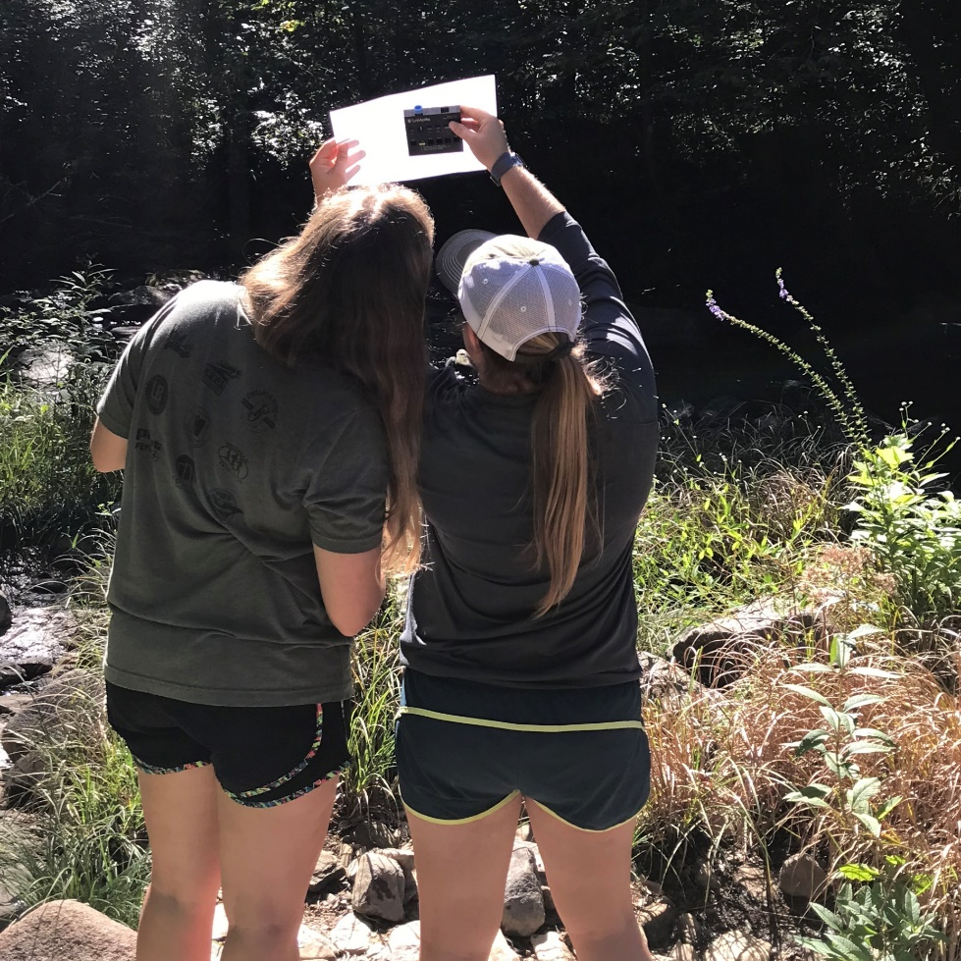
Start Monitoring!
Set up monitoring schedule
Consistently monitor one or more sites
Submit and review data
Follow up on problems
Notes:
Set up a monitoring schedule
Consistent monitoring and data entry is important for understanding baselines and catching irregularities
Submit your data AS SOON AS POSSIBLE after monitoring, and review your data to catch any errors or deviations from baseline
If you find any issues or irregularities, contact your local coordinator/government
Check out the “Who to Call” list on the monitoring resources page of the AAS website (resource below)
Monitoring resources: https://adoptastream.georgia.gov/data-forms-2/monitoring-resources

Slide 19
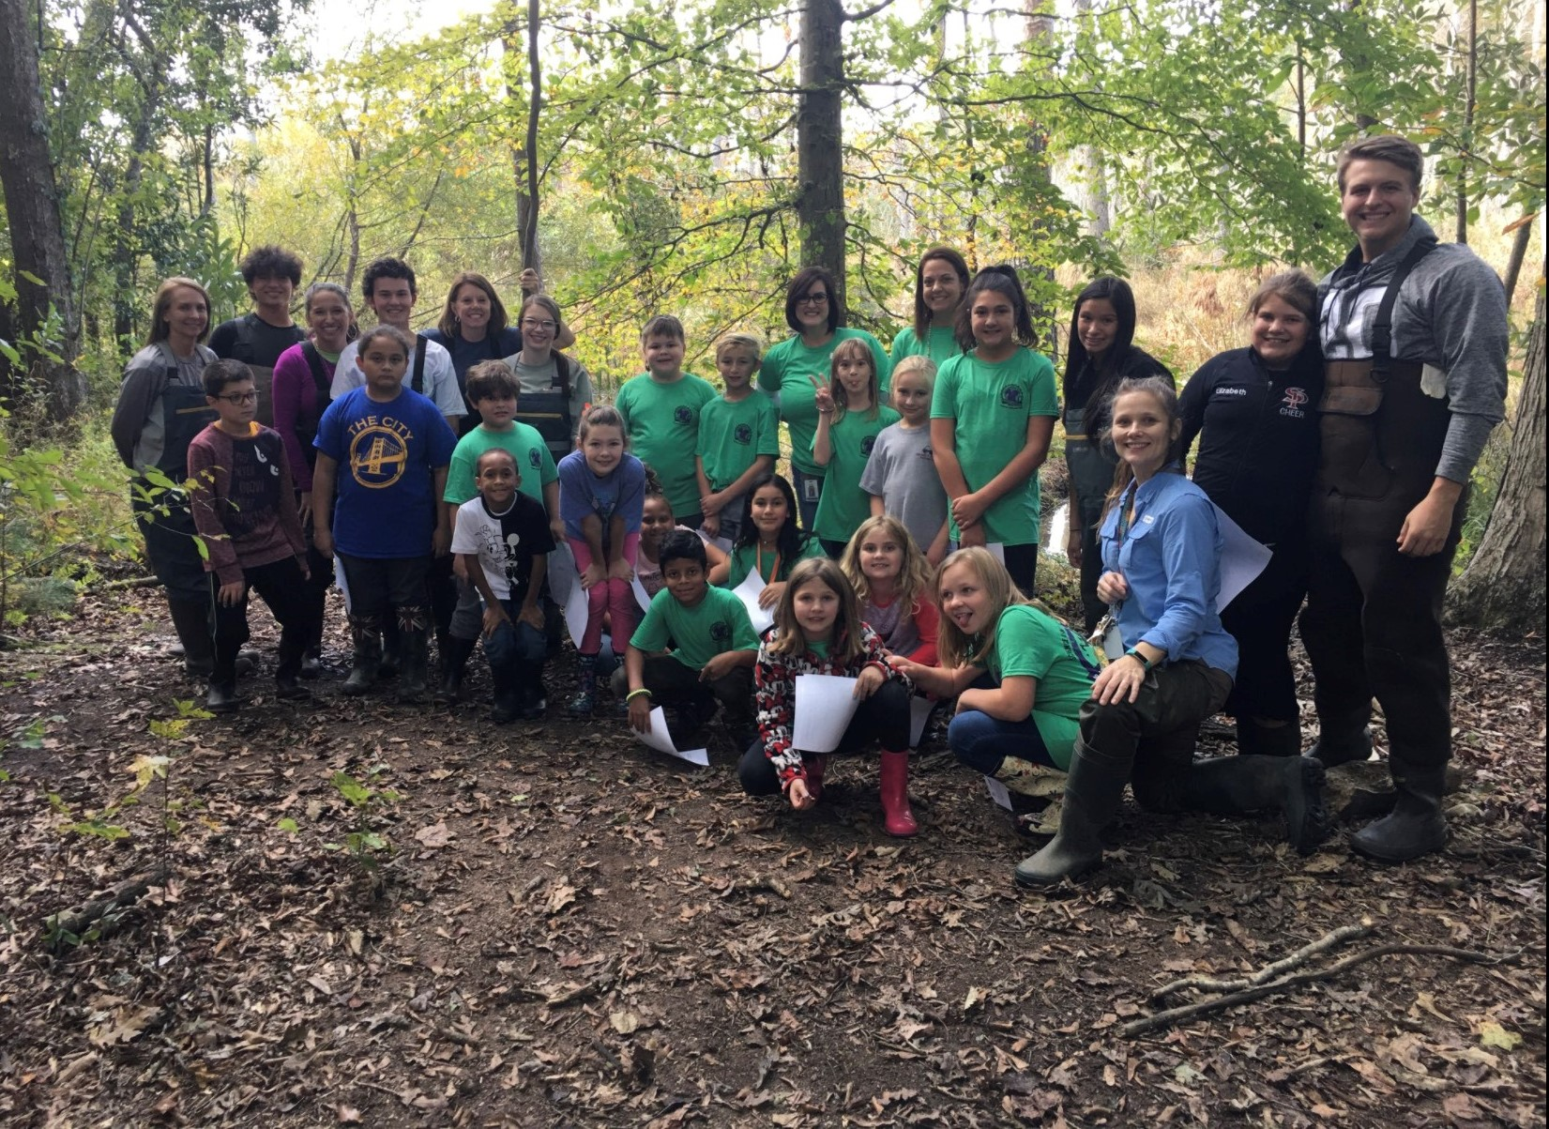
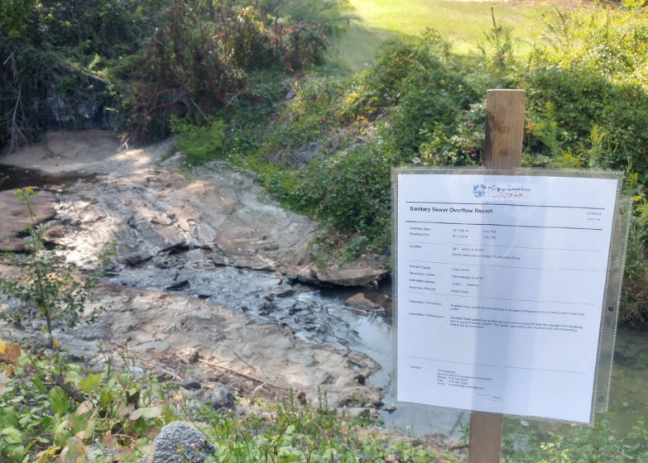
How are your data used?
Establish baseline conditions for waterbodies across the state
Discover and report water quality issues
Educate your community
Help inform status of streams for 303d/305b list
Notes:
After you collect data at your stream, lake, wetland, estuary, etc., we ask that your data be submitted ASAP to the online AAS database because your data are being used!
Anyone across the state, nation, and world can access data from the AAS database (open access)
Regular monitoring helps establish baseline conditions for your local waterways
It is impossible to understand what is “normal” for a waterbody from just one sampling event, and there aren’t enough scientists/technicians to be able to consistently collect baseline conditions for all streams across the state- that’s why we need citizen scientist volunteers!
Baseline data is incredibly valuable to communities in being able to track improvements and impairments over time and mitigate any detrimental alterations
Consistent monitoring and an established baseline also allows problems, such as sewage spills, to be detected quickly and more frequently (bottom left photo= sewer spill notice; graph- point represents deviation from baseline)
Use your data to educate your community about their impacts on water quality
Describe what is “normal” for your stream and watershed, and what fluctuations you may have seen
Remember, Awareness is one of the AAS goals!
Finally, AAS data can also be used as a justification for drawing up a state approved QAPP that provides data needed to list/delist streams
Refer to info presented during the “determine your goals” slide
Clean Water Act requires waterways that are not supporting their designated uses to be put on this list.
If waterbodies are not meeting their designated uses, this could limit recreation (fishing, swimming, boating, etc.) and more. (resource below)
Your local trainers will also receive emails every time you submit data so that we all stay informed of happenings in our watershed. This can also help us work with you to rectify any problems or pollution sources you may find while out collecting data. Can use actual example here.
Resource: https://epd.georgia.gov/watershed-protection-branch/watershed-planning-and-monitoring-program/water-quality-Georgia

Slide 20
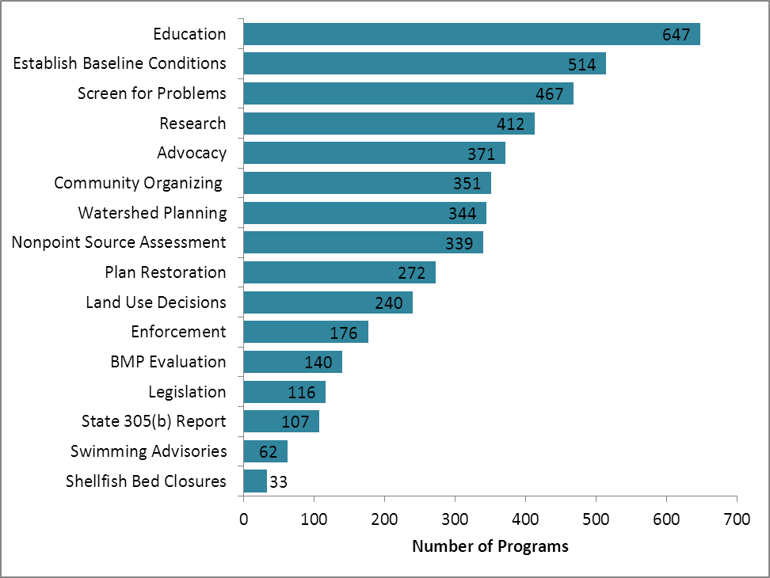
Volunteer Monitoring Data Uses
Notes:
Your hard work and data matter! You can find countless uses for it and so can others across the state, nation, and world!
Open access database- anyone can view your data!
Data uses:
Public education, student research, academia
Identify sewage spills, leaking pipes, septic leaks
Agriculture and forestry best management practices and erosion and sedimentation issues
Permit violations (noncompliance, land applications)
Develop watershed management plans
Data can help drive statewide monitoring plans
Under a state approved monitoring plan (SQAP), data can be used for listing/delisting streams

Slide 21
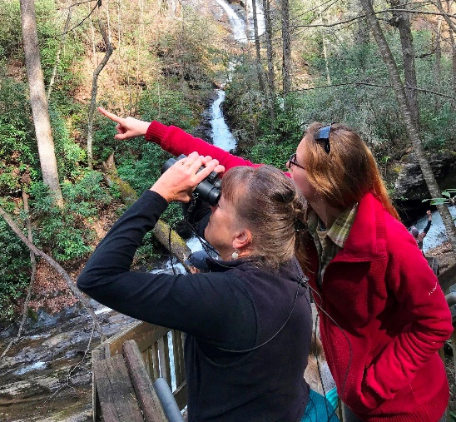
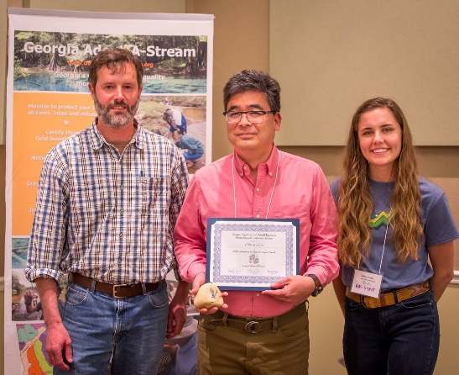
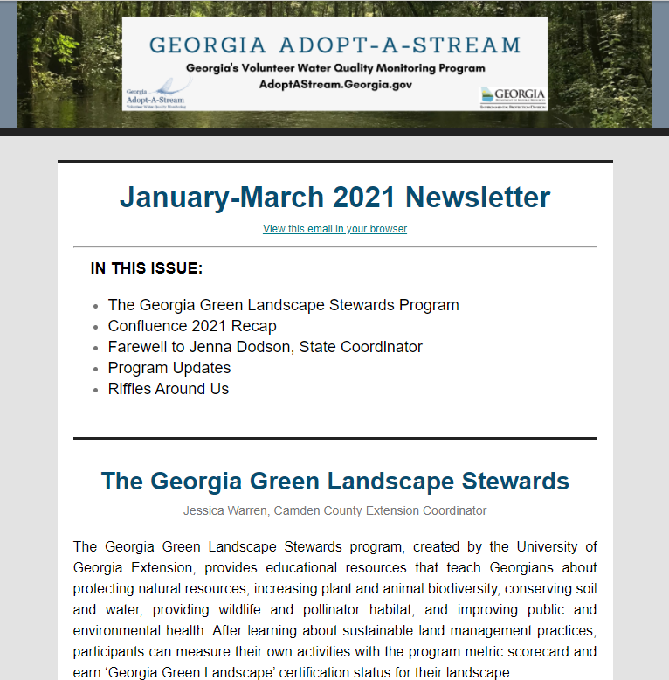
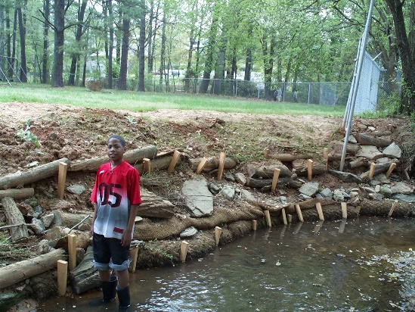
More Ways to Get Involved
Confluence
Annual volunteer conference
Expert talks and workshops
Networking and social events
Awards
Volunteers
Trainers
Watershed groups
Quarterly E-Newsletter
Green Infrastructure
Stream restoration
Rain gardens and barrels
Notes:
Go beyond monitoring and check out these other ways to get involved with AAS!
Confluence is AAS’s annual volunteer monitoring conference
Offers a number of specialty workshops and expert talks on a variety of water-related subjects
Also opportunities to network and socialize with other AAS volunteers
Annual Adopt-A-Stream awards
Presented at Confluence
Given to dedicated volunteers, trainers, and watershed groups that went above and beyond in the previous year
Quarterly e-newsletter
Articles, announcements, and AAS updates
Email or check out AAS website to subscribe
Green infrastructure opportunities and workshops
We don't lead stream restoration projects, but we can provide basic information both through our website and by conducting demos
Rain garden/rain barrel demos

Slide 22
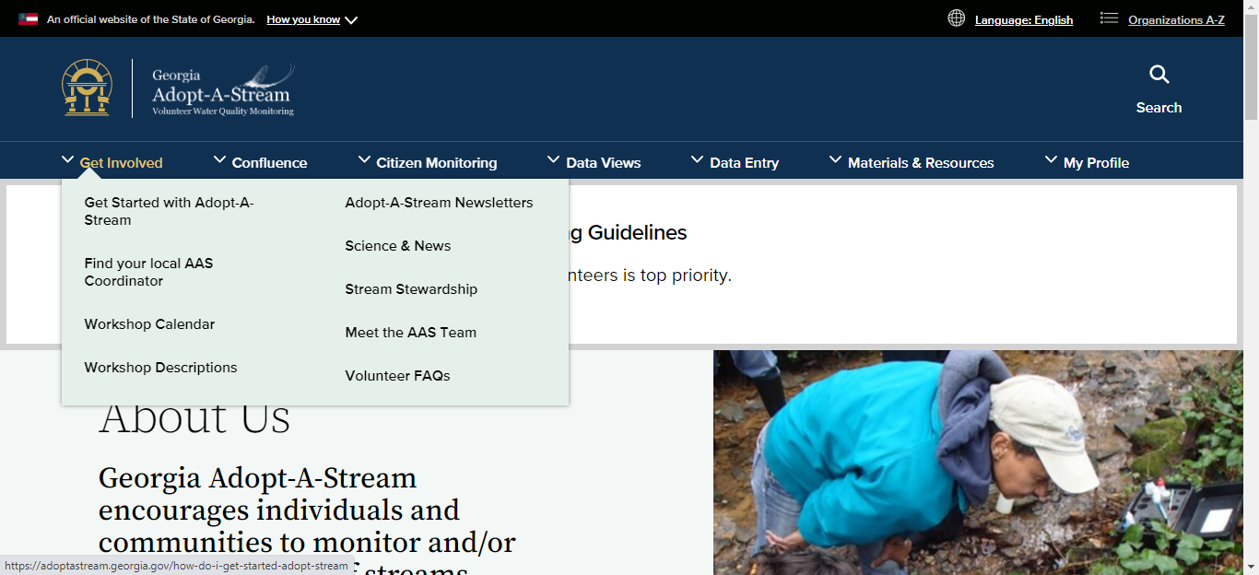
AAS Website - Get Involved
Notes:
Brief overview of the AAS website.
Get Involved tab contains resources for new volunteers on how to get involved with the program
Information on how to become a volunteer, volunteer FAQs, where to find your local coordinator, and descriptions of the workshops and their upcoming dates
Can also view previous editions of the AAS newsletters, which contain informative articles related to water quality and partnership highlights (more on this later)
Science and News page features articles and papers written by current or former AAS volunteers and trainers on water quality topics
Stream stewardship page is a compilation of resources on how to decrease your impact on water quality

Slide 23
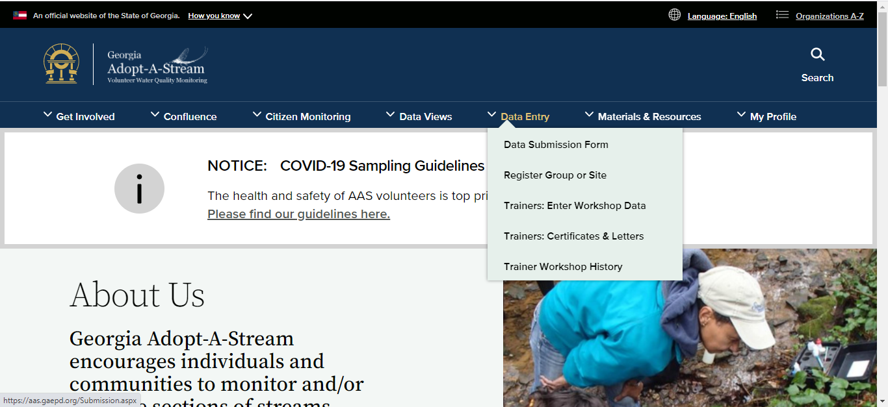
AAS Website - Data Entry
Notes:
Once certified, you can also enter data and register groups and sites through our online database
Must have an AAS account to access this part of the website
Also sections for trainers to enter workshop information

Slide 24
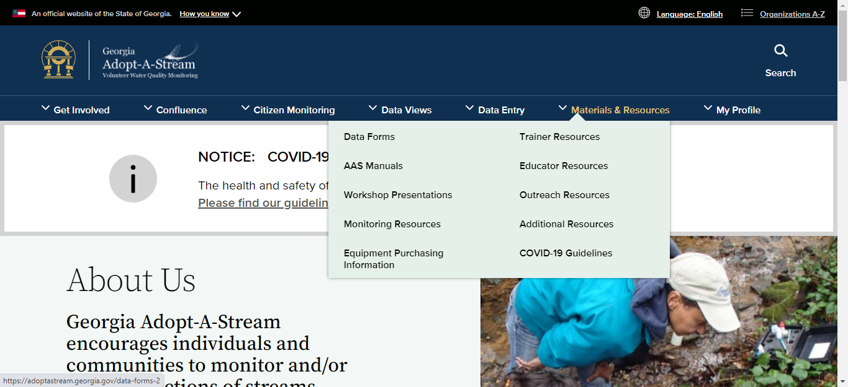
AAS Website - Materials & Resources
Notes:
Resources available to aid in your monitoring and outreach efforts
Data sheets and sampling protocols to print out and bring to field
Manuals provide background info and instruction on monitoring
Equipment purchasing info and links
Resources to help educators to bring AAS and water education into the classroom
Information and resources to conduct outreach events in your community

Slide 25
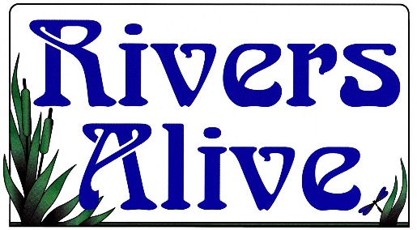
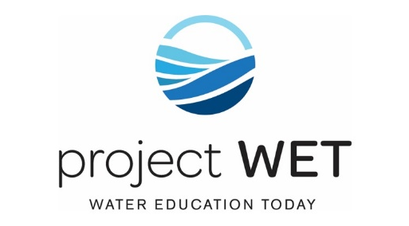
Other EPD Outreach Programs
Rivers Alive- Georgia’s statewide annual volunteer waterway cleanup program
Project WET (Water Education Today)- Curriculum designed for formal and non-formal educators of K-12 students to promote stewardship of water resources
River of Words- Annual youth poetry and art contest that inspires children to translate observations of their watersheds into creative expression
Notes:
If you like AAS, check out these other programs in the EPD Outreach Unit
Rivers Alive:
GA’s statewide annual volunteer waterway cleanup
Happens every fall, volunteers across the state collect trash from local waterways
Project WET
Stands for Water Education Today (international org, this is the GA branch)
Provides water-related curriculum for formal and non formal educators to promote knowledge and stewardship of water resources
River of Words
International annual water-related youth art and poetry contest
K-12, different age categories
Georgia ROW organized as a part of GA Project WET

Slide 26
Follow AAS and Stay Connected!
aas@dnr.ga.gov
AdoptAStream.Georgia.gov​
facebook.com/georgiaadoptastream
@georgiaadoptastream
Harold Harbert, Watershed Outreach Manager
Bailey Crapps Sauls, AAS State Coordinator
2 Martin Luther King Jr. Drive​
Suite 1462, East Tower​
Atlanta, Georgia 30334​
470.938.3341
470.524.5791​
Cecilia Nachtmann, AAS State Coordinator
Jackie Encinas, Outreach Specialist
Notes:
Replace info and photos with your own if you’d like!
Connect with us!
Email, website, Facebook, Instagram, address, and phone
Here is the AAS staff!

