Slide 1
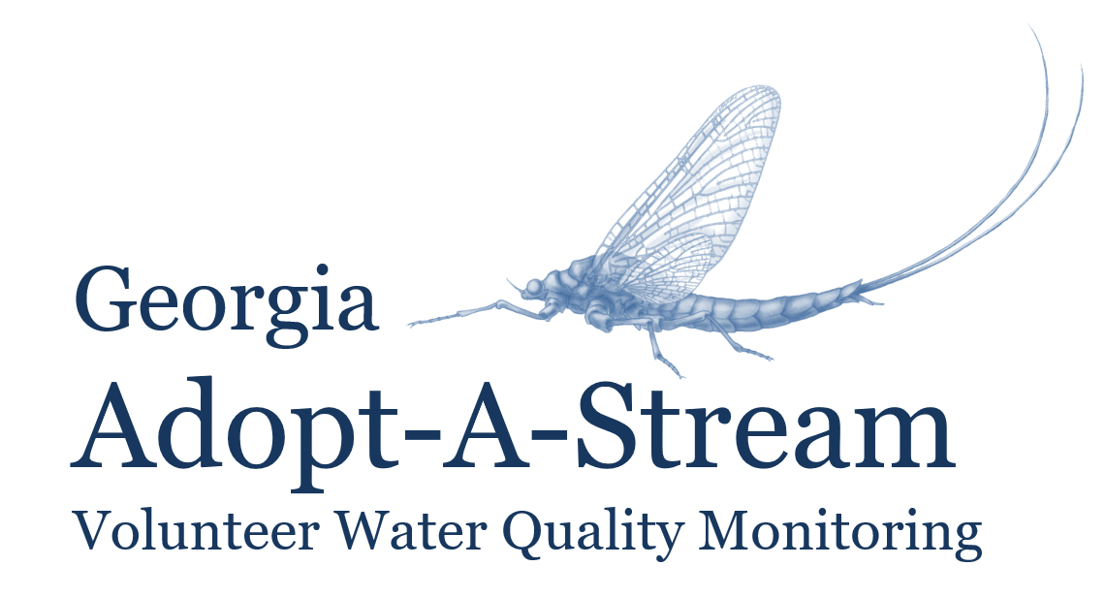
Chemical Monitoring workshop
Georgia Adopt-A-Stream
Notes:
Notes to Presenters:
Refer to text on slides for pertinent info and be sure to emphasize bold text, as that is the information volunteers need to know for the test. This is true throughout the presentation
You are not required to say everything that is in the notes or present the information in the same way; these notes are simply included for your reference, so use them as much or as little as you like.
Please feel free to use your own examples, anecdotes, photos, etc. throughout the presentation. Make the presentation yours!
Just do not take out any of the bold text
Notes Key:
Bold text= info that will be on the test
Italicized text= direction for presenter, not to be said aloud
Underlined text= give emphasis, but not necessarily on the test

Slide 2
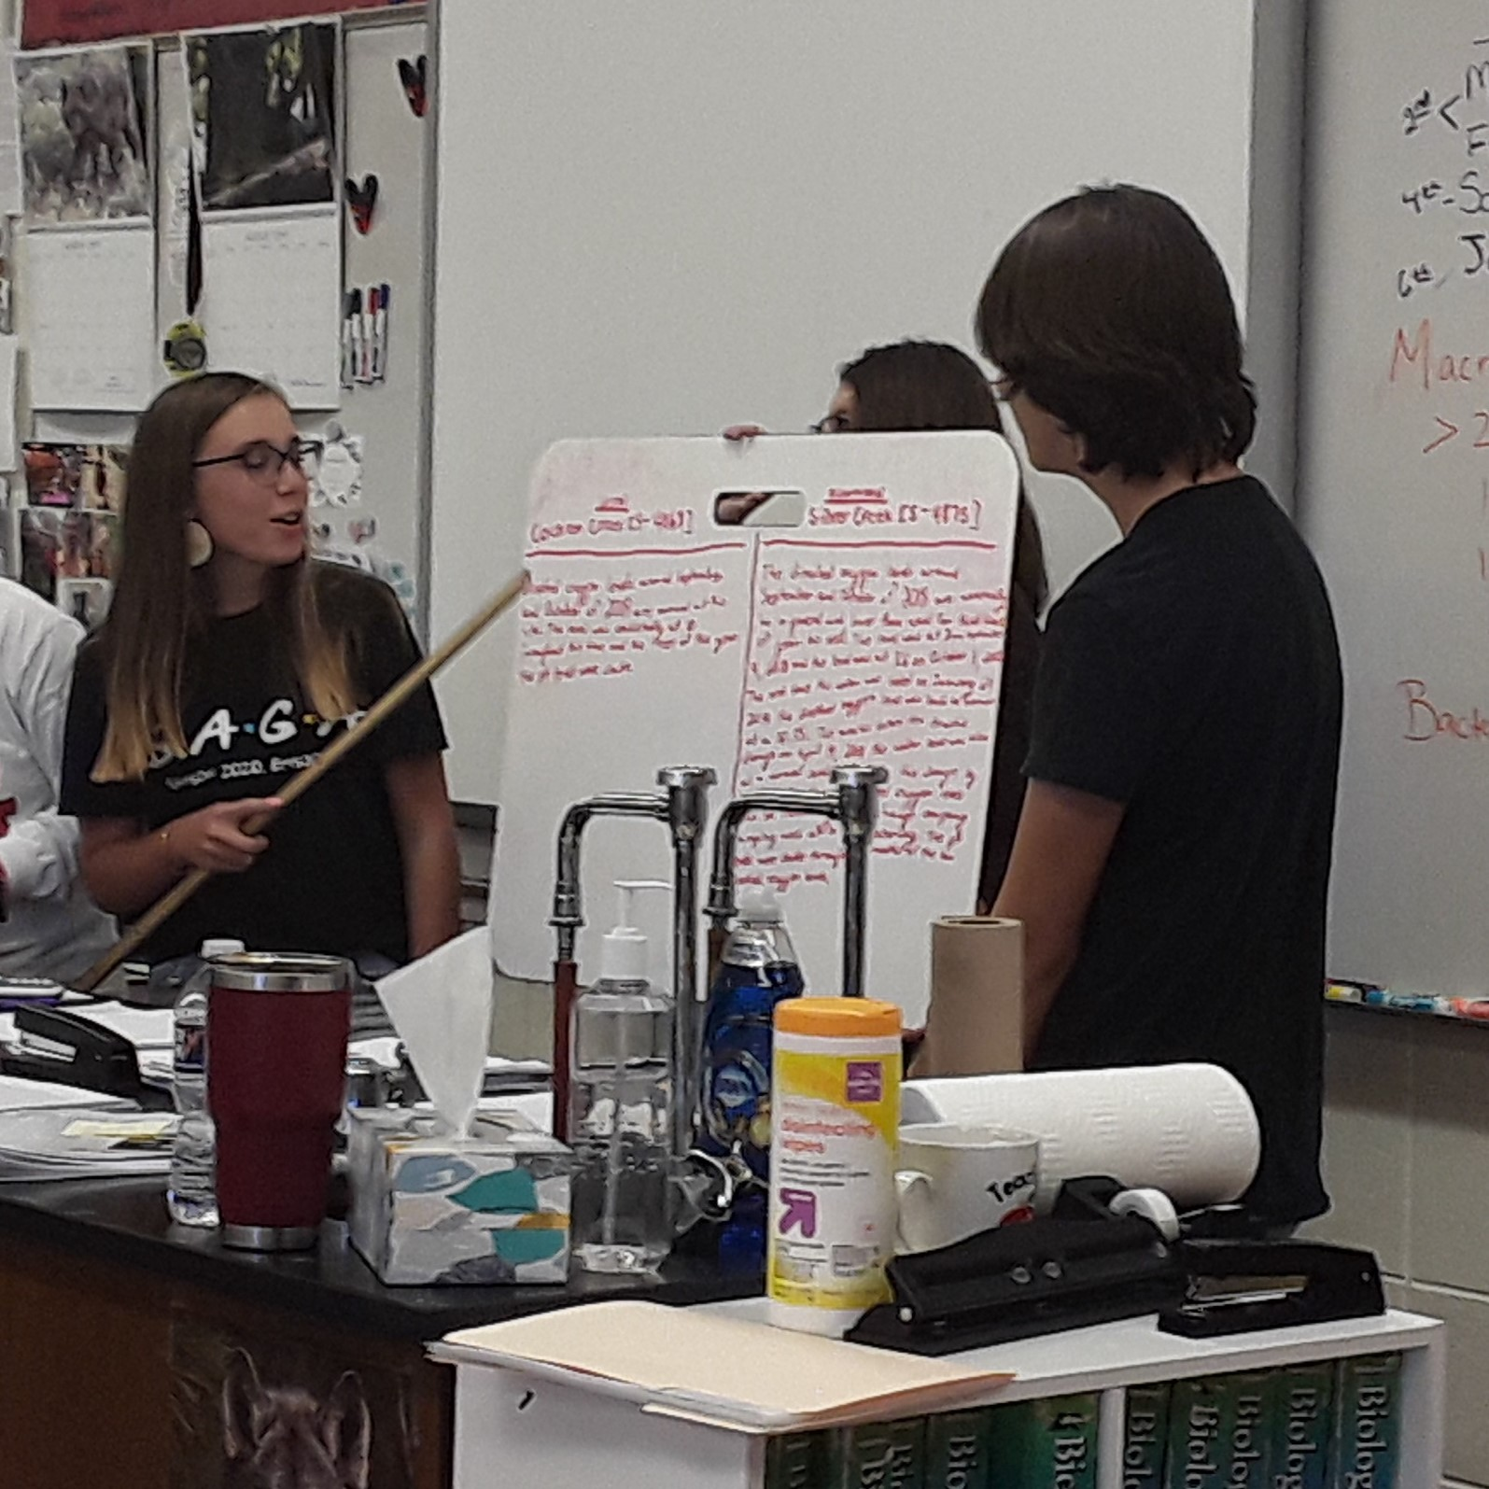
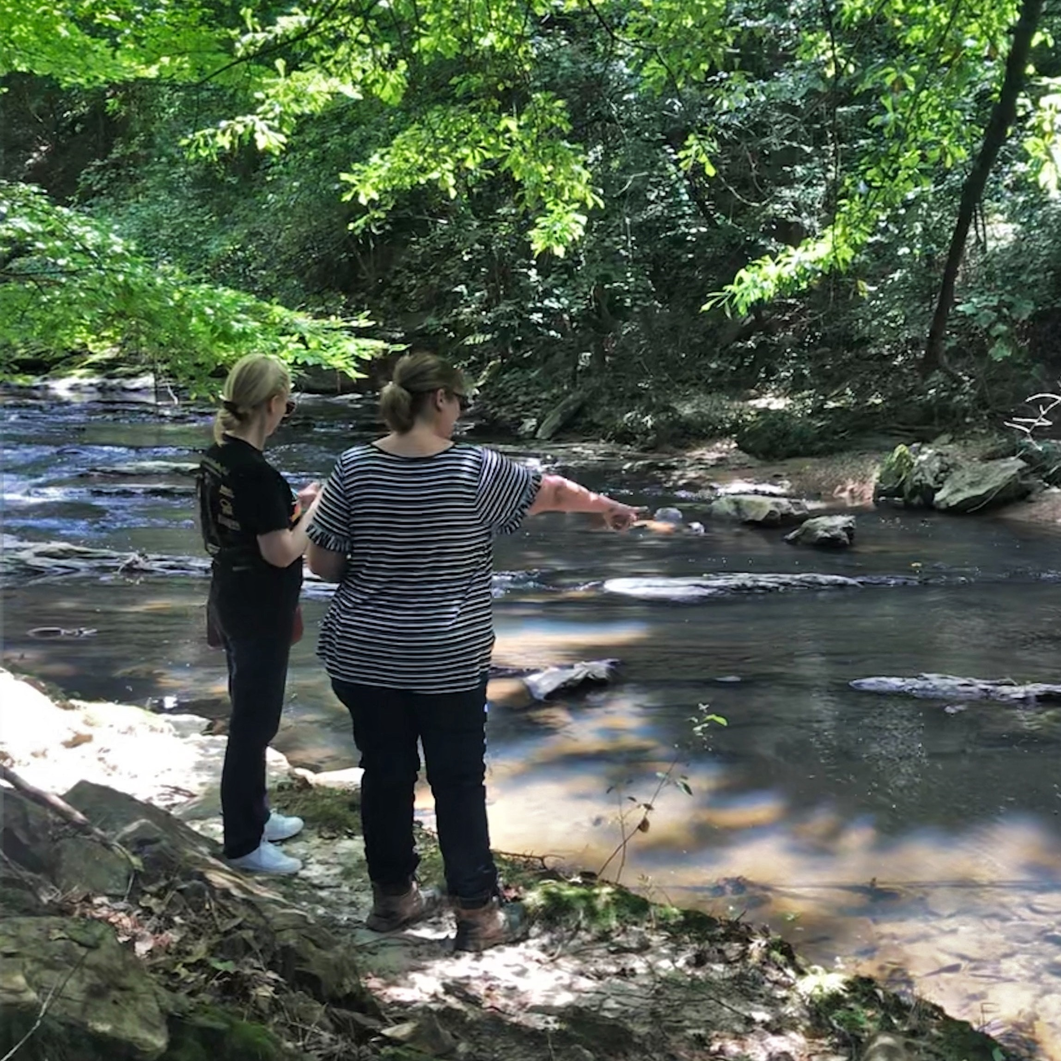
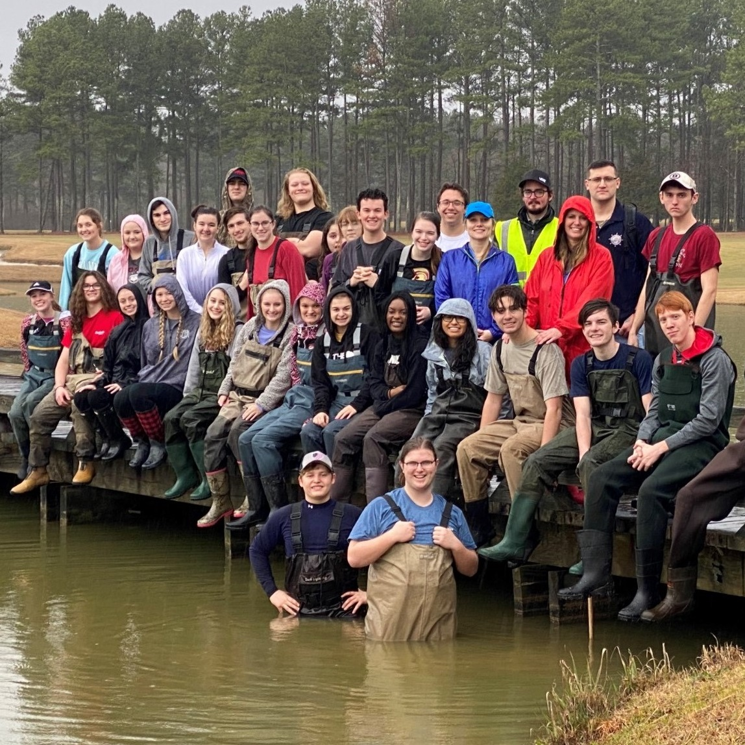
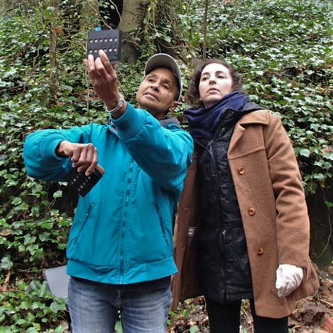
Georgia Adopt-A-Stream
A citizen science water quality monitoring program encouraging all Georgians to get familiar with their watersheds, monitor impacts, improve streams, rivers, wetlands, lakes, and estuaries, and inform others about their effect on water quality.
A
D
O
P
T
Awareness
Data
Observations
Partnerships
Tools & Training
Increase public awareness of nonpoint source pollution & water quality issues
Collect baseline water quality data according to Adopt-A-Stream protocols
Take observations of sites to note water quality conditions
Seek partnerships with local gov’ts, nonprofits, & other organizations to share results & resources
Utilize tools & training provided by staff & local coordinators
Notes:
Awareness: we are striving to increase public awareness of water quality issues throughout Georgia and its neighboring states by hosting outreach events (like cleanups, monitoring demos, etc.) in communities, consistent monitoring, understandable data, and an annual conference to celebrate and foster connectivity between volunteers
Data: AAS has an online, open-access database that has thousands of data points that allow anyone to see the value and importance of baseline data. Over time, data collected consistently (in the same locations, using the same protocols) will show natural fluctuations and trends in the waterbody that can be monitored for any deviations that could indicate pollution or impairment. Think of this like the stream’s heartbeat; it needs to be monitored carefully to ensure that the stream is healthy and any issues can be found and resolved quickly.
Observations: An incredibly important part of monitoring is being aware of the area around you and making careful observations. Just by noting what you see or smell, a sewage spill or other pollutant source could be found before you even start monitoring! It is also important to note any changes you see over time as these can also represent impacts on water quality. Once you take a look at the AAS data form, you'll quickly see the prominence observations have and how easy it is to gather these data!
Partnerships: forming partnerships throughout your journey as an AAS volunteer is incredibly valuable! Not only can forming these relationships help you get equipment you need (like macro kits, Petrifilm, reagent refills, etc.), but you will also find that you will be supported if you find any pollutants or harmful impacts on your stream. We all have something we can offer when we work together to solve problems.
Tools and training: You’re here today to fulfill part of this goal. AAS has many partners that work to provide equipment, support, and training opportunities for our volunteers.

Slide 3
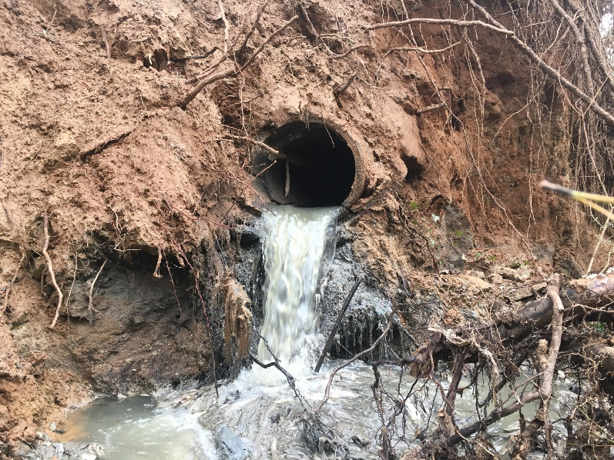
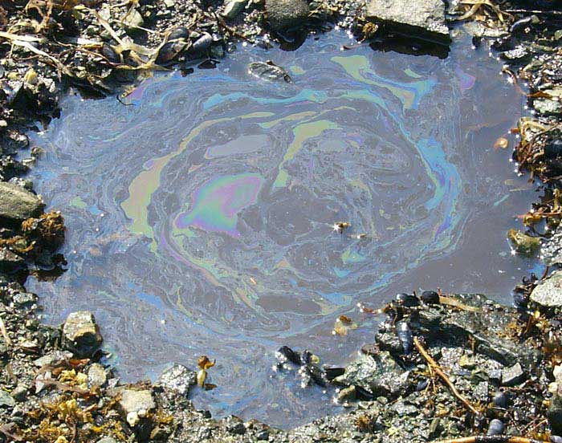
Types of Pollution
Chattahoochee Riverkeeper​
POINT SOURCE POLLUTION
Easily identifiable pollutant source
Regulated by GA EPD through NPDES permitting process
NONPOINT SOURCE POLLUTION
Sources not easily distinguished/identified
Everyone contributes
Main cause of water quality problems in GA
Notes:
Pollutants- substances that, when introduced, have adverse effects on the surrounding environment.
There are two main types of pollution: point source and nonpoint source.
Point source pollution:
Discharged from an easily identifiable source such as factories, construction sites, or wastewater treatment plants.
Georgia's Environmental Protection Division (EPD) regulates point source discharges through a permitting process called the National Pollutant Discharge Elimination System (NPDES). These permits set limits for the amount of pollutants discharged into a system.
Nonpoint source pollution (NPS):
Discharge source is not easily identifiable and/or pollutants come from an array of different sources (compare to point source)
More difficult to control, and therefore is the main cause of water quality issues throughout Georgia.
Enters waterways as runoff, a result of precipitation traveling over the ground and picking up substances before eventually entering a waterbody.
Examples: fertilizer from agricultural fields, oil from impervious surfaces, soaps and chemicals from car washes or pressure washing, E. coli from dog poop, etc.
NPS pollution moves through the stormwater system to get to the waterways.
For example, the vast majority of the ATL metro area is on a stormwater system that is separate from the sewer. Many people don’t understand this and think that the storm drains lead to treatment plants, and so dumping pollutants in these drains is harmless. However, this is not true!
NPS is the main type of pollution that AAS is focused on- you can help identify sources of nonpoint source pollution and raise Awareness of the sources and impacts of NPS on waterways

Slide 4
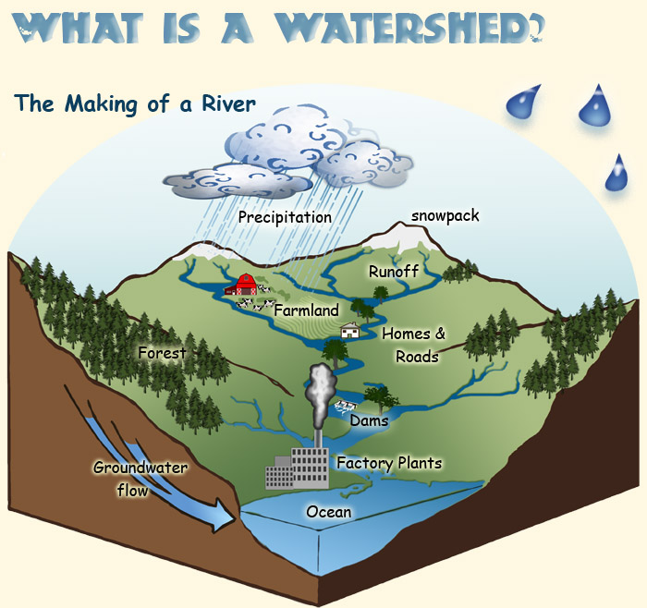
What is a watershed?
A land area from which water, sediment, and dissolved materials drain to a common point along a stream, wetland, lake, or river.
Its boundaries are defined by the highest points of land around the waterbody.
There is an unbreakable link between human health and wellbeing and ecosystems. -Walter Reid
A. Vicente, U.S. Forest Service
Notes:
A watershed is a land area! A watershed is not just the waterbody, rather the entire area of land over which all the water, sediment, and dissolved materials flow and drain to a common point (i.e. the waterbody)
Boundaries are defined by the highest points of land around the waterbody
Everything that touches the land (flora, fauna, pollution, man-made disturbances) impacts waterways.
This is where we see the effects of nonpoint source pollution accumulate and potentially harm ecosystems and impact human health
Essentially, each waterbody has its own watershed, and the size of the watershed depends on the size of the waterbody; therefore, watersheds can be as small as a neighborhood or go across an entire state (will see state watersheds on next slide)
Ultimately everything will drain to the oceans
Example: you can cup your hands to show that high points (thumb and pointer fingers) define the land area/watershed. When precipitation falls over the watershed, everything that’s on the land (fertilizers, car fluids, litter, pet waste, etc.) will wash down into the common/low point (crease where pinky fingers meet). This common point is usually a stream, river, wetland, or lake.
Photo source: https://www.fs.fed.us/rm/boise/research/techtrans/projects/scienceforkids/watersheds.shtml; A. Vicente, U.S. Forest Service.

Slide 5
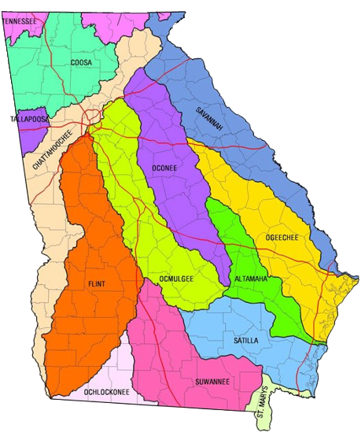
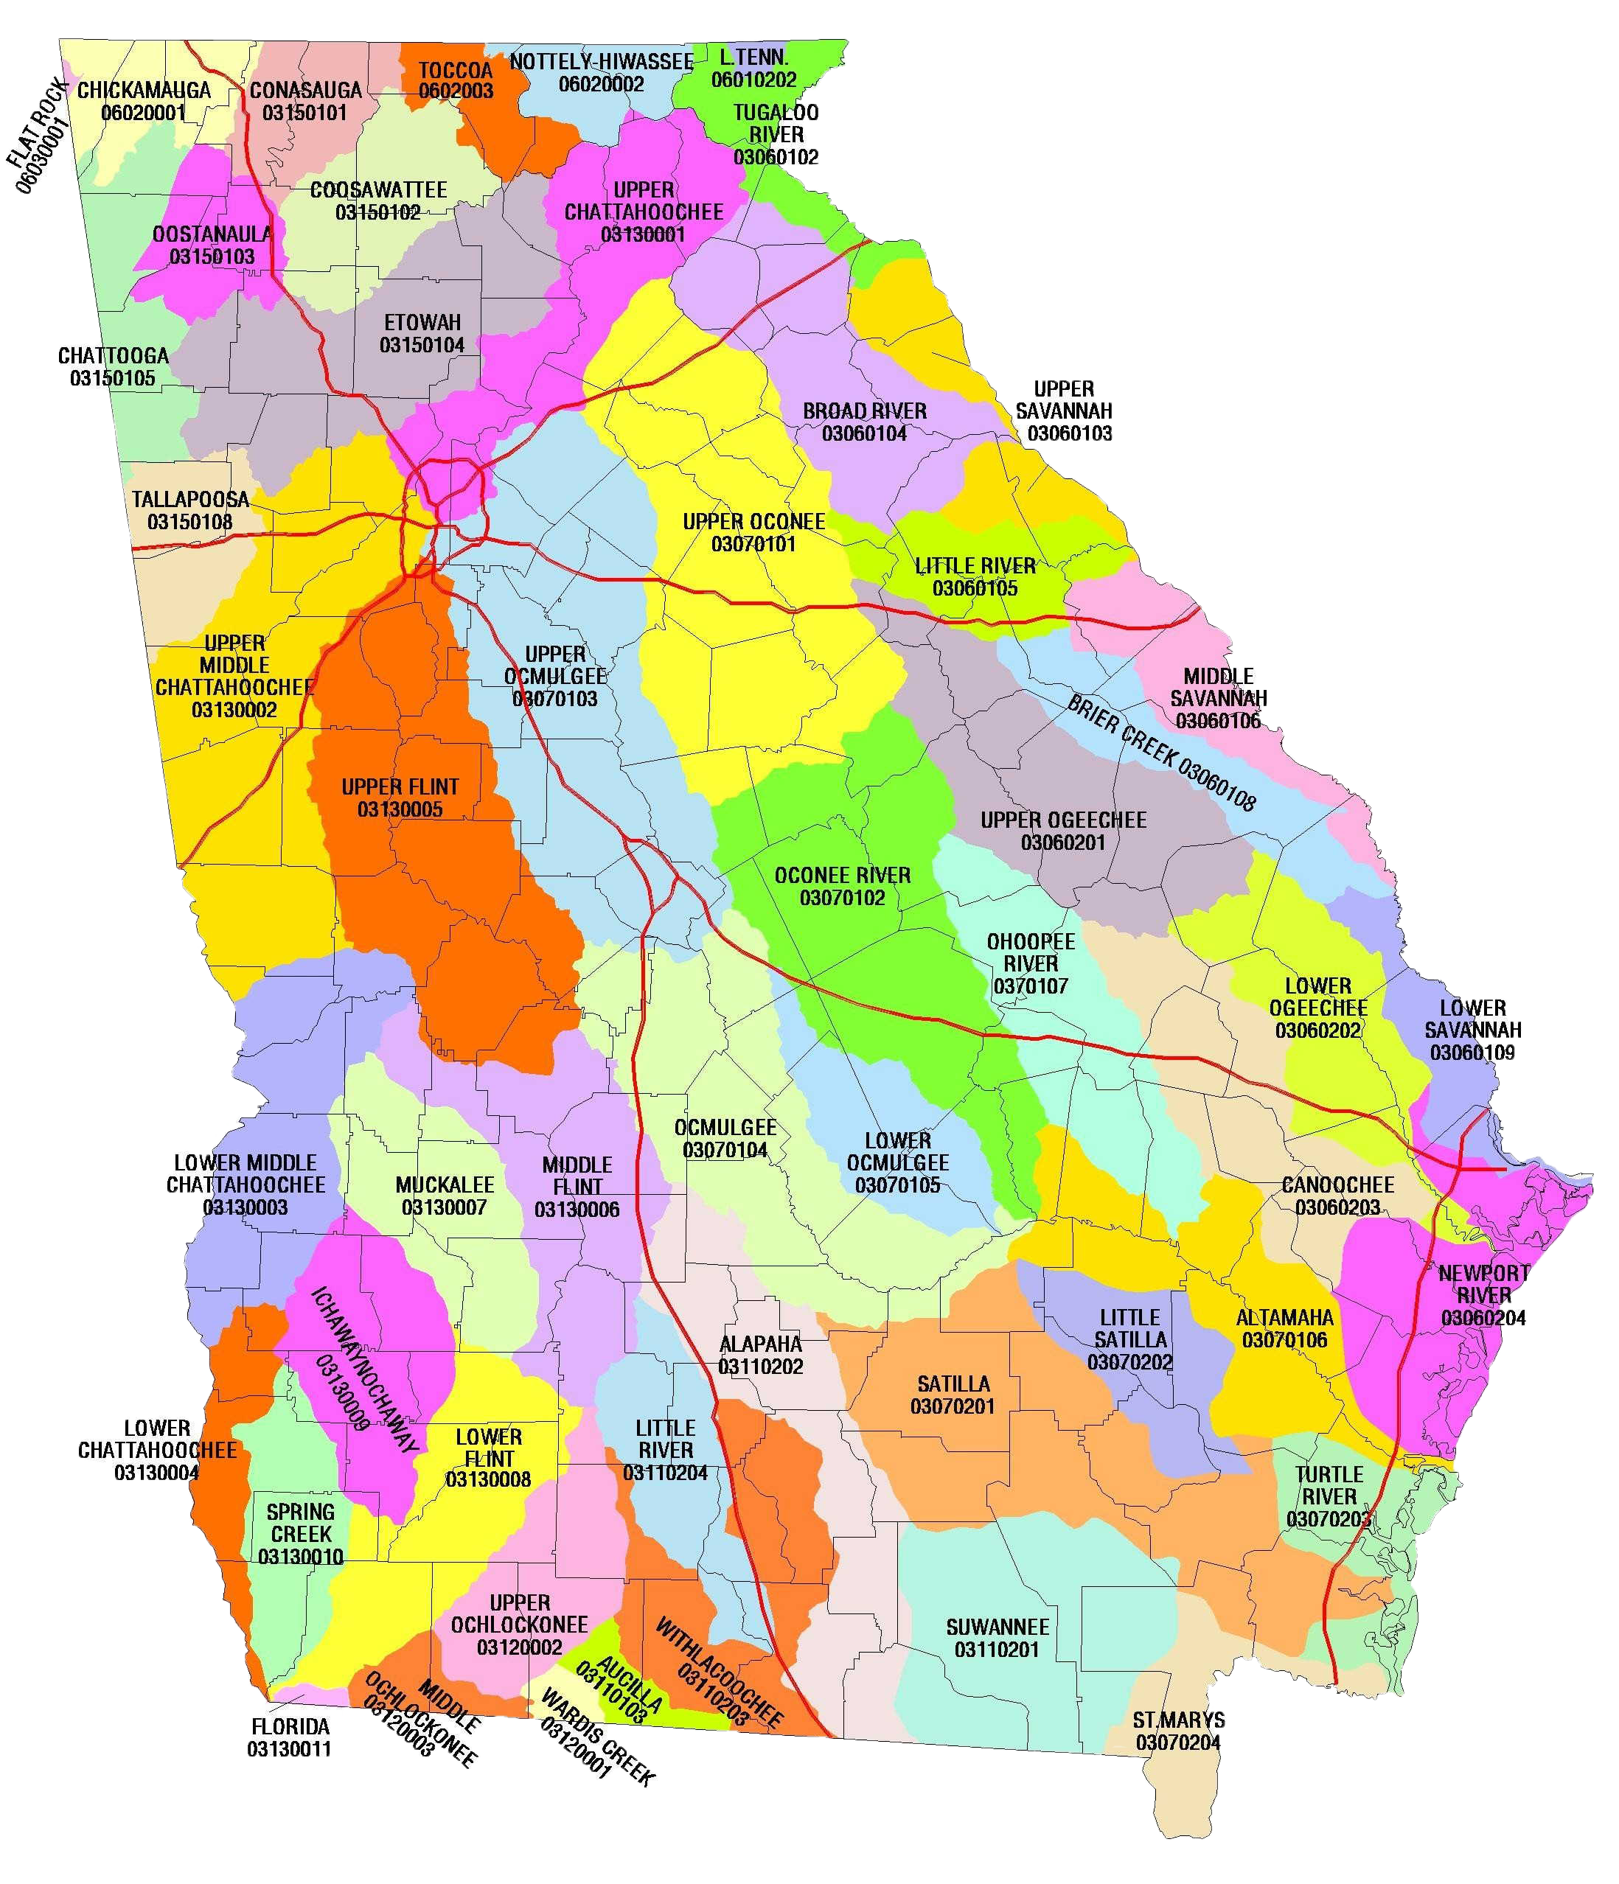
Where is your watershed?
Notes:
This slide has animations
Feel free to give an example of an issue specific to your watershed that can help demonstrate the watershed concept. Or add a local watershed map if you have one available.
Now that we know what a watershed is- where can they be found in our state?
The answer is literally everywhere! Everything is located on a watershed
Georgia has 14 major watersheds (1st photo), what major watershed are we in today?
The second photo shows us the 52 sub-watersheds in the state. What watershed are we in according to the second photo?
Notice how the larger watersheds can be broken down into smaller watersheds​
Even though these land areas are separated by high points of land and other demarcating factors, remember that “we all live downstream” ​
Look at the metro Atlanta area; there are 4 watersheds just within the perimeter of 285. Imagine the impact on water quality! ​​
helpful resource for GA watersheds: https://garivers.org/georgia-rivers/

Slide 6
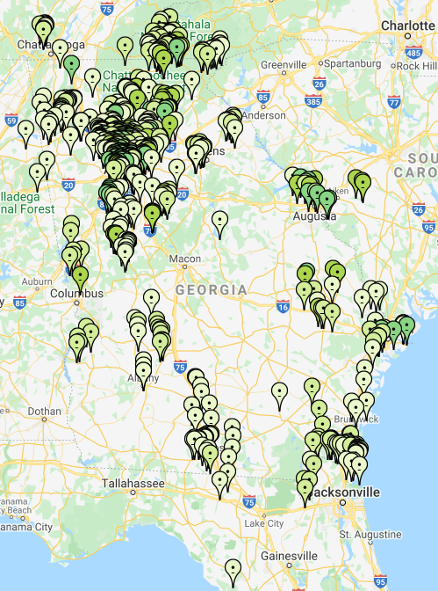
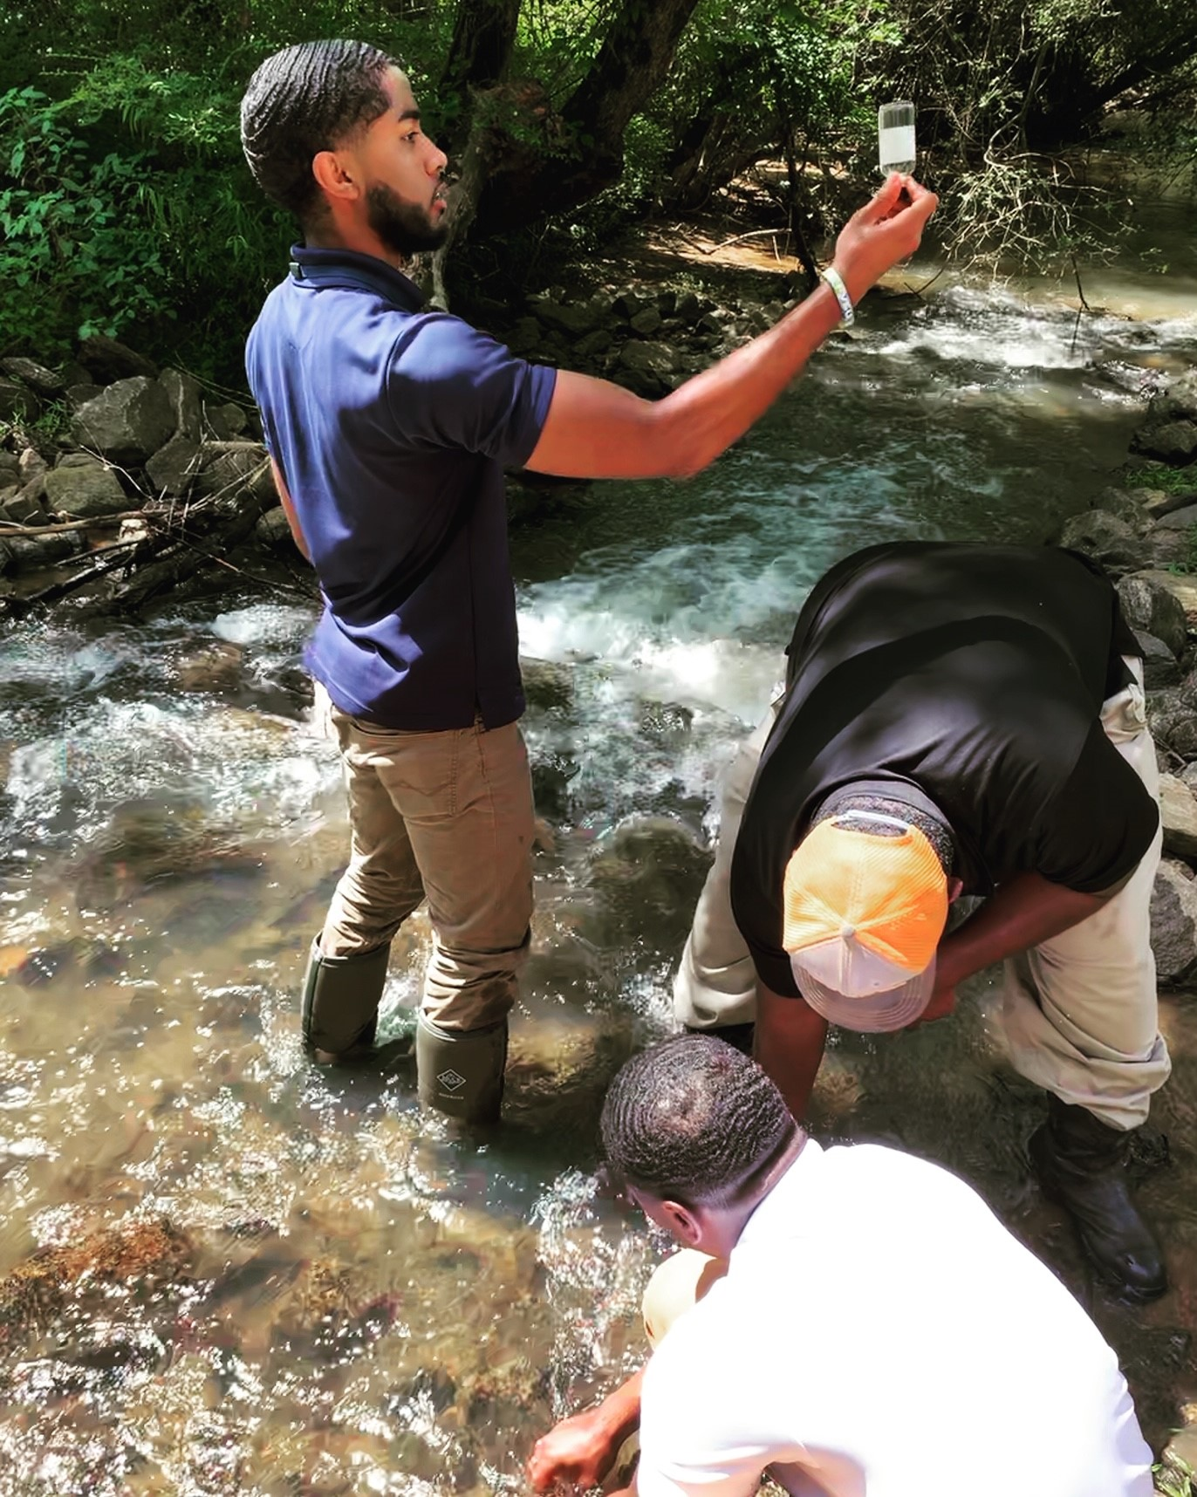
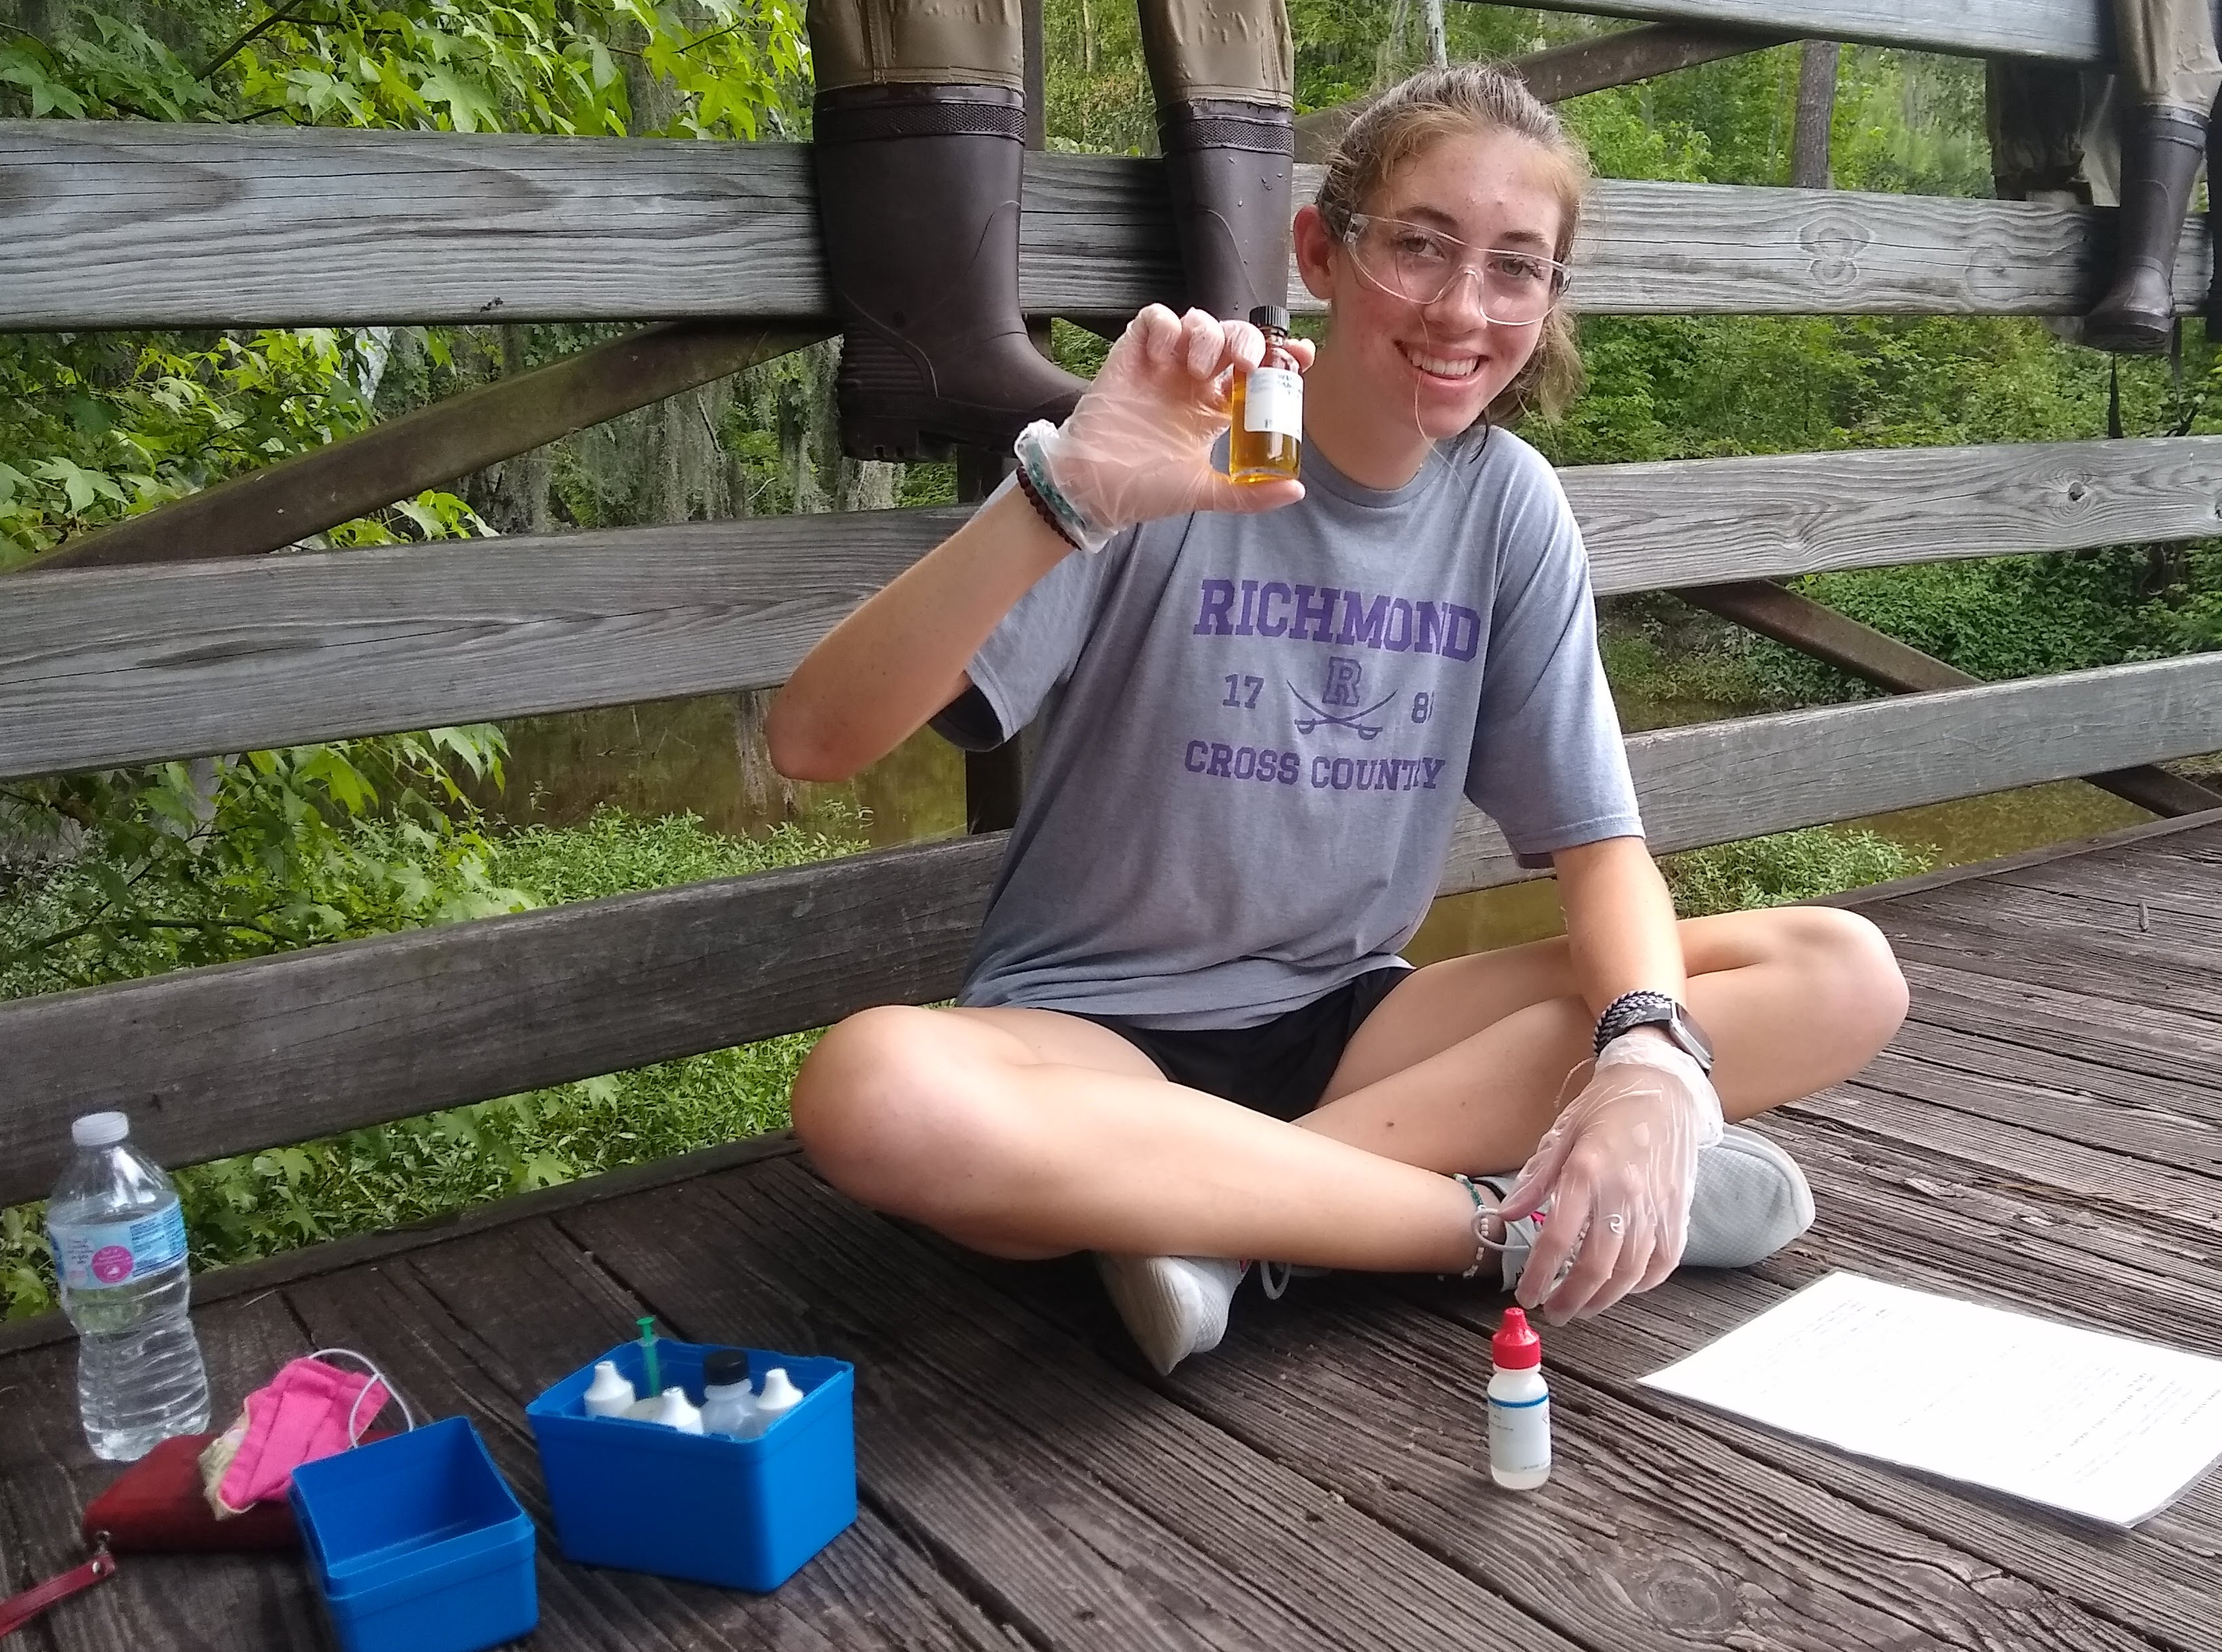
Volunteer network and support
State
Staff
2 to 4
Board Members
20
Local Coordinators
70
Volunteers
3,000 +
Notes:
This slide has animations
(Map photo) This map shows all the active AAS sites across the state. Working off the knowledge from the previous slide, are there vols working in your watershed already?
Hopefully, this map shows that you have AAS sites in your watershed already. If it does not, we are so excited that you are leading the way in your area!
(map with photos) You are joining a network of volunteers across the state (and beyond!) that are collecting and submitting data. These may be professors or their students using the data for research, a retiree acting on their interest in water chemistry, a neighborhood association member concerned about the lake they live on, a young family making sure their backyard stream is safe for their children and pets to play in, a scout troop, a riverkeeper volunteer, you name it!
(triangle graphic)
Volunteers- As you can see, volunteers are the reason this program exists. Without such a large number of interested and active community members, AAS would not be able to monitor anywhere close to the number of sites shown on the previous map. But thanks to you and all other AAS volunteers, our database is ever growing, and we are here to support your efforts.
Local coordinators- Local coordinators/trainers are an integral part to the AAS program as well. They are responsible for providing training and support to regions of the state and staying up to date with information that the state and local governments put out. These coordinators are trained by the state office and provide many of the workshop opportunities that are offered across the state.
Board members- AAS also has an advisory board that guides the program to be the most effective and meaningful for the citizen scientists that are engaged.
State staff- The smallest number you can see at the top of the triangle is state staff. These few employees support this volunteer program for the state of Georgia and provide support and guidance when possible. They also organize the annual conference and travel to participate in other outreach and data collection events.

Slide 7
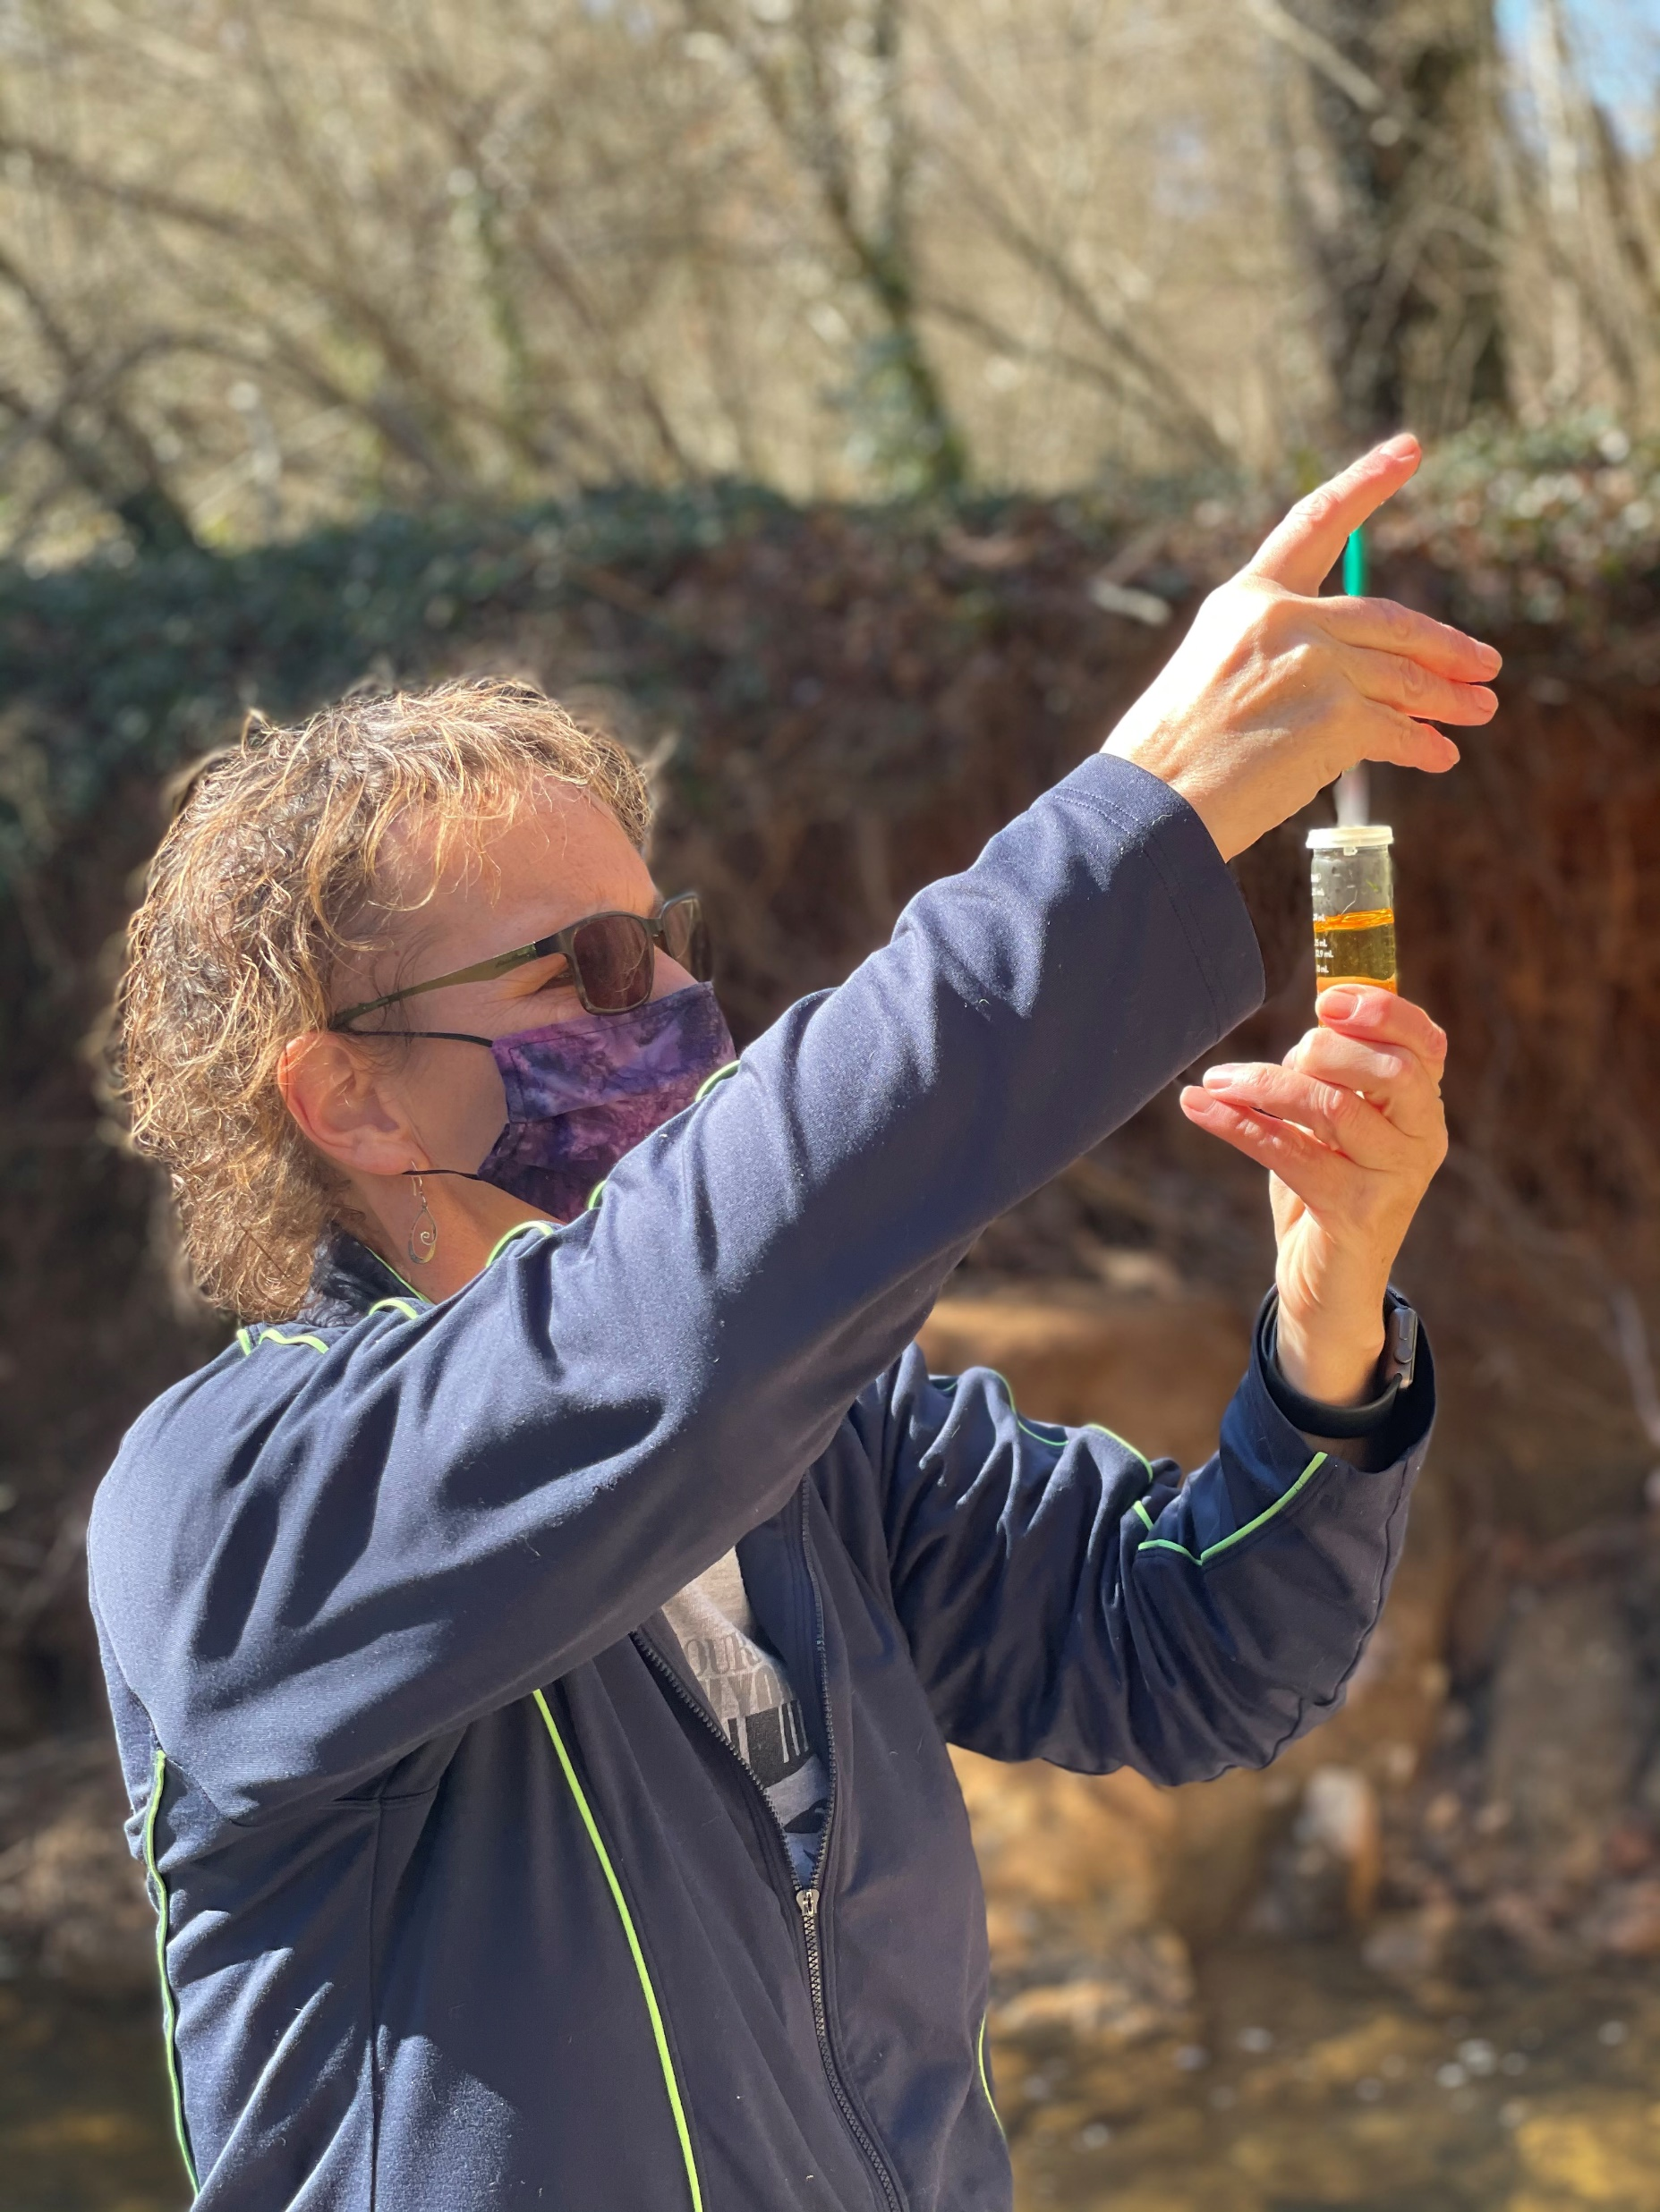
AAS volunteers use Standardized protocols
EPA Approved Quality Assurance Project Plan (QAPP)
Quality Assurance/Quality Control (QA/QC)
Required to attend workshop(s) and pass certification test(s) to become certified
Only individuals are certified
Set monitoring protocol ensures all volunteers are collecting baseline data using standard methods
Only certified volunteers can enter data, but anyone can access the 20+ years of data in the online AAS database
Notes:
With so many volunteers and local coordinators, we all need to be on the same page so that the data being collected is replicable and be trusted.
Therefore, AAS has an EPA approved QAPP (quality assurance project plan)
The QAPP lays out all the details in the QA/QC protocols
QA/QC protocols simply give every monitor a standard to abide by. Once we start talking about chemical monitoring specifically today, you’ll see that there are steps and processes to follow and that is the same for everyone the submits data to the AAS database
Besides specific protocols, QA/QC provides a framework for volunteers to get certified, submit data, and continue working with AAS
Therefore, before you are a certified volunteer, you must attend a workshop and pass the applicable certification test
Only individuals are certified (for ex., if a teacher gets certified, their whole class is not certified- just the person that attend and passed the workshop

Slide 8
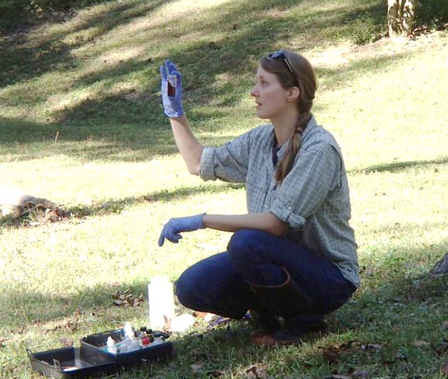
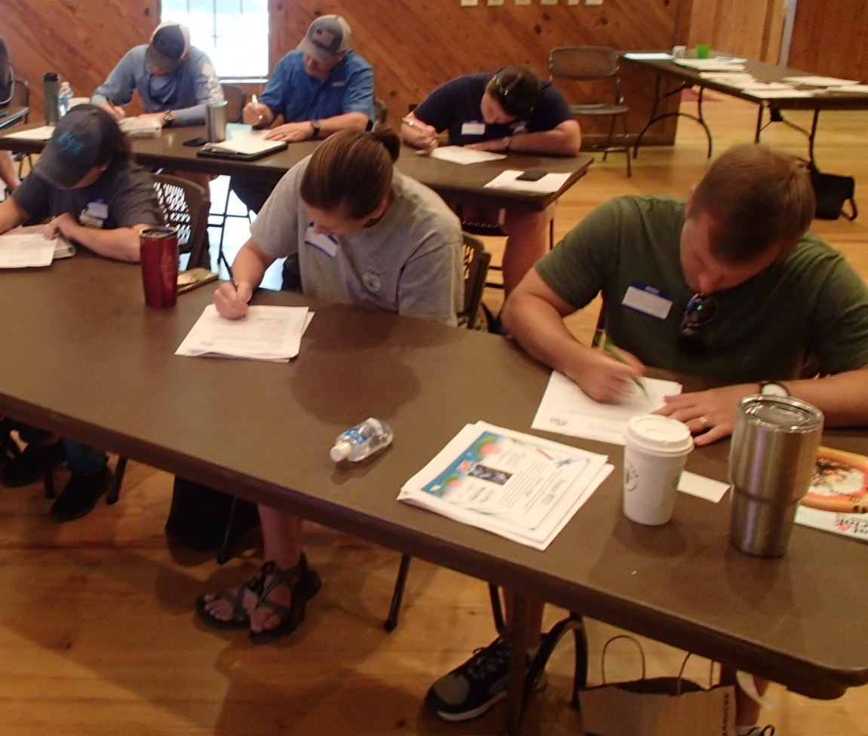
Earning your qa/qc Chemical certification
FIELD:​
Volunteers must demonstrate how to properly collect data and obtain results within duplicate precision of the trainer
WRITTEN TEST:
Volunteers must pass a written evaluation with a score of at least 80%​
Notes:
To gain your certification, we will work our way through this PowerPoint of background information.
You will then use this information to collect data and obtain results within duplicate precision
Following this hands-on practice, you will be given a test which you must pass with 80%

Slide 9
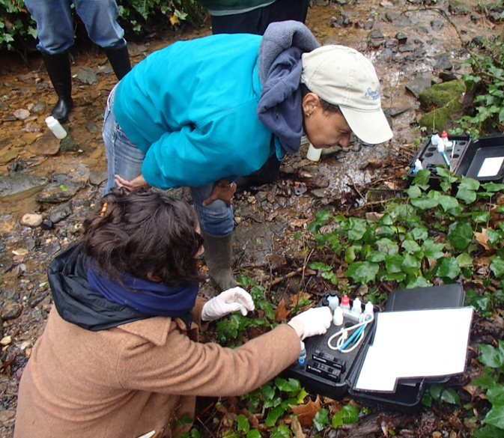
Why monitor Water Chemistry?
Water chemistry parameters provide information about stream health
Establishing a baseline helps detect changes in water quality
Aquatic life is adapted to certain range of water quality conditions
Data can help determine which pollutants may be affecting water quality
Notes:
An assessment of water chemistry can tell us a lot about stream health
The chemical water quality monitoring program helps to protect water quality of local waterways by:
Providing information about the health of your local stream through regular monitoring
Establishing baseline data to gauge what the normal levels are for your stream
Cannot understand what is “normal” from just one reading
This allows deviations to be more easily detected
If only monitoring circumstantially (ex. only after rain events), you will not have a reference for what your levels should be in your stream.
Recording specific information about water quality parameters that are important to aquatic life, such as dissolved oxygen and pH.
Potentially indicating what factors are affecting the water quality
Chemical monitoring (with AAS) does not test for the presence of specific chemicals or pollutants in the water. However, these data can sometimes be helpful in determining which pollutants may be affecting the health of the stream.

Slide 10
What does chemical monitoring involve?
AAS recommends monitoring these core chemical parameters:
Temperature
Dissolved Oxygen
pH
Conductivity (Stream and Lake)
Clarity (Coastal and Lake)
Salinity (Coastal)
Nutrient testing, alkalinity, and settleable solids monitoring may be added to your list as interest and equipment allows.​
Notes:
AAS recommends monitoring these core chemical parameters at all sites
Temperature, dissolved oxygen, pH
Some parameters are site specific
If you’re monitoring a stream or lake, it’s recommended you monitor conductivity.
Lake and coastal sites may monitor for water clarity
Coastal sites may monitor salinity
You may add additional parameters, like nutrient testing, alkalinity and settleable solids, to your monitoring plan as interest and equipment allows.

Slide 11
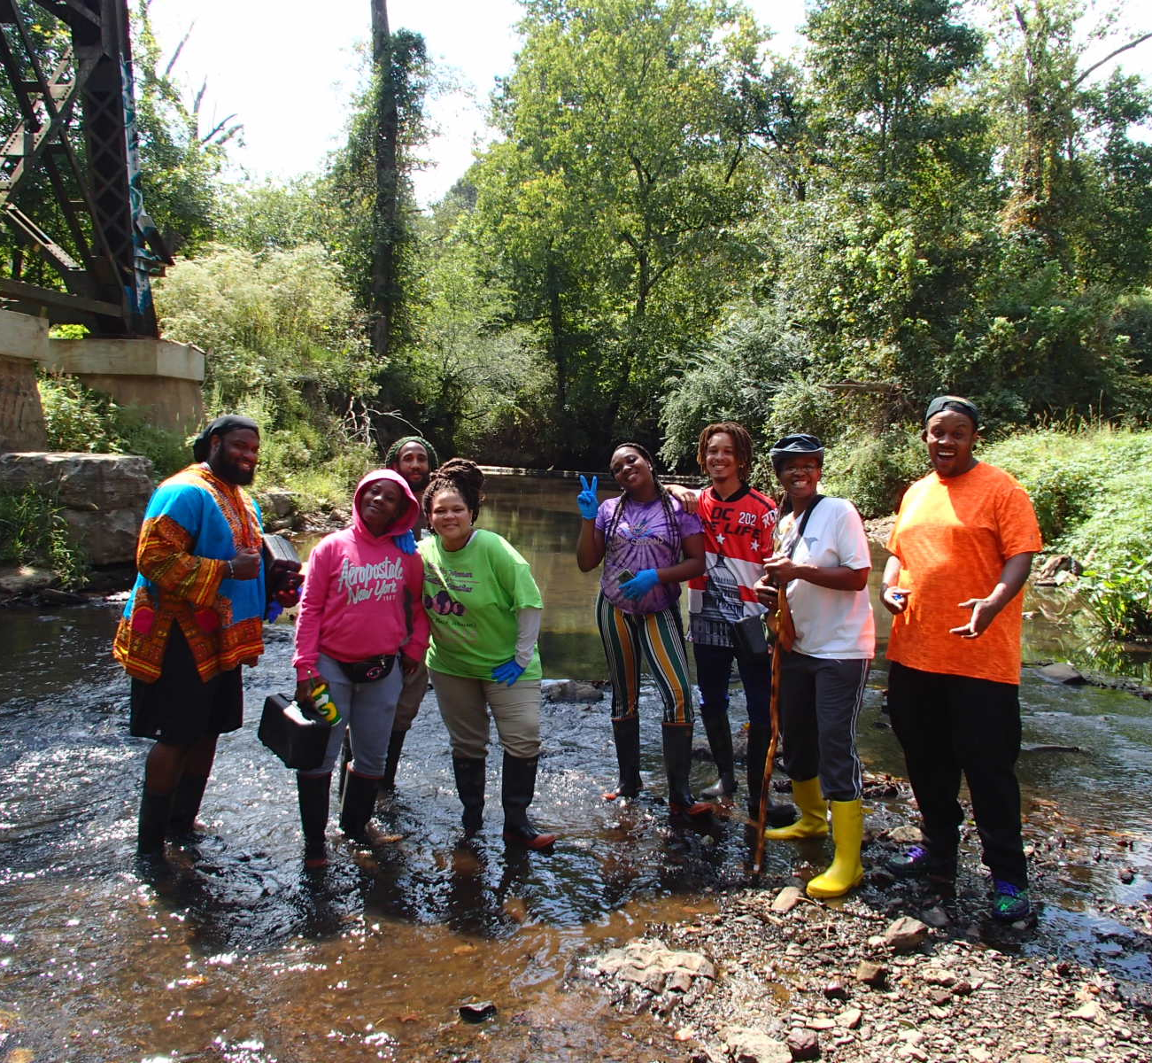
Where, When, and How Often?
Where to monitor:
Well mixed, flowing area of water
Same site location
When to monitor:
Normal flow conditions
Same time of day
How often to monitor:
Once a month
Notes:
Where:
Monitor in well mixed, flowing area. Be sure to avoid the streambed and any sediment when collecting your sample.
Aim to monitor in the same site location each time, if possible, to ensure comparable data
When:
Precipitation and flooding events can affect your readings. Therefore, also try to monitor during normal flow conditions, as this helps establish baseline conditions
Aim to monitor the same time of day each time, if possible, to ensure comparable data.
How often:
AAS recommends volunteers monitor chemical parameters once a month

Slide 12
Core Chemical Parameters
Notes:
Let's get into the core chemical parameters AAS monitors for…

Slide 13
Temperature
A MEASURE OF THE THERMAL ENERGY PRESENT IN A SUBSTANCE OR OBJECT
Notes:
The first core parameter is temperature. Temperature is a measure of the thermal energy present in a substance or object, or to put it simply, how hot or cold something is.

Slide 14
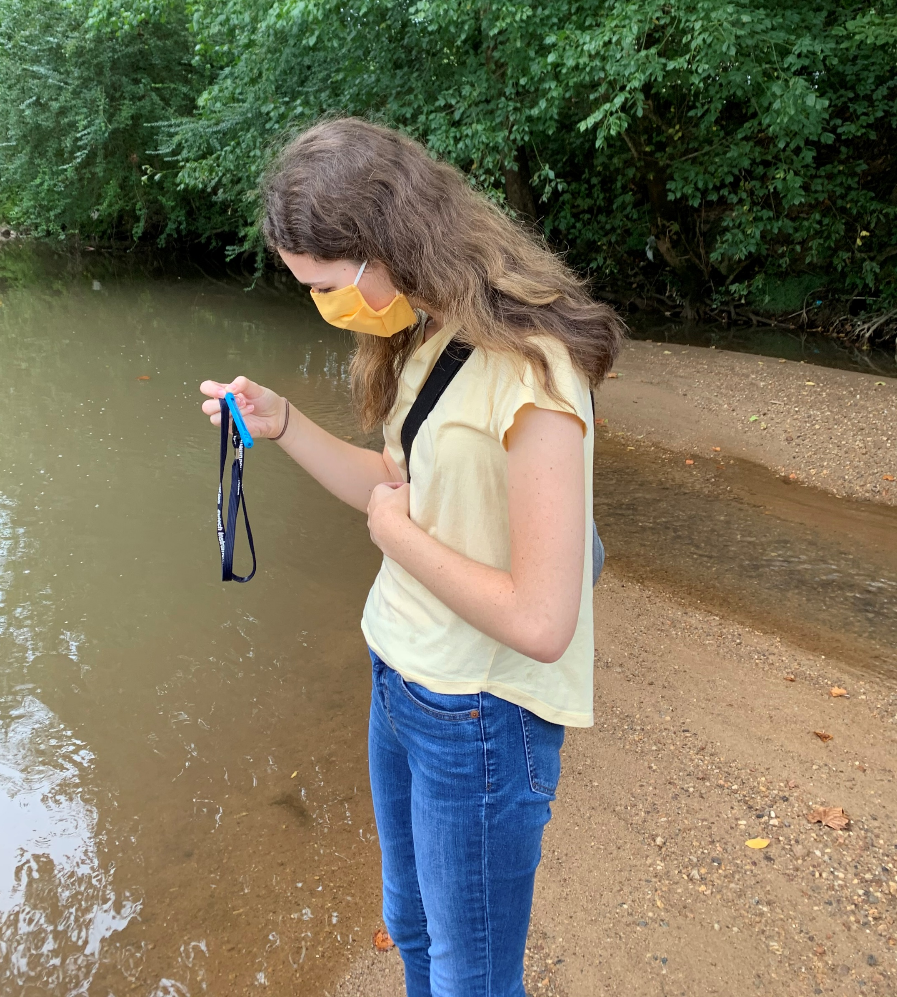
Temperature
Units: degrees Celsius (°C)
Measurement:
Thermometer
In the shade, away from direct sunlight.
Take air temperature before water temperature.
Single measurement for each parameter
State Standard for Water Temperature:
Less than 32.2°C (90°F)
Notes:
Temperature is recorded in degrees Celsius.
Take air and water temperature using a thermometer in the shade, away from direct sunlight
Be sure to take air temperature before water temperature
Water droplets on the thermometer can affect the reading (evaporation= a cooling process).
Always use the same instrument for both air and water for consistency
Take only one measurement each for air and water temperature
The state standard for water temperature is less than 32.2°C (90°F)
There is no state standard for air temperature
Fahrenheit to Celsius conversion (if interested): (X°F − 32) × 5/9 = Y°C
Celsius to Fahrenheit conversion (if interested): (X°C × 9/5) + 32 = Y°F

Slide 15
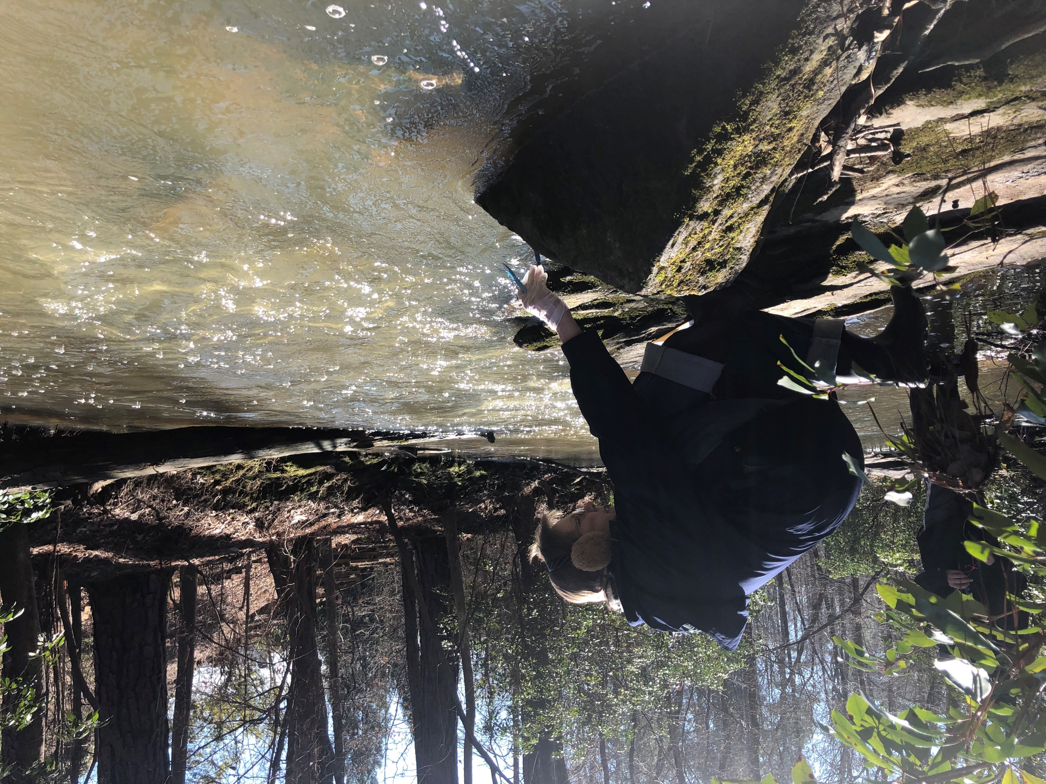
What Impacts water Temperature?
Water temperature naturally varies with time of day and seasons
Increased by:
Industrial or utility plant discharge of water
Runoff from heated, impervious surfaces
Removal of tree canopy
Decreased by:
Cool, underground water sources
Snowmelt
Over-hanging vegetation
Importance:
Temperature affects feeding, respiration, and metabolism
May affect other chemical parameters
Notes:
There will be variation by season and time of day, but deviations from baseline data and/or normally observed temperature for the climate can indicate an issue with overall water quality.
Factors that can increase water temperature:
Industrial or utility plants use stream water to cool down their systems and then discharge this now very hot water back into the stream
Runoff from heated surfaces such as roads, roofs and parking lots can also warm water temperatures
Removal of tree canopy reduces shade, exposing stream to direct sunlight
Factors that can decrease water temperature:
Cold underground water sources like springs (ex. blue holes on the Flint)
Snowmelt
Overhanging vegetation increases shade
Importance of temperature:
Feeding, respiration, and metabolism of aquatic organisms are influenced by water temperature.
Life adapts to a narrow range of temperatures and some aquatic organisms are sensitive to temperature changes.
Variations of only a few degrees can affect the life in a stream.
Temperature may also affect other chemical parameters.
For examples, temperature and dissolved oxygen (which we will discuss in the next slide) have an inverse relationship. The warmer the temperature, the less oxygen water can hold.

Slide 16
Dissolved Oxygen
oxygen dissolved in water and available for living organisms to use for respiration
Notes:
Time to elaborate more on dissolved oxygen. Dissolved oxygen (aka DO) is the oxygen dissolved in water and available for living organisms to use for respiration.

Slide 17
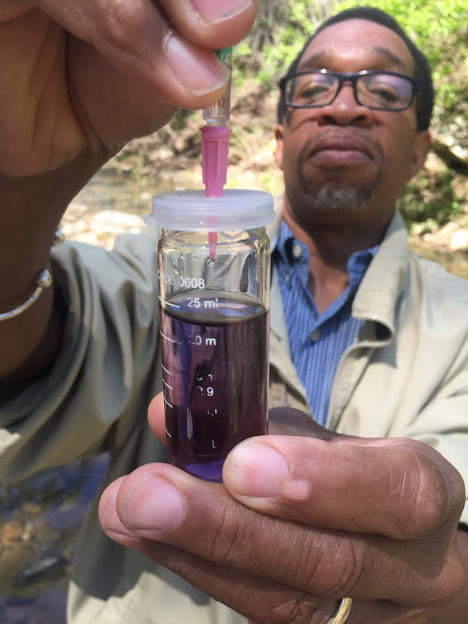
Dissolved Oxygen
Units: mg/L or ppm (1 mg/L = 1 ppm)
Measurement:
Winkler titration
Take two samples for duplicate precision
Must be within +/- 0.6 mg/L of each other
If not, take another sample until two are within that range
State Standards for DO:
No less than 4 mg/L
Trout streams: no less than 5 mg/L
Some south GA streams will naturally have a lower DO
Notes:
DO is measured in milligrams per liter (mg/L) or parts per million (ppm). These are interchangeable, so pick whichever one you like best!
AAS protocol uses the Winkler Titration method to measure the amount of oxygen dissolved in a sample of water (we will explain what this means in the field).
Take two measurements to ensure duplicate precision (i.e. the two readings must be reasonably close to one another to account for human error in the procedure)
Readings must be within +/- 0.6 mg/L of each other.
If the results of your samples are not within duplicate precision, take another sample until two are within that range.
The state standards for DO levels are a minimum of 4 mg/L. Some cold-water species require higher levels of DO, so the standard for trout streams is a minimum of 5 mg/L.
Some south GA streams will have a naturally lower DO in all seasons because of the differing ecosystems, geology, hydrology, and weather.

Slide 18
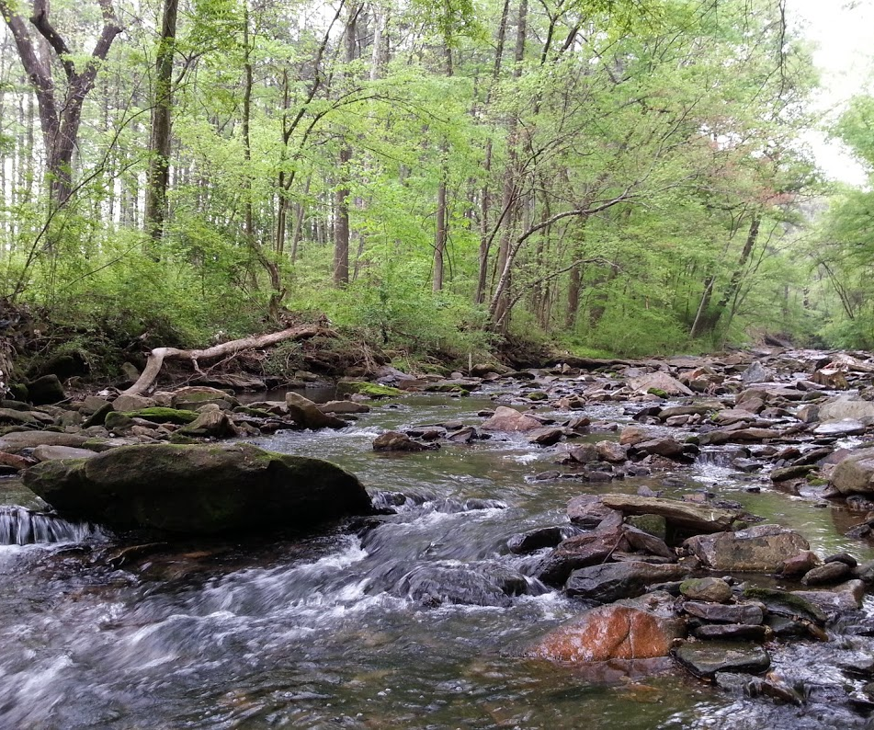
What Impacts Dissolved Oxygen?
Temperature and DO are inversely related
Introduced/Increased by:
Diffusion from the atmosphere
As a waste product of photosynthesis
Turbulent mixing (riffles)
Decreased by:
Rising temperatures
Slow moving, deep water
An overload of decaying organic matter (due to excess nutrients)
Importance
Aquatic organisms need dissolved oxygen for respiration
TEMPERATURE
DO
TEMPERATURE
DO
Atmospheric Diffusion
Photosynthesis
Turbulent Mixing
Notes:
As mentioned previously, temperature and dissolved oxygen have an inverse relationship (i.e., As temperature increases, DO decreases, and vice versa)
DO is introduced into water via:
diffusion from the atmosphere
plant metabolism as a waste product of photosynthesis
turbulent mixing (riffles)
DO levels may decrease due to
rising temperatures
slow moving, deep water
an overload of decaying organic matter due to excess nutrients (further explain on next slide)
Importance
Aquatic organisms need dissolved oxygen for respiration
DO levels below 3 ppm are stressful
Levels below 1 ppm will not support fish
Levels of 5 to 6 ppm are usually required for growth and activity

Slide 19
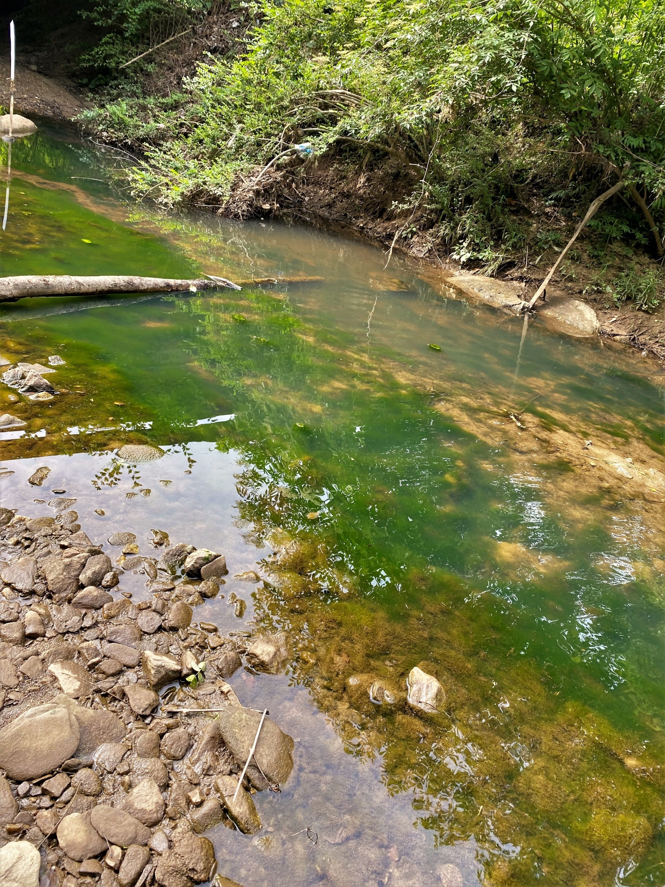
Eutrophication
Eutrophication: when a body of water becomes excessively enriched with nutrients
Two main types of nutrients:
Nitrates (fertilizers, animal waste, sewage)
Phosphates (soaps, fertilizers, animal waste, sewage)
Eutrophication can result in algal blooms, affecting sensitive aquatic organisms and decreasing dissolved oxygen levels
Notes:
Eutrophication- when a body of water becomes excessively enriched with nutrients
Naturally-occurring process, particularly in lakes that slowly fill with sediment over time (become shallower, concentration of nutrients naturally increases)
However, human activity can result in an influx of nutrients entering the system, accelerating the process
The two main types of nutrients are nitrates and phosphates
Nitrates are found in fertilizers and animal waste (including human waste)
Phosphates are naturally released from the slow erosion of rocks, but can also be found in soaps, fertilizer, animal waste, industrial effluent and sewage
Nutrients are not one of our core chemical parameters, but if you are interested in monitoring nutrient levels, you can reach out to us, and we can provide more information on what you need to get started
The methods of nitrate/phosphate testing is high-level and not typically done on the volunteer level. If you have a site of concern, you can send a water sample to a lab for testing.
An overload of nutrients can result in algal blooms, affecting sensitive aquatic organisms and decreasing dissolved oxygen levels; explained more on next slide

Slide 20
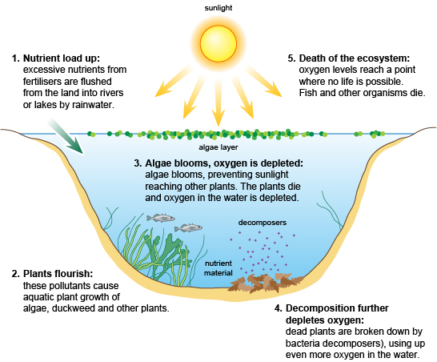
Eutrophication
5. Oxygen levels get so low that aquatic life can no longer be supported
1. Excess nutrients enter waterbody
3. Algae blooms block sunlight
2. Rapid plant growth occurs, initially increasing DO levels
4. Plants (and algae) die, decomposers deplete dissolved oxygen
,
This Photo by Unknown Author is licensed under CC BY-SA-NC
Notes:
Definition again: when a body of water becomes excessively enriched with nutrients
Frequently due to runoff from the land or sewage spills
Often causes a dense growth of plant life and death of animal life from lack of oxygen
Explain diagram
Excess nutrients flow into a waterbody
Rapid aquatic plant growth occurs
Algae blooms also occur
Due to increased plant/algae growth and heightened levels of photosynthesis, there is an initial increase in DO in water (note that volunteers may get DO levels higher than 14.6 mg/L, aka “supersaturation”, if sampling at the beginning of an algal bloom)
Algae blooms will eventually get so large that they severely limit the amount of sunlight available for photosynthesis by aquatic plants
These plants die due to lack of sunlight, and eventually the algae die as well once all the nutrients are used up.
Decomposing bacteria break down this dead organic material and use up the remaining dissolved oxygen in the process (re-emphasize the reduction of DO as a result of increased nutrients)
The system then becomes uninhabitable for aquatic life
While eutrophication often happens naturally over time due to the buildup of decaying plant material and sediment, human activity can cause the process to be expedited and have serious consequences to the aquatic ecosystem

Slide 21
pH
A MEASURE OF the hydrogen ions (H+) present in a substance; how acidic or basic a substance is
Notes:
The next core parameter is pH. pH is the measure of hydrogen ions present in a substance, or how acidic or basic a substance is.

Slide 22
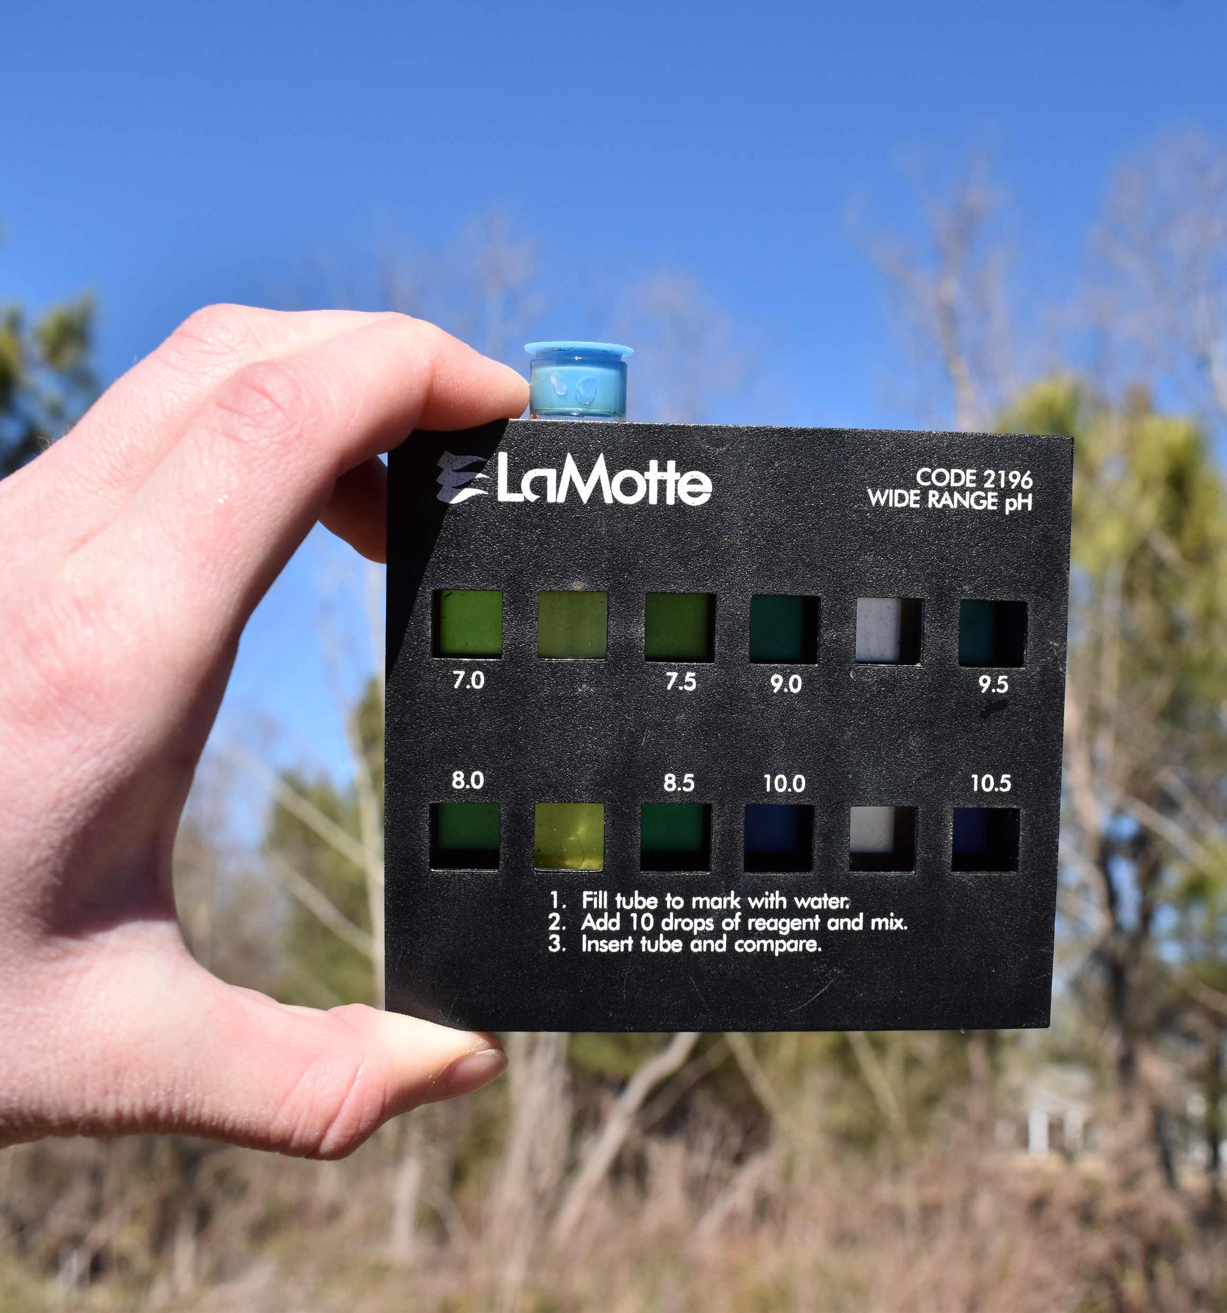
pH
Units: none (0-14 scale with 7 being neutral)
Measurement:
Color comparator
Take 2 samples for duplicate precision
Must be within +/-0.25 of each other
If not, take another sample until two are within that range.
State standard:
Between 6 and 8.5
South Georgia streams can get as low as 3.5
Coastal: pH increases (becomes more basic) with higher salinity
Notes:
No units! (logarithmic scale)
pH is the concentration of H+ ions in a substance
Higher H+ means more acidic, lower on the pH scale
Lower H+ means more basic, higher on the pH scale
Pure water is right in the middle of the scale (at 7) and is therefore neutral
Measured using a color comparator (see photo)
pH wide range indicator added to stream water sample, results in a color change
Match the color of the sample to colors on the comparator
Take two samples for duplicate precision
Results must be within +/- 0.25 of one another (can refer to photo)
If the results of your samples are not within duplicate precision, take another sample until two are within that range.
State standard
Most GA streams should be between 6-8.5
South GA streams can be as low as 3.5 (will get to this on the next slide)
For coastal vols, mention that as salinity increases, so will pH (i.e., water will become more basic)
Ocean water contains calcium carbonate (limestone), which is an alkaline salt that contributes to salinity readings. When it dissolves, it increases the pH.

Slide 23
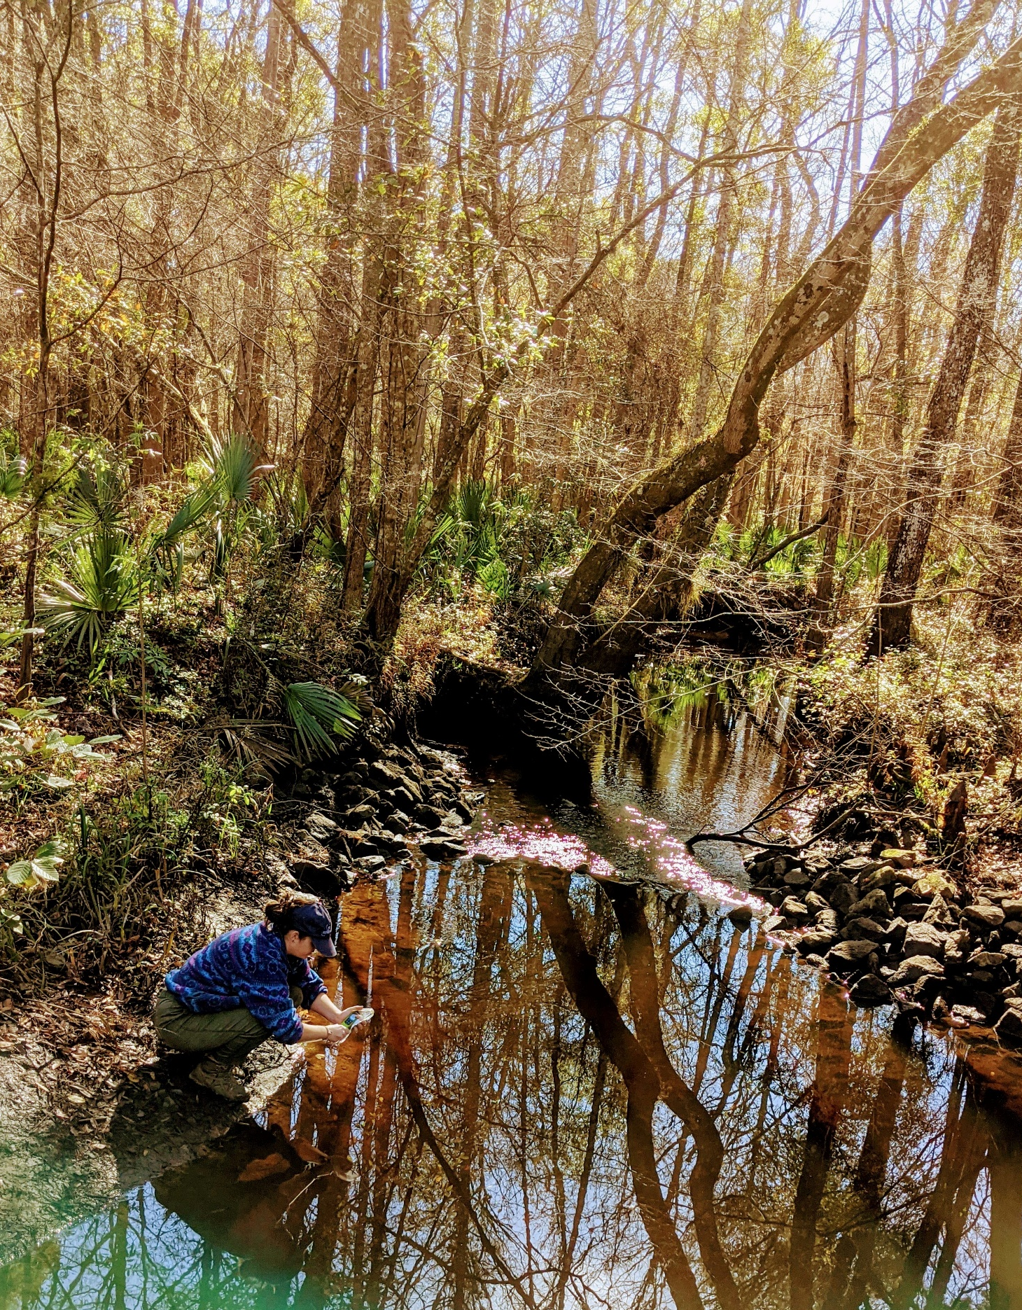
WHAT IMPACTS pH?
pH should remain relatively consistent, so closely monitor for deviations
Increased by:
Photosynthesis
Calcium carbonate from limestone
Decreased by:
Respiration
Tannins
Mine drainage
Importance:
Small change in pH represents large change in H+ ions
Aquatic organisms sensitive to fluctuations
Impacts the solubility of nutrients and heavy metals
Notes:
pH should remain relatively consistent, so if you notice deviation, look for some of these things
Increased by
Photosynthesis- this process removes CO2, which is mildly acidic, from the water
Calcium carbonate (lime) naturally released in areas with limestone bedrock, increases pH
Decreased by
Respiration decreases pH by adding CO2 to the water (reverse of photosynthesis)
Tannins- acids released from vegetation native to south Georgia, decreases pH
Reason why south GA streams can get down to 3.5
Also cause water to take on reddish brown color (reference photo- from St. Mary's trib)
Mine drainage- releases sulfuric acid
Climate change- as we mentioned previously, CO2 is mildly acidic; ask if anyone has heard of ocean acidification, which is caused by increased uptake of CO2 in the ocean and is a leading cause of coral bleaching
Pollutants (point and nonpoint source) can cause the pH to increase OR decrease depending on the type of pollutant
Importance
Small change in pH represents huge change in how acidic or basic the substance is (Will go into this more on the next slide)
Aquatic organisms can only survive within a narrow range of pH levels
Toxic heavy metals typically become more soluble under acidic conditions

Slide 24
pH SCALE FOR REFERENCE
Notes:
Graphic represents the pH of different substances on the scale
Remember how a small change in pH represents huge change in how acidic or basic the substance is
Measured on a logarithmic scale- essentially means that decrease of one on the scale represents 10 times more H+ ions present
Ex. 2 units on the pH scale represents the difference between cola and hydrochloric acid
Source: https://commons.wikimedia.org/wiki/File:PH_Scale-_Acidic_vs._Basic_(Alkaline).png

Slide 25
Conductivity
A MEASURE OF a substance’s ability to pass an electrical current; indicates the presence of ions
Notes:
Conductivity is a measure of a substance’s ability to pass an electrical current; indicates the presence of ions in a solution
Note the bold text on this slide!

Slide 26
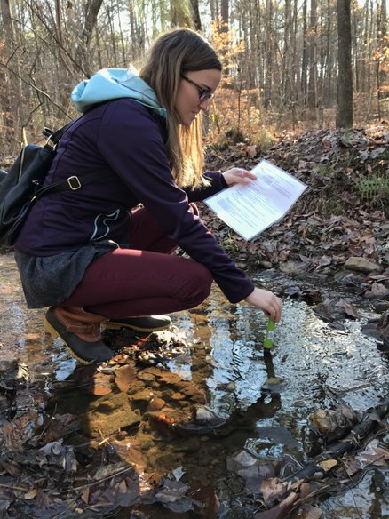
Conductivity
Units: microSiemens per centimeter (µS/cm)
Measurement:
Conductivity meter (single reading)
Conductivity meter should be calibrated within 24 hours prior to each monitoring event
State Standard:
No state standard for conductivity in Georgia
Georgia waters generally range from 50-1500 µS/cm
Volunteers should monitor consistently to establish baseline levels and note any deviations
Notes:
Measured in microSiemens per centimeter (µS/cm)
Conductivity meter used to take reading
Only one reading (no duplicate precision needed because equipment is calibrated beforehand to ensure accuracy)
Meter must be calibrated within 24 hours before event
Can use conductivity standard- a solution with a known conductivity reading, where you take a reading with the meter and adjust the reading to match the known standard
Can also use de-ionized water- same process but will have a conductivity of 0; can buy at the grocery store
No state standard for conductivity b/c it naturally varies across the state (Will go into this more on the next slide)
General range listed here, but it is more important to establish the baseline conductivity level at your stream via consistent monitoring
Deviations from this baseline can indicate disturbances
Conductivity meter can be used as an investigative tool if a disturbance is detected
Provides instant results with little effort
Useful for tracking pollution and determining the source of a disturbance in a stream (take multiple readings, working upstream, until the source is isolated)

Slide 27
what impacts Conductivity?
Natural Factors:
Geology
Salinity
Granite bedrock
(lower cond.)
Increased salinity
(higher cond.)
Limestone bedrock
(higher cond.)
Notes:
Natural Factors:
Geology of the area through which the water flows
Granite- typically lower conductivity
Limestone or clay- typically higher conductivity
Salinity- tidal/coastal waters typically have higher conductivity (salts=ions)

Slide 28
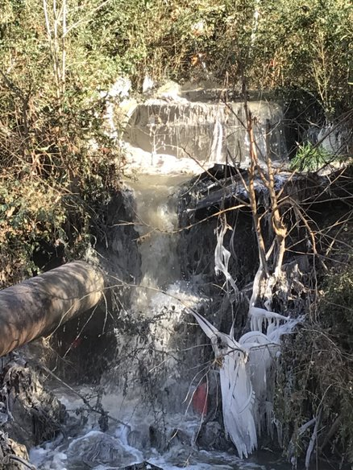
what impacts Conductivity?
Human Factors:
Mining operations
Agriculture
Sewage effluent
Urban runoff
Importance:
Indicates the presence of potentially harmful chemicals
Further testing required to determine what chemicals are present
Notes:
Baseline conditions vary throughout state due to natural geography (recall- no state standard for cond.); necessary to establish baseline conditions in your area to detect changes
Human Factors (all increase):
Mining operations- iron, copper, and cadmium
Agriculture- nutrients (nitrates and phosphates)
Sewage effluent- nutrients (nitrates and phosphates), chloride (sewer overflow due to clogging from fats, oils, and greases shown in photo)
Urban runoff- auto fluids, road salts, and other chemicals
Importance:
Conductivity readings can only warn you of the possible presence of harmful chemicals; they cannot tell you what those chemicals are
If you get an abnormal conductivity reading, especially in conjunction with abnormalities in your observations and/or other chemical, bacterial, or macro results, may want to report the stream for testing
This photo shows a spill in an urban creek that was traced back to a FOG (fats, oils, and greases) clog.

Slide 29
Salinity
A measure of the amount of dissolved salts in water
Notes:
For coastal volunteers only! Ask if you have any coastal vols. If no, skip this section.

Slide 30
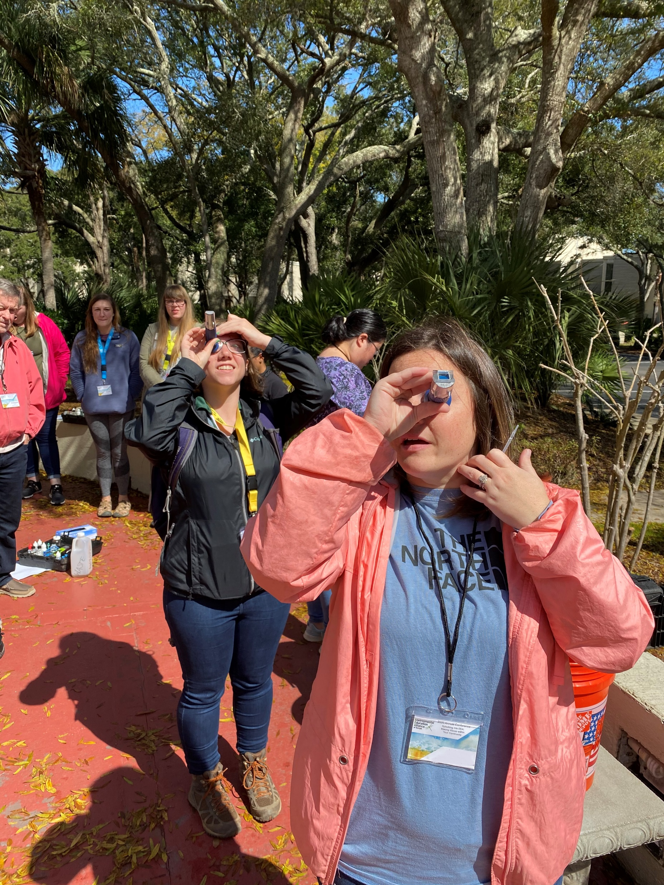
Salinity
Units: parts per thousand (ppt)
Measurement:
Refractometer
Two samples taken for duplicate precision
Must be within +/- 1.0 ppt of each other
If not, take another sample until two are within that range.
Refractometer should be calibrated within 24 hours prior to each monitoring event
State Standard:
No state standard for salinity in Georgia
Salinity varies depending on tidal stage and freshwater inputs
Salinity of seawater is ~35 ppt
Notes:
Measured in parts per thousand (i.e., how many "parts" of salt per 1000 "parts" of water)
Salinity measurement taken using a refractometer
Two samples taken for duplicate precision
Must be within +/- 1.0 ppt of one another.
Otherwise, another sample must be taken until this requirement is met.
Refractometer must be calibrated before every monitoring event within 24 hours
Can use DI water, which has a salinity of 0
No state standard for salinity
Dependent on tides and freshwater input
Salinity of seawater generally accepted to be ~35 ppt

Slide 31
what impacts Salinity?
Natural Factors:
Tides
Water temperature
Human Factors:
Saltwater intrusion
Sea level rise
Importance:
Aquatic plants and animals are adapted to certain salinity levels and are sensitive to change
University of Georgia Marine Extension and Georgia Sea Grant
Notes:
Natural Factors:
Tides- inshore waterways on the coast have highly variable salinity conditions due to tidal influences
Temperature- warmer water is less dense, decreasing the amount of dissolved salts it can hold (and vice versa, colder water holds more dissolved salts)
Human Factors:
Saltwater intrusion- a reduction of freshwater flow from drought or excessive withdrawal can result in saltwater flowing farther upstream than normal
Sea level rise- impact of climate change, ocean water moving farther inland and invading/overtaking freshwater and/or brackish systems
Importance:
While some aquatic organisms can withstand a variety of salinities, particularly those that dwell in estuaries and coastal marshes, many are adapted to survive in specific salinity levels and are highly sensitive to changes in salinity levels. Additionally, even particularly hardy estuarine organisms, such as spartina grass, are unable to survive in pure seawater.

Slide 32
Water Clarity
THE TRANSPARENCY OR CLEARNESS OF THE WATER
Notes:
For coastal and lake volunteers only! Ask if you have any coastal and/or lake vols. If no, skip this section.

Slide 33
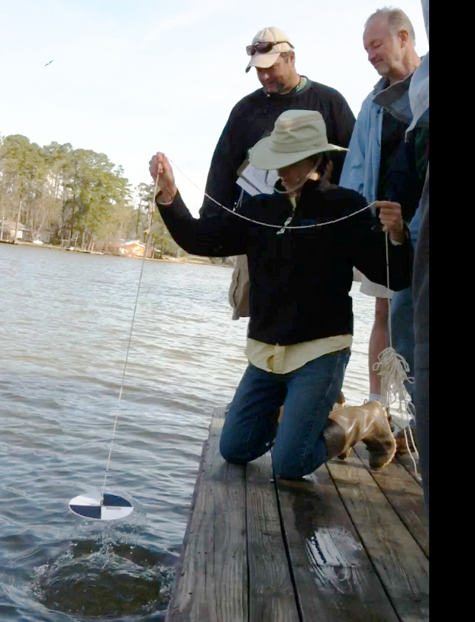
Water Clarity
Units: Centimeters (cm) depth
Measurement:
Secchi disk
Two samples taken for duplicate precision
Must be within +/- 10 cm of each other
If not, take another sample until two are within that range.
State Standard:
No state standard for water clarity in Georgia
Notes:
Water clarity is measured in centimeters of depth (i.e., how far can you see below the water's surface)
Use a Secchi disk
Contrasting black and white quarters
Lowered into the water until it cannot be seen any more, then raised until it is just visible
The distance from the disk to the water's surface is the water clarity reading (the "Secchi depth")
Two samples taken for duplicate precision
Must be within +/- 10 cm of one another
If not, take another sample until this requirement is met
No state standard for water clarity in GA
Can also test for turbidity (a more specific/accurate measurement of water clarity that measures the degree to which light is scattered by suspended particles) but need a turbidimeter (expensive).

Slide 34
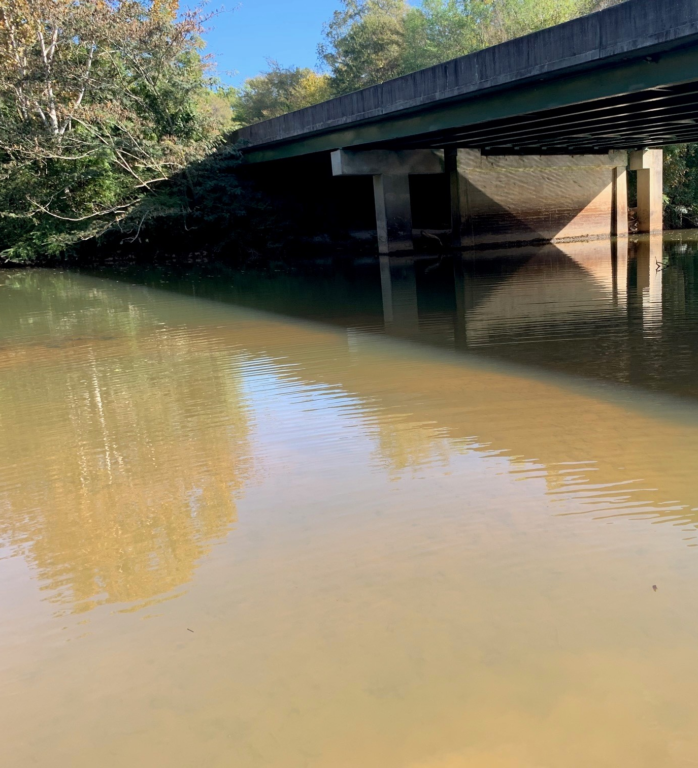
what impacts water clarity?
Natural Factors:
Rainfall
Tidal stage
Algae growth
Human Factors:
Eutrophication
Development/erosion
Dredging operations
Importance:
Low water clarity limits the amount of sunlight available for photosynthesis
Suspended particles can damage gills or suffocate aquatic organisms and disturb filter feeding
Notes:
Natural Factors:
Rainfall- carries runoff, which can contain soil and other solids
Tidal stage- in tidal areas, water flow can be strong enough to resuspended bottom sediments
Algae growth- algae are a natural part of many aquatic systems; however, their presence can also be the result of human impact (see next bullet)
Human factors
Eutrophication- nutrient influx causes unnatural increase in algae growth, as we discussed previously
Development/erosion- releases sediment into water; can be exacerbated by heavy rainfall
Dredging operations- stirs up sediment in water
Importance
Decreased water clarity limits the amount of sunlight available for photosynthesis by aquatic plants
Whether the low water clarity is caused by algae or suspended solids can have differing impacts on aquatic life
Algae could be a sign of eutrophication and DO swings
Suspended sediments can damage gills or suffocate aquatic organisms and disturb filter feeding, as well as suppress water temperature

Slide 35
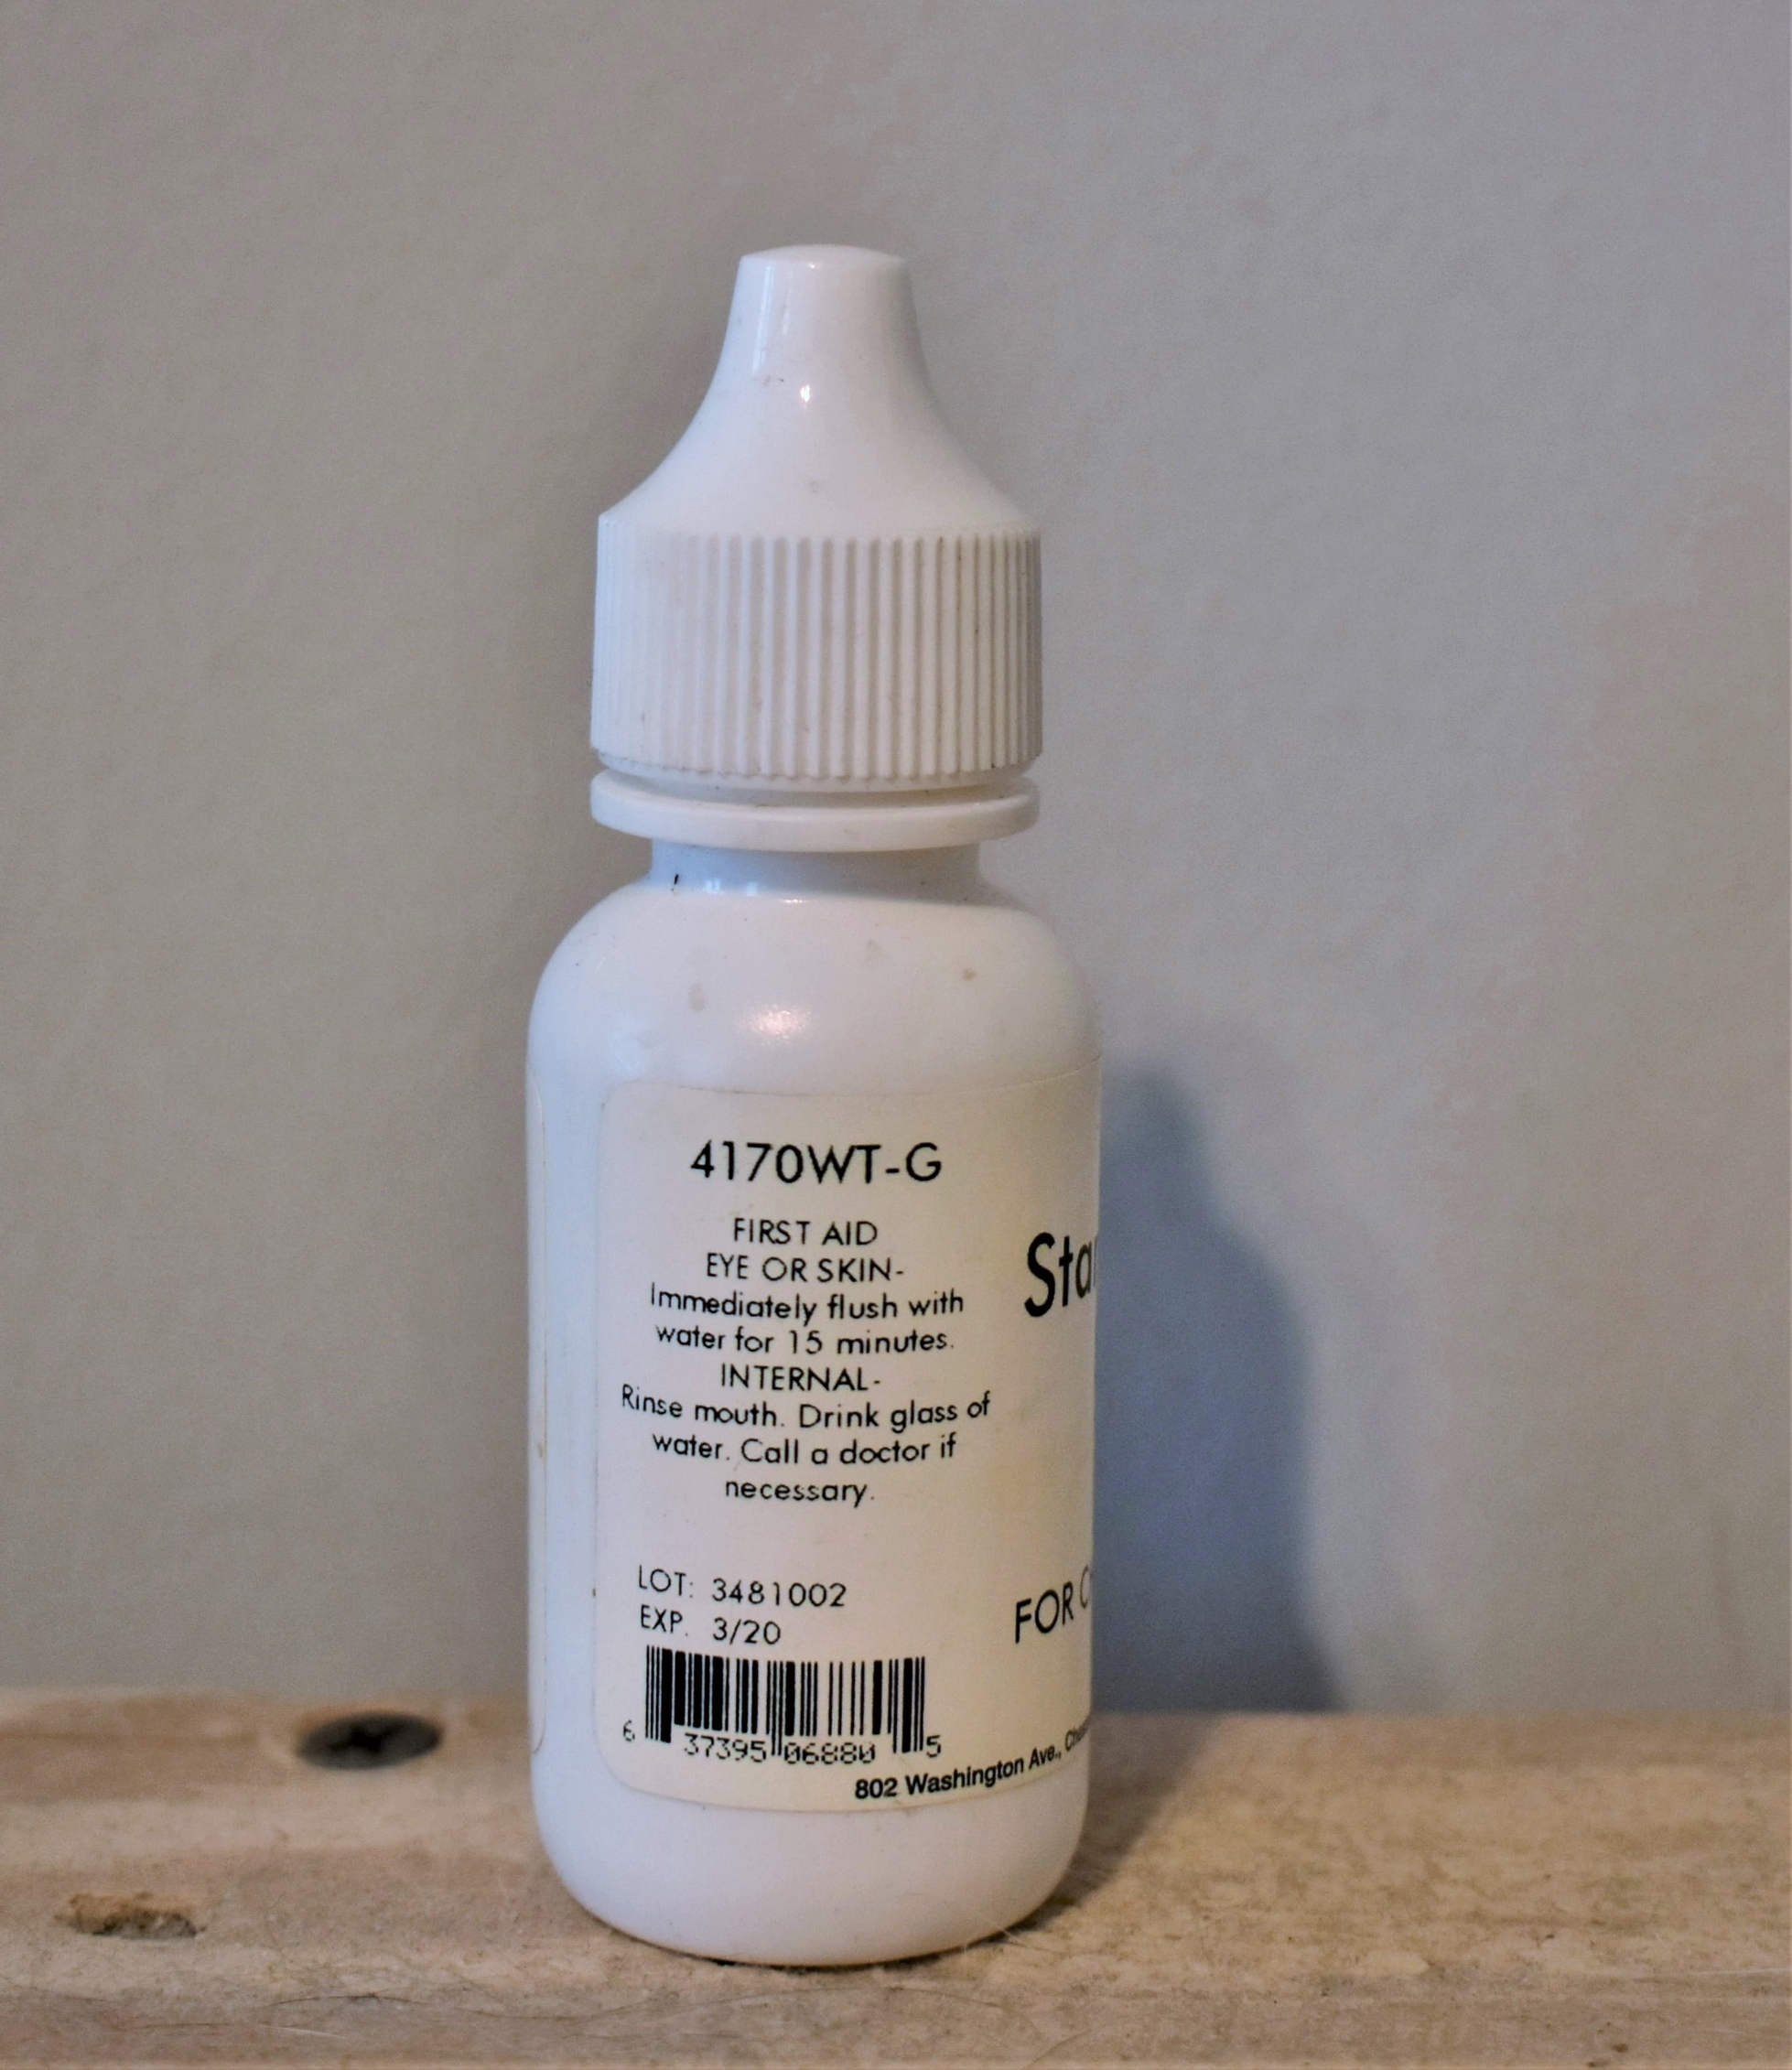
REAGENT maintenance AND DISPOSAL
Store chemical kits in a cool, dark place
Replace reagents when expired or contaminated
Disposal of reagents:
On municipal system- expired/contaminated reagents can be poured down the drain and flushed with water
On septic- solidify expired/contaminated reagents using cat litter and throw away, or bring to AAS office or water treatment facility
Contact your local coordinator or the State office for replacement equipment or reagents
Notes:
We're done with all the parameters! Now we're going to discuss how to store, maintain, and dispose of your reagents
Reagent- a substance added to a system to cause a chemical reaction; defines all the chemicals found in your chem kits
Reagents must be stored in a cool, dark place- do not leave your chem kits in the garage!
Dispose of and replace expired or contaminated reagents, and do not continue using them to conduct monitoring
How to dispose of your reagents (including from waste containers after monitoring):
If on municipal- these reagents can be dumped down the drain with water; the waste water treatment plant can easily process these chemicals
If on septic- DO NOT DUMP DOWN YOUR DRAIN! These reagents will harm the bacteria present in your septic tank. Options for those on septic:
Solidification- pour chemicals in a screw jar and add cat litter, then throw it away
Can go to a building on a municipal system and dump them there
Bring them to your local coordinator/the state office so they can properly dispose of the chemicals
If there is a hazardous waste day happening near you, your reagents can also be dropped off there

Slide 36
Results Outside of the State Standard
If your results are outside the range of the state standard or deviate from your baseline
INVESTIGATE site to identify possible sources
I found a source!
I did not find a source
Take more samples upstream
NOTIFY local AAS coordinator and/or water authority
Still outside the range/ found a source
Within the range
Monitor as usual
Notes:
This slide has animations
If your results are outside the range of the state standard or deviate from baseline, we ask that you take action to identify to source of the disturbance while still at your site location!
If you find a source, IMMEDIATELY contact your local AAS coordinator and/or water authority and provide a detailed description of your findings
See the "Who to Call" list on the AAS website if you are unsure who to call.
Limit contact with water, wear boots and PPE, and thoroughly wash hands if in contact with water
If you did not find a source, continue walking upstream and taking samples to try to pinpoint where the possible source might be
Use a measurement that is quick and easy to take, like conductivity (possibly pH)
If your upstream samples are still outside of the threshold, or if you find the source, contact your local AAS coordinator and/or water authority and provide a detailed description of your findings
If your upstream samples are within the threshold:
Survey the original monitoring area one more time to see if there might be any extenuating circumstances (you may also want to take one more sample at the first site)
Continue to monitor monthly. You can reach out to local coordinators, authorities, and watershed groups for advice and information about your findings.

Slide 37
Safety
Try not to sample alone- take a monitoring buddy!
Do not sample during high flows or after a heavy rain event
Obtain permission if sampling on private property
Wear PPE when sampling
Notes:
Safety is our primary concern when monitoring!
If you must sample alone, be sure to tell someone what you are doing, where you will be, and when you should be back.
Avoid sampling in during high flows or during extreme weather events
Do not enter private property without permission
Wear proper safety gear (gloves, boots, etc.) when sampling
This is not a comprehensive list- be as safe as possible and don’t ever sample if you are uncomfortable.

Slide 38
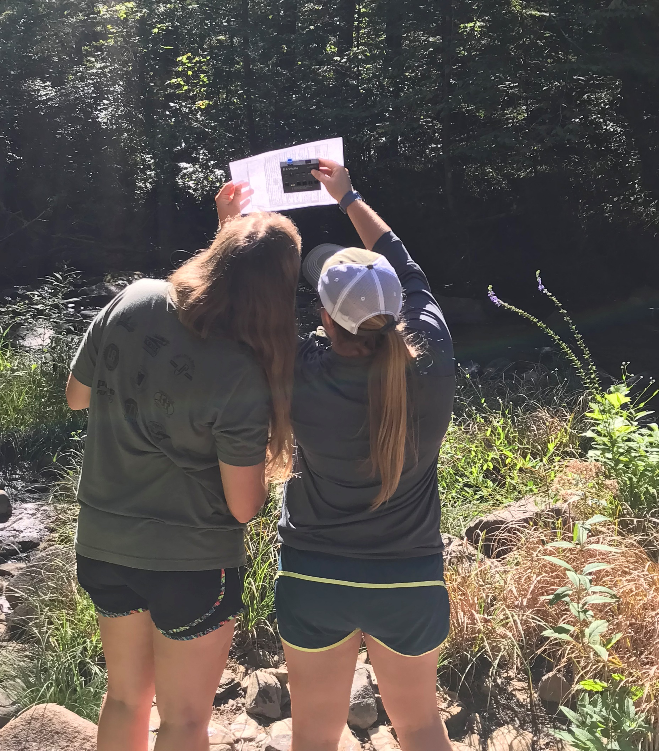
Once you’re certified
You get an account to our online database!​
Only certified volunteers can submit data
Certification is valid for one year​
Volunteers must attend an annual recertification workshop
Notes:
After going through the chemical workshop (presentation and field portions) and you pass your certification test, you will be a certified AAS volunteer!
Your trainer will enter your certification in the AAS database, and an account will be created for you.
Information to access your account will be sent to the email you registered with (more on this later)
You must be certified to enter data: you can work with anyone that’s interested in monitoring (even if they’re not certified), but only YOU can enter the data that is collected.
For example, some teachers will collect data with students and submit the data on their behalf
Your AAS certification is good for one year and then you’ll need to recertify.
Recertification workshops serve as a time to share updates and challenges.
You will review the information once again (presentation and hands-on) and retake the certification quiz.

Slide 39
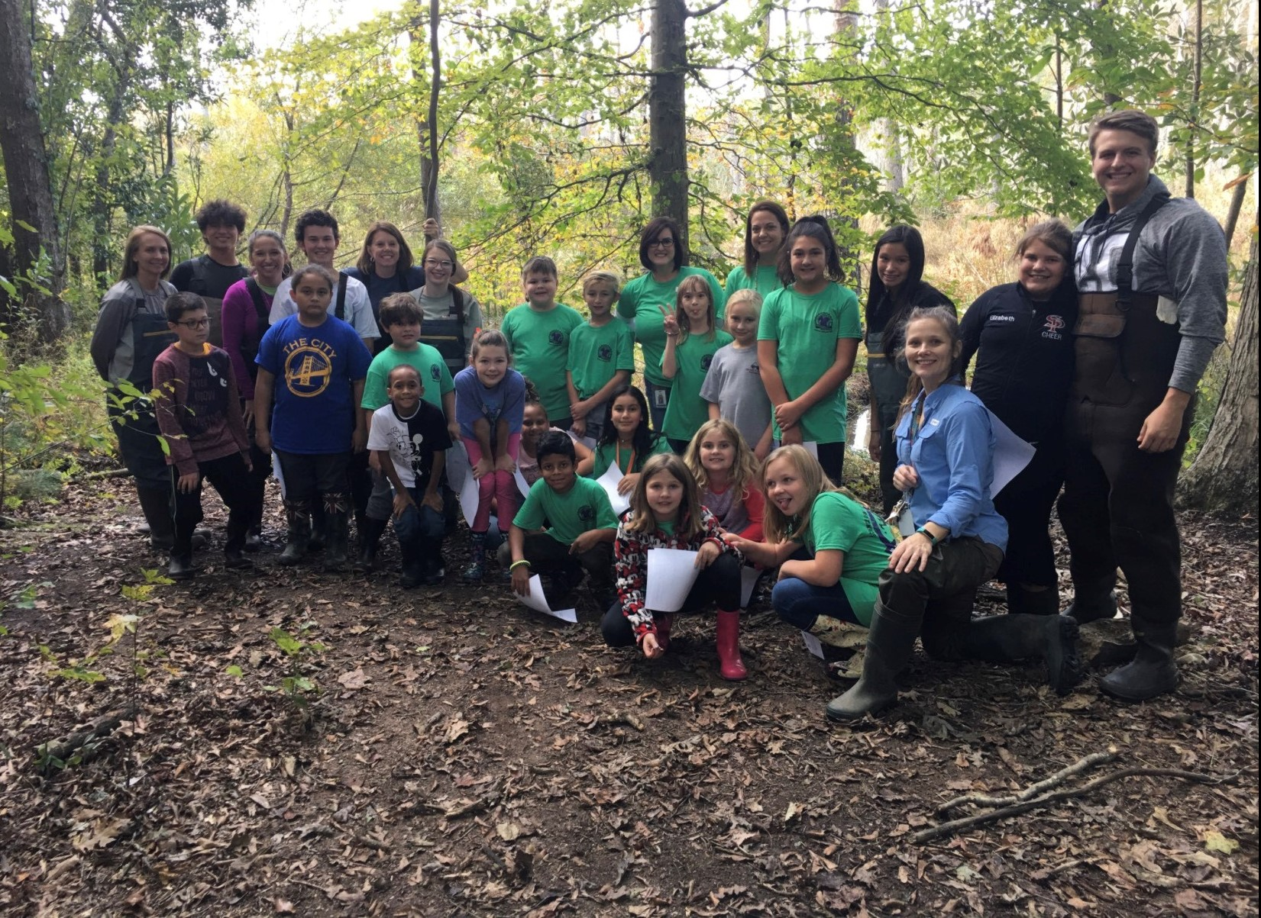
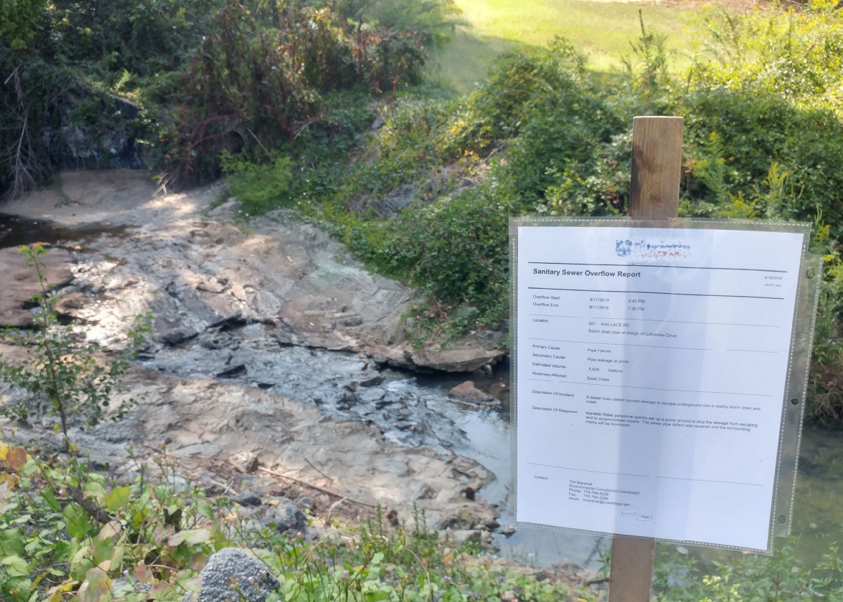
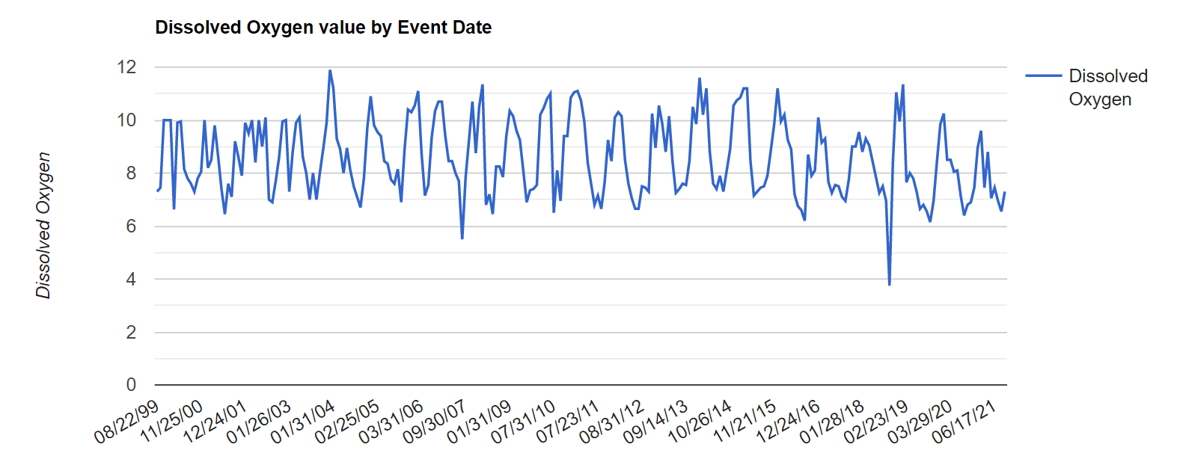
How are your data used?
Establish baseline conditions for waterbodies across the state
Discover and report water quality issues
Educate your community
Help inform status of streams for 303d/305b list
Notes:
After you collect data at your stream, lake, wetland, estuary, etc., we ask that your data be submitted ASAP to the online AAS database because your data are being used!
Anyone across the state, nation, and world can access data from the AAS database (open access)
Regular monitoring helps establish baseline conditions for your local waterways
It is impossible to understand what is “normal” for a waterbody from just one sampling event, and there aren’t enough scientists/technicians to be able to consistently collect baseline conditions for all streams across the state- that’s why we need citizen scientist volunteers!
Baseline data is incredibly valuable to communities in being able to track improvements and impairments over time and mitigate any detrimental alterations
Consistent monitoring allows problems, such as sewage spills, to be detected quickly and more frequently (bottom left photo= sewer spill notice; graph- point represents deviation from baseline)
Use your data to educate your community about their impacts on water quality
Describe what is “normal” for your stream and watershed, and what fluctuations you may have seen
Remember, Awareness is one of the AAS goals!
Finally, AAS data can also be used as a justification for drawing up a state approved QAPP that provides data needed to list/delist streams
Clean Water Act requires waterways that are not supporting their designated uses to be put on this list.
If waterbodies are not meeting their designated uses, this could limit recreation (fishing, swimming, boating, etc.) and more. (resource below)
Your local trainers will also receive emails every time you submit data so that we all stay informed of happenings in our watershed. This can also help us work with you to rectify any problems or pollution sources you may find while out collecting data. Can use actual example here.
Resource: https://epd.georgia.gov/watershed-protection-branch/watershed-planning-and-monitoring-program/water-quality-Georgia

Slide 40
Database login
From the AAS website’s homepage, hover over the My Profile tab and click Sign In
Notes:
This is the sign in page on the website. You will need to log in before you are able to access the data submission form
Once you pass and receive your certification, you will receive an email from your trainer with information on how to log in.
Your username will be the email address that you wrote on the waiver/sign in sheet (unless otherwise noted by trainer) and then you can create a password by clicking the Email My Password button.
However, only trainers and state staff can create new profiles, so be sure to wait until you receive your confirmation email before trying to log in.
Additional info can be found on the Volunteer FAQs page on the AAS website: https://adoptastream.georgia.gov/how-do-i-get-started-adopt-stream/volunteer-faqs

Slide 41
Data Submission Form
From the AAS website’s homepage, hover over the Data Entry tab and click Data Submission Form
Notes:
This screenshot shows the data submission form on the AAS website. You must be logged in with an up-to-date certification to access this page.
This is where you will enter all types of data that you collect
We will go over how to click through this online form after we review the paper data form

Slide 42
Site, Weather, and Observations
Notes:
Paper forms will be very similar to online forms
All forms have a site, weather, and observations section
Remember, Observations is one of the main goals of AAS!
Go through datasheet and discuss some of the parameters and their importance

Slide 43
Chemical Data
Submit data ASAP to online database
Access database via AdoptAStream.Georgia.gov
Notes:
Correlate the sections of the datasheet to what they have learned so far
Remember, submit ASAP to online AAS database!

Slide 44
Fill out site data first, then navigate to the chemical tab to continue entering data
After entering all of your data, click “Submit All” to submit your data to the database
Use “Save as Draft” to finish submitting data at a later time. Data must be submitted within 7 days of saving as a draft.
Notes:
This slide has animations
Here is how to submit data on the online database
Make sure your directions are very clear in toggling between forms and clicking submit

Slide 45
Follow aas and stay connected
AAS@dnr.ga.gov
AdoptAStream.Georgia.gov​
facebook.com/georgiaadoptastream
@georgiaadoptastream
2 Martin Luther King Jr. Drive​
Suite 1462, East Tower​
Atlanta, Georgia 30334​
470-938-3341 and 470-524-5791
Notes:
Replace info and photos with your own if you’d like!
Connect with us!
Email, website, Facebook, Instagram, address, and phone
Here is the AAS staff!

Slide 46
Test review
Notes:
Make sure to review all text in bold! Go through test questions verbally with attendees
Field:
Practice air and water temperature, DO, pH, and conductivity
Practice salinity and clarity as needed

