Slide 1
Bacterial Monitoring workshop
Georgia Adopt-A-Stream
Notes:
Notes to Presenters:
Refer to text on slides for pertinent info and be sure to emphasize bold text, as that is the information volunteers need to know for the test. This is true throughout the presentation
You are not required to say everything that is in the notes or present the information in the same way; these notes are simply included for your reference, so use them as much or as little as you like.
Please feel free to use your own examples, anecdotes, photos, etc. throughout the presentation. Make the presentation yours!
Just do not take out any of the bold text
Notes Key:
Bold text= info that will be on the test
Italicized text= direction for presenter, not to be said aloud
Underlined text= give emphasis, but not necessarily on the test

Slide 2
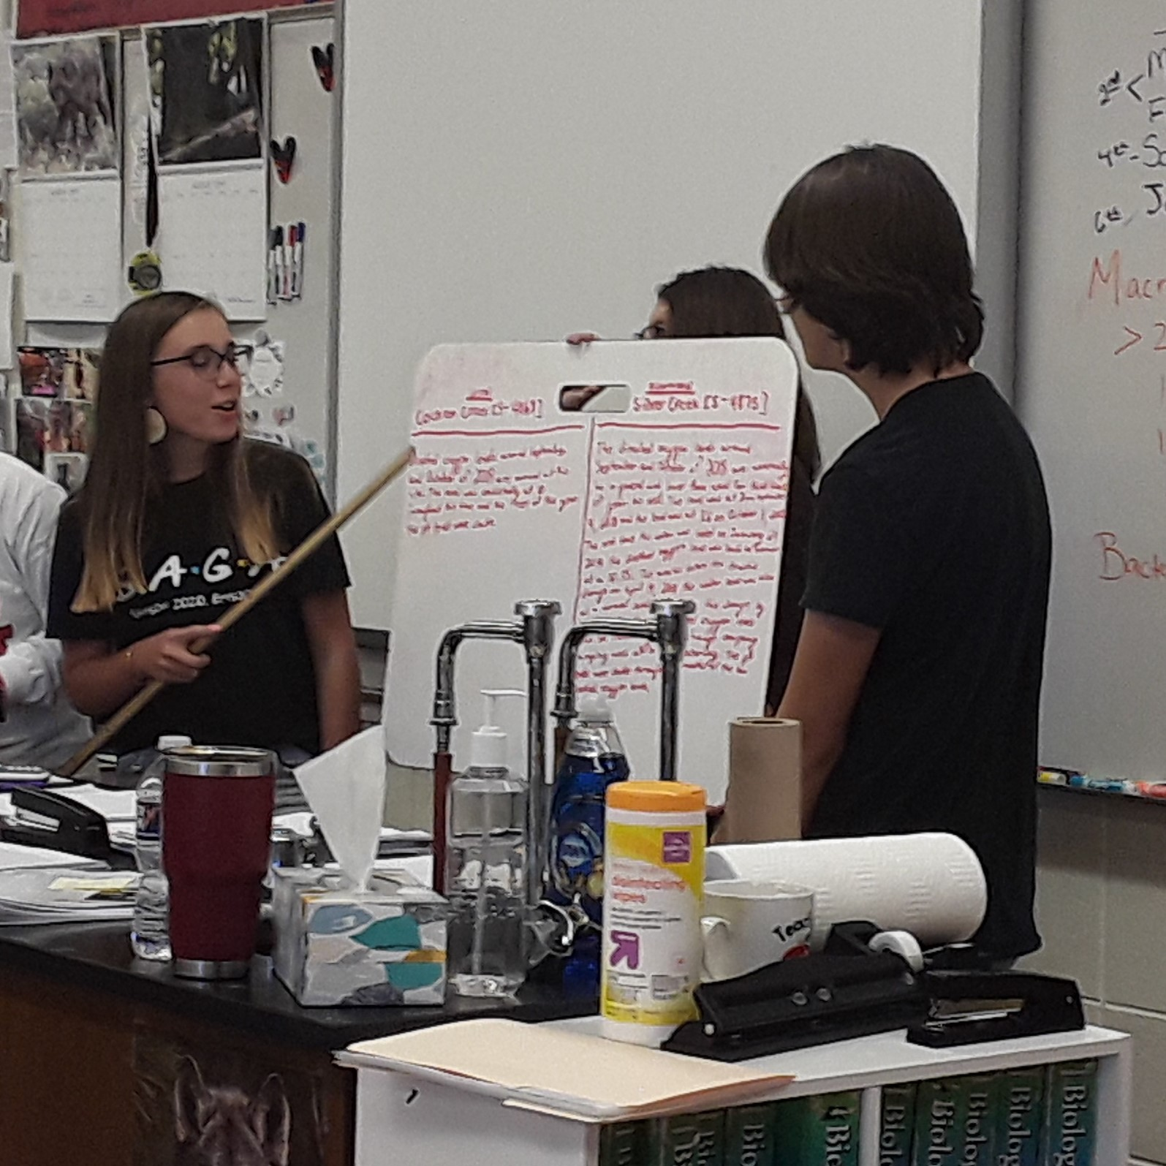
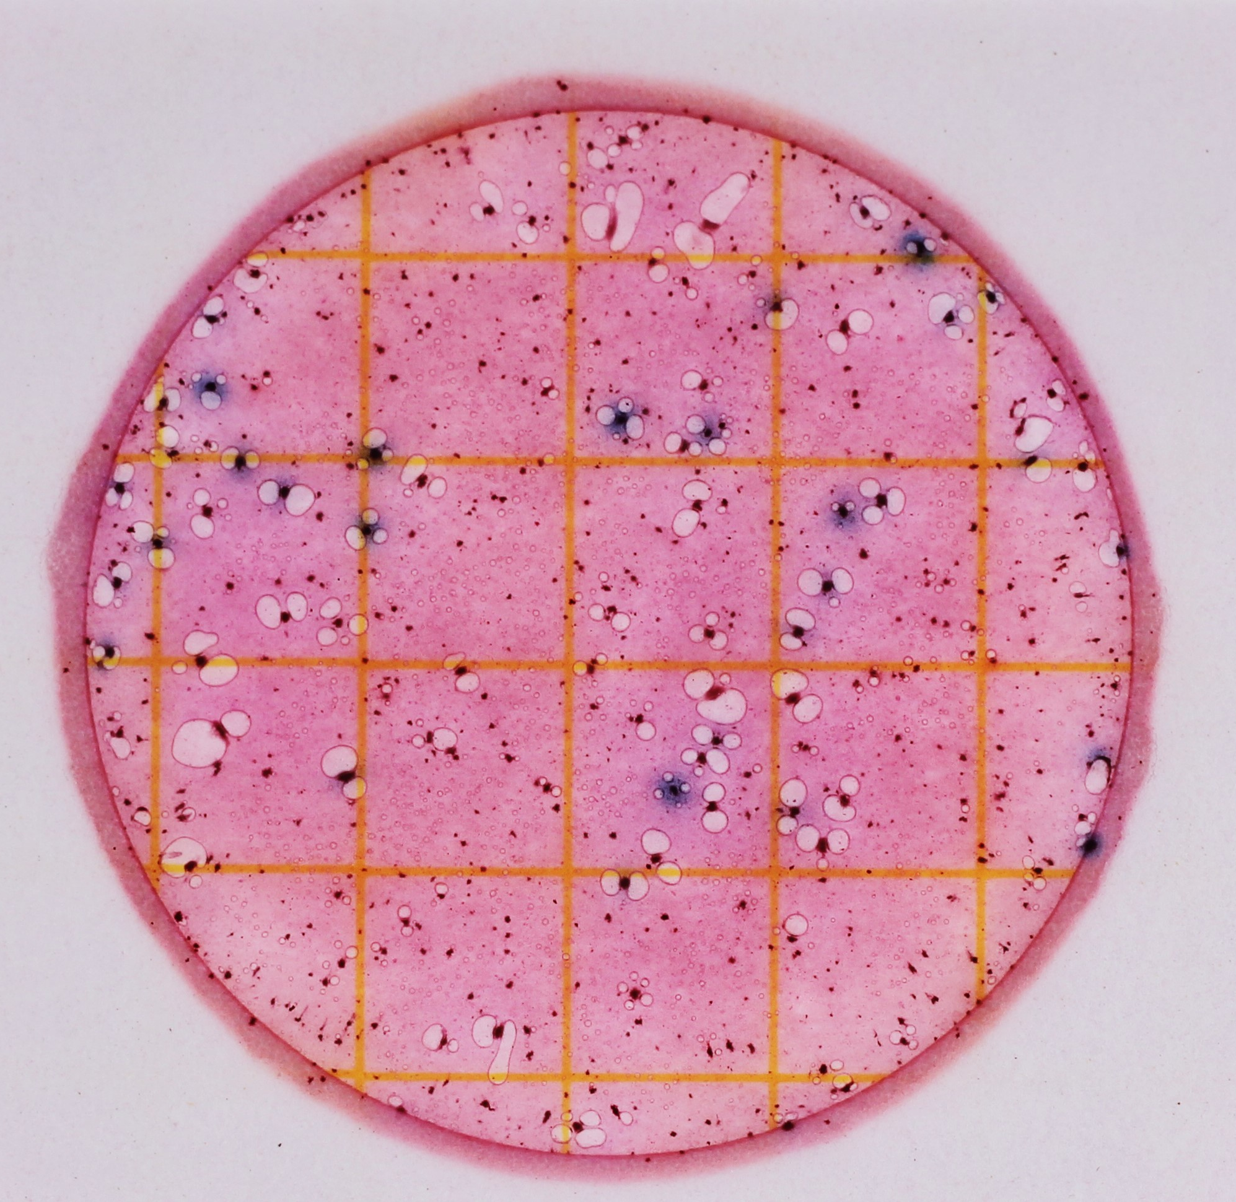
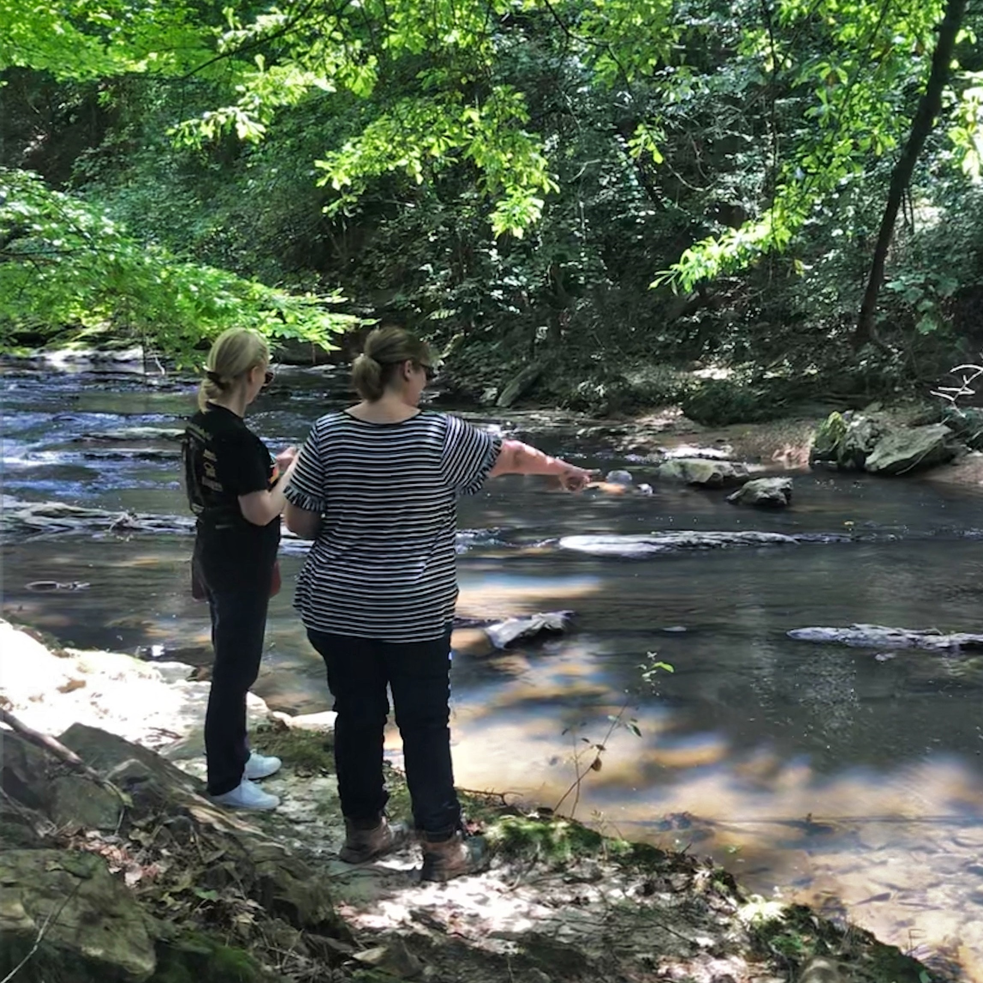
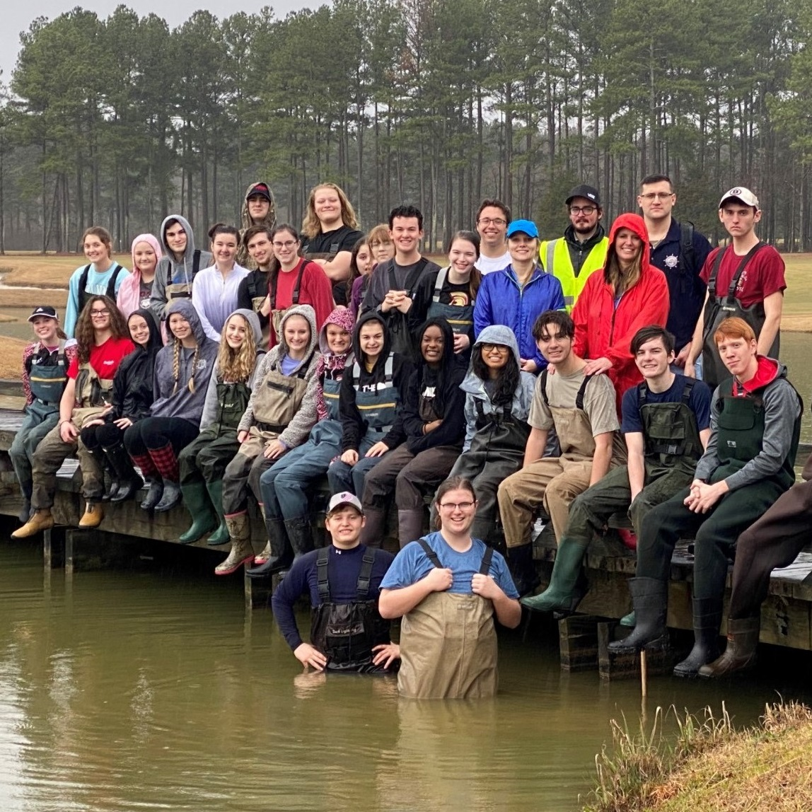
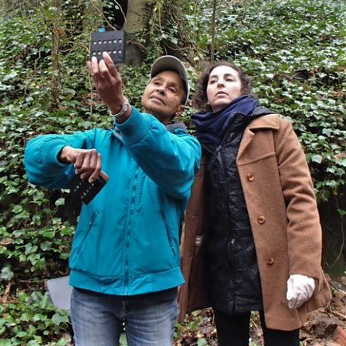
Georgia Adopt-A-Stream
A citizen science water quality monitoring program encouraging all Georgians to get familiar with their watersheds, monitor impacts, improve streams, rivers, wetlands, lakes, and estuaries, and inform others about their effect on water quality.
A
D
O
P
T
Awareness
Data
Observations
Partnerships
Tools & Training
Increase public awareness of nonpoint source pollution & water quality issues
Collect baseline water quality data according to Adopt-A-Stream protocols
Take observations of sites to note water quality conditions
Seek partnerships with local gov’ts, nonprofits, & other organizations to share results & resources
Utilize tools & training provided by staff & local coordinators
Notes:
Awareness: we are striving to increase public awareness of water quality issues throughout Georgia and its neighboring states by hosting outreach events (like cleanups, monitoring demos, etc.) in communities, consistent monitoring, understandable data, and an annual conference to celebrate and foster connectivity between volunteers
Data: AAS has an online, open-access database that has thousands of data points that allow anyone to see the value and importance of baseline data. Over time, data collected consistently (in the same locations, using the same protocols) will show natural fluctuations and trends in the waterbody that can be monitored for any deviations that could indicate pollution or impairment. Think of this like the stream’s heartbeat; it needs to be monitored carefully to ensure that the stream is healthy and any issues can be found and resolved quickly.
Observations: An incredibly important part of monitoring is being aware of the area around you and making careful observations. Just by noting what you see or smell, a sewage spill or other pollutant source could be found before you even start monitoring! It is also important to note any changes you see over time as these can also represent impacts on water quality. Once you take a look at the AAS data form, you'll quickly see the prominence observations have and how easy it is to gather these data!
Partnerships: forming partnerships throughout your journey as an AAS volunteer is incredibly valuable! Not only can forming these relationships help you get equipment you need (like macro kits, Petrifilm, reagent refills, etc.), but you will also find that you will be supported if you find any pollutants or harmful impacts on your stream. We all have something we can offer when we work together to solve problems.
Tools and training: You’re here today to fulfill part of this goal. AAS has many partners that work to provide equipment, support, and training opportunities for our volunteers.

Slide 3
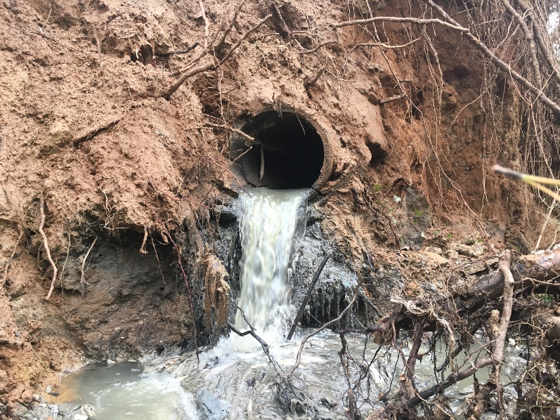
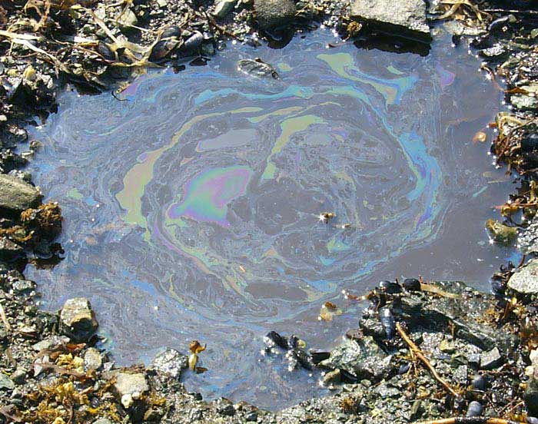
Types of Pollution
Chattahoochee Riverkeeper​
POINT SOURCE POLLUTION
Easily identifiable pollutant source
Regulated by GA EPD through NPDES permitting process
NONPOINT SOURCE POLLUTION
Sources not easily distinguished/identified
Everyone contributes
Main cause of water quality problems in GA
Notes:
Pollutants- substances that, when introduced, have adverse effects on the surrounding environment.
There are two main types of pollution: point source and nonpoint source.
Point source pollution:
Discharged from an easily identifiable source such as factories, construction sites, or wastewater treatment plants.
Georgia's Environmental Protection Division (EPD) regulates point source discharges through a permitting process called the National Pollutant Discharge Elimination System (NPDES). These permits set limits for the amount of pollutants discharged into a system.
Nonpoint source pollution (NPS):
Discharge source is not easily identifiable and/or pollutants come from an array of different sources (compare to point source)
More difficult to control, and therefore is the main cause of water quality issues throughout Georgia.
Enters waterways as runoff, a result of precipitation traveling over the ground and picking up substances before eventually entering a waterbody.
Examples: fertilizer from agricultural fields, oil from impervious surfaces, soaps and chemicals from car washes or pressure washing, E. coli from dog poop, etc.
NPS pollution moves through the stormwater system to get to the waterways.
For example, the vast majority of the ATL metro area is on a stormwater system that is separate from the sewer. Many people don’t understand this and think that the storm drains lead to treatment plants, and so dumping pollutants in these drains is harmless. However, this is not true!
NPS is the main type of pollution that AAS is focused on- you can help identify sources of nonpoint source pollution and raise Awareness of the sources and impacts of NPS on waterways

Slide 4
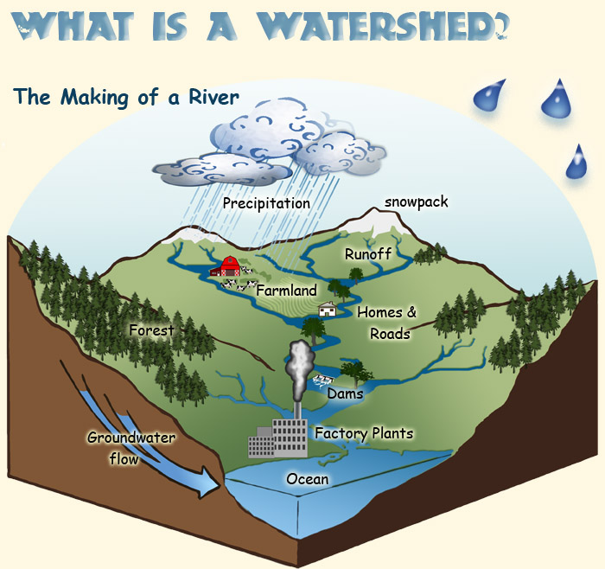
What is a watershed?
A land area from which water, sediment, and dissolved materials drain to a common point along a stream, wetland, lake, or river.
Its boundaries are defined by the highest points of land around the waterbody.
There is an unbreakable link between human health and wellbeing and ecosystems. -Walter Reid
A. Vicente, U.S. Forest Service
Notes:
A watershed is a land area! A watershed is not just the waterbody, rather the entire area of land over which all the water, sediment, and dissolved materials flow and drain to a common point (i.e. the waterbody)
Boundaries are defined by the highest points of land around the waterbody
Everything that touches the land (flora, fauna, pollution, man-made disturbances) impacts waterways.
This is where we see the effects of nonpoint source pollution accumulate and potentially harm ecosystems and impact human health
Essentially, each waterbody has its own watershed, and the size of the watershed depends on the size of the waterbody; therefore, watersheds can be as small as a neighborhood or go across an entire state (will see state watersheds on next slide)
Ultimately everything will drain to the oceans
Example: you can cup your hands to show that high points (thumb and pointer fingers) define the land area/watershed. When precipitation falls over the watershed, everything that’s on the land (fertilizers, car fluids, litter, pet waste, etc.) will wash down into the common/low point (crease where pinky fingers meet). This common point is usually a stream, river, wetland, or lake.
Photo source: https://www.fs.fed.us/rm/boise/research/techtrans/projects/scienceforkids/watersheds.shtml; A. Vicente, U.S. Forest Service.

Slide 5
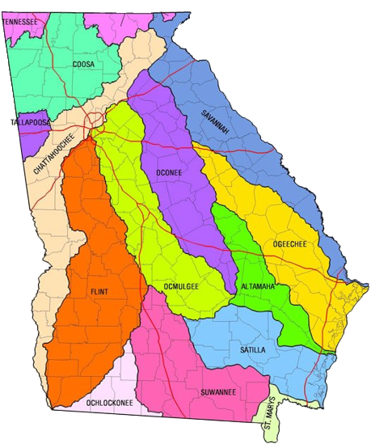
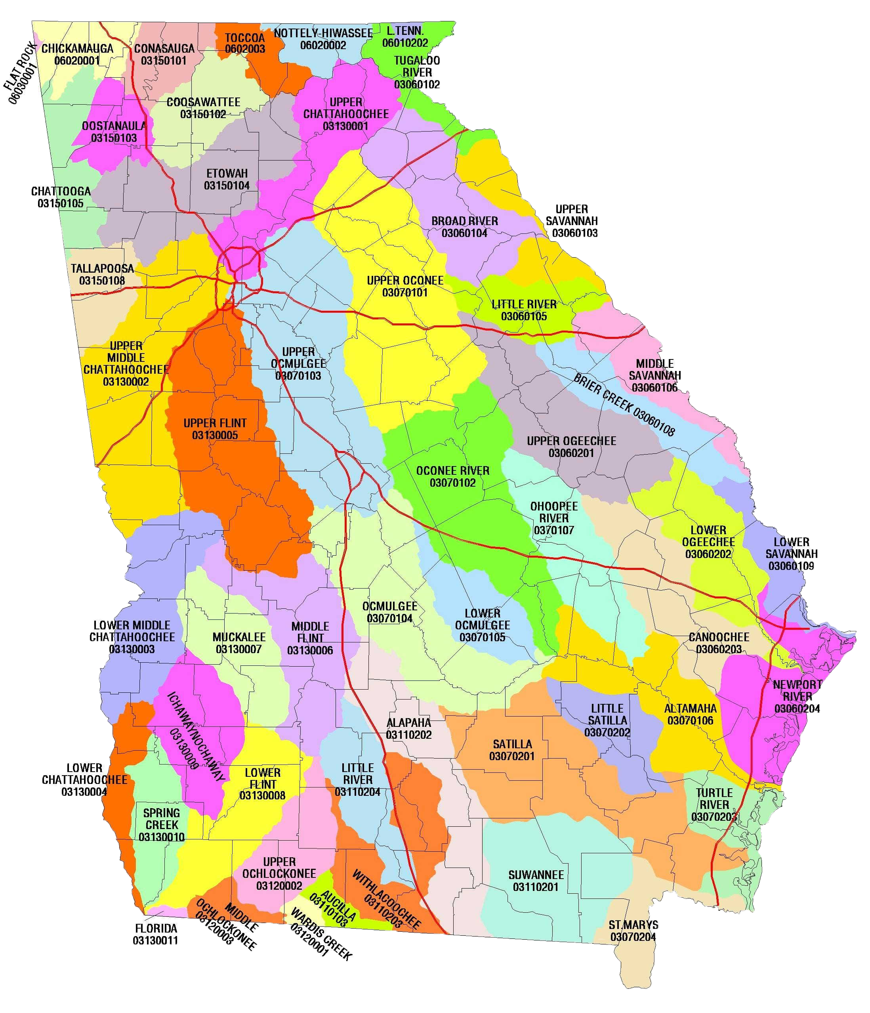
Where is your watershed?
Notes:
This slide has animations
Feel free to give an example of an issue specific to your watershed that can help demonstrate the watershed concept. Or add a local watershed map if you have one available.
Now that we know what a watershed is- where can they be found in our state?
The answer is literally everywhere! Everything is located on a watershed
Georgia has 14 major watersheds (1st photo), what major watershed are we in today?
The second photo shows us the 52 sub-watersheds in the state. What watershed are we in according to the second photo?
Notice how the larger watersheds can be broken down into smaller watersheds​
Even though these land areas are separated by high points of land and other demarcating factors, remember that “we all live downstream” ​
Look at the metro Atlanta area; there are 4 watersheds just within the perimeter of 285. Imagine the impact on water quality! ​​
helpful resource for GA watersheds: https://garivers.org/georgia-rivers/

Slide 6
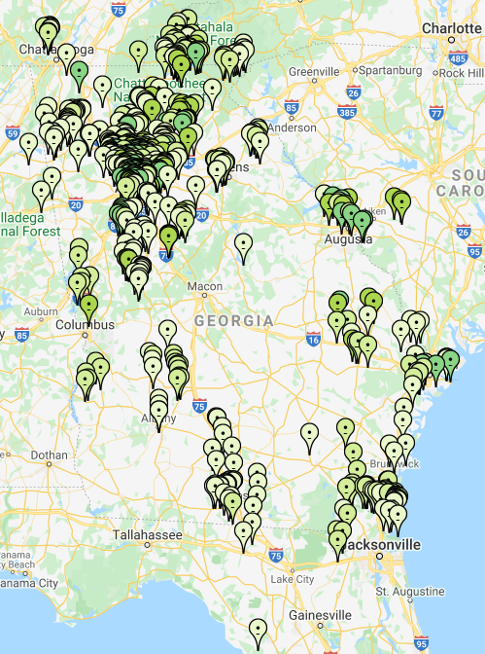
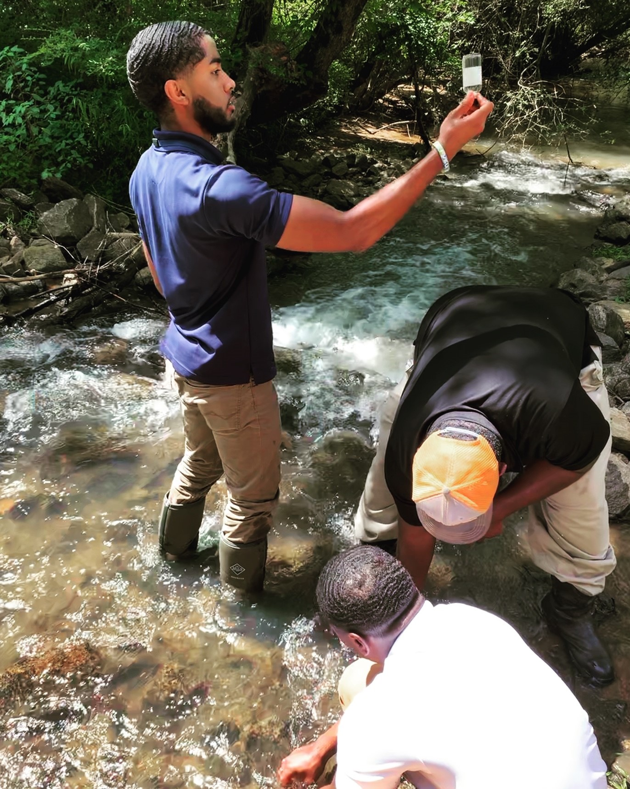
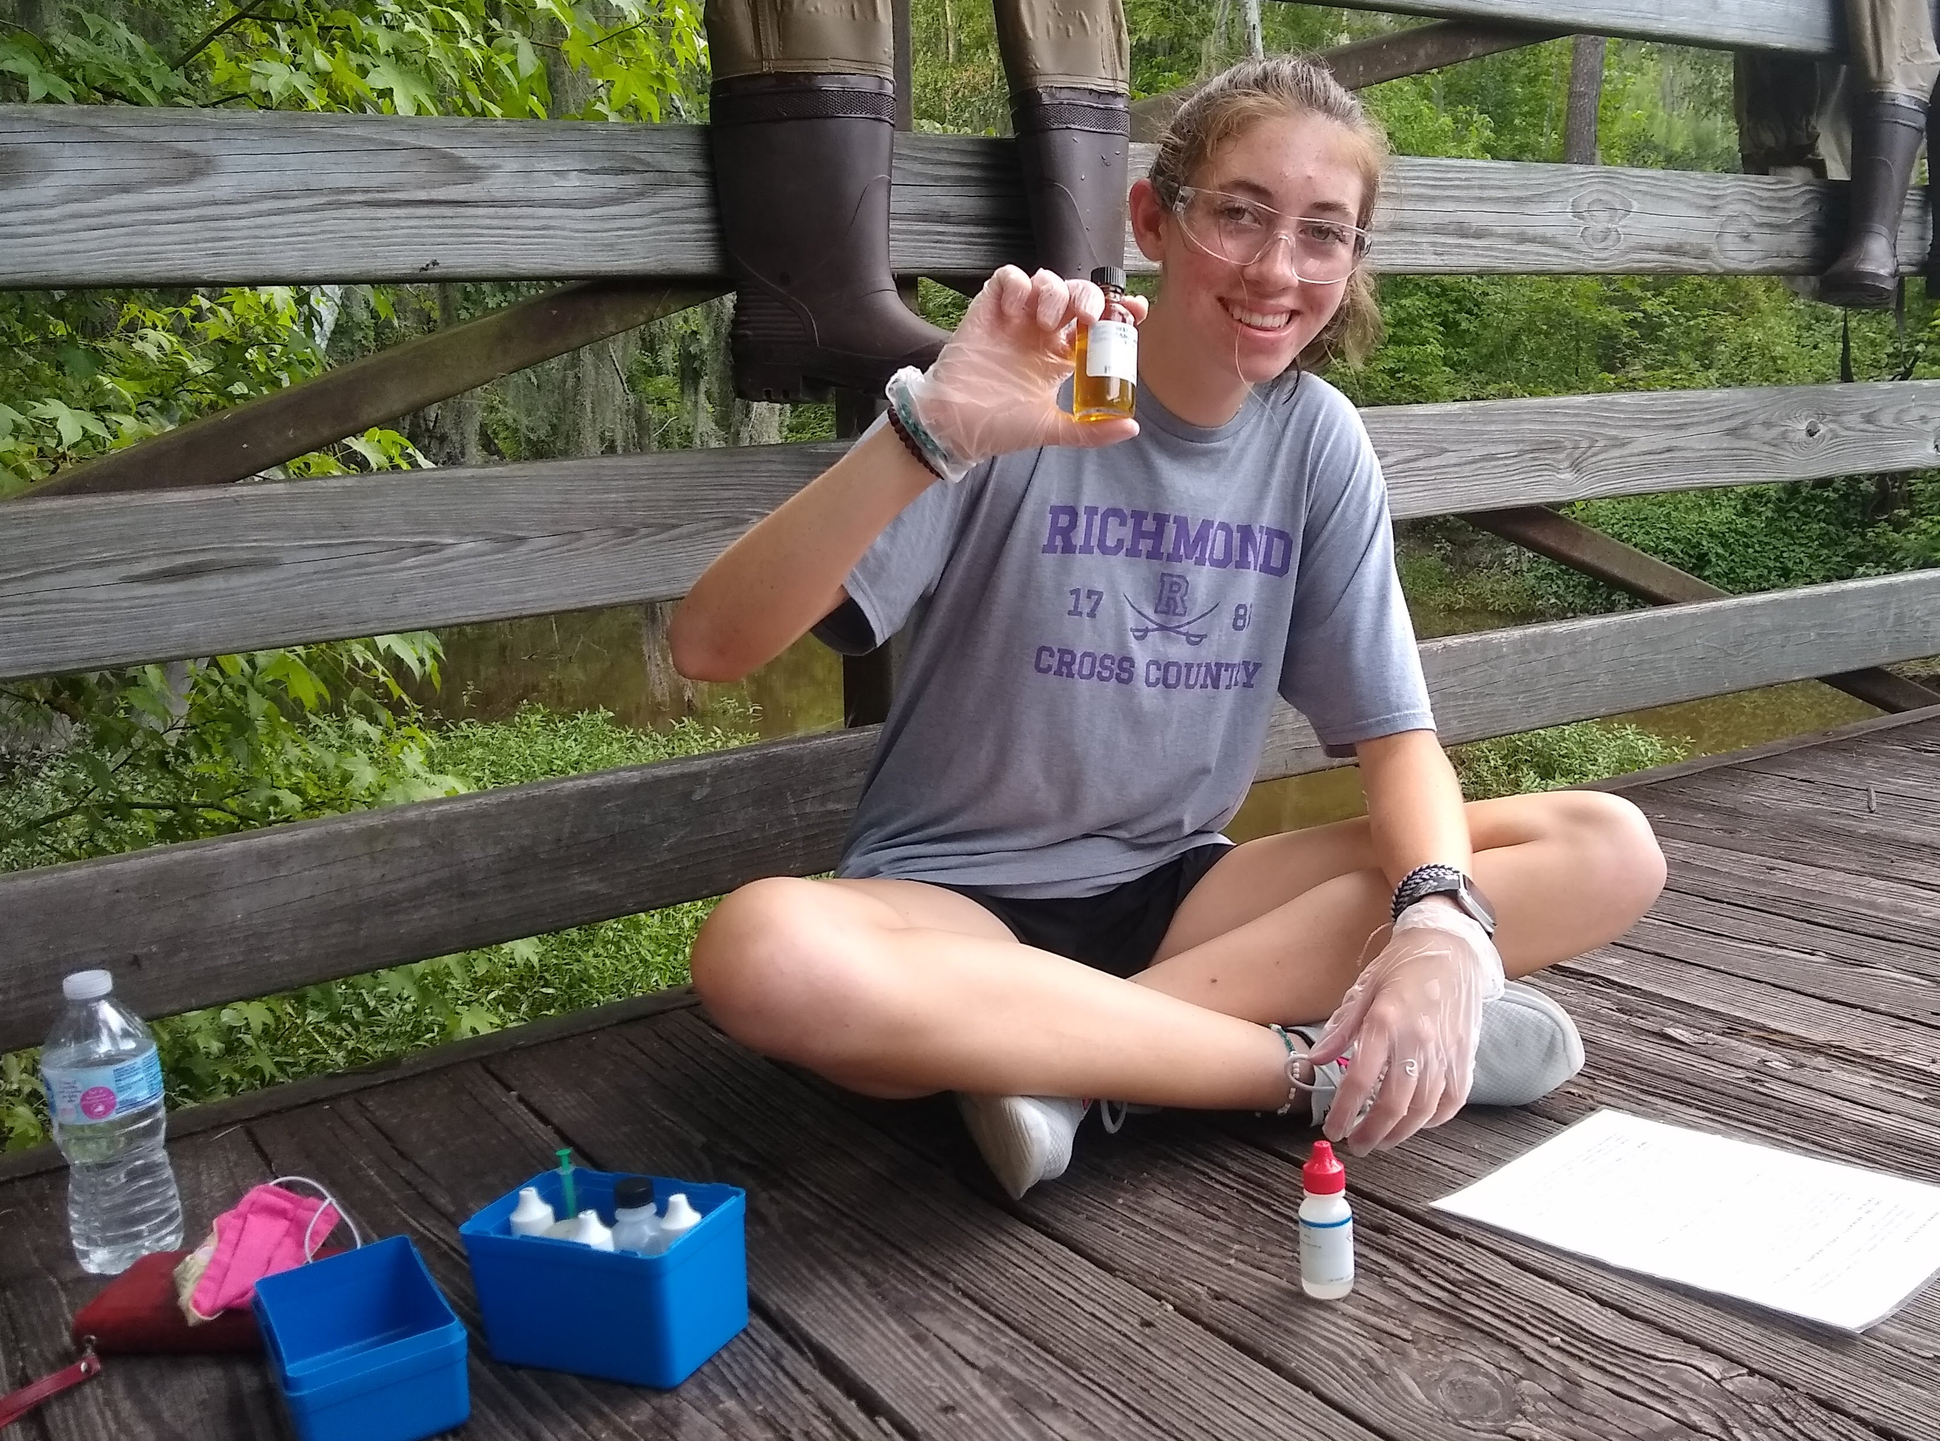
Volunteer network and support
State
Staff
2 to 4
Board Members
20
Local Coordinators
70
Volunteers
3,000 +
Notes:
This slide has animations
(Map photo) This map shows all the active AAS sites across the state. Working off the knowledge from the previous slide, are there vols working in your watershed already?
Hopefully, this map shows that you have AAS sites in your watershed already. If it does not, we are so excited that you are leading the way in your area!
(map with photos) You are joining a network of volunteers across the state (and beyond!) that are collecting and submitting data. These may be professors or their students using the data for research, a retiree acting on their interest in water chemistry, a neighborhood association member concerned about the lake they live on, a young family making sure their backyard stream is safe for their children and pets to play in, a scout troop, a riverkeeper volunteer, you name it!
(triangle graphic)
Volunteers- As you can see, volunteers are the reason this program exists. Without such a large number of interested and active community members, AAS would not be able to monitor anywhere close to the number of sites shown on the previous map. But thanks to you and all other AAS volunteers, our database is ever growing, and we are here to support your efforts.
Local coordinators- Local coordinators/trainers are an integral part to the AAS program as well. They are responsible for providing training and support to regions of the state and staying up to date with information that the state and local governments put out. These coordinators are trained by the state office and provide many of the workshop opportunities that are offered across the state.
Board members- AAS also has an advisory board that guides the program to be the most effective and meaningful for the citizen scientists that are engaged.
State staff- The smallest number you can see at the top of the triangle is state staff. These few employees support this volunteer program for the state of Georgia and provide support and guidance when possible. They also organize the annual conference and travel to participate in other outreach and data collection events.

Slide 7
AAS volunteers use Standardized protocols
EPA Approved Quality Assurance Project Plan (QAPP)
Quality Assurance/Quality Control (QA/QC)
Required to attend workshop(s) and pass certification test(s) to become certified
Only individuals are certified
Set monitoring protocol ensures all volunteers are collecting baseline data using standard methods
Only certified volunteers can enter data, but anyone can access the 20+ years of data in the online AAS database
Notes:
With so many volunteers and local coordinators, we all need to be on the same page so that the data being collected is replicable and be trusted.
Therefore, AAS has an EPA approved QAPP (quality assurance project plan)
The QAPP lays out all the details in the QA/QC protocols
QA/QC protocols simply give every monitor a standard to abide by. Once we start talking about bacterial monitoring specifically today, you’ll see that there are steps and processes to follow and that are the same for everyone that submits data to the AAS database
Besides specific protocols, QA/QC provides a framework for volunteers to get certified, submit data, and continue working with AAS
Therefore, before you are a certified volunteer, you must attend a workshop and pass the applicable certification test
Only individuals are certified (for ex., if a teacher gets certified, their whole class is not certified- just the person that attended and passed the workshop)

Slide 8
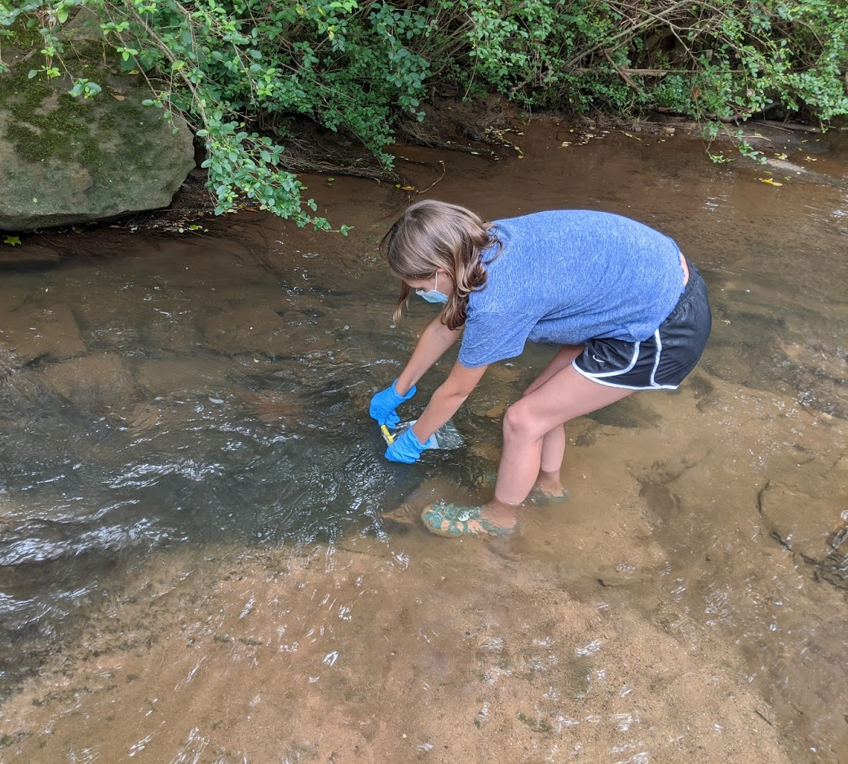
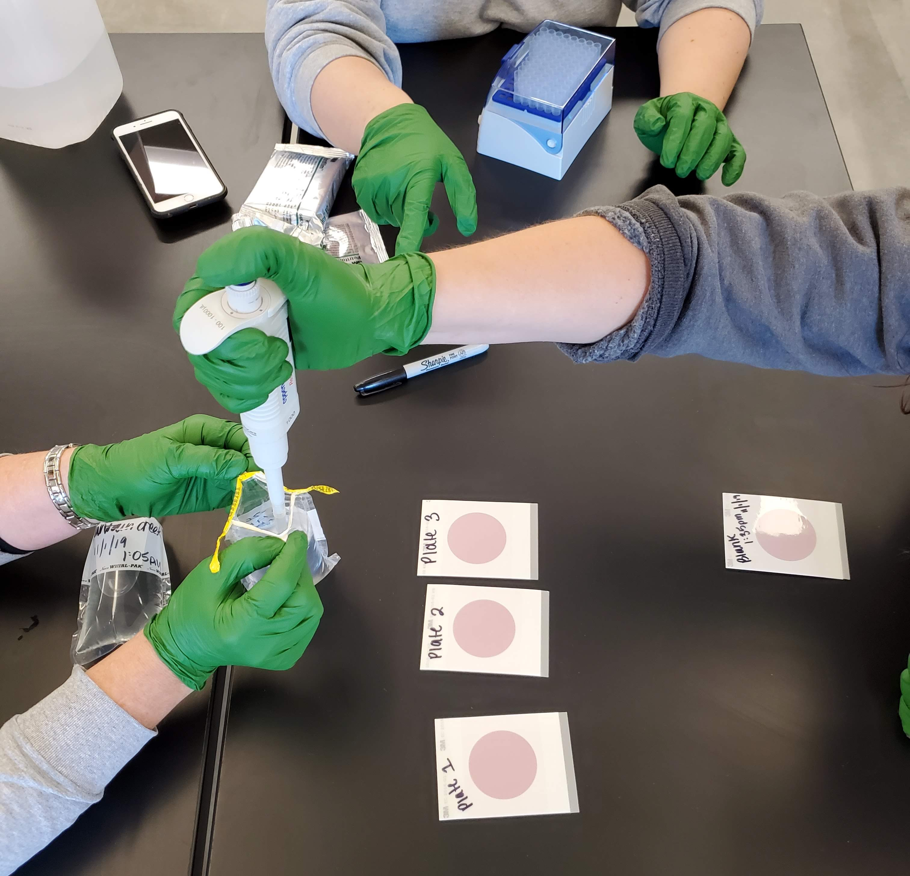
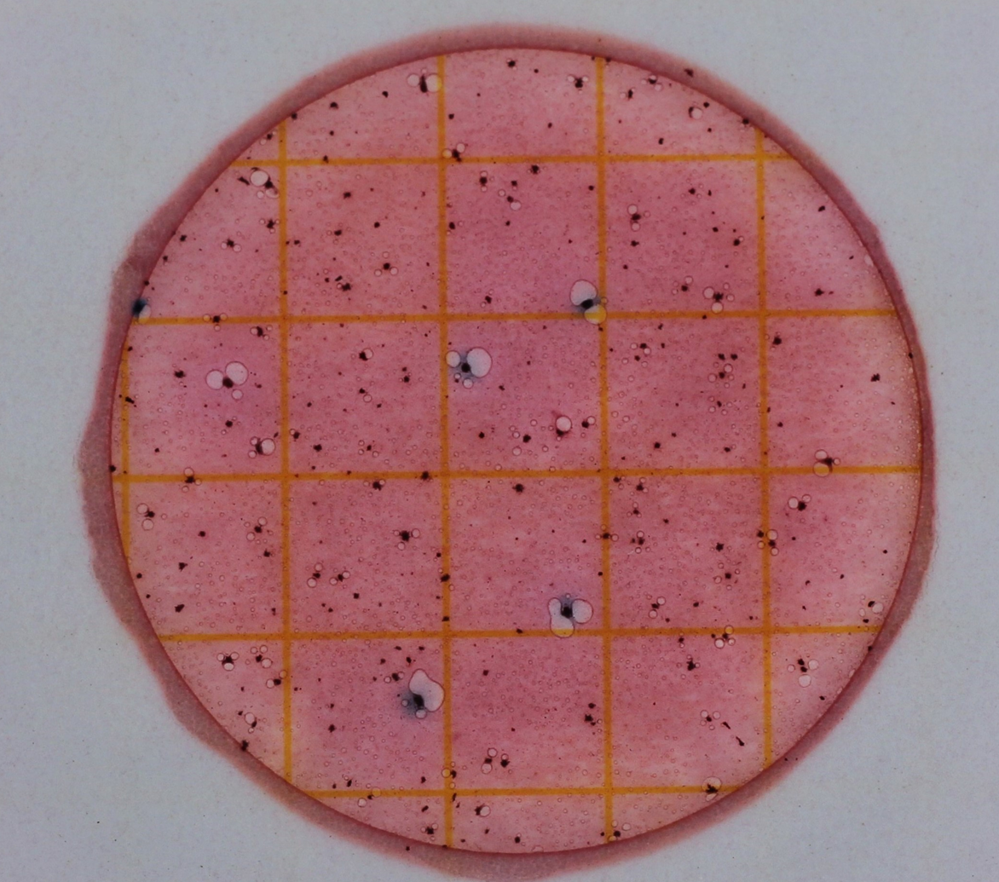
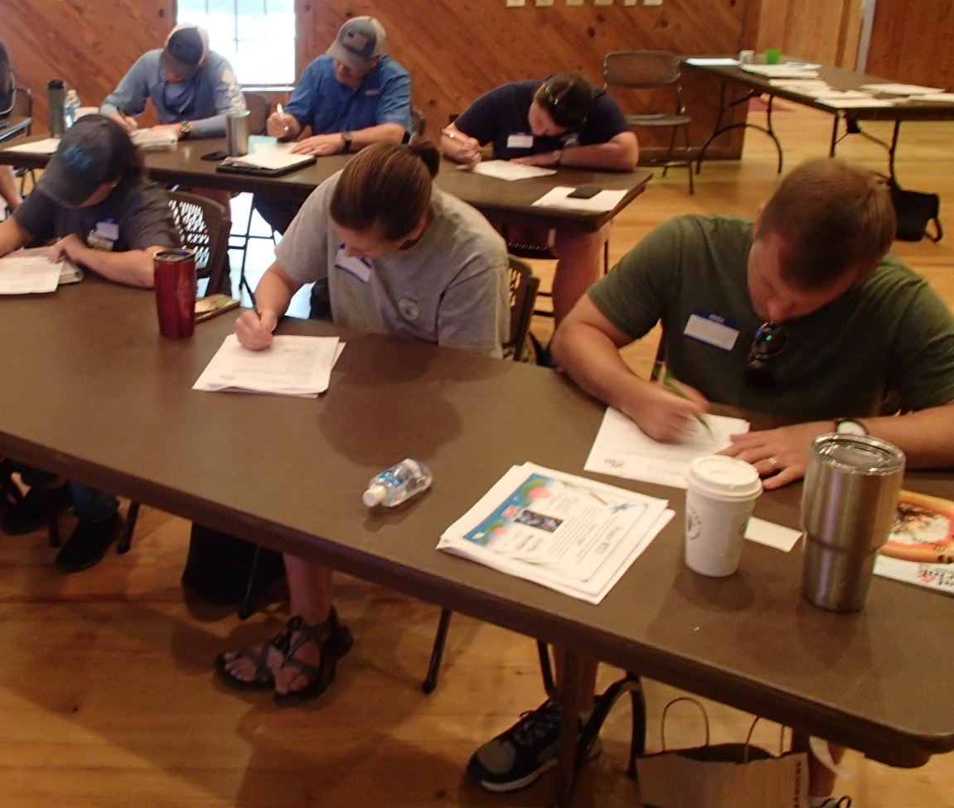
Earning your qa/qc bacterial certification
FIELD & LAB: ​
Volunteers must demonstrate how to properly collect and plate a sample​
WRITTEN TEST: ​
Volunteers must pass a written evaluation with a score of at least 80%​ and must correctly identify
E. coli colonies and calculate E. coli levels of example plates with accuracy of at least 90%
Notes:
To gain your certification, we will work our way through this PowerPoint of background information.
You will then use this information to collect and plate samples.
Following this hands-on practice, you will be given a test which you must pass with 80% and the ID portion must be passed with 90%

Slide 9
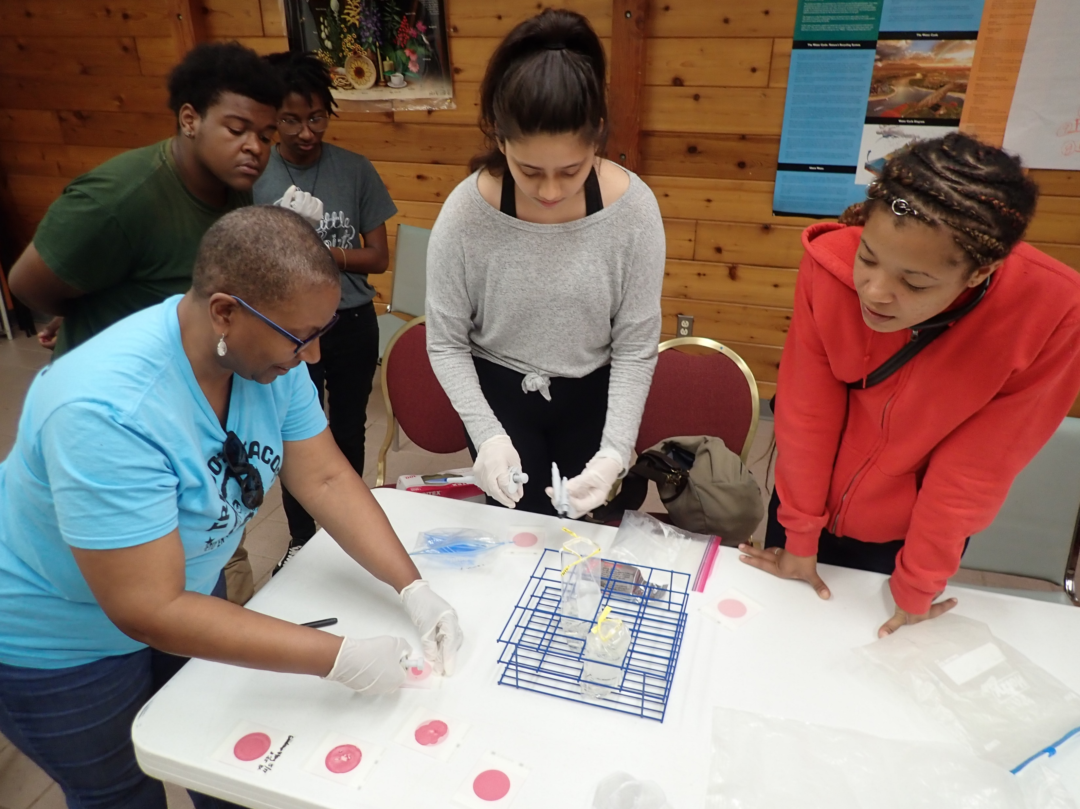
Why is bacterial monitoring important?
Monitor bacterial contamination of surface waters to assess if pathogens are present
Human health is at risk when in contact with waters that contain harmful bacteria
Gaining a snapshot of surface water contamination (E. coli colonies), not long-term trends
Notes:
Monitoring for E.coli can be extremely informative as it can indicate when human health (and potentially ecosystem health) is at risk ​ ​
More info about E. coli and the significance of indicator bacteria will be on slide 11
Pathogens= any microorganisms that can cause disease, will go into more detail in the next slide
This type of monitoring involves collecting, plating, and counting E. coli colonies​
Bacterial monitoring only provides a snapshot of current water quality conditions, not necessarily long-term trends
​

Slide 10
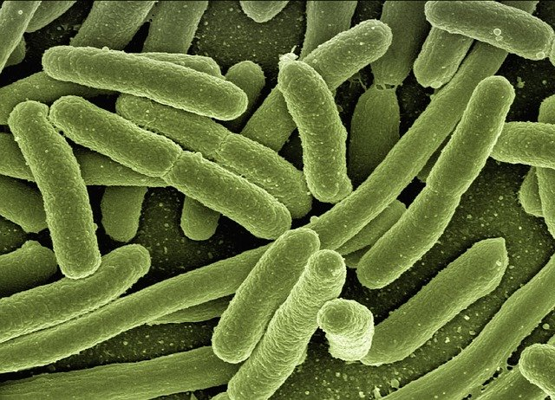
About Bacteria
Single-celled, living microscopic organisms
Pros:
Decomposition
Digestion
Nutrient Cycling
Pollution Control
Risks:
Release Toxins
Cause Disease (Pathogens)
Notes:
Bacteria- Single-celled, living microscopic organisms
There are more bacteria on Earth than any other living thing; they can be found EVERYWHERE!
Pros:
Decomposition: important part of the life cycle, break down organic matter and return nutrients to soil
Digestion: gut microbiome, bacteria in stomach help break down food
Nutrient cycling: nitrogen-fixing bacteria in soil take nitrogen from the atmosphere and turn it into a form that can be taken up by plants; can also refer back to decomposition
Pollution control: Bioremediation uses micro-organisms to reduce pollution through the biological degradation of pollutants into non-toxic substances
Cons:
Release toxins: soil bacteria release toxins in response to competition w/ other soil bacteria, can impact human health as a side effect
Pathogens: disease-causing bacteria, what probably comes to mind when you think of "bacteria"; negative impacts on human health due to replication; what we are focusing on during this workshop

Slide 11
What is e. coli?
Coliforms
Biological family of bacteria naturally found in the soil
Fecal Coliforms
Subgroup of coliforms, found in intestinal tracts of warm-blooded animals
E. coli
Subgroup of fecal coliforms
Notes:
This slide has animations
When monitoring for bacteria as a part of AAS, looking for the presence of E. coli specifically.
E. coli falls under umbrella of "coliform bacteria", broad classification, biological family of bacteria found in soil
Fecal coliforms- within coliforms, subgroup found in intestinal tracts of warm-blooded animals (humans, dogs, birds, deer, etc.), comes out in waste
E. coli- smaller subset, within fecal coliforms, make up about 60% of fecal coliforms, what we will be focusing on for the rest of the workshop

Slide 12
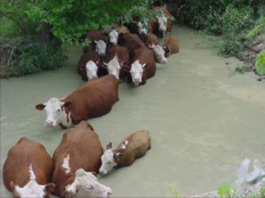
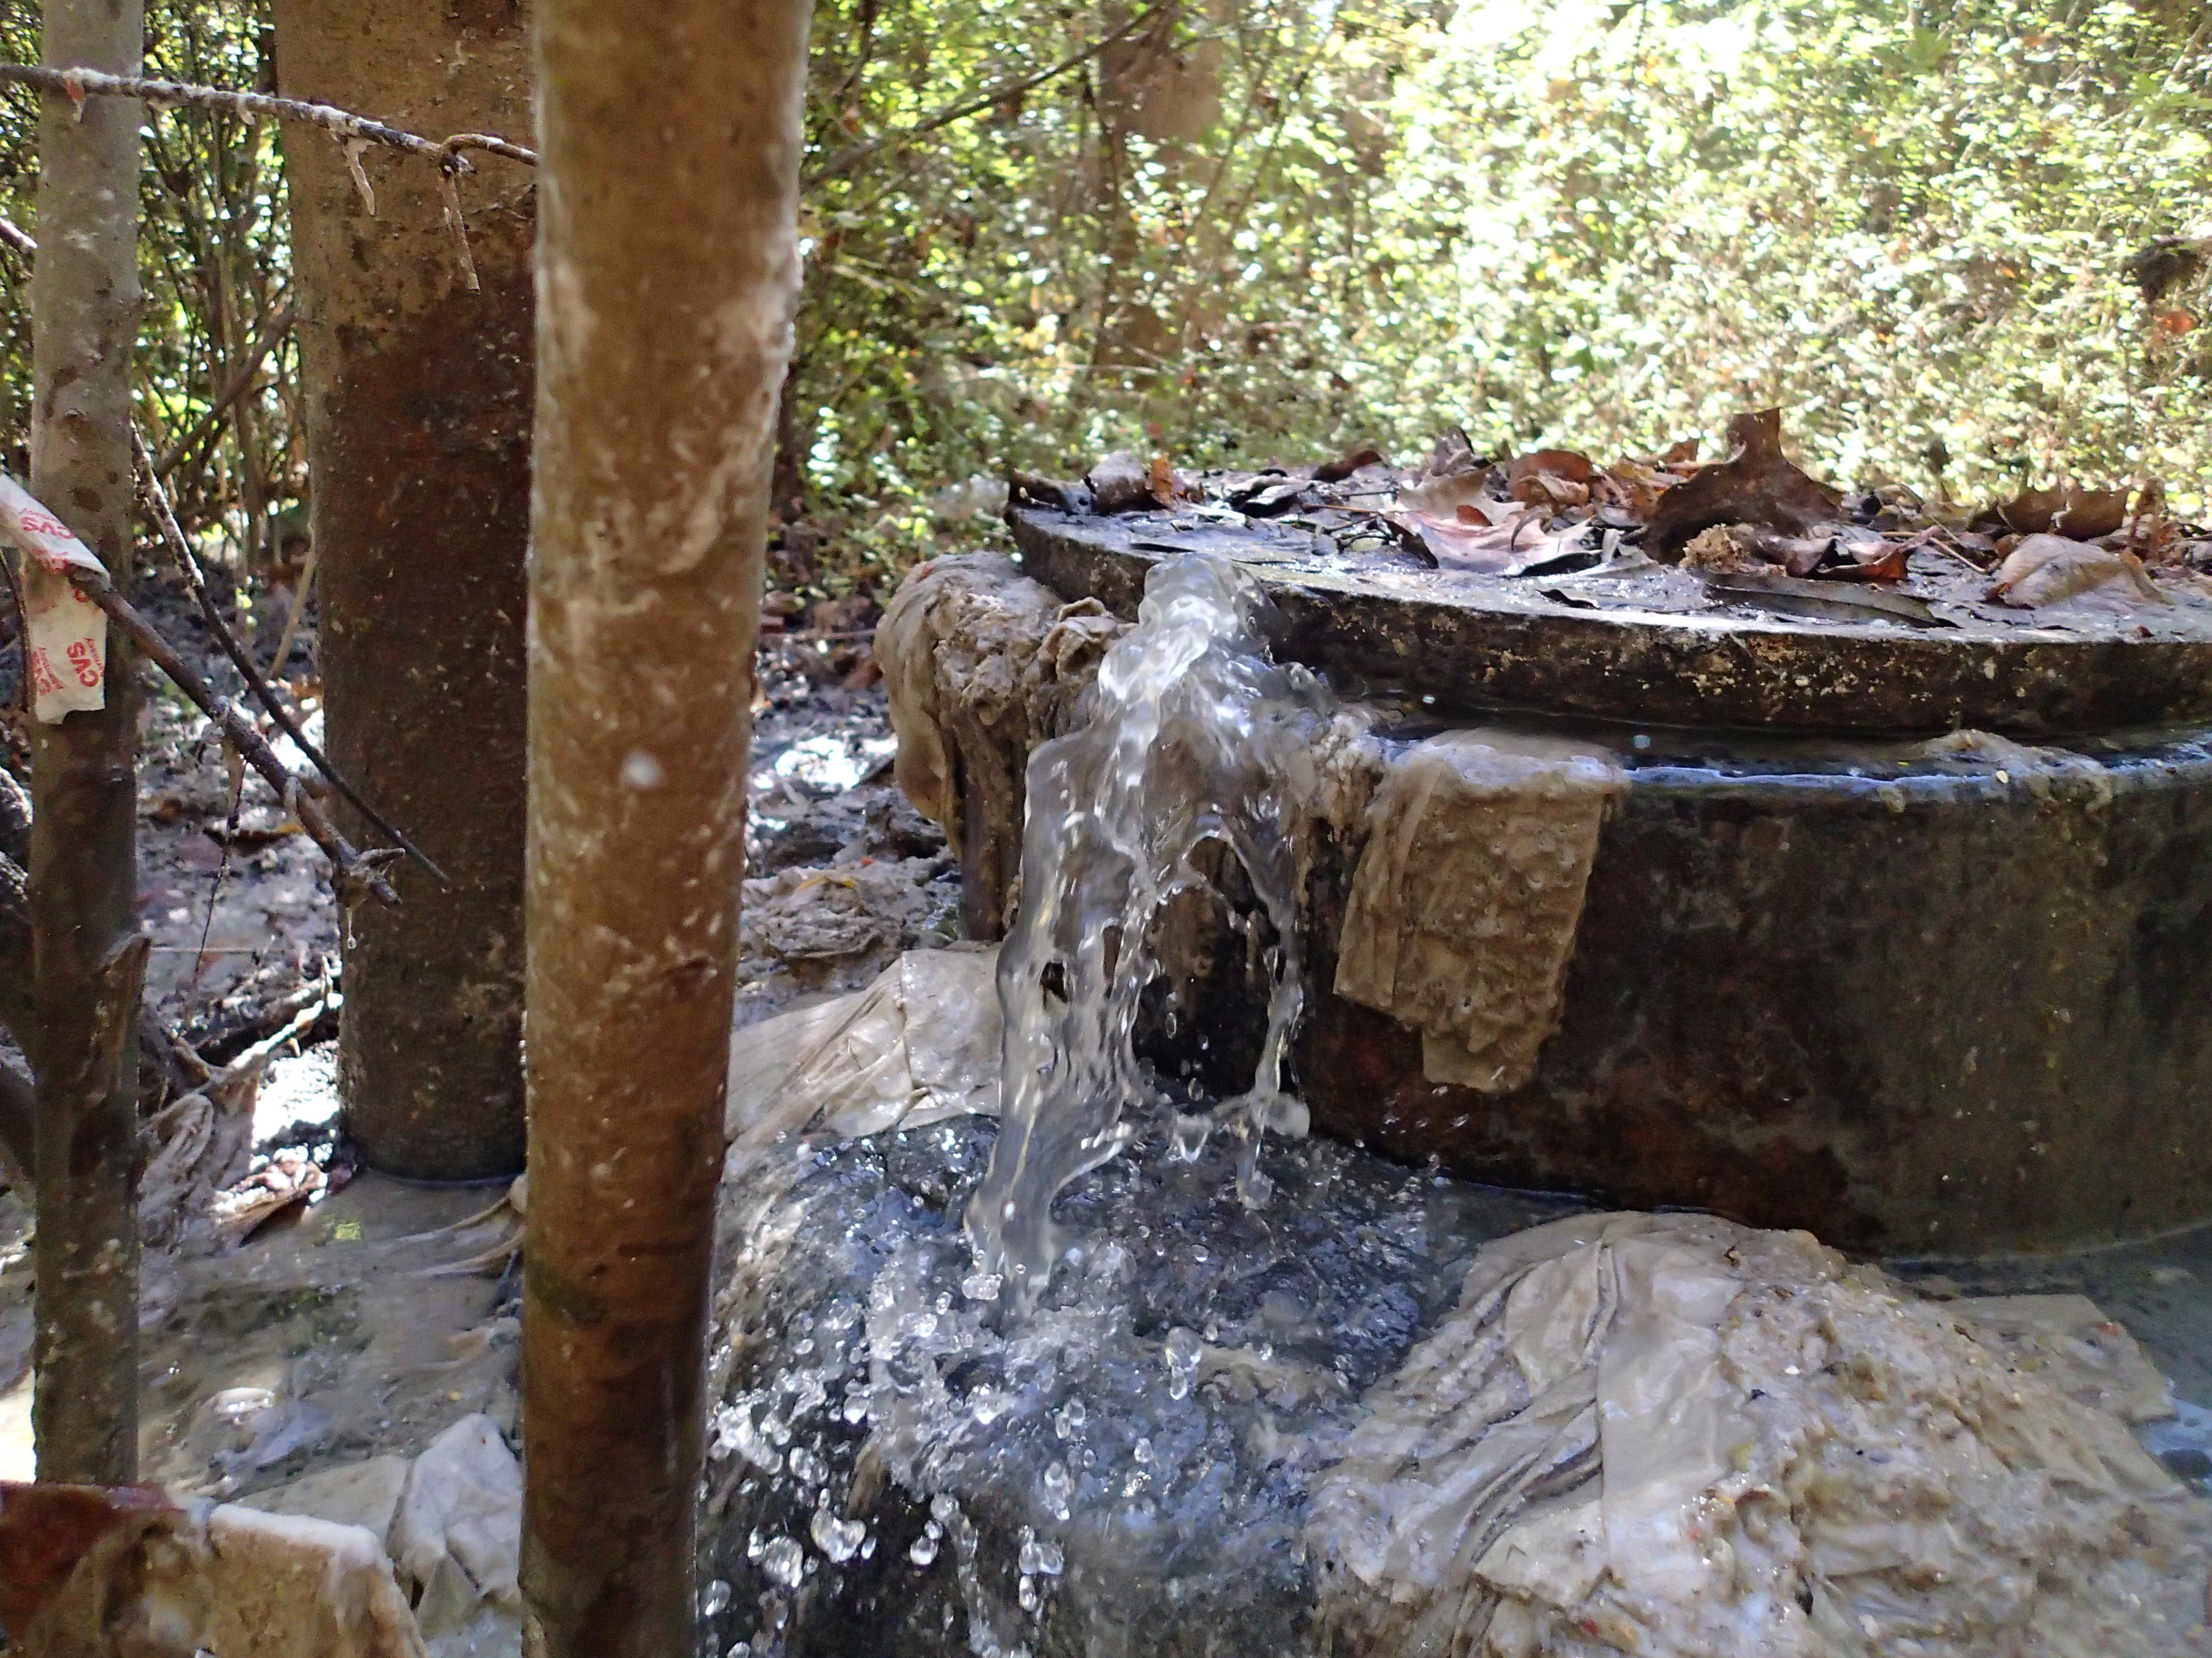
Why monitor for e. coli?
High levels indicate the possible presence of pathogens
Sources of E. coli in waterways:
Wildlife
Livestock
Urban storm runoff
Sewage
Leaking sewage pipes
Combined sewer overflow
Wastewater treatment plants
Failing septic systems
Notes:
E. coli = indicator species for pathogens. There are harmful strains of E. coli, but it is more commonly used to indicate the possible presence of pathogens (especially when found in high levels).
It is not practical to test drinking water for every type of pathogen, but the methods are well developed to test drinking water for E.coli bacteria.
Sources:
Wildlife
Any warm-blooded wild animal can release E. coli into the stream via waste.
Avoid taking samples directly in the same areas as wildlife (geese, for example) because you might receive false high readings (this may be unavoidable, but try to get a representative sample of the whole stream)
Livestock
Streams that run along pastures can receive run-off containing manure
Sometimes cattle will wade directly in the stream and release waste (refer to photo)
Urban storm runoff
Stormwater flows over sidewalks and roads, can contain pet waste and other contaminants.
Note that storm drains flow directly to streams, not to waste water treatment plants
Sewage
Leaking sewage pipes
Untreated sewage going into stream. If this is found, call local water authorities ASAP
Combined sewer overflow
Combined sewer systems carry raw sewage and small amounts of rainwater to wastewater treatment plants; however, large rain events can cause these systems to overflow, allowing raw sewage to enter waterways directly
Wastewater treatment plants
Treated and/or partially treated wastewater discharged from the wastewater treatment plant. Treatment plants have discharge permits with numeric limits for bacteria, however the limit is not zero hence they are a source.
Failing septic systems
Also untreated sewage
Septic failures often intermittent, making them hard to track; can lead to an unexpected high bacteria count
If on septic, be sure to get serviced every 3-5 years. That is the standard guidance from Environmental Health and Metro District.
Own examples if you have them

Slide 13
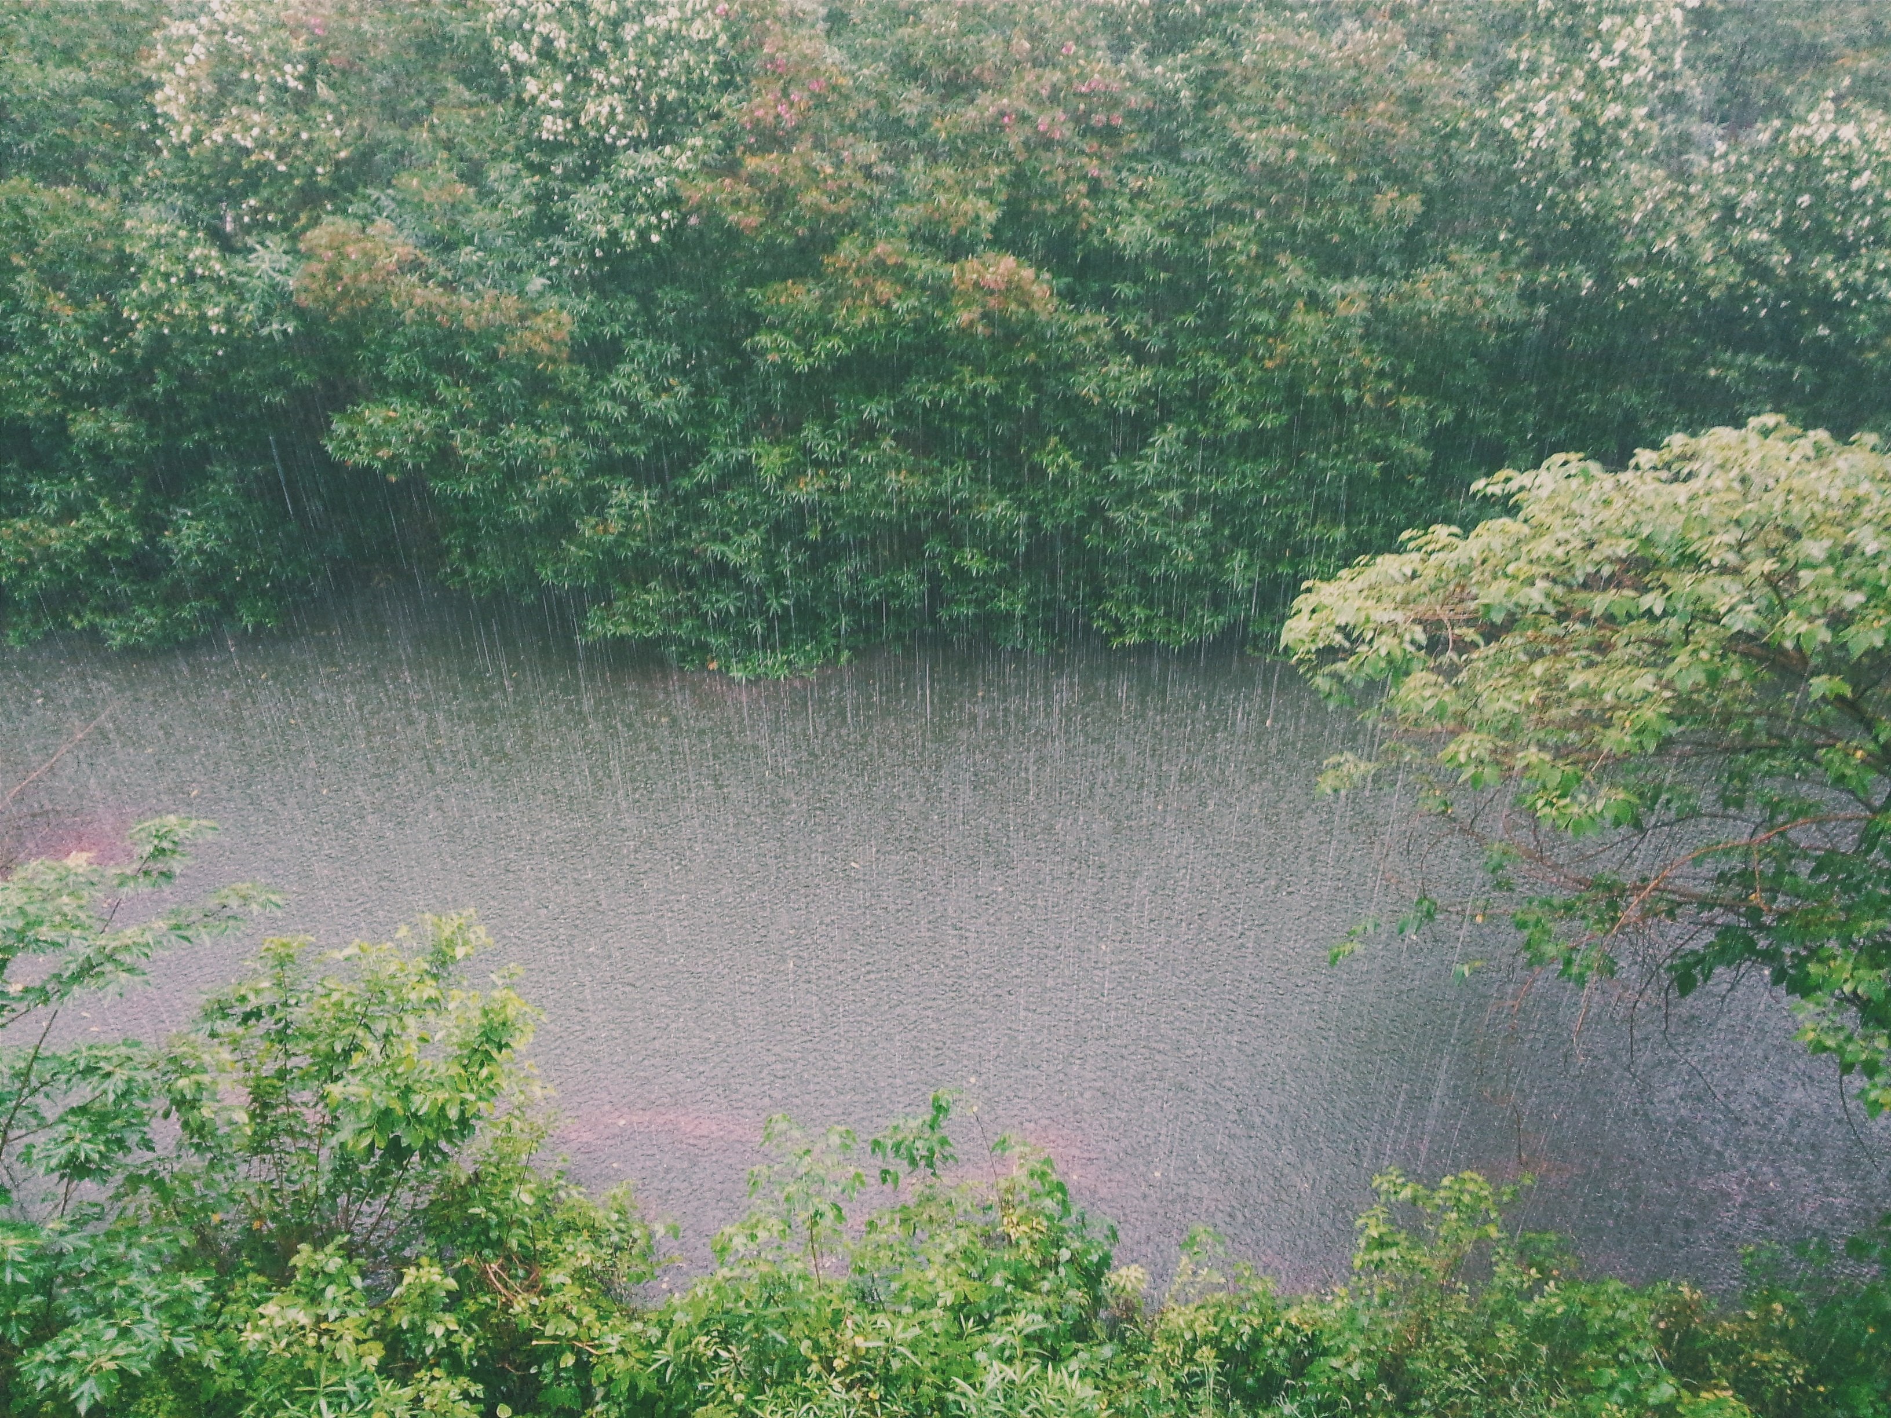
Factors Influencing E. COLI counts
Weather:
Higher levels following a rainstorm or heavy runoff event
Avoid sampling during high flow
Season/Temperature:
Warmer water temperature = higher E. coli replication rates
Colder water temperature = lower E. coli replication rates
Notes:
Strong correlation between E. coli levels and recent precipitation levels.
High levels present after rainstorms or heavy runoff events, since everything that was present on the land (from dog parks, cattle pastures, etc) will get washed away into the stream.
Avoid sampling during high flow (safety)
Replication rates higher when water temp is warmer
Higher counts in the summer compared to the winter
True for most bacteria species; think about food kept in refrigerator vs in a hot car (the food in the hot car will spoil faster)

Slide 14
Where, when, and how often?
Where to monitor:
Well mixed, flowing area of water
Same site location
When to monitor:
Normal flow conditions
Same time of day
How often to monitor:
Once a month
Notes:
Where:
Monitor in well mixed, flowing area. Be sure to avoid the streambed and any sediment when collecting your sample.
Bacteria tend to settle on the streambed, so be sure not to disturb before collecting.
Don’t collect right on the surface of the water, if possible, as this can be warmer than the stream as a whole. Bacteria also like to be warm!
Aim to monitor in the same site location each time, if possible, to ensure comparable data
When:
Precipitation and flooding events can drastically affect the bacteria counts in waterways. Therefore, also try to monitor during normal flow conditions, as this helps establish baseline conditions
Aim to monitor the same time of day each time, if possible, to ensure comparable data.
How often:
AAS recommends volunteers monitor once a month for bacterial contamination
Can be more, and should sample again if you find a spike in counts (will discuss later in ppt)

Slide 15
How to Monitor for e. coli
Notes:
Let's get into how to monitor for E. coli! Protocol broken down into 7 steps...

Slide 16
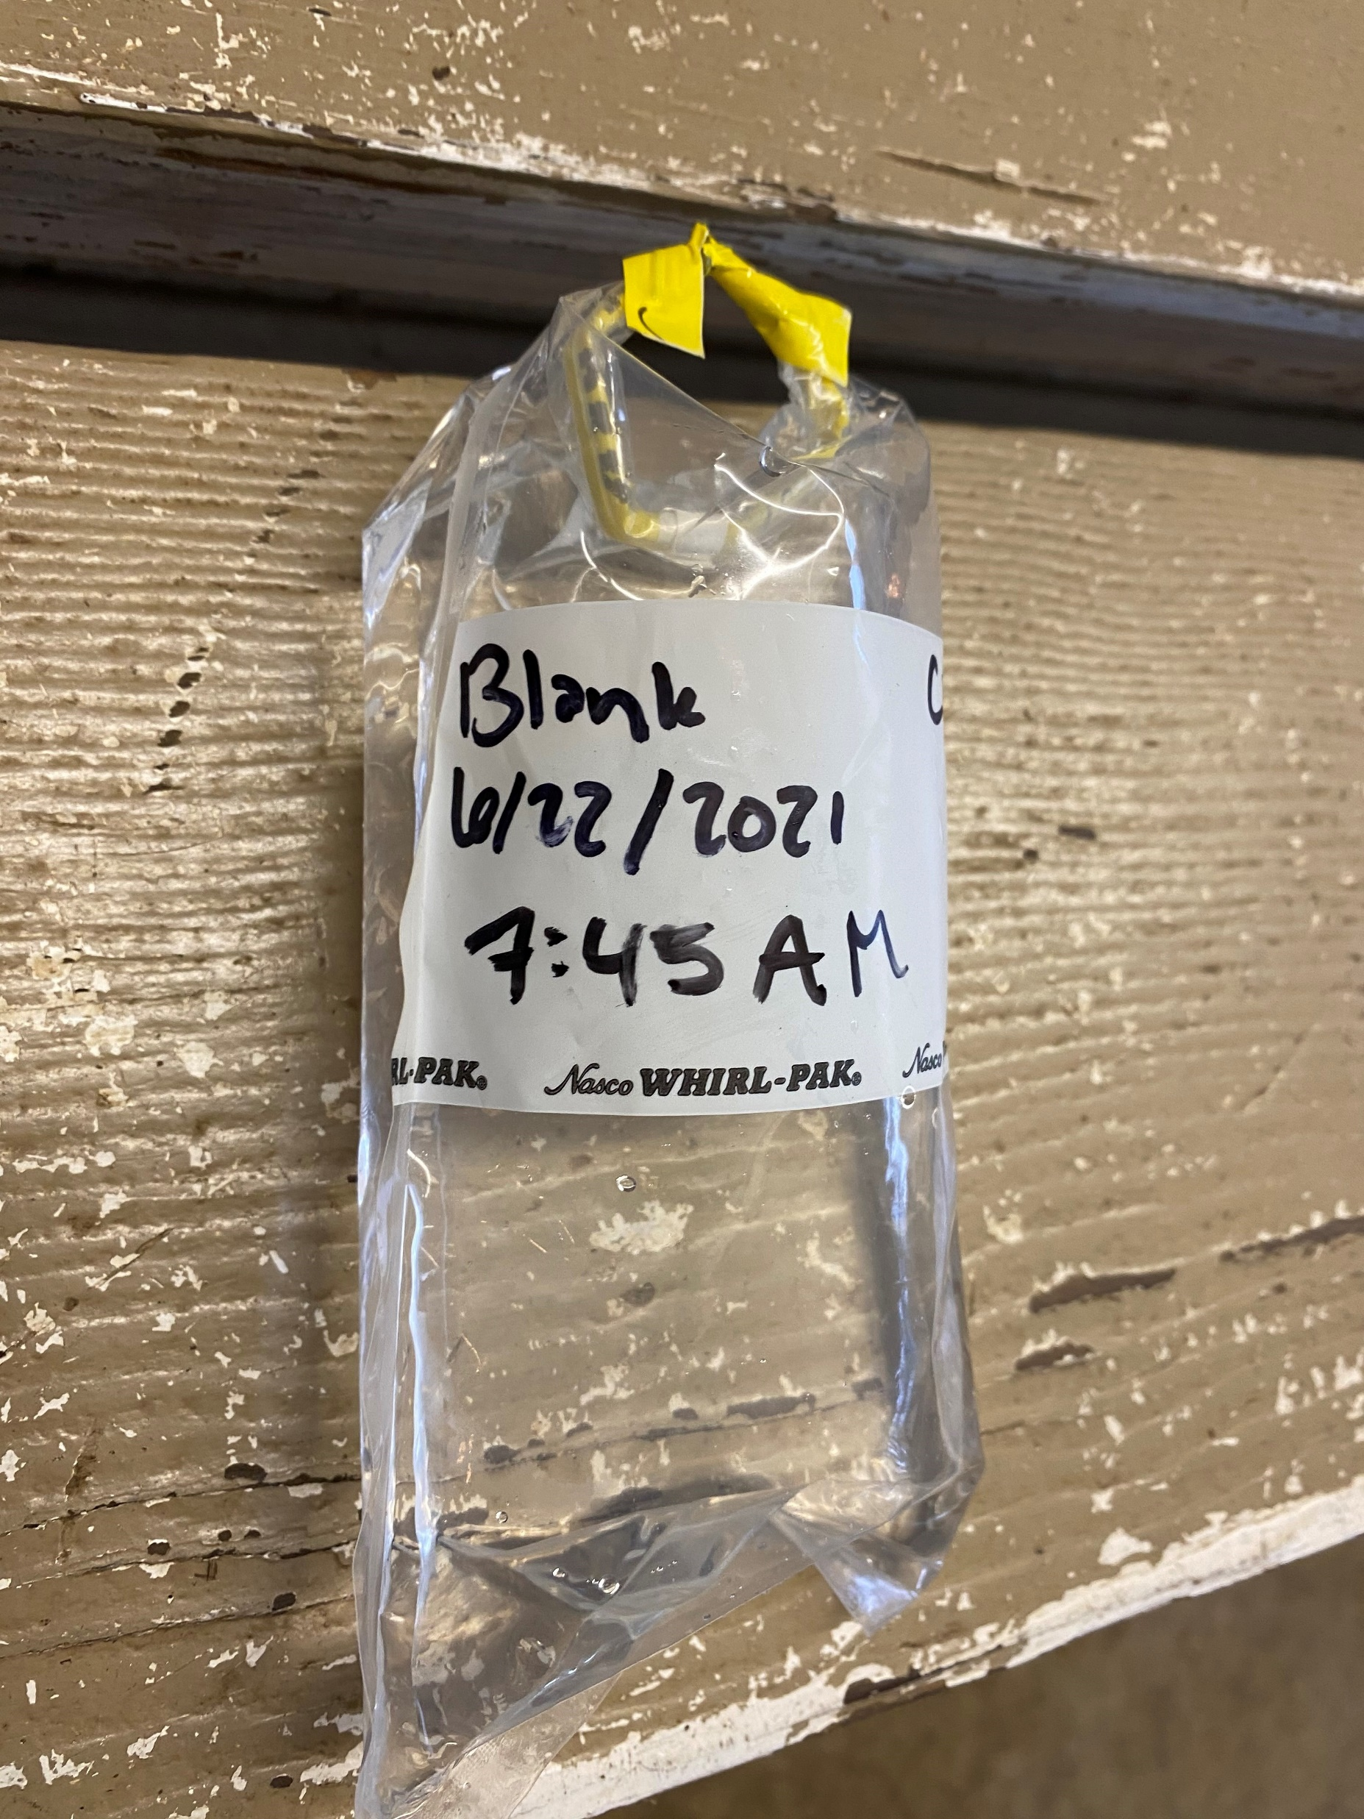
Step 1: Prepare the blank/control
Proves no contamination occurred during sample collection, transport, or plating
How to prepare a blank:
Label Whirl-pak® bag as a blank
Put gloves on and remove perforated seal
Use small white tabs to open the bag
Fill the bag 2/3 up with DISTILLED WATER
Whirl!
Place in sanitized cooler with ice
Notes:
First step- prepare the blank/control.
Blank will be held under the same conditions as the samples from site but only contains distilled water.
There should be no bacteria of any kind present on your blank- if there is, there has been some form of contamination. Must discard all samples and redo sampling.
(proceed through steps of preparing a blank on slide)
Notes:
Blank can be prepared at home and immediately placed in sample cooler or be prepared in the field.
However, all samples, including the blank, must be processed within 24 hrs of collection, so be conscious of time constraints when choosing method.
Label should include "Blank", date, and time
Whirl-paks are sterile, so do not touch the inside of the bag with anything, not even your gloves or the distilled water jug
Place blank in cooler
Cooler will also hold the samples from your site(s)
Only need 1 blank/cooler, but can have samples from multiple sites in same cooler

Slide 17
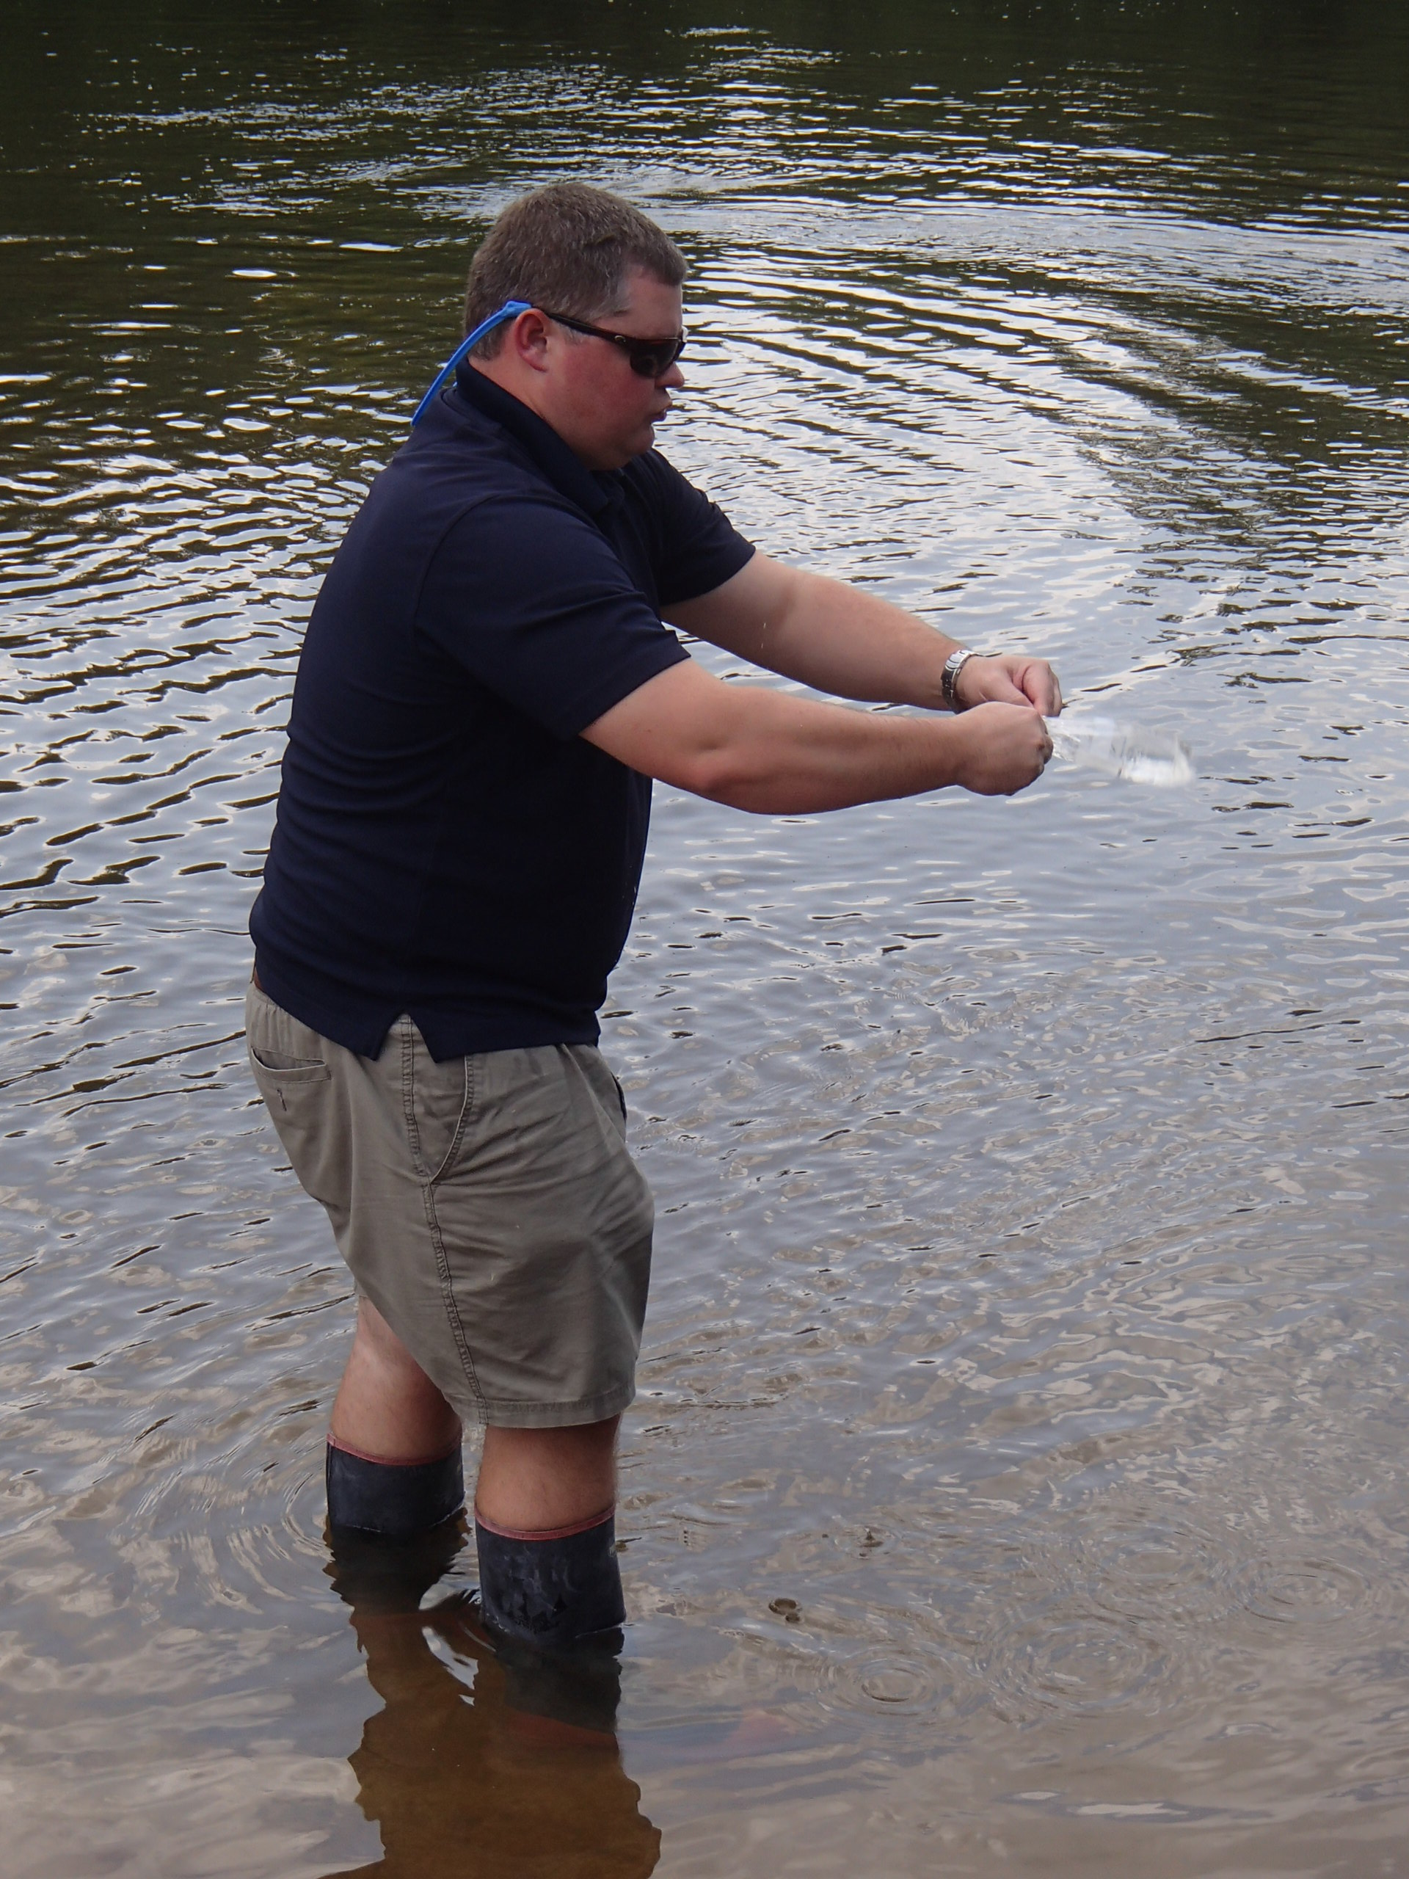
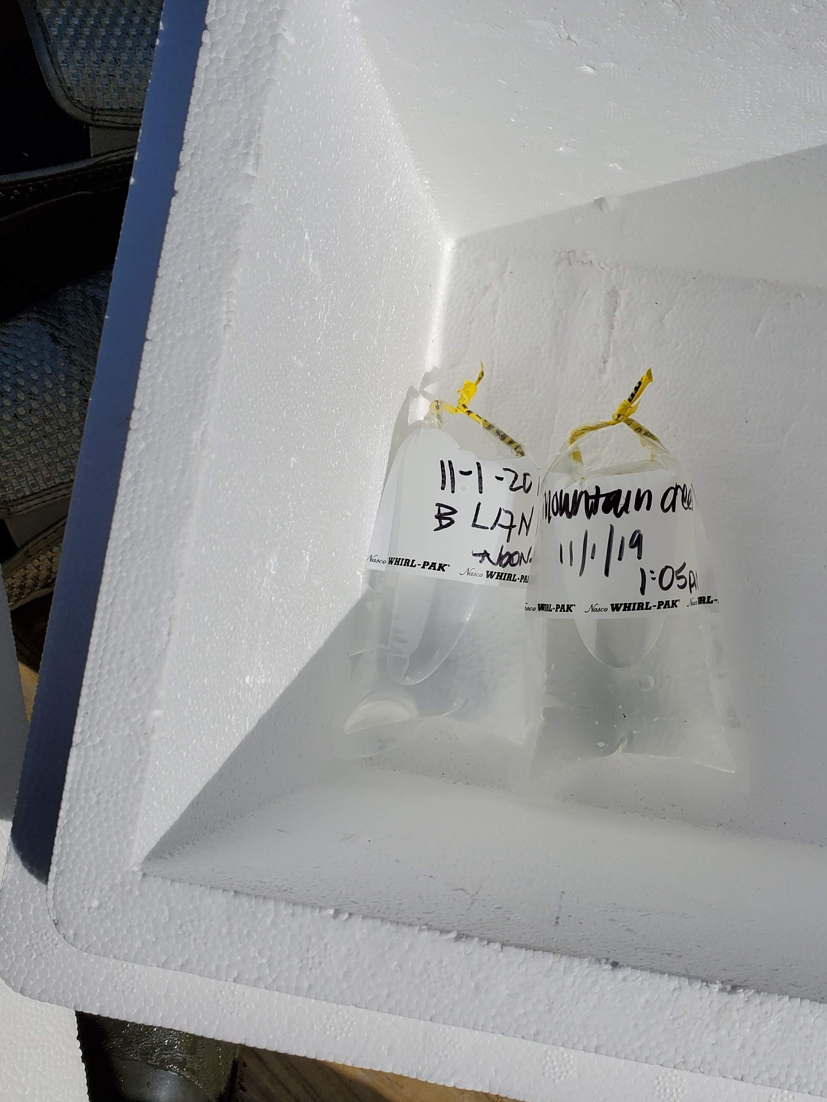
Step 2: Collecting a sample
Label a Whirl-pak® bag with the location, date, and time
Use same procedure as blank to open
Fill Whirl-pak® 2/3 with stream water (collected upstream) and whirl!
Place sample in cooler immediately after collection
Ice prevents E. coli from replicating
Lid prevents UV rays killing existing bacteria
Plate within 24 hrs of collection
Notes:
Time to head out to your site!
Remember to bring the cooler with your blank.
Label the Whirl-paks with your site name, date, and time collected.
Use same process to open as with the blank (gloves on, tear perforated seal at the top, and open using white tabs).
Face upstream when sampling (because the water downstream of you has been impacted by your presence) and scoop water from your site while holding on to the yellow tabs.
Whirl away from your face!
Place in cooler with blank.
Cooler must contain ice to prevent bacteria from replicating (recall info about higher temperatures breeding bacteria), therefore preserving the sample
Also must have a lid because UV rays can kill existing bacteria.
Plate within 24 hours of collection.
Note: If sampling multiple sites, you can have multiple samples in one cooler. However, if you are using multiple coolers, you must have a blank in each cooler.
Ask if anyone is planning on sampling 11+ sites- if so, they will need 2 blanks and 2 coolers (only 10 sites per cooler)

Slide 18
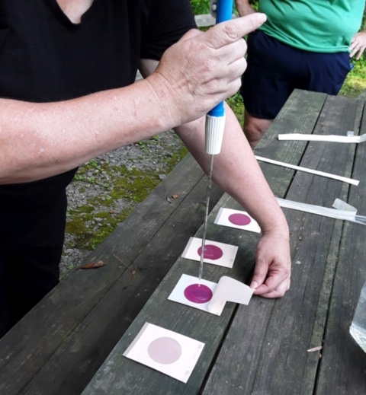
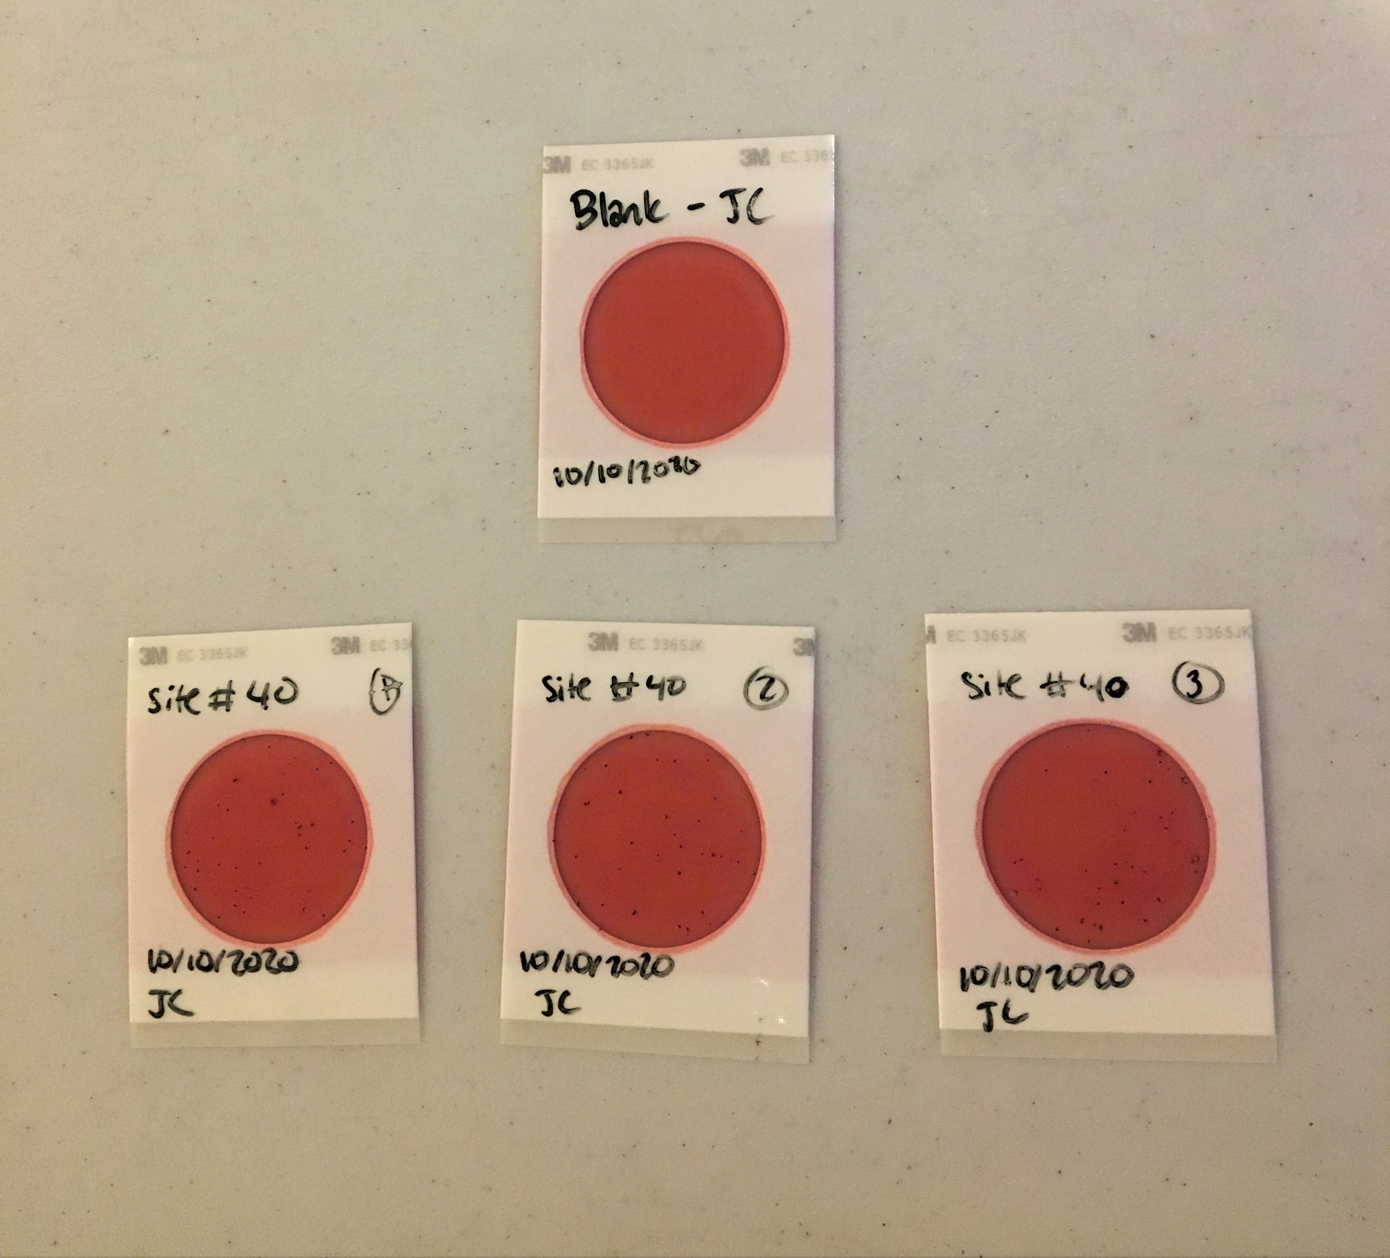
Step 3: plating your sample
Clean area with disinfectant
Invert Whirl-pak® to mix sample
Label 3M Petrifilm plates
Date and time
Site name
Blank, Plate 1, Plate 2, Plate 3
Use pipette to take one 1 mL sample from the blank, plus three 1 mL samples from the stream water (4 plates total)
Notes:
Wearing gloves, disinfect work area.
Invert Whirl-pak to mix sample (settling can occur).
You will be using 3M Petrifilm to plate your samples, which has a special medium to detect E. coli.
Check expiration dates on Petrifilm!
Label 3M Petrifilm plates
Will have 3 plates for each sample, plus the blank.
Label them with the date and time, site name, and then plate 1, plate 2, and plate 3 (or for the blank, "Blank"). (Refer to bottom photo)
Plating samples
Use a pipette to take a 1 mL sample from your blank and place it on the Petrifilm
Be sure to discuss pipette functionality during practical portion (2 stops)
Slowly lower the cover over the plate (refer to top photo).
Move on to plating stream water samples the same way
Reminder- will have 3 plates for each site, plus the blank (a total of 4 plates) (refer to bottom photo again)
Always plate blank first, then samples to avoid contamination
Notes:
If using multiple coolers, indicate which cooler each blank belongs to in label
Only need to plate the blank once if all sites in the same cooler (i.e. if you have 2 site samples in one cooler, you will have 7 plates- 3 from each site plus 1 blank)

Slide 19
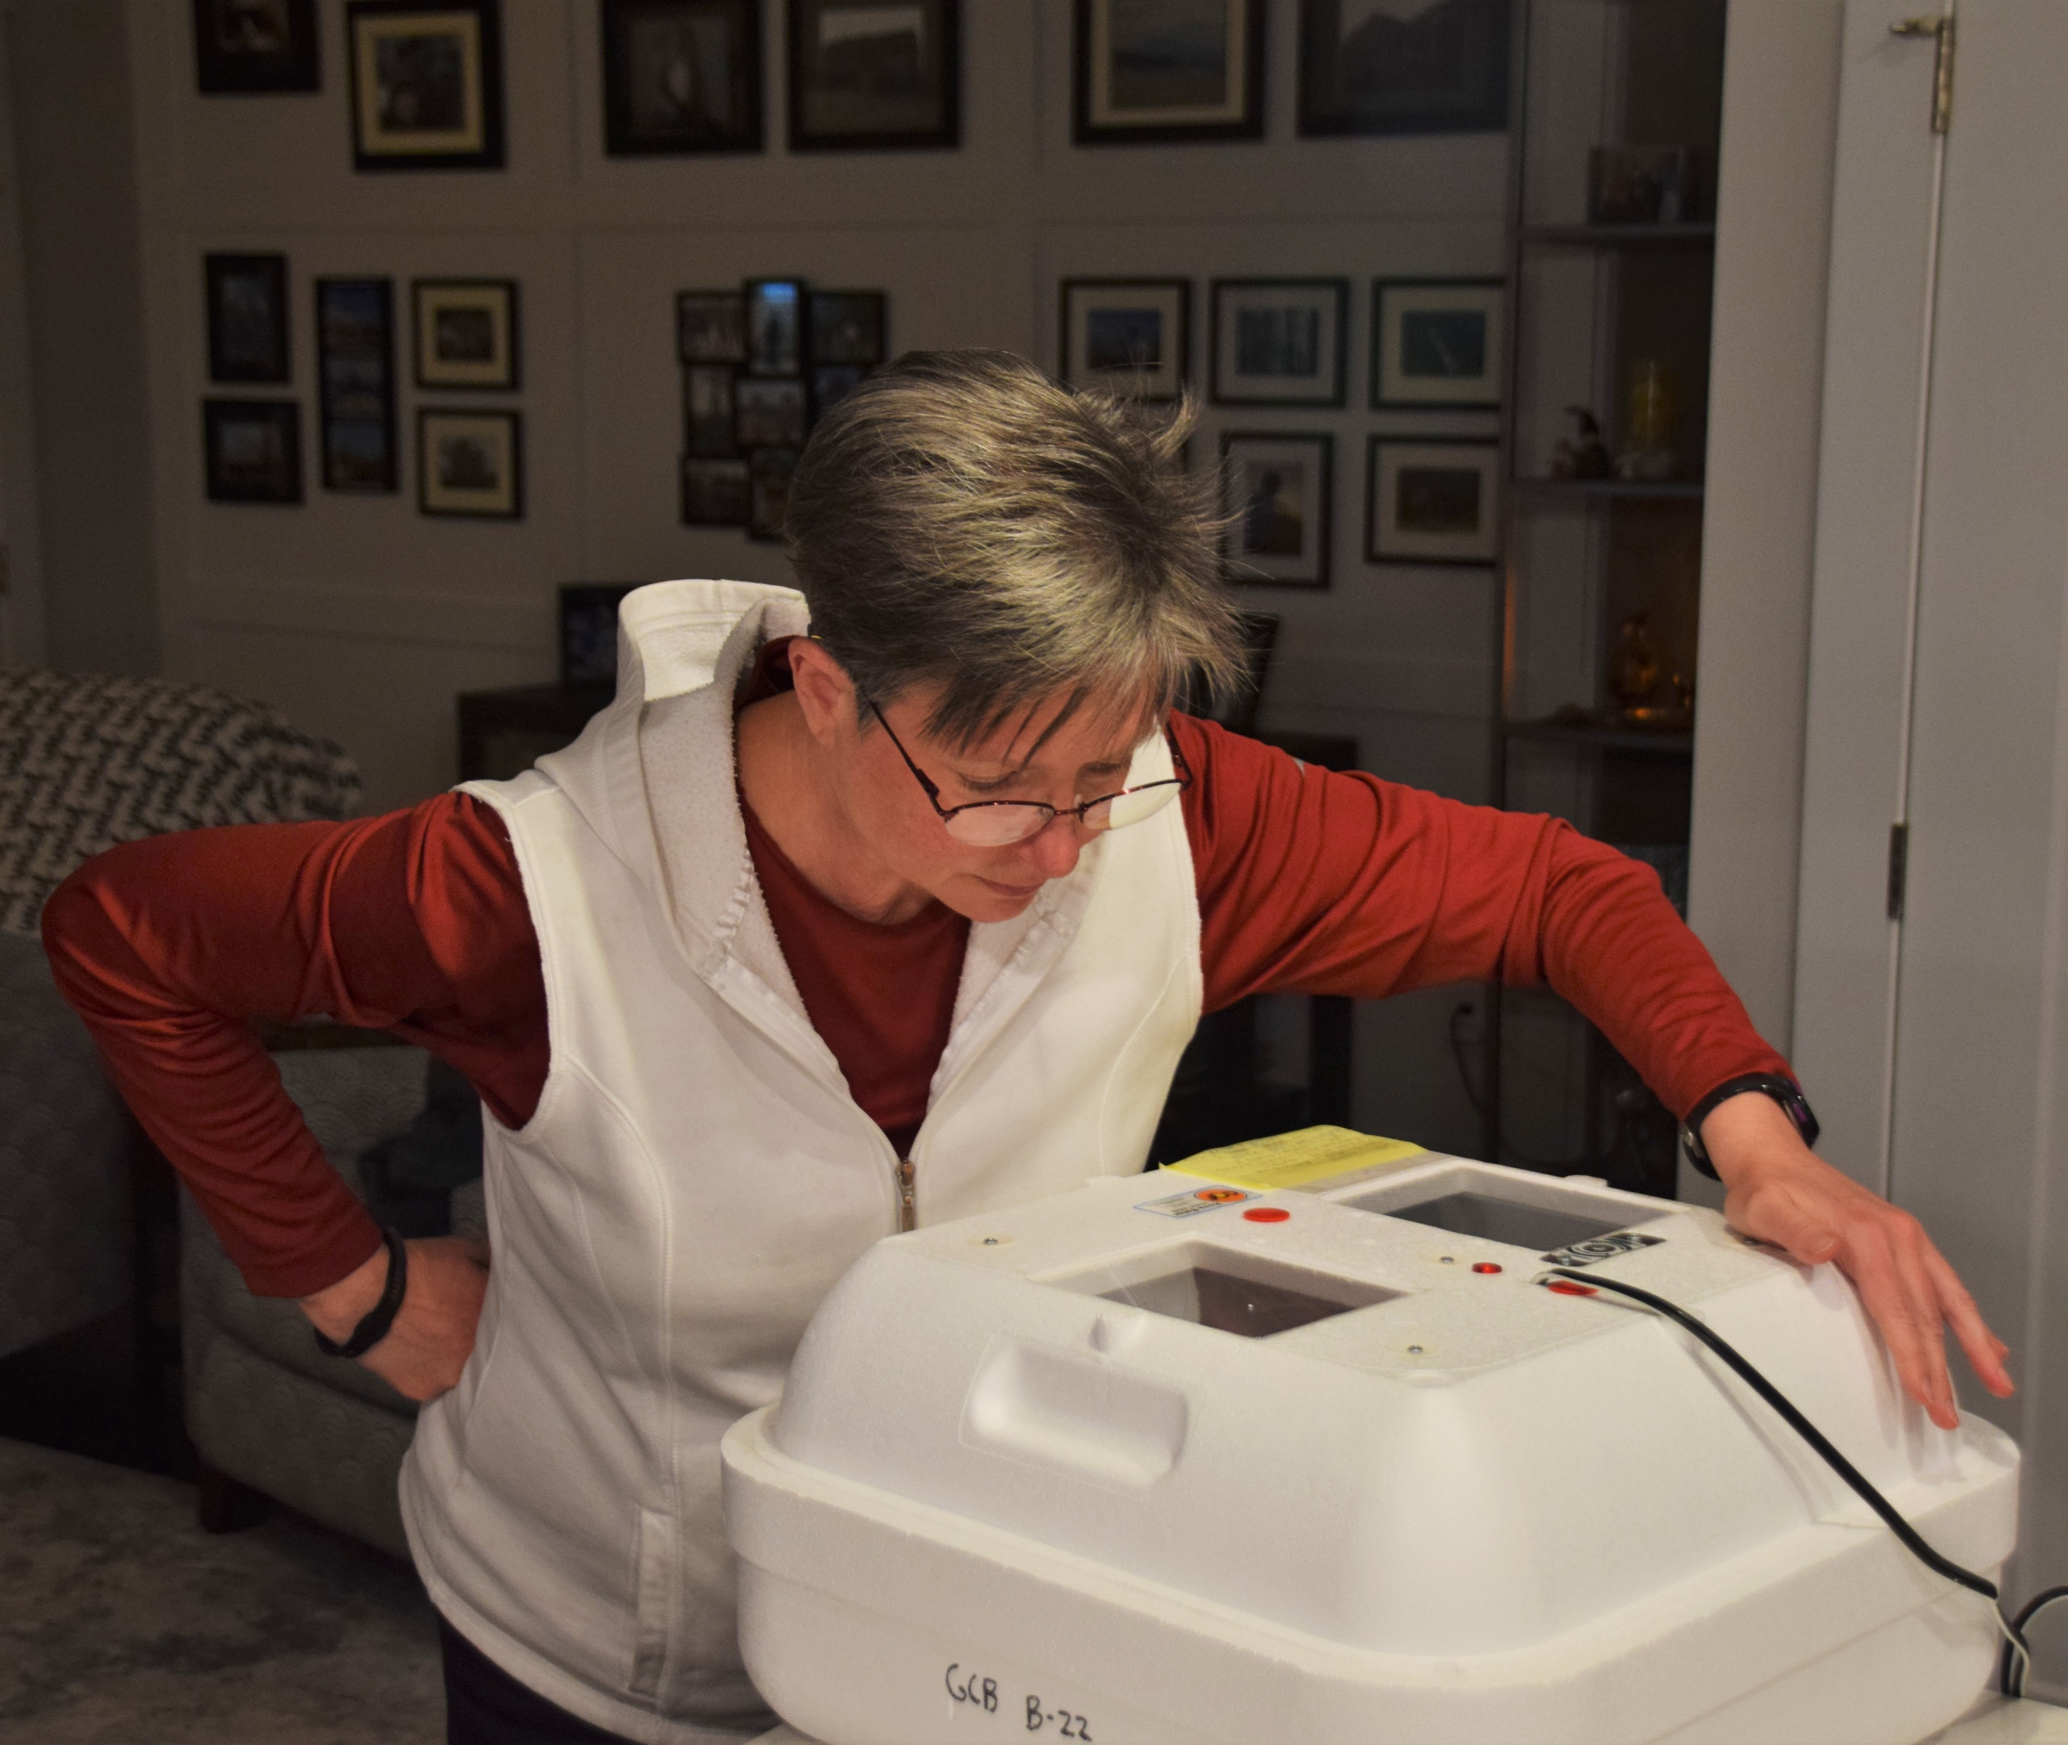
Step 4: Incubating your sample
35°C ± 1°C for 24 hours ± 1 hour
Check minimum and maximum temperatures after incubating
Use AAS or EPA approved incubator
Notes:
Use an AAS or EPA recommended incubator to incubate the plates.
Preheat incubator to 34-36 degrees Celsius, then place plates into incubator.
Leave for 23-25 hours
Make note of time on separate sheet or on plates
Check the min and max temperatures after incubating to ensure it didn't go outside the range of 34-36°C .
Tips:
Test out using incubator beforehand to get a feel for how it works (can be temperamental)
Wait to reset min and max temperature on thermometer until the temp has stabilized from putting the plates in (opening and closing the incubator)

Slide 20
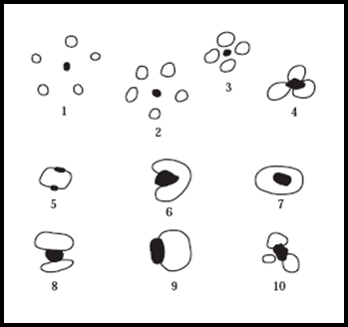
Step 5: Reading your results
Only count blue colonies with gas bubbles
Do not count colonies growing more than halfway off the medium
Units for bacteria: Colony Forming Units (CFU)/100 mL
Possible gas bubble patterns
Notes:
After incubating for 24 hours, it's time to read the results.
E.coli grows on the Petrifilm and forms colonies
We are only counting blue colonies with a gas bubble, as these represent viable E. coli colonies (emphasize blue and bubble).
Red colonies may also appear on the slide, but these are just general coliforms (do not count!)
May also see blue colonies without a bubble (do not count!). These are not viable colonies.
Additionally, don't count if colony is more than halfway off the medium.
Final reading is going to be in terms of CFU/100 mL (CFU=Colony Forming Units)

Slide 21
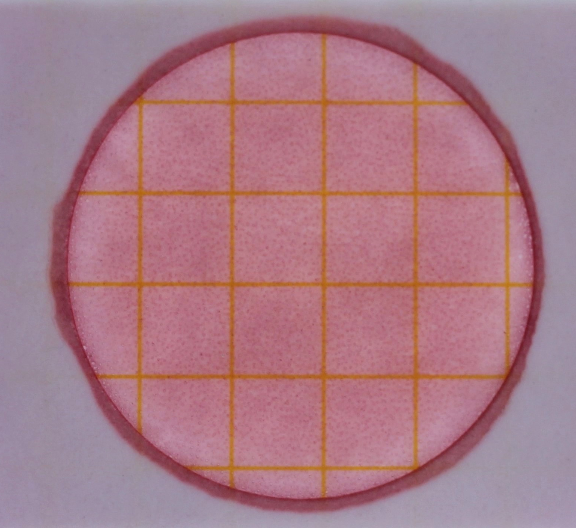
Blank/ Control
There should not be any colonies (E. coli or general coliform) on the blank!
Notes:
If any colonies appear on blank, sample is null and void, and new sample must be taken from site location
(note that text on this slide is bolded)

Slide 22
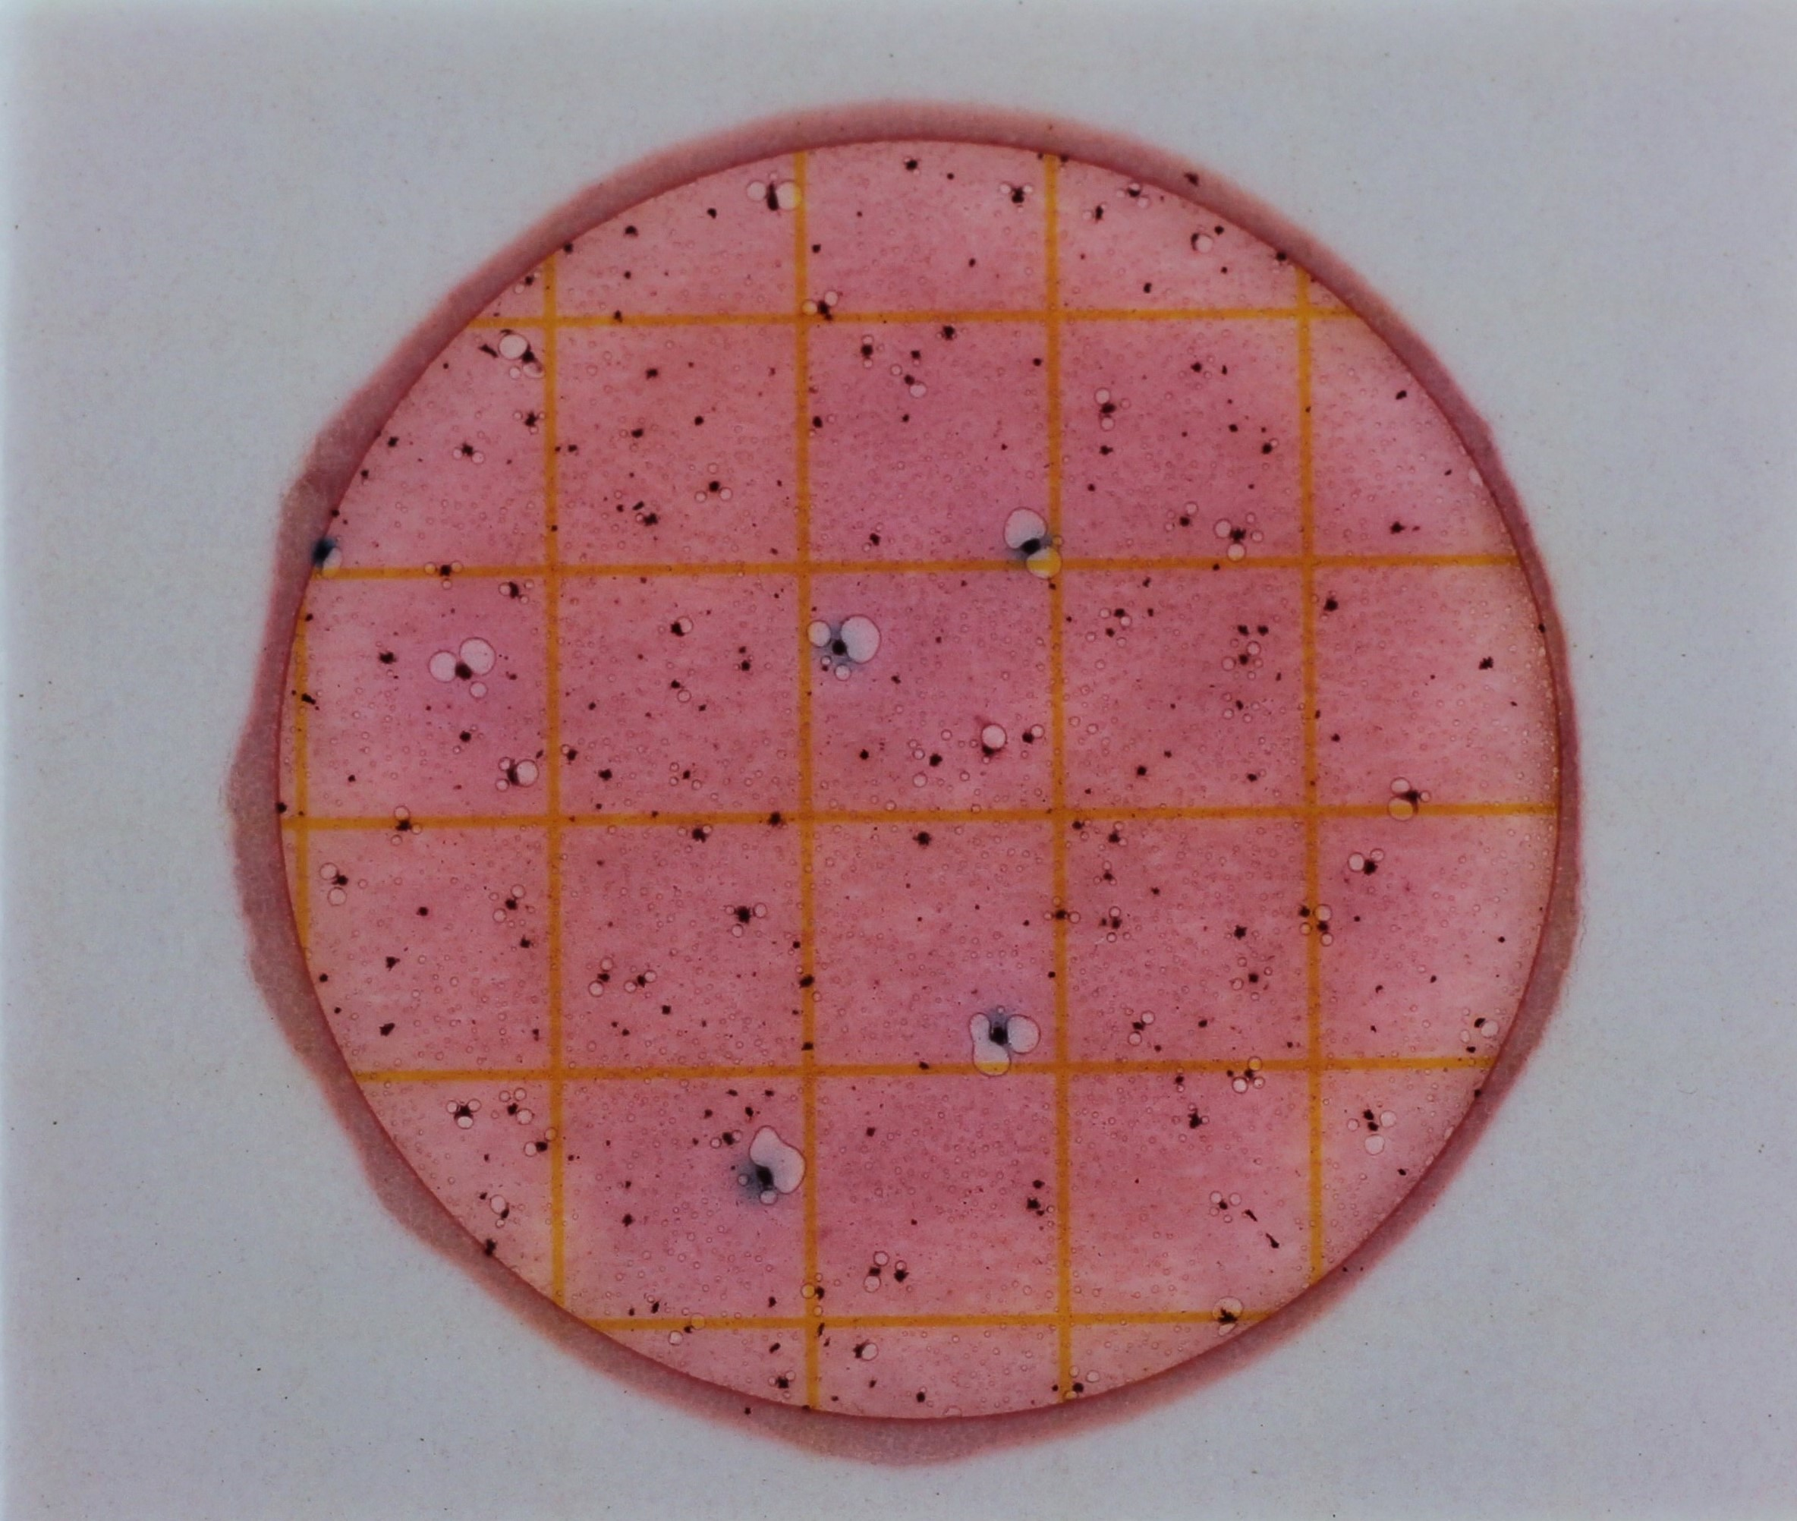
Example #1
How many E. coli colonies do you see?
Notes:
All of the following count slides have animations to show the E. coli colonies. Wait for volunteers to count before displaying results.
Answer: 5

Slide 23
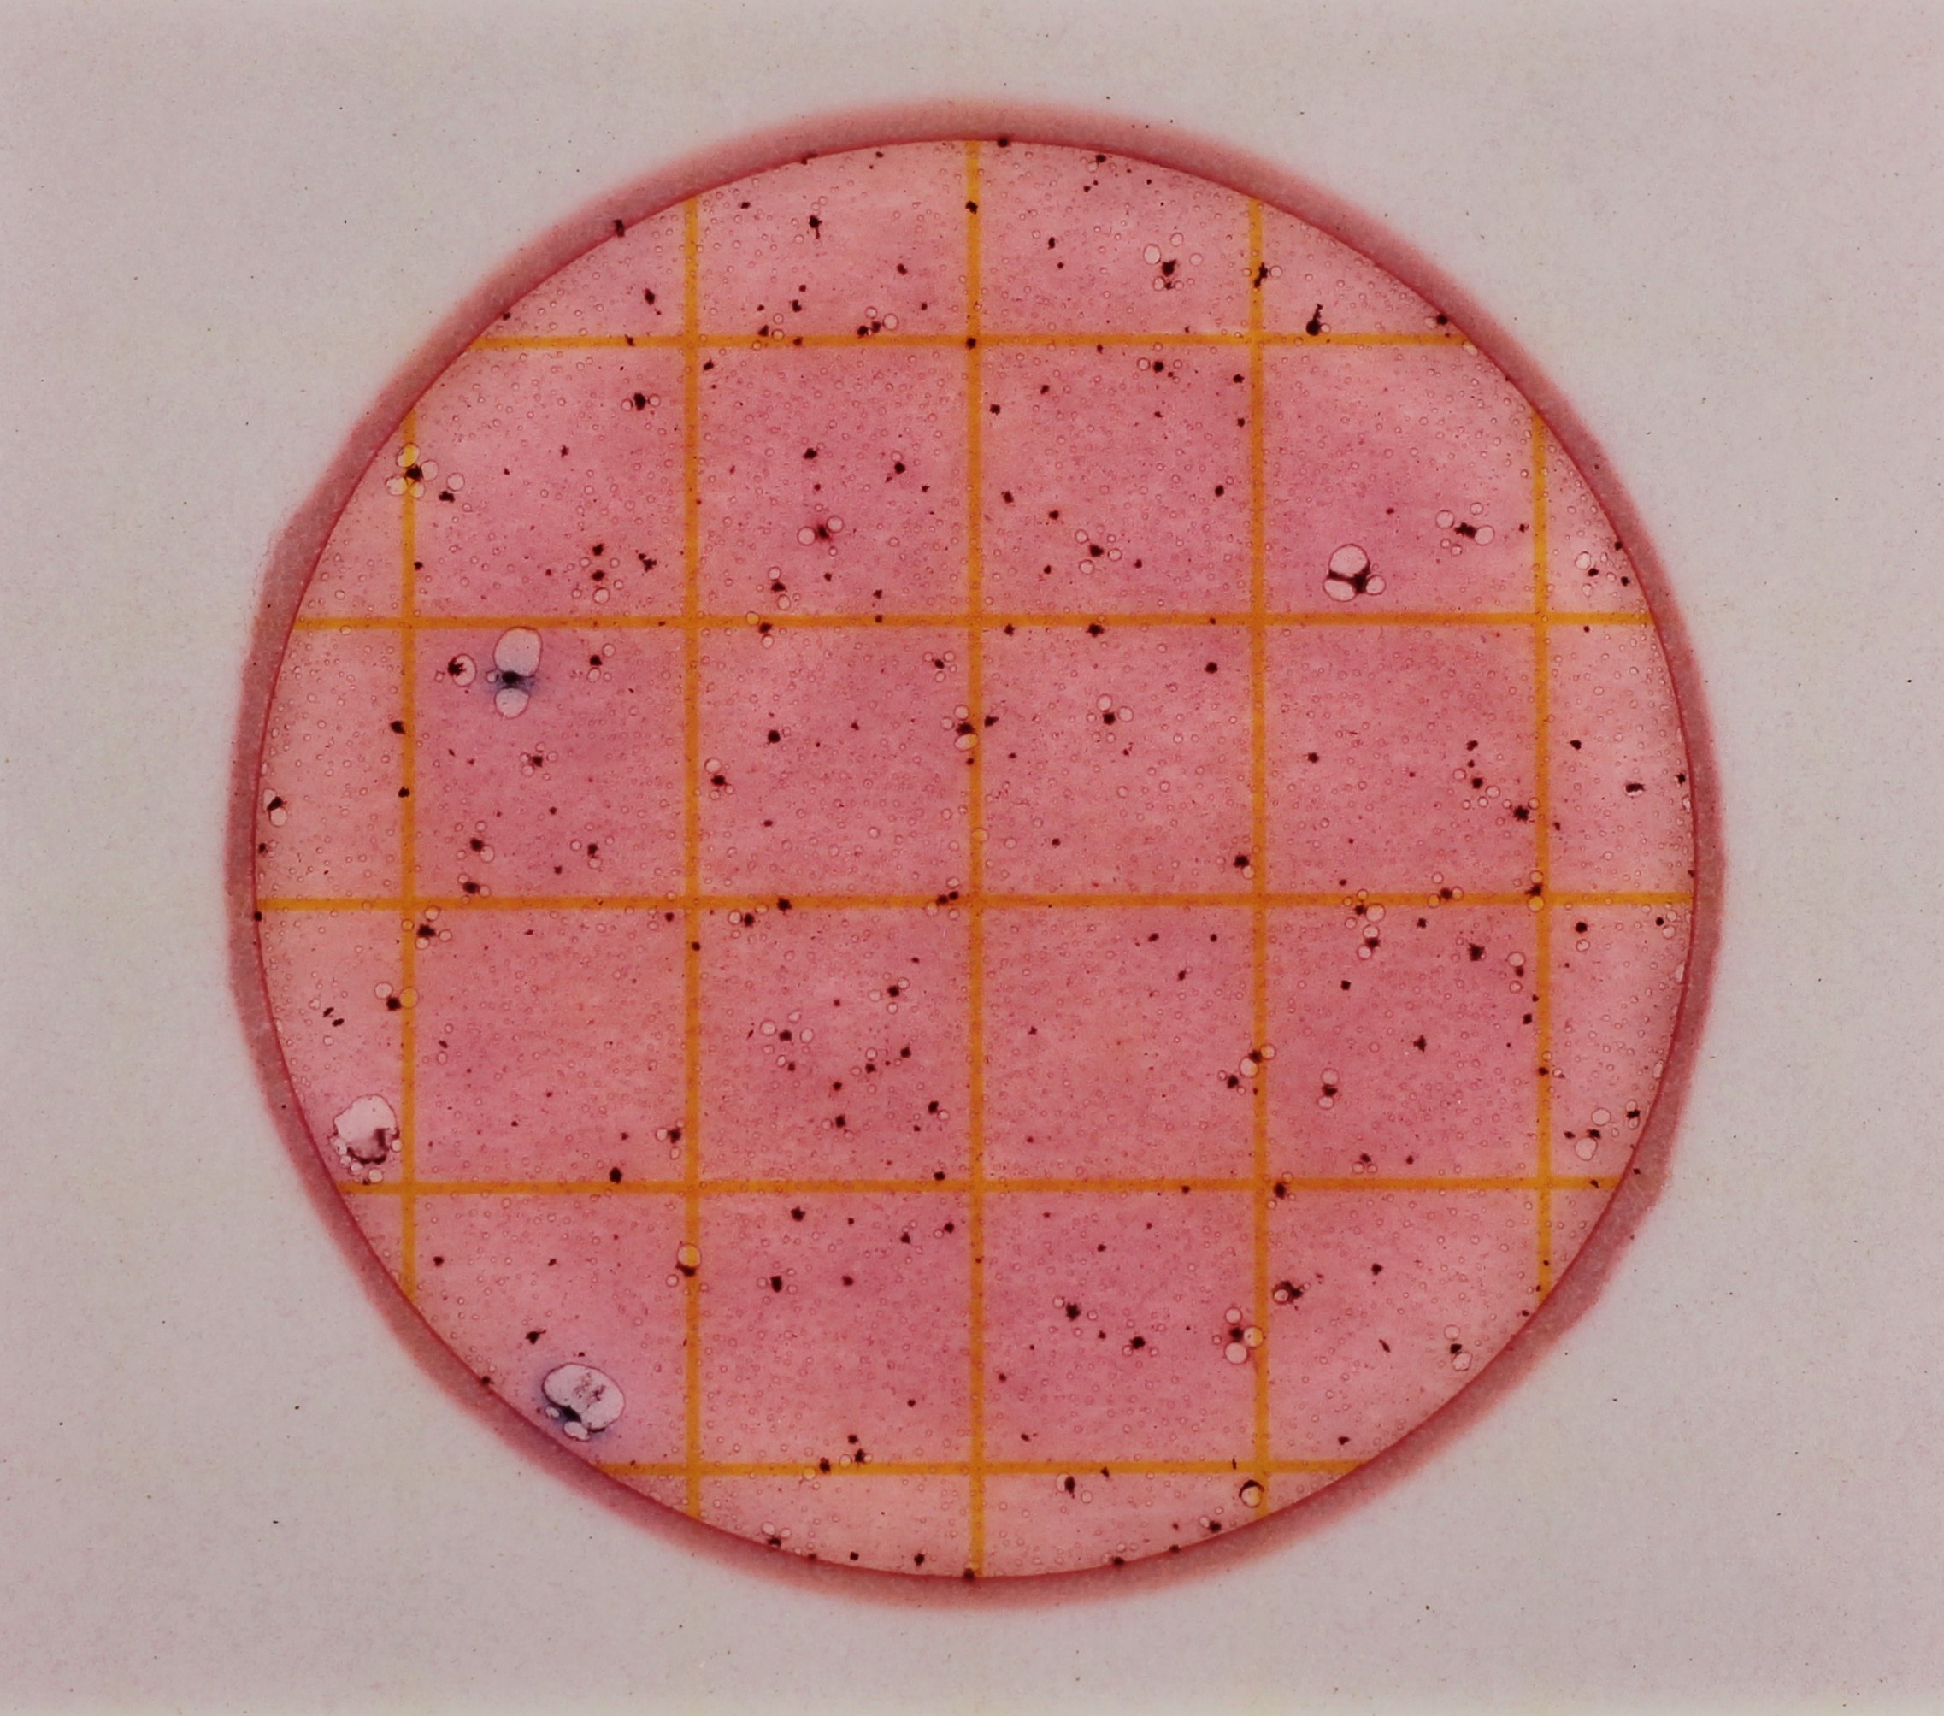
Example #2
How many E. coli colonies do you see?
Notes:
Answer: 2

Slide 24
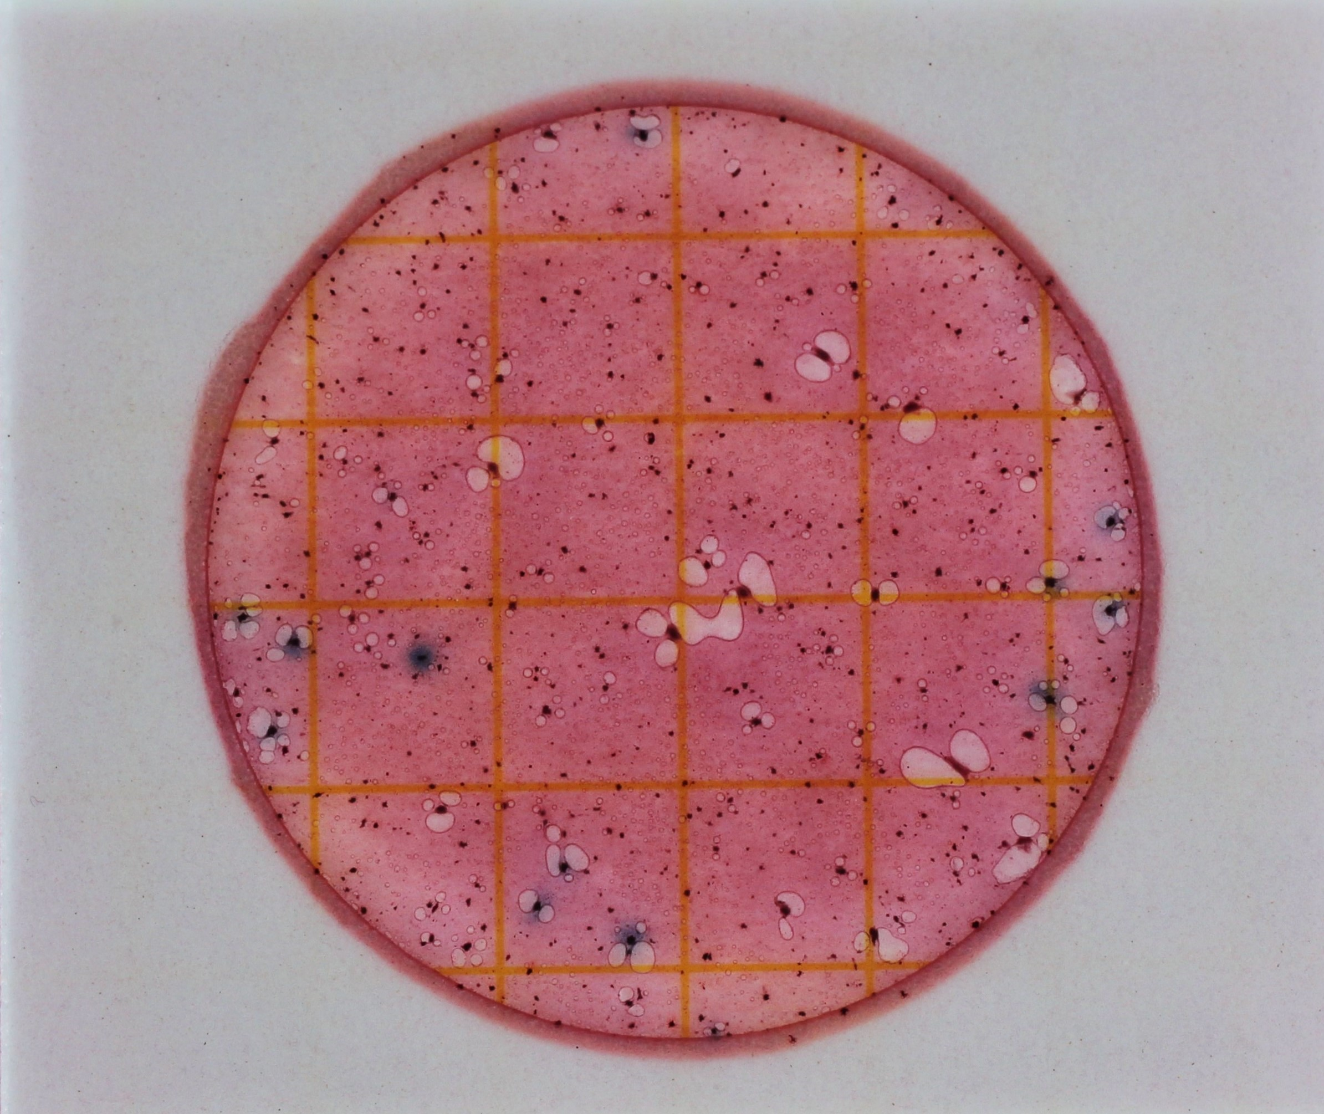
Example #3
How many E. coli colonies do you see?
Do not count blue colonies without bubbles
Notes:
Answer: 12

Slide 25
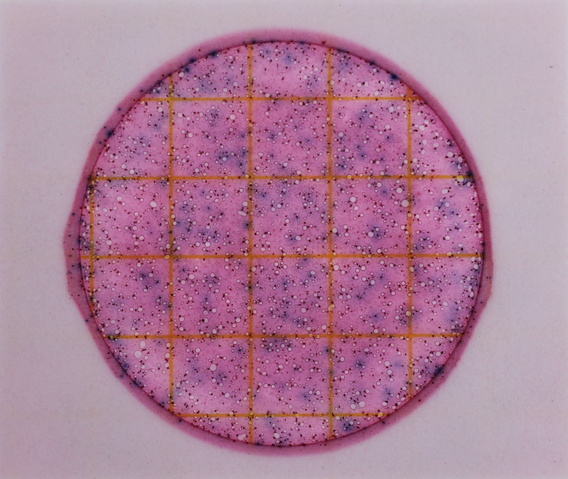
Example #4
Too Numerous To Count (TNTC)
How many E. coli colonies do you see?
Notes:
Answer: TNTC (Too Numerous to Count)
Plate will turn dark purple color (animation: compare to the color of a slide with low E. coli count)

Slide 26
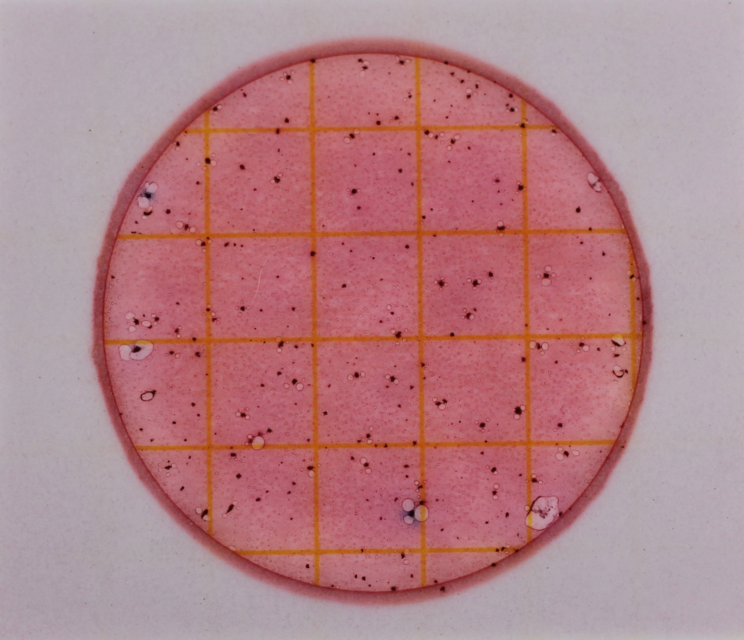
Example #5
How many E. coli colonies do you see?
Notes:
Answer: 2
Note: Volunteers might say 3, as the one in the far left on the middle line may look blue as well; feel free to use this opportunity to say that it is typically easier to read a physical plate in person than a photo of a plate. As long as they are reasonably close (within 1-2 of the answer for most examples) and understand that they're looking for blue colonies with bubbles, they should be fine.

Slide 27
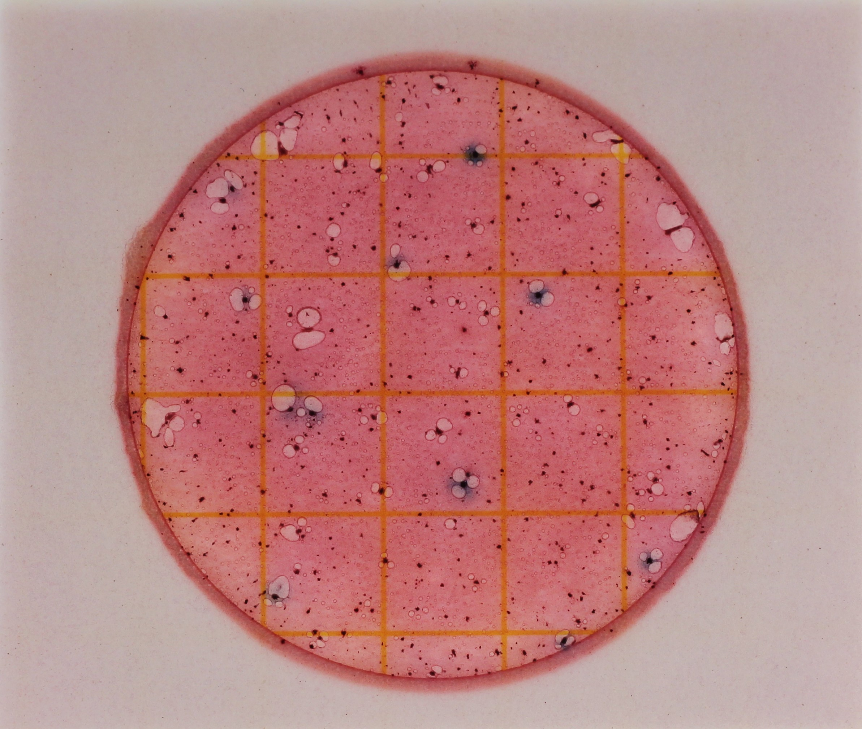
Example #6
How many E. coli colonies do you see?
Notes:
Answer: 11

Slide 28
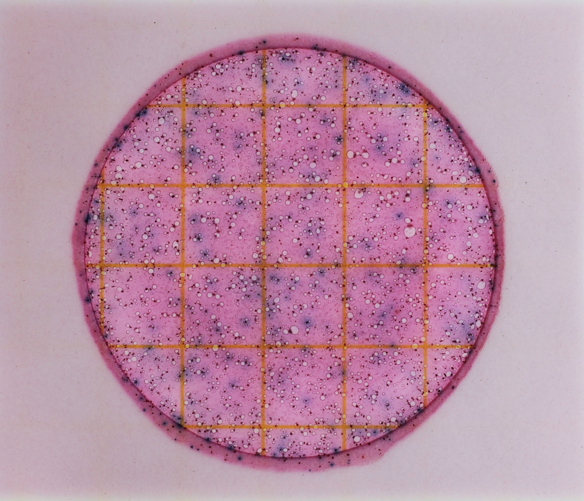
Example #7
Too Numerous To Count (TNTC)
How many E. coli colonies do you see?
Notes:
Answer: TNTC

Slide 29
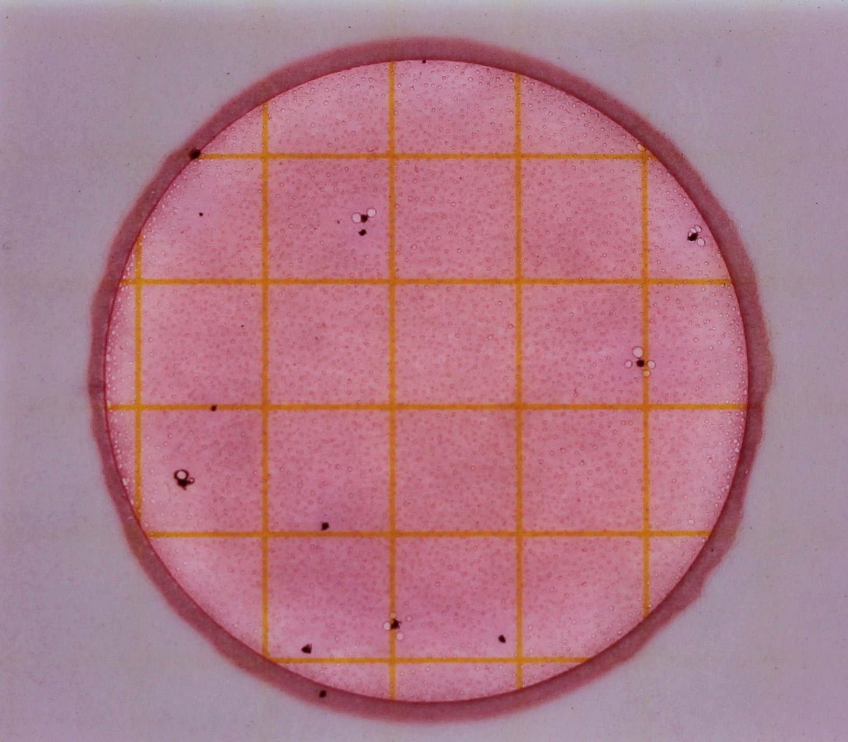
Would this be an acceptable blank?
Example #8
How many E. coli colonies do you see?
Notes:
Answer: 0
No, this is not an acceptable blank because bacteria is still present on the plate. Even though there are no E. coli colonies, contamination has still occurred. Must discard all samples and redo sampling.

Slide 30
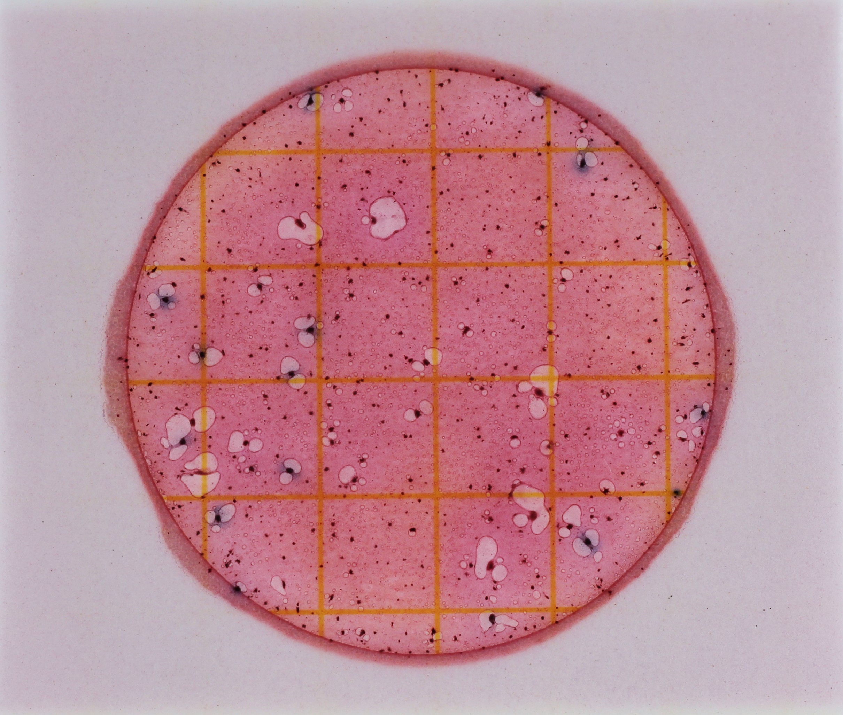
Example #9
How many E. coli colonies do you see?
Notes:
Answer: ~13

Slide 31
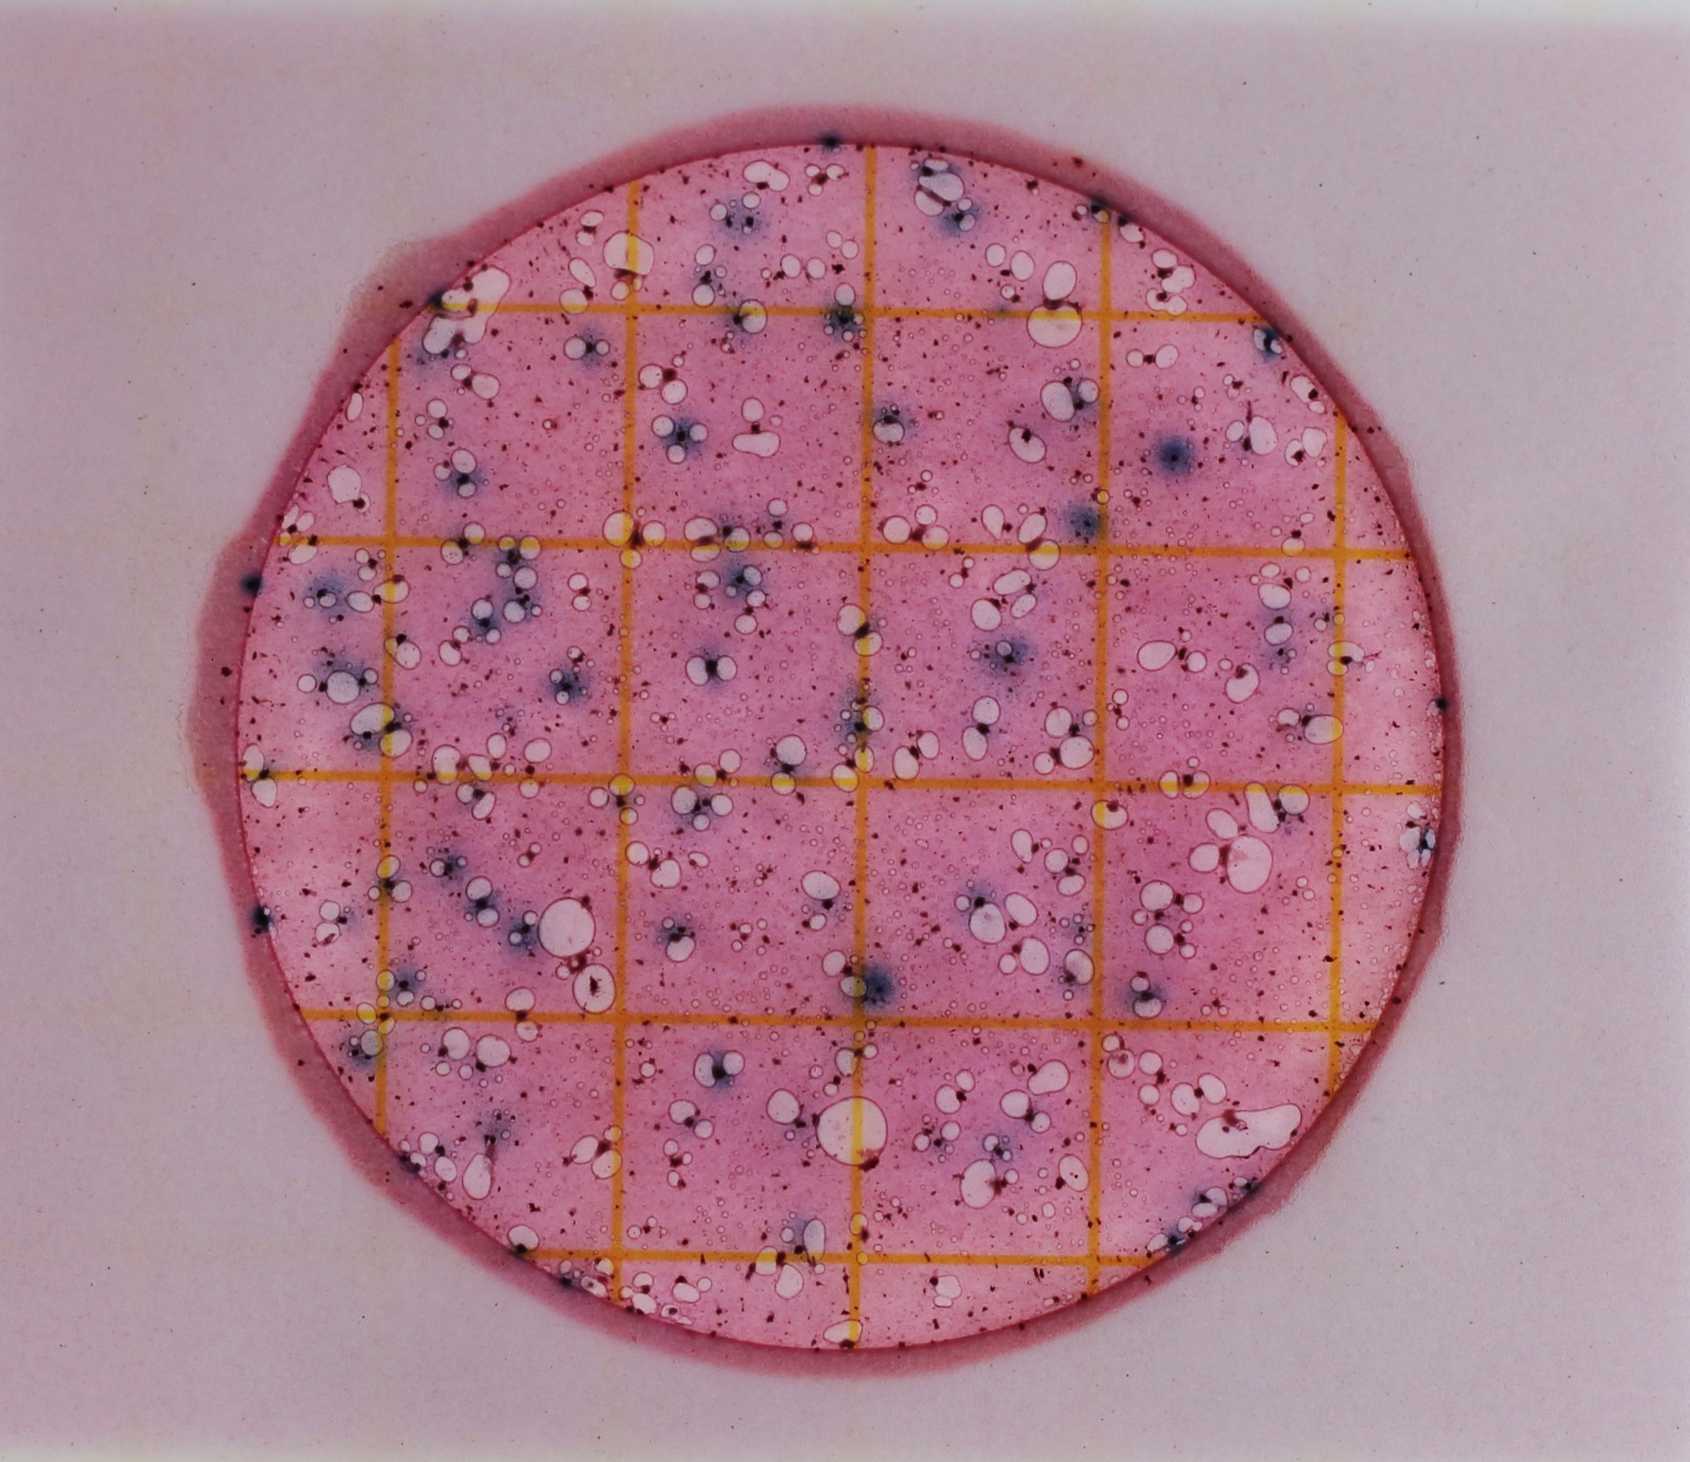
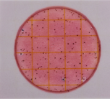
Example #10
How many E. coli colonies do you see?
Notes:
Don’t make volunteers count this slide!!
Answer: ~62
Too few to be TNTC, but not all blue colonies have air bubbles.
When there are lots of bacteria on the plate, there is not enough “food” to support all the colonies and not all of them can form gas bubbles. The guidance provided by 3M (maker of Petrifilm) is to count all blue colonies as presumptive E. coli colonies, whether or not they have gas bubbles.
Slide will also turn a deeper, purple-red (compare to this low count slide).
Count up to 150 colonies; above that, mark it as TNTC
Uncommon situation, this will not be on the test

Slide 32
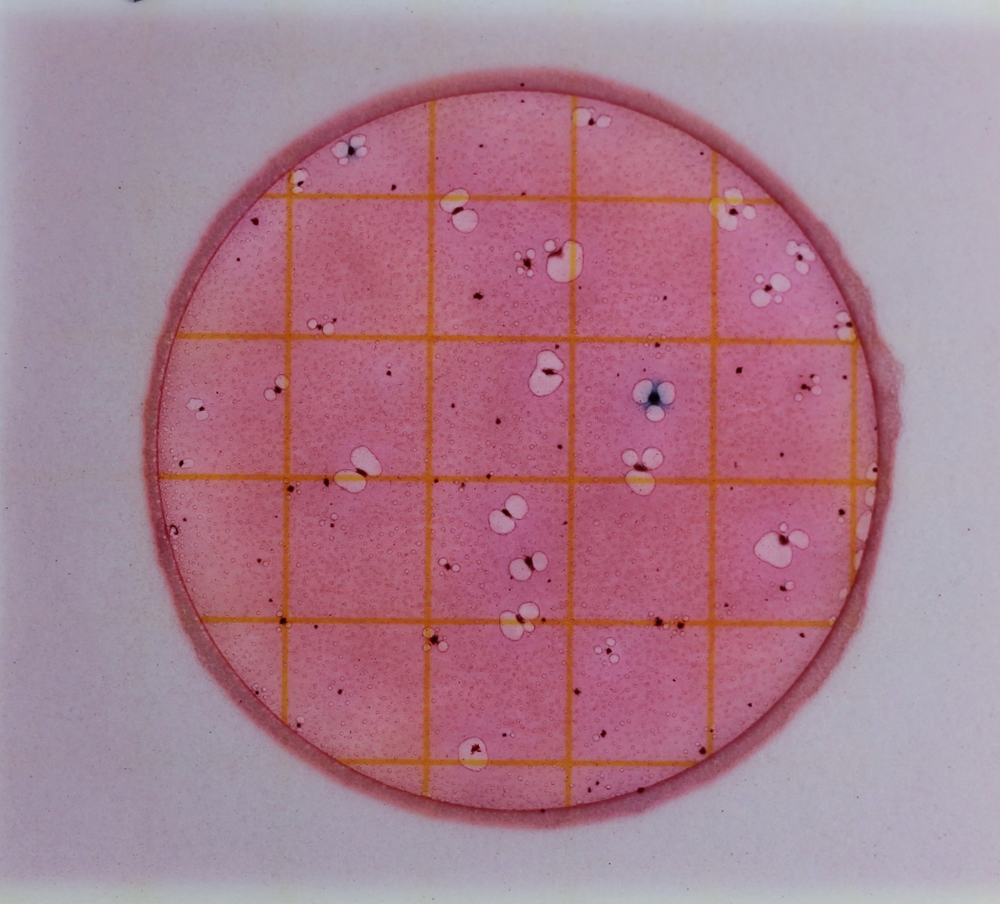
Example #11
How many E. coli colonies do you see?
Notes:
Answer: 2

Slide 33
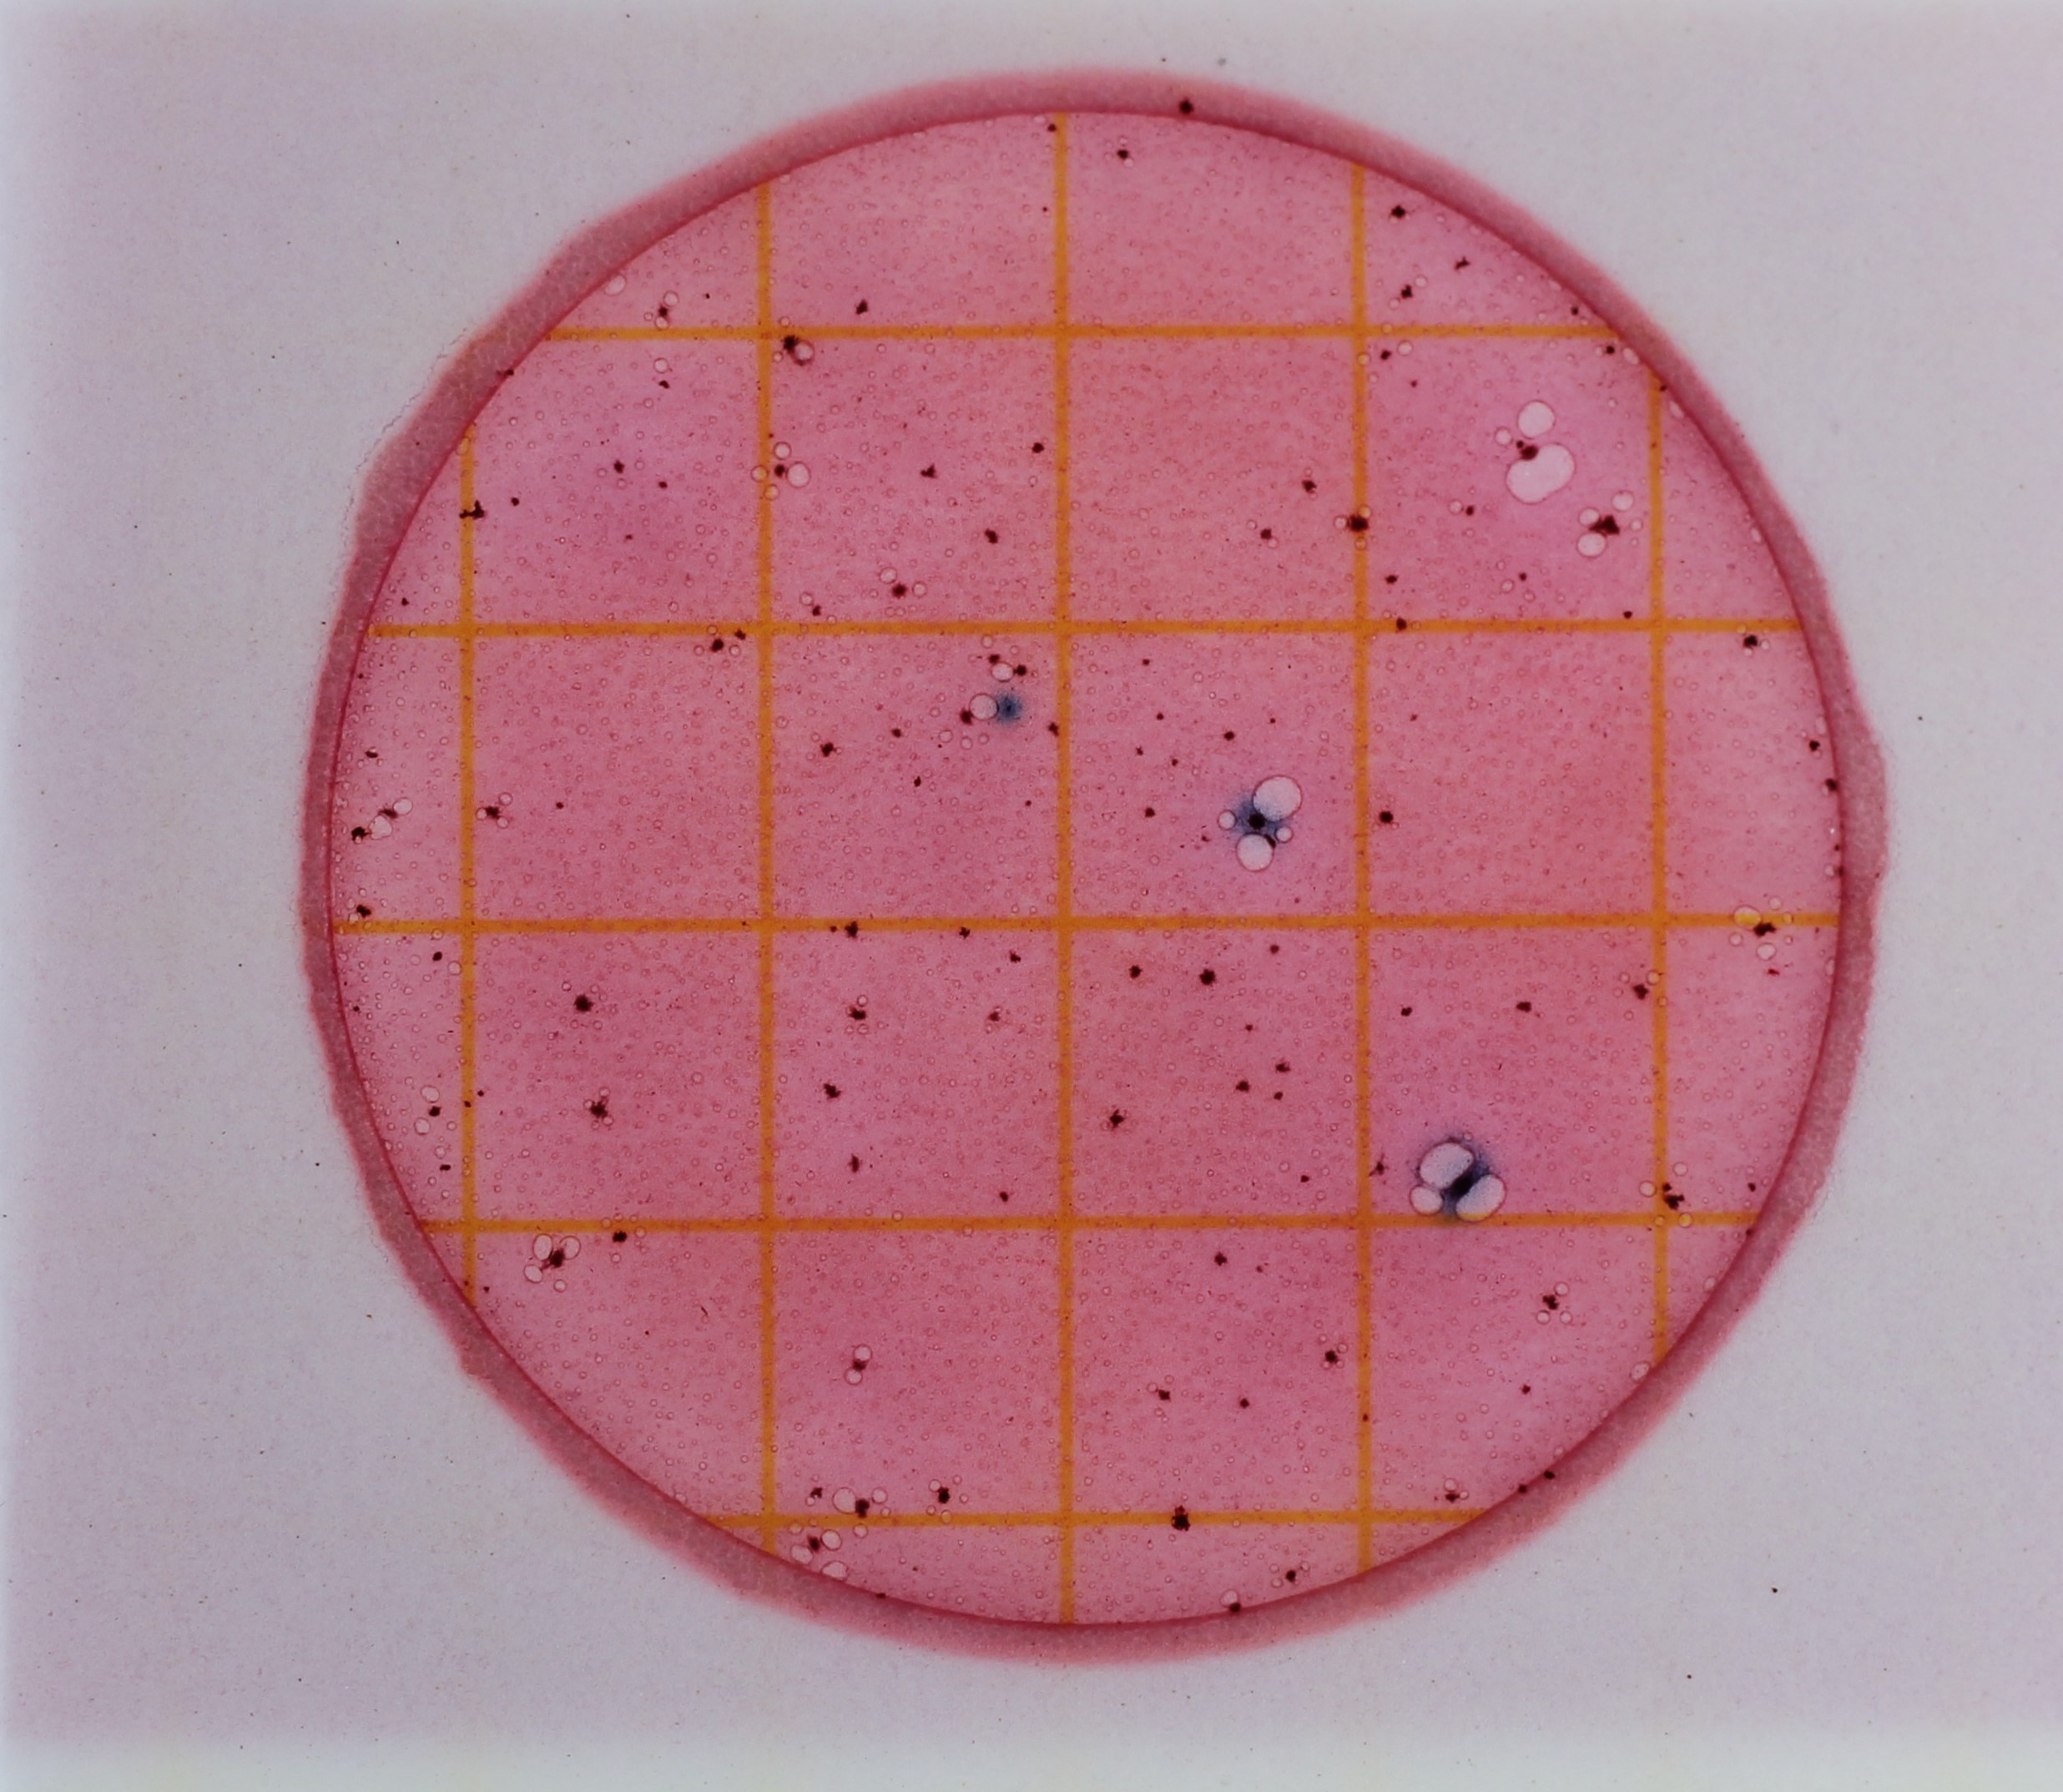
Example #12
How many E. coli colonies do you see?
Notes:
Answer: 3

Slide 34
Step 6: Calculating your results
Plate 1
Plate 2
Plate 3
 | Plate 1 | Plate 2 | Plate 3
E . coli colonies | 5 | 2 | 2
Notes:
Time to calculate results! We've put the counts of these three slides into a table, similar to what is on your datasheet.

Slide 35
Step 6: Calculating your results
(Plate 1 + Plate 2 + Plate 3)
Step 1:
= Average CFU/1 mL
3
(total # of plates)
Step 2:
Average CFU/1 mL * 100
= Average CFU/100 mL
Notes:
This slide has animations
Step 1:
Calculate the average number of CFUs per slide across the three slides (remember, each slide holds 1 mL of sample water)
Add up the counts from all three plates and divide by 3, which is the total number of plates. This will give the average CFU/1mL
Step 2:
Looking for CFU/100mL, not CFU/1mL
Multiply the answer from the first step by 100 to get final answer

Slide 36
Step 6: Calculating your results
 | Plate 1 | Plate 2 | Plate 3
E . coli colonies | 5 | 2 | 2
(5 + 2 + 2)
Step 1:
= 3.00 CFU/1 mL
3
Step 2:
3.00 CFU/1 mL * 100
= 300 CFU/100 mL
Notes:
This slide has animations
Let's do it with real numbers to help it make more sense! (Explain process again with numbers)

Slide 37
Step 6: Calculating your results
Plate 1
Plate 2
Plate 3
 | Plate 1 | Plate 2 | Plate 3
E . coli colonies | TNTC | TNTC | TNTC
Notes:
What if all your plates are TNTC? Here’s how you would calculate those results

Slide 38
Step 6: Calculating your results
 | Plate 1 | Plate 2 | Plate 3
E . coli colonies | TNTC | TNTC | TNTC
(TNTC + TNTC + TNTC)
= TNTC
3
Notes:
They’re all TNTC, so your answer will simply be TNTC- no calculation needed!
There should never be a scenario where you have a mix of TNTC and countable samples within the triplicate
i.e., TNTC, 10, 14
If this happens, volunteers should disregard these samples and test again, as well as report this to local coordinator.

Slide 39
Step 7: Disposal and Clean-up
Spray plates with disinfectant, seal in bag/used Whirl-Pak, and throw away
Wipe down incubator & surrounding surfaces with disinfectant
Wash hands!
Notes:
Wrap up- disinfect stations and dispose of materials
Sample water from the Whirl-paks can be dumped down the drain or in the toilet. Can also be used to water plants!
The plates hold live bacteria colonies- should be placed in a zip lock bag or used Whirl-pak, sprayed with disinfectant, sealed, and thrown away
Wipe down the incubator and surrounding surfaces with disinfectant
Wash your hands thoroughly

Slide 40
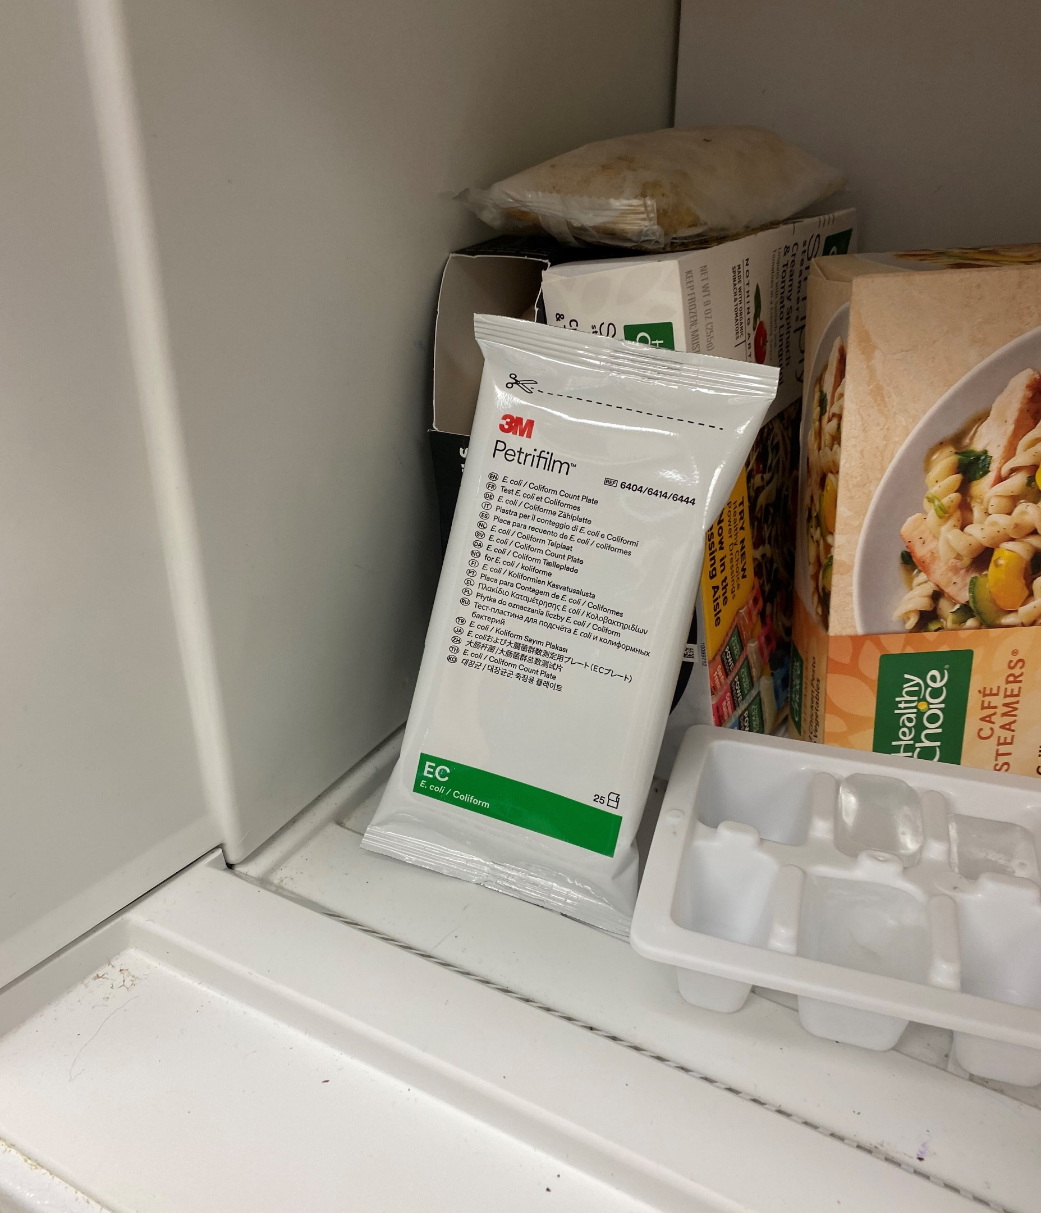
How to store petrifilm
If using within one month, keep in the fridge
If not, store in the freezer and thaw before use
Notes:
Petrifilm must be kept cold!
Either keep in the fridge if planning on using it soon, or store in the freezer and thaw before use.
Again, always keep an eye on expiration dates!

Slide 41
Regulatory standards
State of GA regulatory data transitioned from fecal coliforms to E. coli
State standards reflect established EPA guidelines
Includes enterococci to indicate presence of pathogens in coastal waters
Statistical Threshold Value (STV) - <10% of samples should exceed given level
Risk level of 36/1,000 people getting sick from primary contact activities
Sample again if sample > STV
Report if samples are consistently > STV (2+ months out of the year)
 | E. coli STV | Enterococci STV
EPA recommended level (CFU/100 mL) | <410 | <130
Notes:
The state of Georgia switched from using fecal coliform bacteria to evaluate the risk of illness from fecal contamination to using E. coli in mid-2021
Reflects established EPA guidelines (in table below)
Can now be directly compared to AAS data
Guidelines also include standards for enterococci counts
Enterococci= another type of bacteria that can be used to indicate possible presence of pathogens
More commonly used on the coast
Recommended levels of enterococci also in EPA resource below
Contact GA EPD for more information
The state standard/EPA recommended level for E. coli is 410 CFU/100mL
Statistical threshold value- no more than 10% of samples should exceed a certain value, in this case 410 CFU/100mL (i.e., only 1 in every 10 samples should be higher than this)
This value corresponds to 36 out of 1000 people getting sick from these E. coli levels during primary contact activities
Primary contact= any activity where a high degree of bodily contact with the water, immersion, and ingestion are likely, such as swimming, tubing, etc.
If you get a sample higher than the state standard, you should sample your stream again
If you are consistently getting samples higher than 410 CFU/100mL, report your stream
One single sample that is higher than this level does not warrant immediate action; only if you are consistently getting readings higher than this
Resources:
GA EPD: https://epd.georgia.gov/document/document/gaepd-specific-water-quality-criteria-march-2020pdf/download
US EPA: https://www.epa.gov/sites/production/files/2015-10/documents/rec-factsheet-2012.pdf

Slide 42
high e. coli counts
AAS Action Value: >1000 CFU/100 mL
If your count exceeds this value and you did find a source:
NOTIFY local AAS coordinator and/or water authority
INVESTIGATE site and identify possible sources
I found a source!
Notes:
This slide has animations
If your counts exceed 1000 CFU/100 mL, we ask that you take action to mitigate the situation ASAP.
Contact your local AAS coordinator and/or water authority and inform them of your findings, and go back to your site ASAP and investigate for possible sources of E. coli
See the "Who to Call" list on the AAS website if you are unsure who to call.
Limit contact with water, wear boots and PPE, and thoroughly wash hands if in contact with water
If you find a source, IMMEDIATELY contact your local AAS coordinator and/or water authority and provide a detailed description of your findings
While 1000 CFU/100mL is the level at which you must notify your coordinator/water authority, we want to reiterate that if you are consistently seeing values over 410 CFU/100mL to also notify local authorities

Slide 43
high e. coli counts
AAS Action Value: >1000 CFU/100 mL
If your count exceeds this value and you did not find a source:
NOTIFY local AAS coordinator and/or water authority
I did not find a source
Take another sample
INVESTIGATE site and identify possible sources
Above threshold again
Below threshold
Monitor as usual
Notes:
This slide has animations
If your counts exceed 1000 CFU/100 mL, we ask that you take action to mitigate the situation ASAP.
Contact your local AAS coordinator and/or water authority and inform them of your findings, and go back to your site ASAP and investigate for possible sources of E. coli
See the "Who to Call" list on the AAS website if you are unsure who to call.
Limit contact with water, wear boots and PPE, and thoroughly wash hands if in contact with water
If you do not find a source, take another sample immediately and repeat the process.
If it is above the threshold again, contact your local coordinator/water authority again and request a regulatory sample
If it is below the threshold, continue to monitor monthly. You can reach out to local coordinators, authorities, and watershed groups for advice and information about your findings.
While 1000 CFU/100mL is the level at which you must notify your coordinator/water authority, we want to reiterate that if you are consistently seeing values over 410 CFU/100mL to also notify local authorities

Slide 44
Safety
Try not to sample alone- take a monitoring buddy!
Do not sample during high flows or after a heavy rain event
Obtain permission if sampling on private property
Wear PPE when sampling and plating
Disinfect thoroughly before and after plating and counting
Notes:
Safety is our primary concern when monitoring!
If you must sample alone, be sure to tell someone what you are doing, where you will be, and when you should be back.
Avoid sampling in during high flows or during extreme weather events
Do not enter private property without permission
Wear proper safety gear (gloves, boots, etc.) when sampling and plating
Disinfect all surfaces that will have or have had contact with plates and samples
This is not a comprehensive list- be as safe as possible and don’t ever sample if you are uncomfortable.

Slide 45
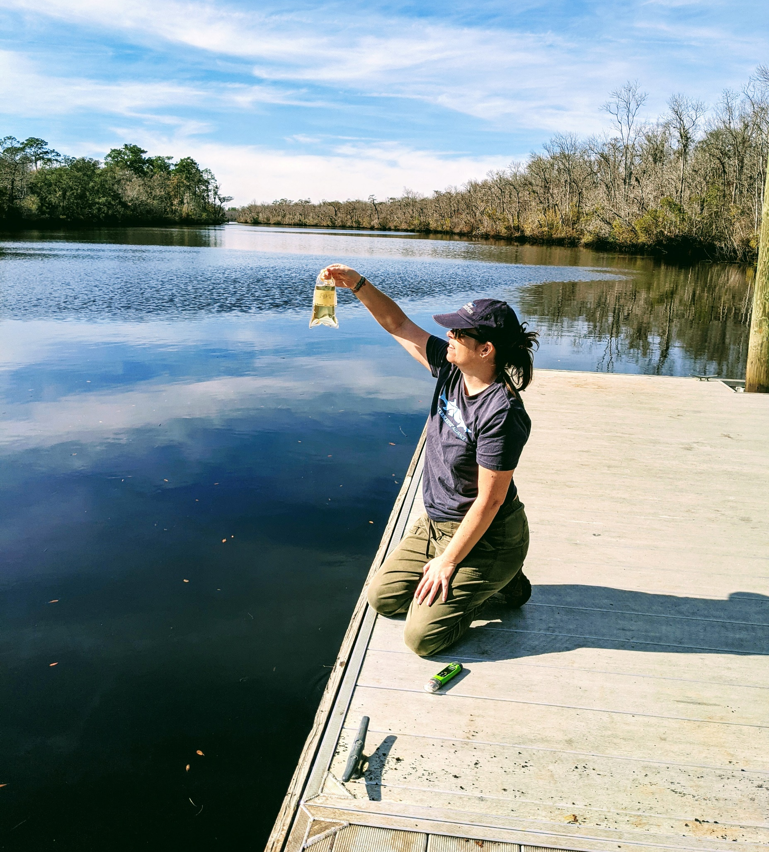
Once you’re certified
You get an account to our online database!​
Only certified volunteers can submit data
Certification is valid for one year​
Volunteers must attend an annual recertification workshop
Notes:
After going through the bacterial workshop (presentation and field portions) and you pass your certification test, you will be a certified AAS volunteer!
Your trainer will enter your certification in the AAS database, and an account will be created for you.
Information to access your account will be sent to the email you registered with (more on this later)
You must be certified to enter data: you can work with anyone that’s interested in monitoring (even if they’re not certified), but only YOU can enter the data that is collected.
For example, some teachers will collect data with students and submit the data on their behalf
Your AAS certification is good for one year and then you’ll need to recertify.
Recertification workshops serve as a time to share updates and challenges.
You will review the information once again (presentation and hands-on) and retake the certification quiz.

Slide 46
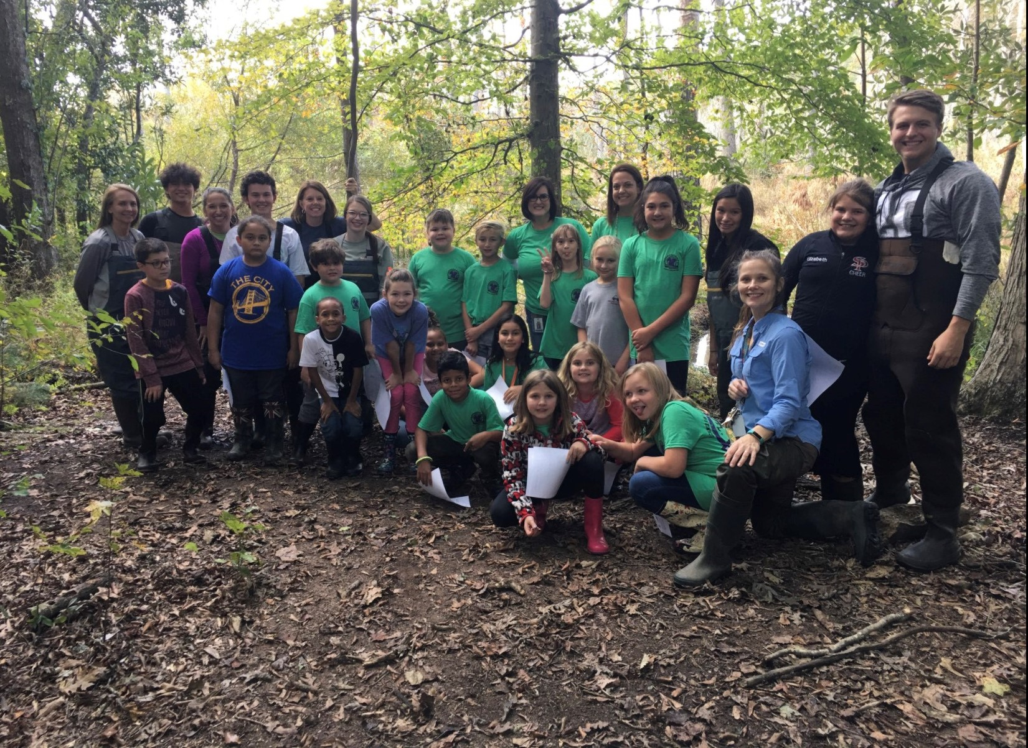
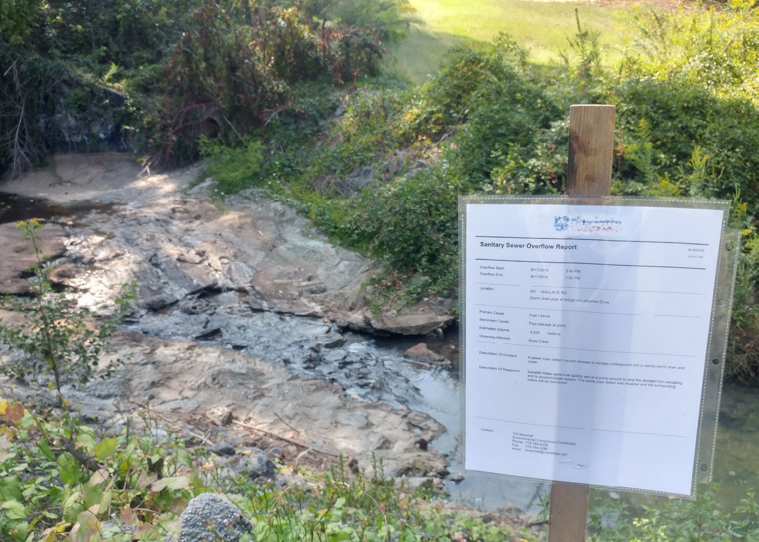
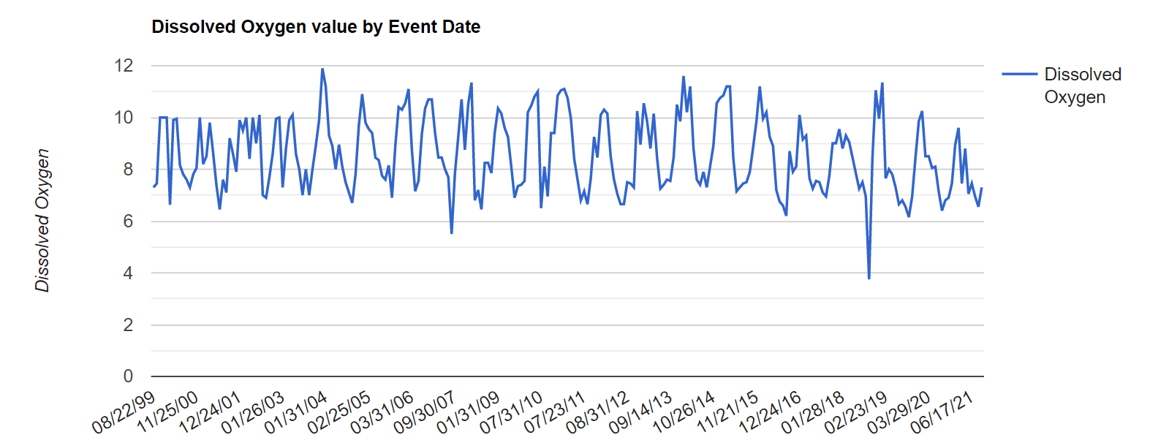
How are your data used?
Establish baseline conditions for waterbodies across the state
Discover and report water quality issues
Educate your community
Help inform status of streams for 303d/305b list
Notes:
After you collect data at your stream, lake, wetland, estuary, etc., we ask that your data be submitted ASAP to the online AAS database because your data are being used!
Anyone across the state, nation, and world can access data from the AAS database (open access)
Regular monitoring helps establish baseline conditions for your local waterways
It is impossible to understand what is “normal” for a waterbody from just one sampling event, and there aren’t enough scientists/technicians to be able to consistently collect baseline conditions for all streams across the state- that’s why we need citizen scientist volunteers!
Baseline data is incredibly valuable to communities in being able to track improvements and impairments over time and mitigate any detrimental alterations
Consistent monitoring allows problems, such as sewage spills, to be detected quickly and more frequently (bottom left photo= sewer spill notice; graph- point represents deviation from baseline)
Use your data to educate your community about their impacts on water quality
Describe what is “normal” for your stream and watershed, and what fluctuations you may have seen
Remember, Awareness is one of the AAS goals!
Finally, AAS data can also be used as a justification for drawing up a state approved QAPP that provides data needed to list/delist streams
Clean Water Act requires waterways that are not supporting their designated uses to be put on this list.
If waterbodies are not meeting their designated uses, this could limit recreation (fishing, swimming, boating, etc.) and more. (resource below)
Your local trainers will also receive emails every time you submit data so that we all stay informed of happenings in our watershed. This can also help us work with you to rectify any problems or pollution sources you may find while out collecting data. Can use actual example here.
Resource: https://epd.georgia.gov/watershed-protection-branch/watershed-planning-and-monitoring-program/water-quality-Georgia

Slide 47
Database login
From the AAS website’s homepage, hover over the My Profile tab and click Sign In
Notes:
This is the sign in page on the website. You will need to log in before you are able to access the data submission form
Once you pass and receive your certification, you will receive an email from your trainer with information on how to log in.
Your username will be the email address that you wrote on the waiver/sign in sheet (unless otherwise noted by trainer) and then you can create a password by clicking the Email My Password button.
However, only trainers and state staff can create new profiles, so be sure to wait until you receive your confirmation email before trying to log in.
Additional info can be found on the Volunteer FAQs page on the AAS website: https://adoptastream.georgia.gov/how-do-i-get-started-adopt-stream/volunteer-faqs

Slide 48
Data Submission Form
From the AAS website’s homepage, hover over the Data Entry tab and click Data Submission Form
Notes:
This screenshot shows the data submission form on the AAS website. You must be logged in with an up-to-date certification to access this page.
This is where you will enter all types of data that you collect
We will go over how to click through this online form after we review the paper data form

Slide 49
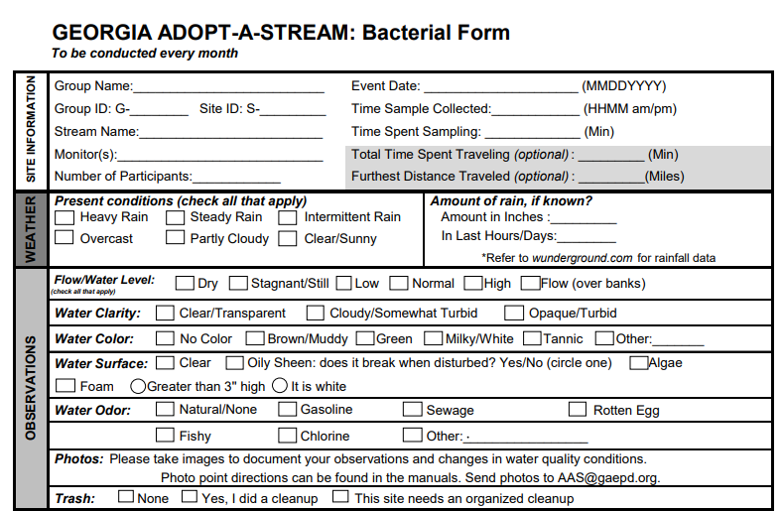
Site, weather, and observations
Notes:
Paper forms will be very similar to online forms
All forms have a site, weather, and observations section
Remember, Observations is one of the main goals of AAS!
Go through datasheet and discuss some of the parameters and their importance

Slide 50
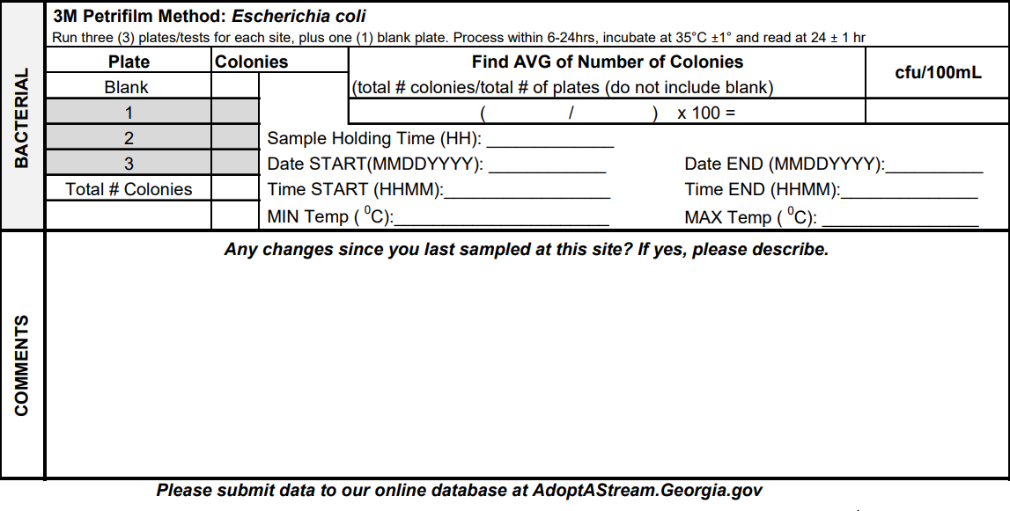
Bacterial data
Submit data ASAP to online database
Access database via AdoptAStream.Georgia.gov
Notes:
Correlate the sections of the datasheet to what they have learned so far
Remember, submit ASAP to online AAS database!

Slide 51
Fill out site data first, then navigate to the chemical tab to continue entering data
After entering all of your data, click “Submit All” to submit your data to the database
Use “Save as Draft” to finish submitting data at a later time. Data must be submitted within 7 days of saving as a draft.
Notes:
This slide has animations
Here is how to submit data on the online database
Make sure your directions are very clear in toggling between forms and clicking submit

Slide 52
Follow aas and stay connected
AAS@dnr.ga.gov
AdoptAStream.Georgia.gov​
facebook.com/georgiaadoptastream
@georgiaadoptastream
2 Martin Luther King Jr. Drive​
Suite 1462, East Tower​
Atlanta, Georgia 30334​
470-938-3341 and 470-524-5791
Notes:
Replace info and photos with your own if you’d like!
Connect with us!
Email, website, Facebook, Instagram, address, and phone
Here is the AAS staff!

Slide 53
Test review
Notes:
Make sure to review all text in bold! Go through test questions verbally with attendees
Field:
Practice whirl-pak
Practice plating
Practice counting and calculating

